Slide 1
MReader.Org

Slide 3
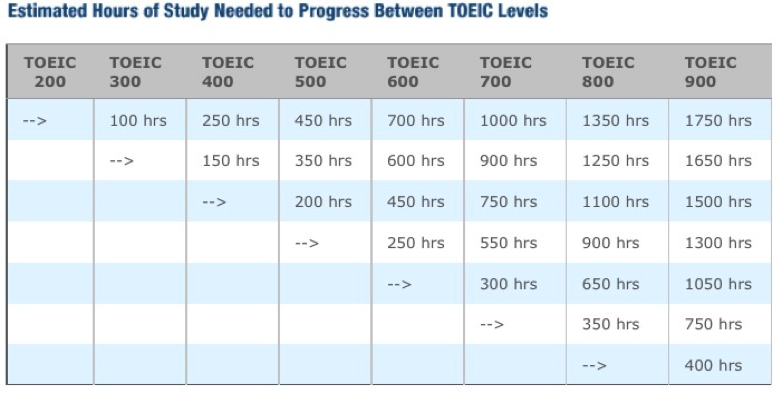
Study Hours Required for Advancement
A1 A2 B1 B2 C1 C2
http://www.prolingua.co.jp/toeic_e.html

Slide 4
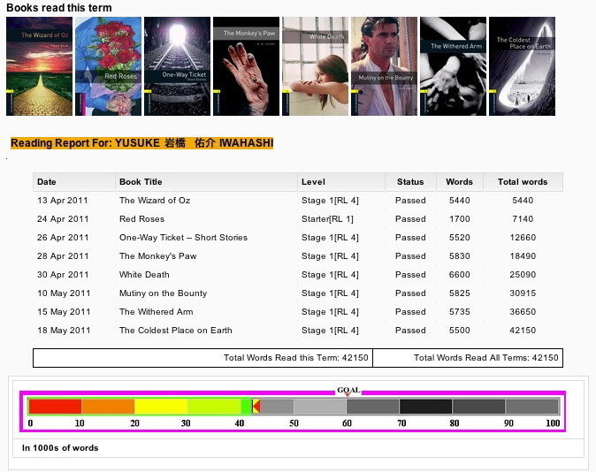

Slide 5
Mreader Features
Quizzes on over 3700 readers
10 randomized questions
Level-controlled
Timed
Enforced time interval between quizzes
Determines “Read”/“Not Read”
Free for schools to use

Slide 6
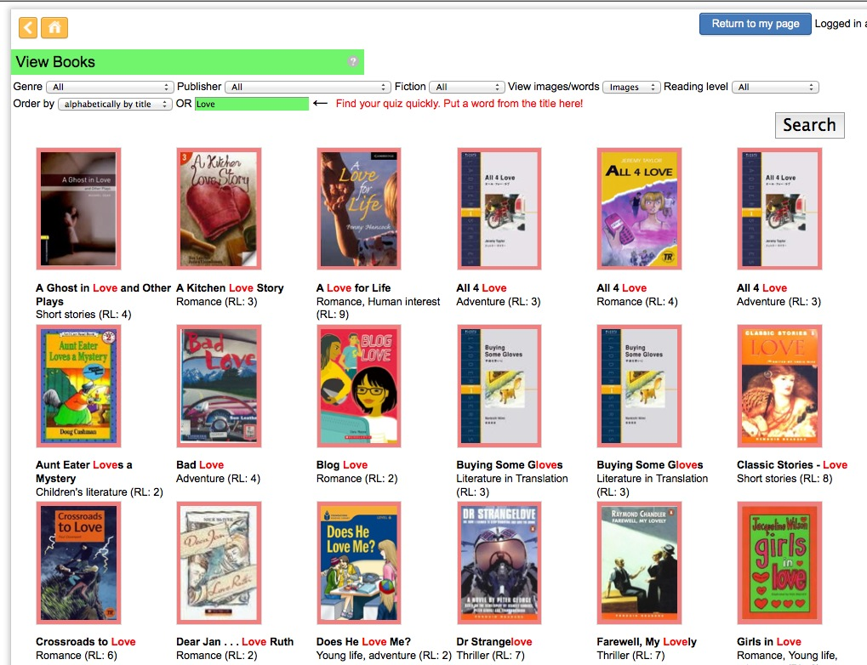
Searching for a book with “Love” in the title

Slide 7
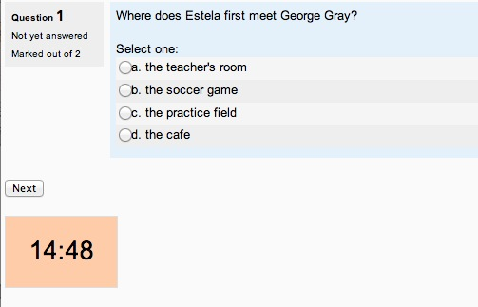
Multiple Choice

Slide 8
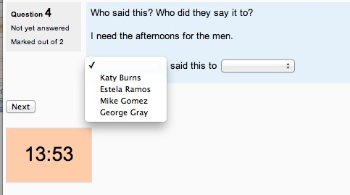
Who said….?

Slide 9
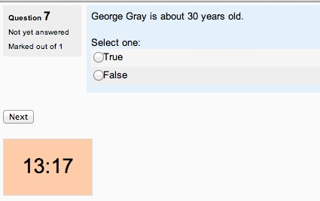
True / False

Slide 10
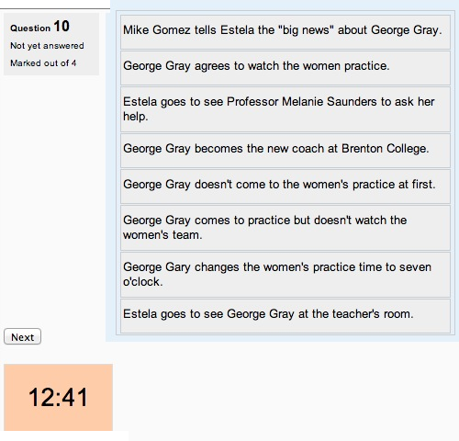
Ordering

Slide 11
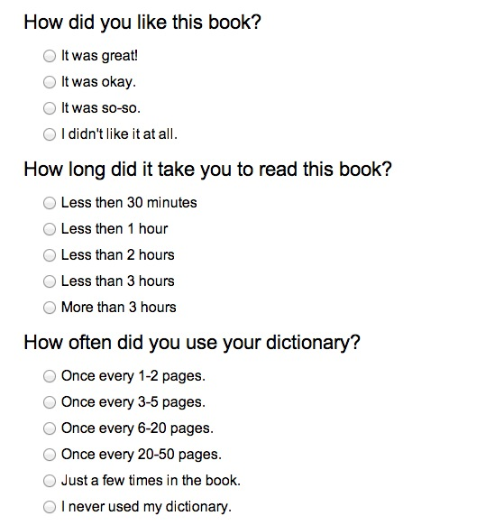
Post-Quiz Questions (1)

Slide 12
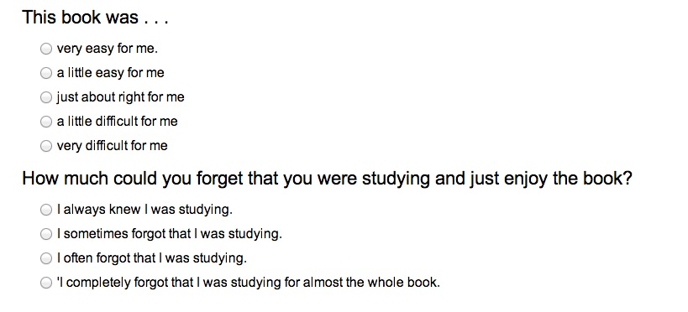
Post-Quiz Questions (2)

Slide 13
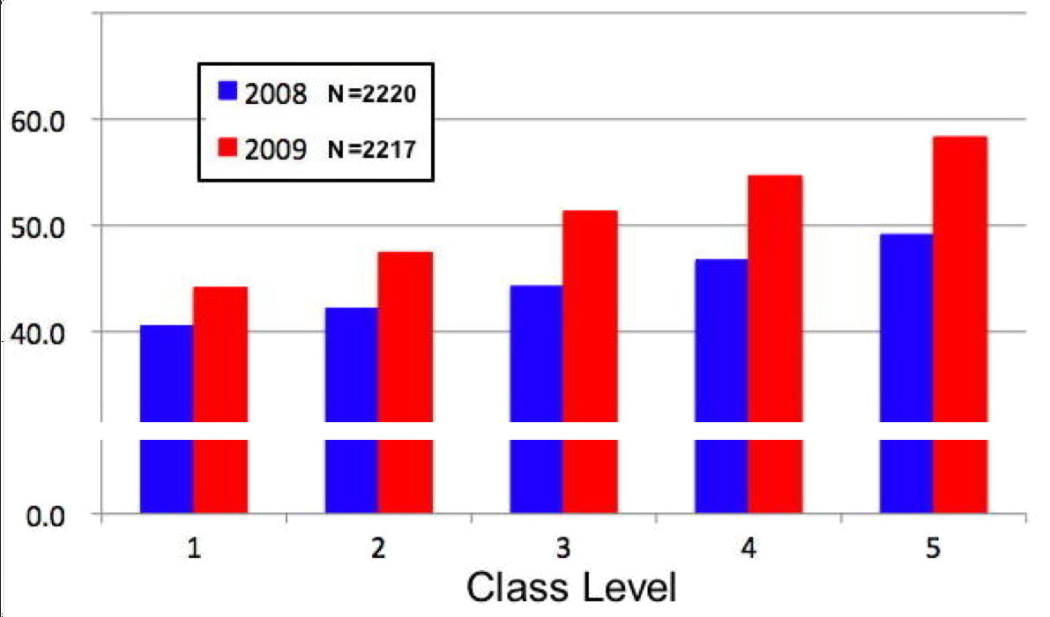
Reading Improvement by class level (using MoodleReader in 2009)

Slide 14
