Slide 1
Reading
Aloud

Slide 2
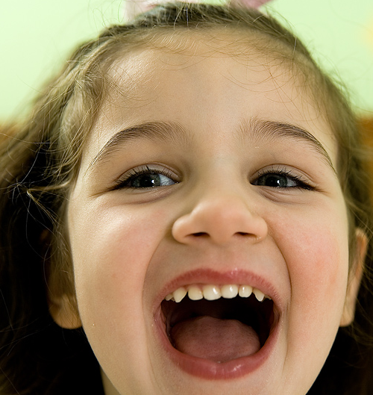
Reading
aloud
Also known as:
Reading
out loud
Oral reading
音読

Slide 3
What do
you like
or dislike
about
reading
aloud?

Slide 4
Waiting for
one kid
to make
a mistake

Slide 5
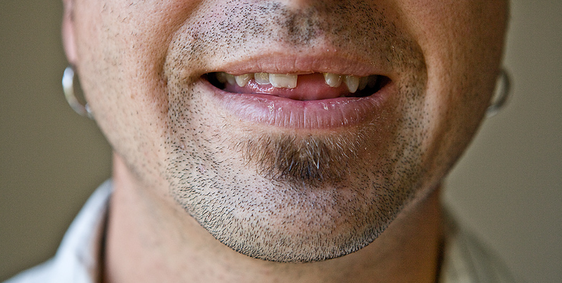
Group mumbling

Slide 6
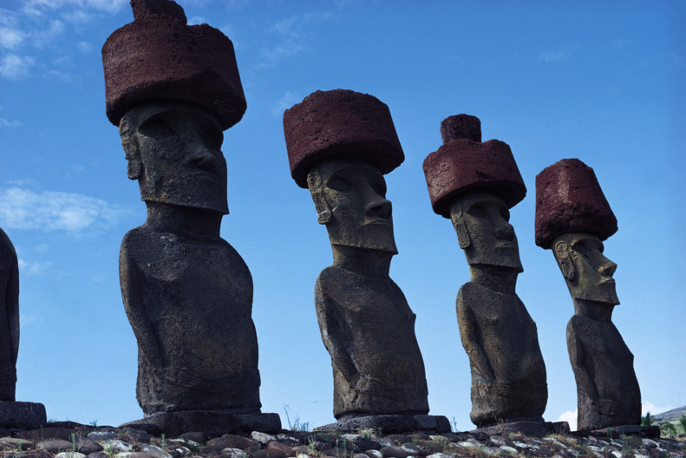
Read the
story aloud.

Slide 7
Pairs. What do
Your remember?

Slide 8
What
Reading aloud is
mosty speaking,
not reading.

Slide 9
Common.
So let’s make it worth doing.
And…
it is good for some things.

Slide 10
Wedon’treadlikethis.

Slide 11
And we don’t
read like this.

Slide 12
We read in units of meaning called chunks.
This activity helps students notice chunks.
//
//
//
//
//
//

Slide 13
Stress
Photo credit:
Rentcafe.com blog

Slide 14
Stress is the
key to natural
English.

Slide 15
Stress is the
key to natural
English.

Slide 16
Stress is the
key to natural
English.

Slide 17
Stress is the
key to natural
English.

Slide 18
Stress is the
key to natural
English.

Slide 19
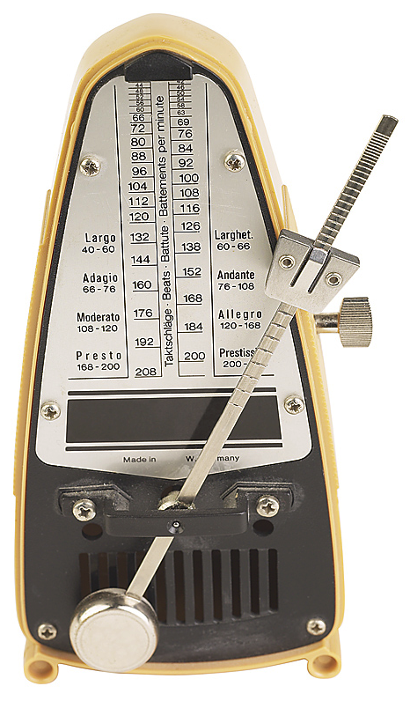
Rhythm
reading
https://www.metronomeonline.com/

Slide 20
What
Read & Look up

Slide 21
Read & Look up
- then shadow

Slide 22
Paired oral reading

Slide 23
Catch the
mitsakes

Slide 24
Catch the
mi t s akes

Slide 25
Catch the emotion

Slide 26
Read to each other

Slide 27
Memory
Check

Slide 28
How many
activities
can you remember?

Slide 29
Reading
Aloud

Slide 30
Stress

