Slide 1
This presentation is © 2016 Marc Helgesen. Previous versions are © 2010- 2014 Marc Helgesen. All rights reserved. This presentation is licensed to ITECC, Manila for use in the Philippines. It may be used by teachers with their students. It may NOT be used for teacher training in commercial ways without the specific permission of Marc Helgesen and/or ITECC. Any such use is illegal, a copyright violation and unethical. Note to teachers in Japan. Slides xx and xy are variations on slides xa and xb. They have Japanese translations of testosterone, cortisol and stress hormones. You might want to use those slides. For teachers in other countries, consider adding the local language for technical vocabulary. Most of the photographs are © clipart.com. They are used under license.

Slide 2
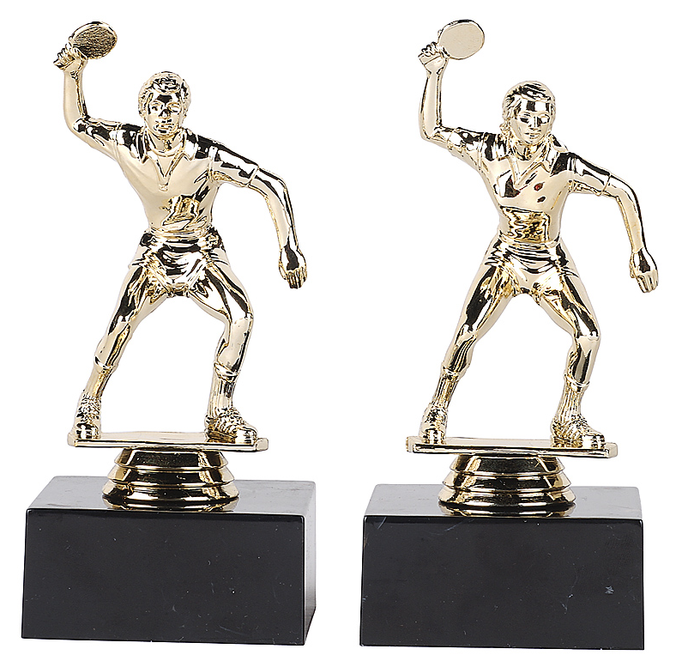
Power Poses
Marc Helgesen
march@mgu.ac.jp

Slide 3
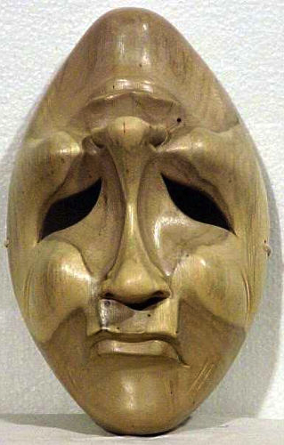
Close your eyes.
Stand up.
Think about a time
you felt sad or
depressed.

Slide 4
Sad or
depressed.
Ask yourself the
uestions
to remember clearly.
Notes:
When did this happen?
Where were you?
Who were you with?.
What happened/
Why did it happen?
How did you feel?

Slide 5
‘s
When did this happen?
Where were you?
Who were you with?
What happened?
Why did it happen?
How did you feel?
Notes:
When did this happen?
Where were you?
Who were you with?.
What happened/
Why did it happen?
How did you feel?

Slide 6
Notice your
body position
Notes:
Usually head down. Slumped.

Slide 7
Stand up.
Close your eyes.
Think about a time
you felt happy.

Slide 8
Happy.
Ask yourself the
uestions
to remember clearly.
Notes:
When did this happen?
Where were you?
Who were you with?.
What happened/
Why did it happen?
How did you feel?

Slide 9
‘s
When did this happen?
Where were you?
Who were you with?
What happened?
Why did it happen?
How did you feel?
Notes:
When did this happen?
Where were you?
Who were you with?.
What happened/
Why did it happen?
How did you feel?

Slide 10
Notice your
body position
Notes:
Usually head down. Slumped.

Slide 11
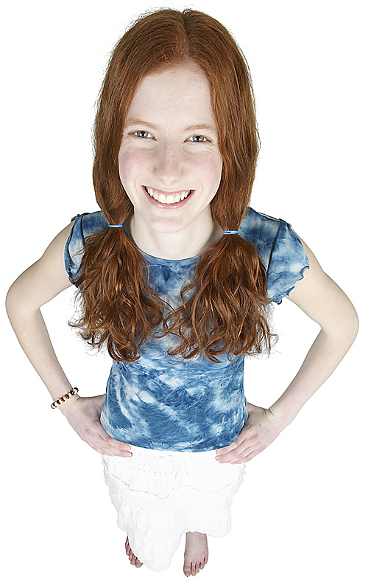
You know
how you
feel
affects
body
position

Slide 12
Did you know
how you
feel
affects
body
position
?

Slide 13
Power poses are body positions.
Many people experience
interesting results.

Slide 14
Slide from Amy Cuddy’s TED talk.
Slide from Amy Cuddy’s TED talk.

Slide 15
Slide from Amy Cuddy’s TED talk.
(Stress hormone)

Slide 16
Slide from Amy Cuddy’s TED talk

Slide 17
Power poses are body positions.
Many people experience
interesting results.
Do you?

Slide 18
Let’s try!

Slide 19
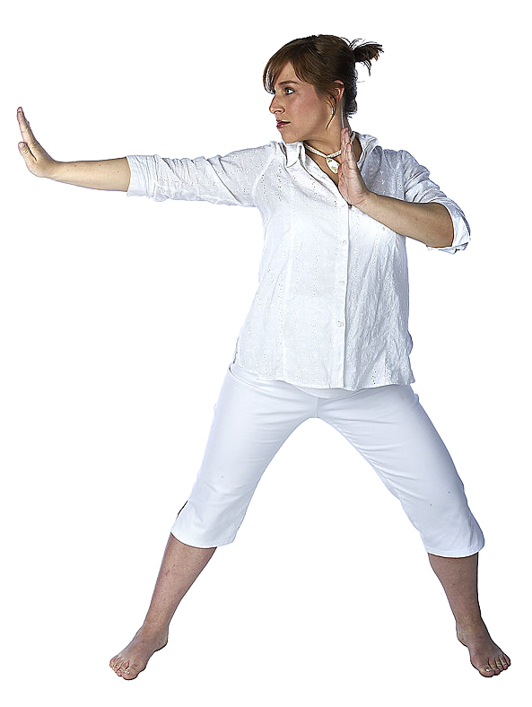
Vocabulary check: Body parts
arm
head
neck
hand
shoulder
chest
stomach
leg
foot

Slide 20
Vocabulary
check
Insert video
breathe
out though mouth
Notes:
Pairwork, then teach other pair

Slide 21
strong
Vocabulary
check
powerful
Notes:
Pairwork, then teach other pair

Slide 22
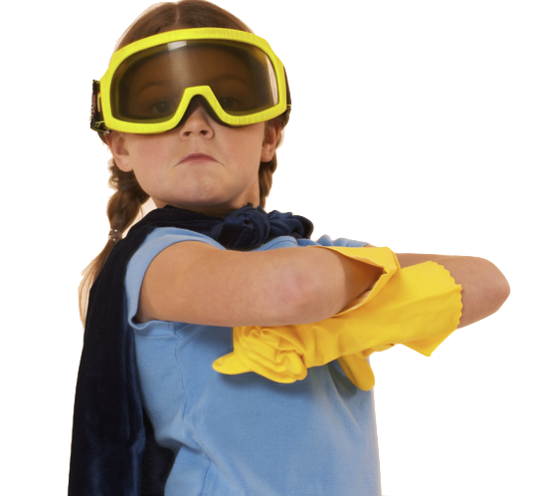
Vocabulary
check
confident
Notes:
Pairwork, then teach other pair

Slide 23
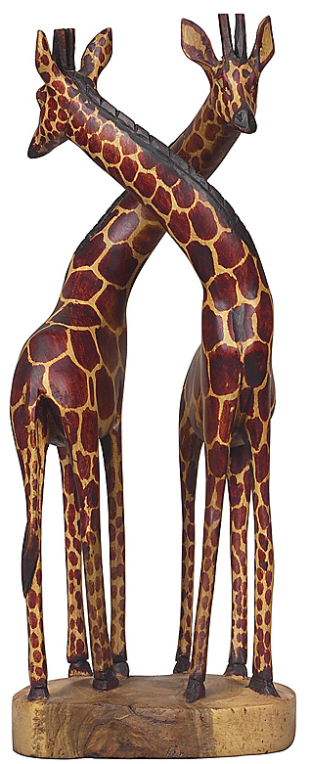
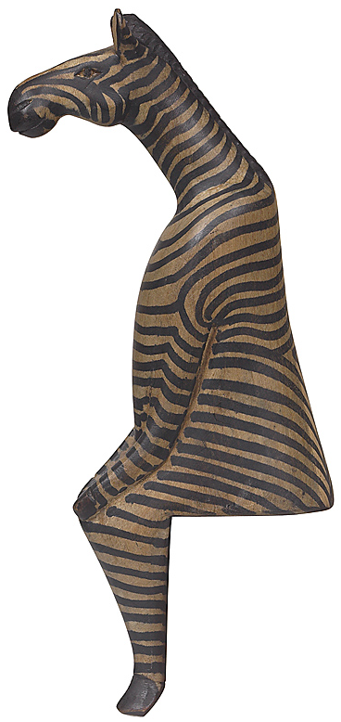
Divide the class into 4 groups: A, B, C & D
Each person gets
a handout:
A, B, C or D

Slide 24
With your partner, read the handout.
Practice.
Learn the
Power Pose.

Slide 25
Let’s try together

Slide 26
Join a partner from a different group.
Join
A
B
←→
Teach your
power pose.
Learn theirs.
←→
← →
←→
← →
C
D
Change partners.
Continue.
←→
Notes:
This position is called King or Queen of the world.
You might want to close your eyes.
Stand with your feet about
45 centimeters* apart. (* 45 cm = 18 inches)
Stand up straight.
Push your chest out.
Hold your head up a little.
Hold your arms out to your side.
Raise your hands up.
Take a deep breath.
You are “King (Queen) of the world.”
Maybe you are going to hug the world!
Keep this position for one minute.
Then say:
Notice your body. How do you feel?
Notice your breathing. Is it fast or slow?
Notice your muscles.
Your stomach.
Your chest.
Your neck.
Your head.
Your shoulders and arms.
Notice your feelings.
Do you feel strong?
Do you feel confident?
Do you feel powerful?
If this “power pose” makes you feel good,
you can use it any time you want to feel this way.

Slide 27
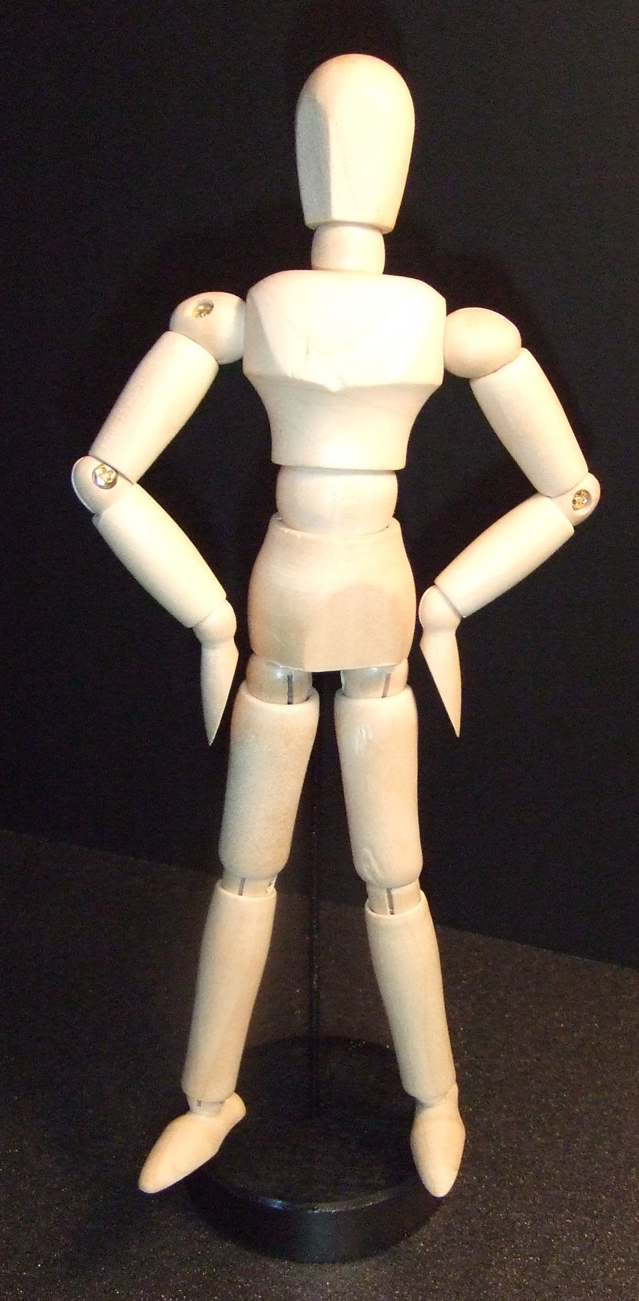
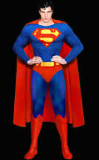
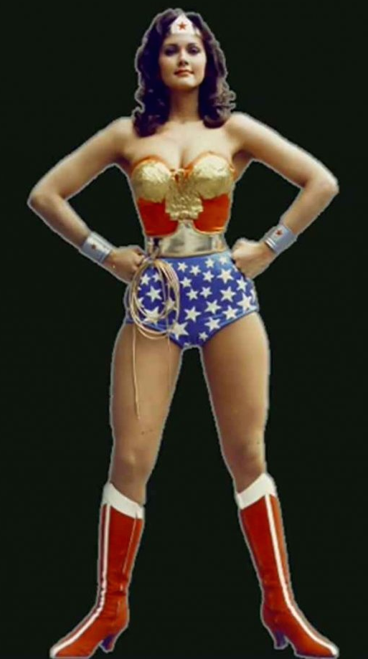
Wonder Woman / Superman
a

Slide 28
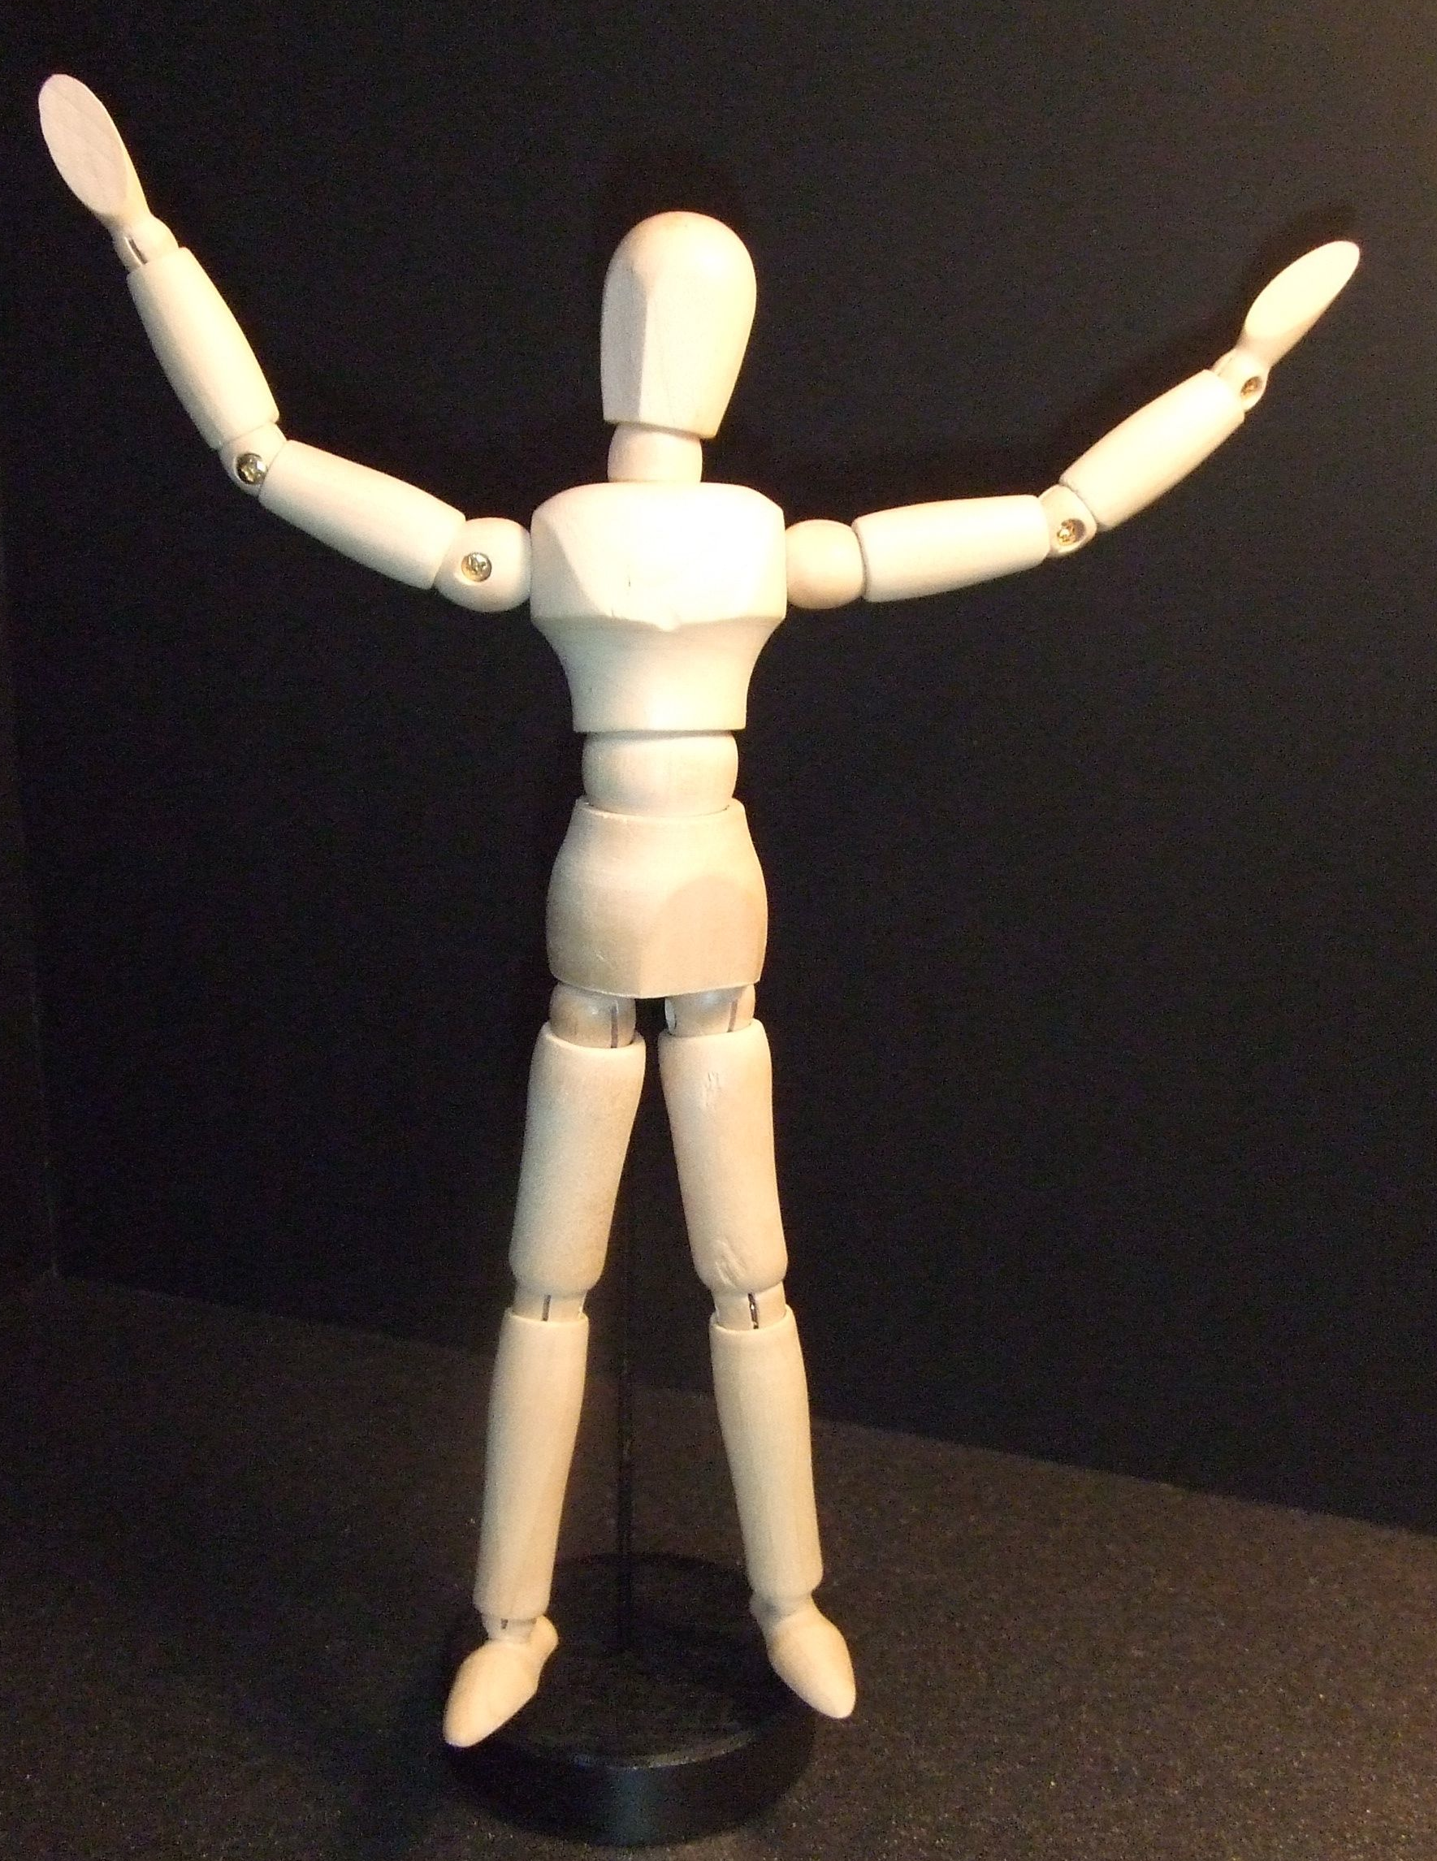
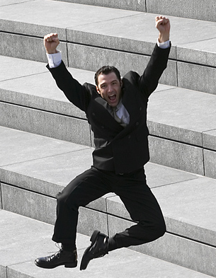
King/Queen of the world
a

Slide 29
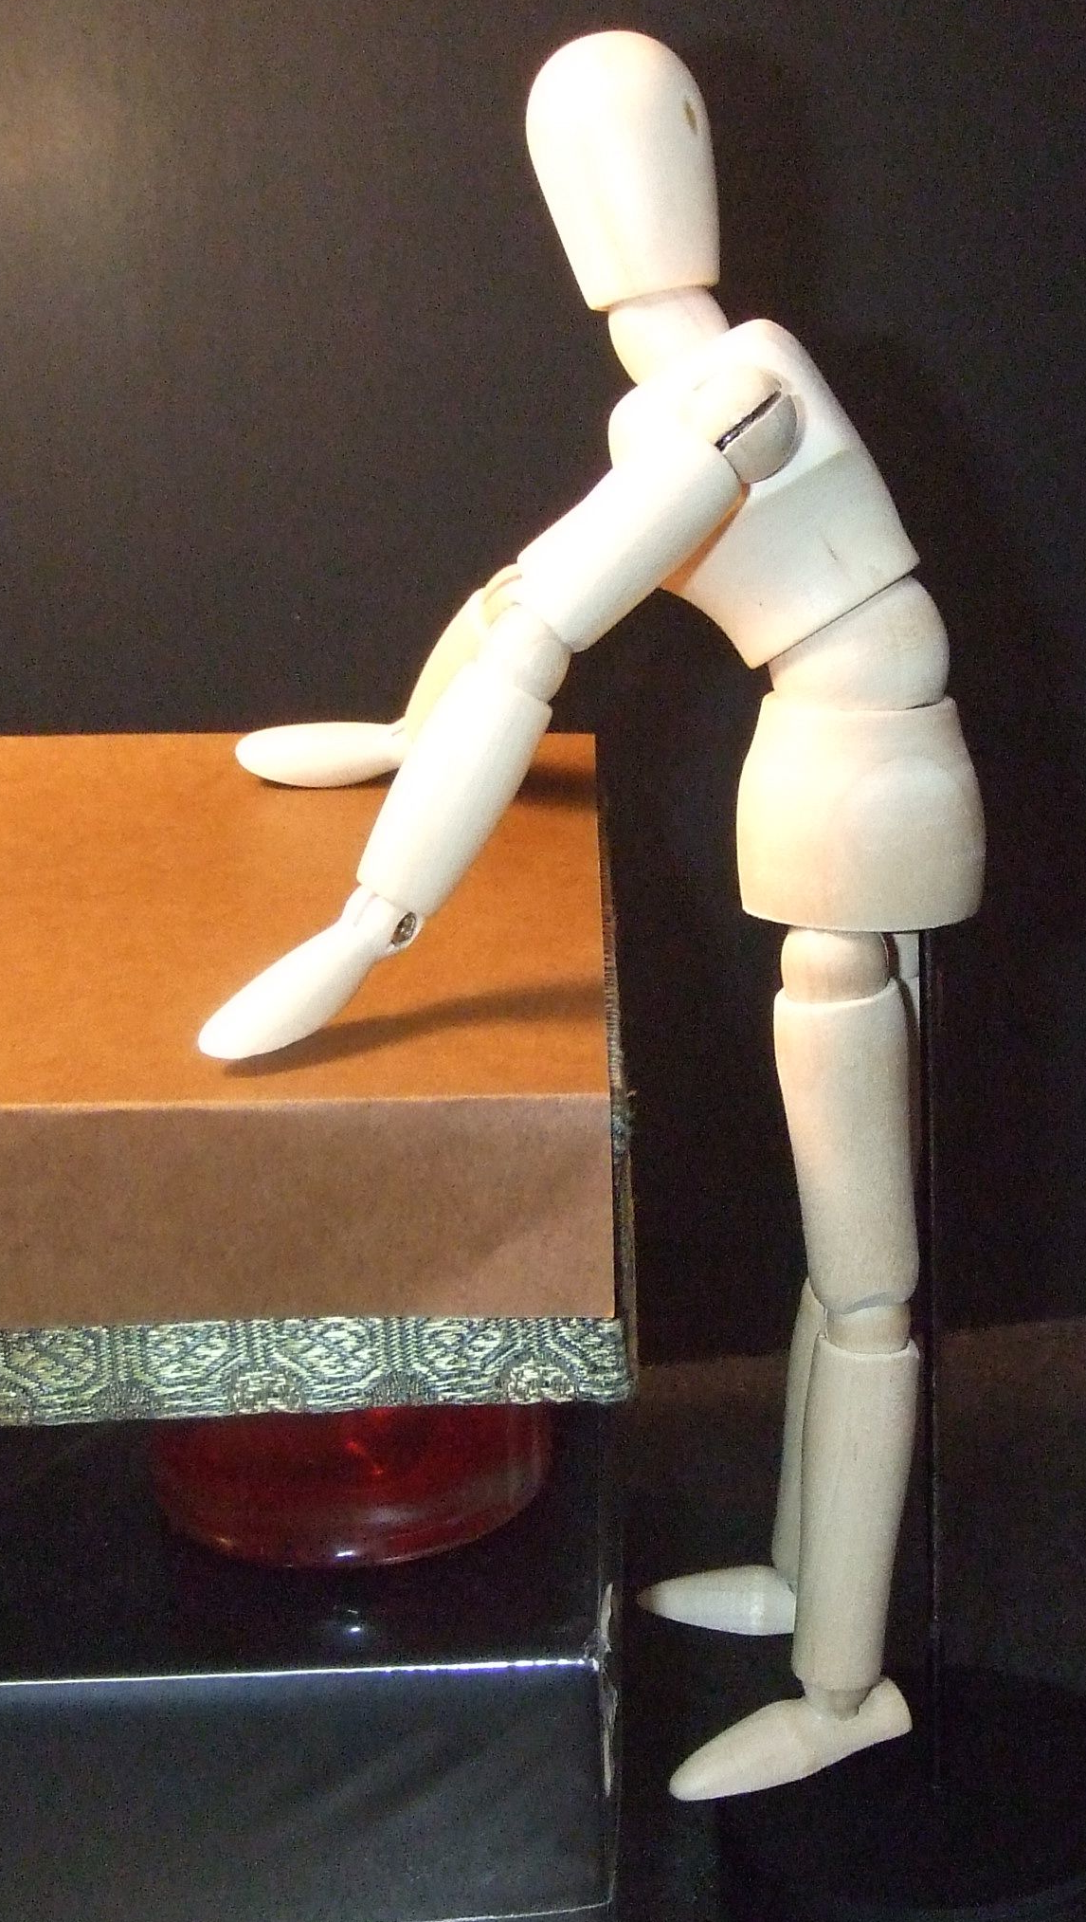
Lean in
a

Slide 30
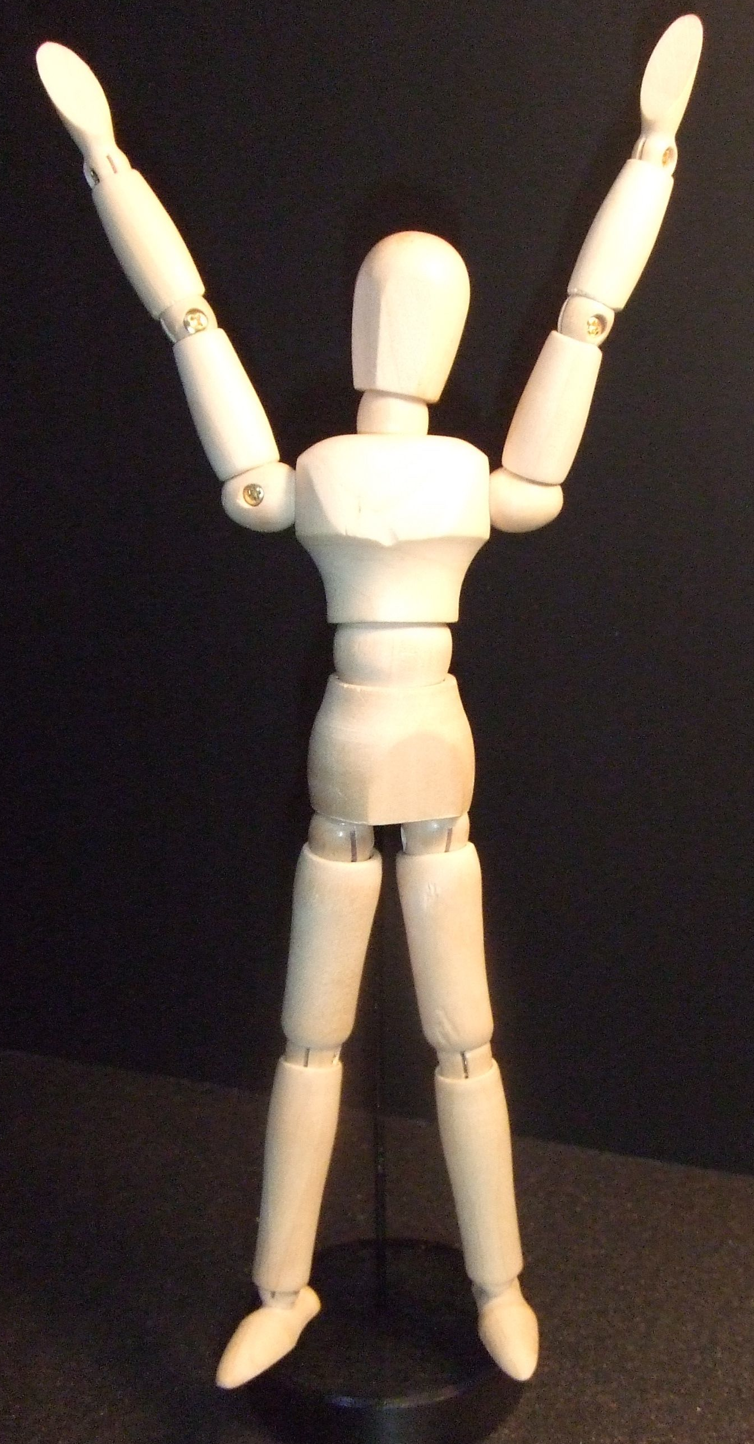
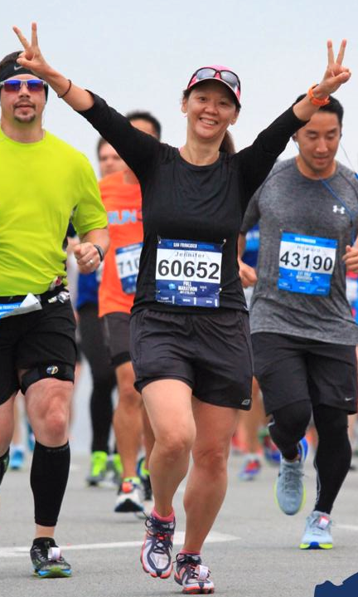
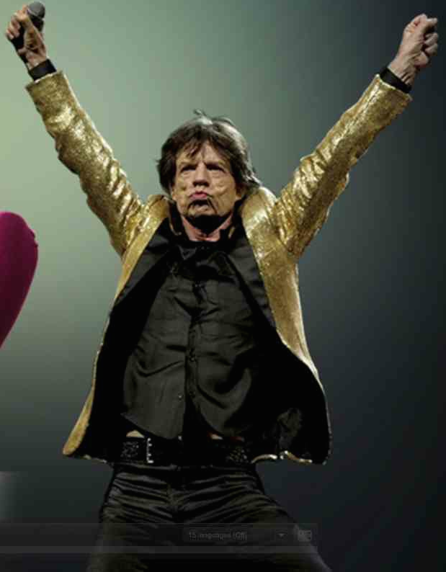
Victory
a

Slide 31
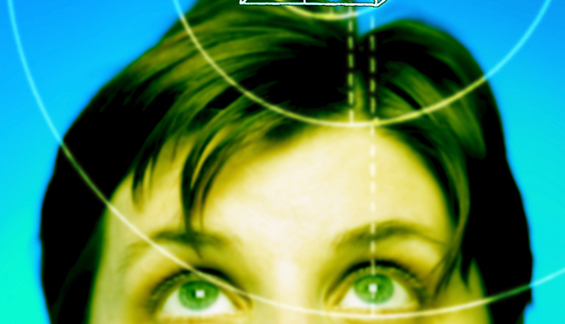
Think Ahead:
Positive
Self-talk

Slide 32
Positive
Self-talk
I am _____.
positive adjective
great!
fantastic!
kind!
cute!
smart!
Good. And parts of me are excellent!
- Ashley Brilliant
Notes:
Info about Ss with low self-esteem. (I’m a good person. I’m not a good person and now I’m a liar, too).

Slide 33
Linguistic
Kross, et al. 2014
Self-distancing
You are ___.
I am _____.
(Your name) is ___.
great!
fantastic!
kind!
cute!
smart!
Good. And parts of me are excellent!
- Ashley Brilliant

Slide 34
Power Pose
(Your name)
is ….
a

Slide 35
Power poses
a
Do you?

Slide 36
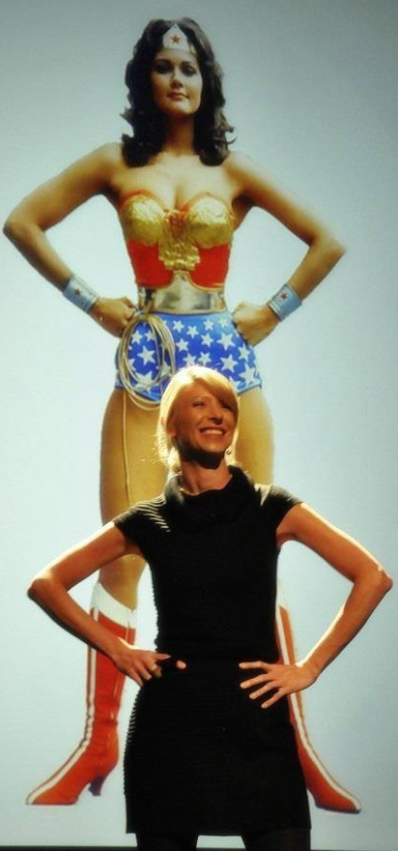
Power
Pose
Fake it
‘till you make it. Fa
Fake it
Until you
make it
BECOME IT!
Dr. Amy Cuddy, Harvard U.

Slide 37
Thank you!
a

Slide 38
Thank you!
a

Slide 39
a

Slide 40
Power
Pose
Notes:
This position is called King or Queen of the world.
You might want to close your eyes.
Stand with your feet about
45 centimeters* apart. (* 45 cm = 18 inches)
Stand up straight.
Push your chest out.
Hold your head up a little.
Hold your arms out to your side.
Raise your hands up.
Take a deep breath.
You are “King (Queen) of the world.”
Maybe you are going to hug the world!
Keep this position for one minute.
Then say:
Notice your body. How do you feel?
Notice your breathing. Is it fast or slow?
Notice your muscles.
Your stomach.
Your chest.
Your neck.
Your head.
Your shoulders and arms.
Notice your feelings.
Do you feel strong?
Do you feel confident?
Do you feel powerful?
If this “power pose” makes you feel good,
you can use it any time you want to feel this way.

Slide 41
Power
Pose
?
½ - Pose A
½ - Pose D

Slide 42
A
B
←→
←→
← →
←→
← →
C
D
←→
Notes:
This position is called King or Queen of the world.
You might want to close your eyes.
Stand with your feet about
45 centimeters* apart. (* 45 cm = 18 inches)
Stand up straight.
Push your chest out.
Hold your head up a little.
Hold your arms out to your side.
Raise your hands up.
Take a deep breath.
You are “King (Queen) of the world.”
Maybe you are going to hug the world!
Keep this position for one minute.
Then say:
Notice your body. How do you feel?
Notice your breathing. Is it fast or slow?
Notice your muscles.
Your stomach.
Your chest.
Your neck.
Your head.
Your shoulders and arms.
Notice your feelings.
Do you feel strong?
Do you feel confident?
Do you feel powerful?
If this “power pose” makes you feel good,
you can use it any time you want to feel this way.

Slide 43
Power
Pose

Slide 44
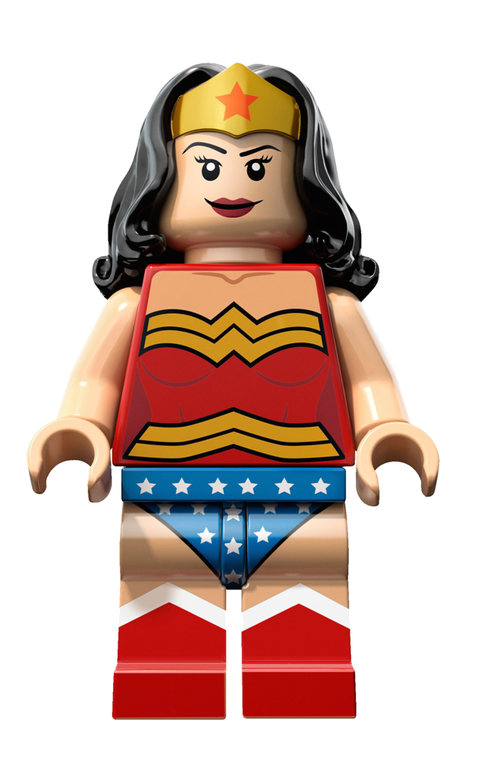

Slide 45
Power
Pose
Notes:
Winner.
Like a runner
Or Mick Jagger getting a lot of satisfaction

Slide 46
Power
Pose

Slide 47
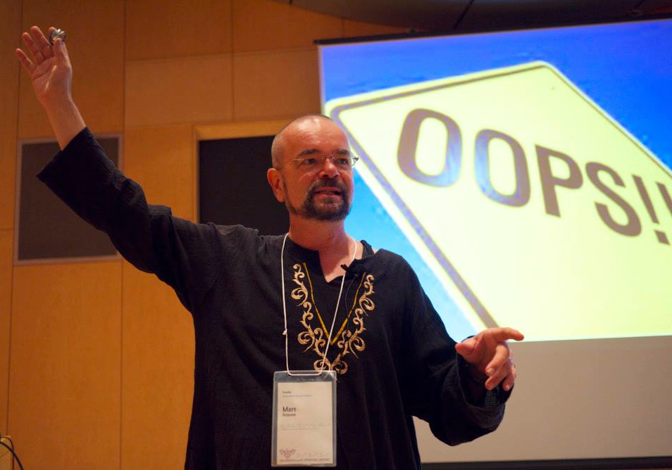

Slide 48
Let’s try!

Slide 50
Slide from Amy Cuddy’s TED talk.
Slide from Amy Cuddy’s TED talk.
テストステロン

Slide 51
Slide from Amy Cuddy’s TED talk.
コルチゾール
(Stress hormone)
ストレスホルモン

