Slide 1
Energy breaks
Human beings were not designed to sit in desks all day. Energy breaks are a series of short, physical activities you can use to get your students moving and energized.
Well balanced students is simple review or fluency activity. When students are doing a speaking/fluency activity or when you want them to review what they been doing have them stand, in pairs, toes toes touching, holding each other’s wrists (see slide 5) and balance each other as they talk.
Afterwards, use the two slides to explain that one minute of movement gives them a 15% increase of blood, and therefore oxygen, to the brain.
© Marc Helgesen. May be freely used for non-commercial purposes.
For more, visit: www.HelgesenHandouts.weebly.com. Click on “Physical activity…”
This slide is for the teacher’s information. The student slide show starts with slide 2.

Slide 2
Energy break

Slide 3
A
well-balanced
activity

Slide 4
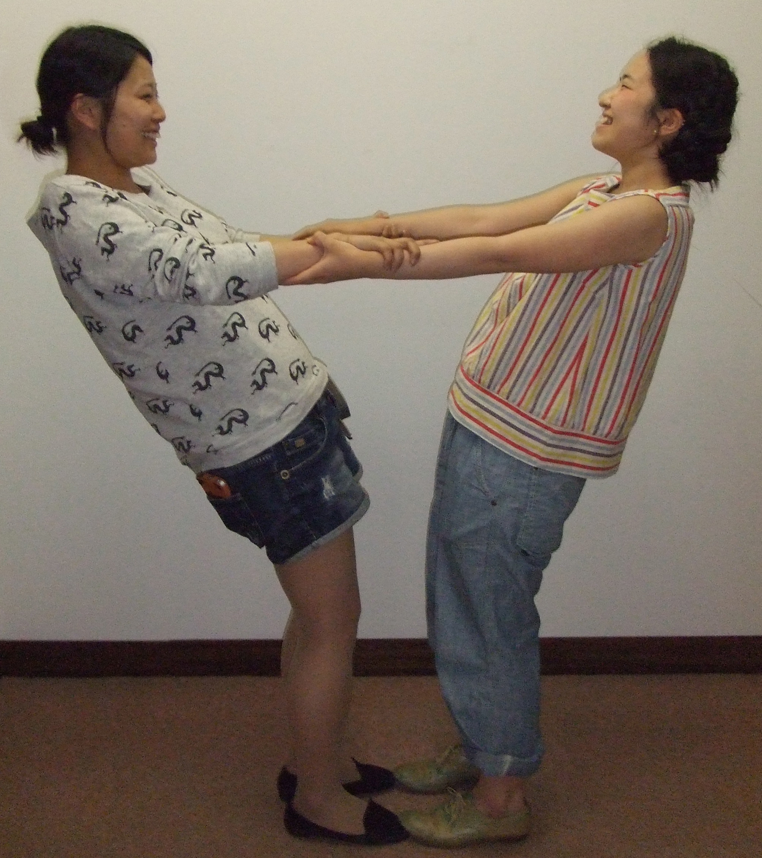
Well balanced students
Notes:
• This conference – what you have learned so far
Or This room.

Slide 5
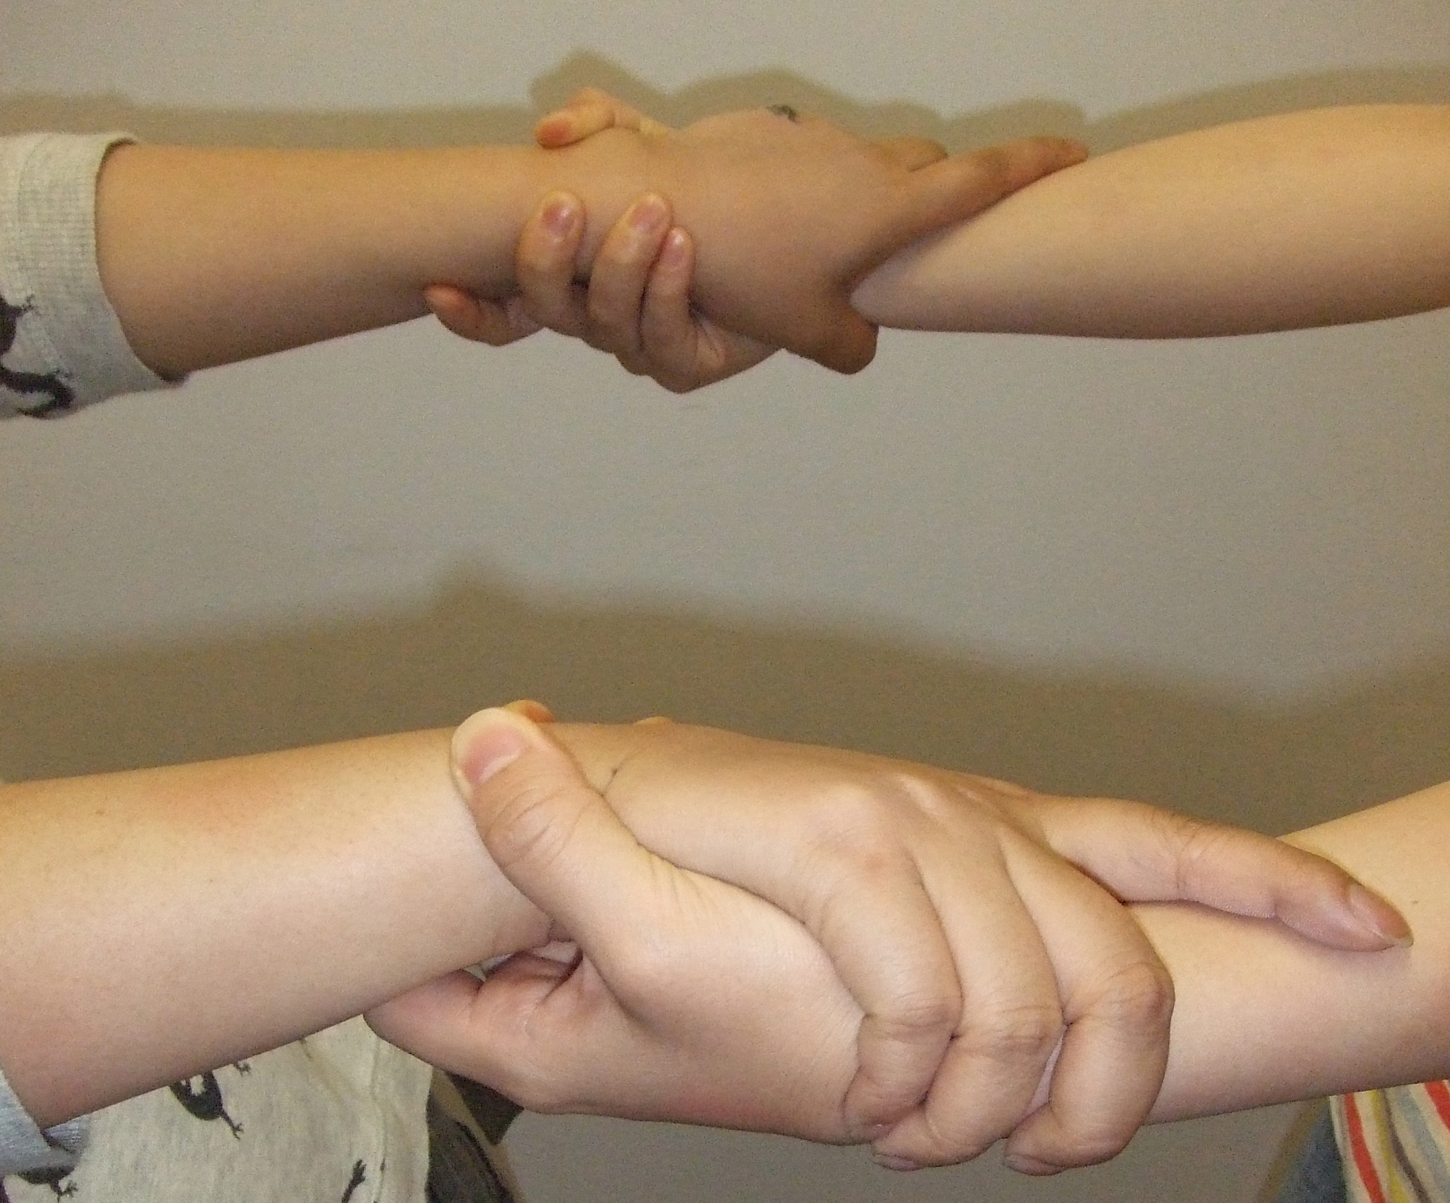

Slide 6
Well balanced students
Notes:
What you do (as teacher or when student – that was physical).

Slide 7
S20
How long
do you
sit in
class?
20
minutes
Blood
build-up

Slide 8
1 minute of movement
+ 15%
blood & oxygen to the brain
Source: Sousa, D. (2011) How the Brain Learns, Thousand Oaks, CA: Corwin Press.

Slide 9
Let’s
move!

Slide 10
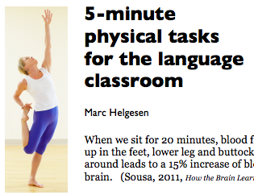
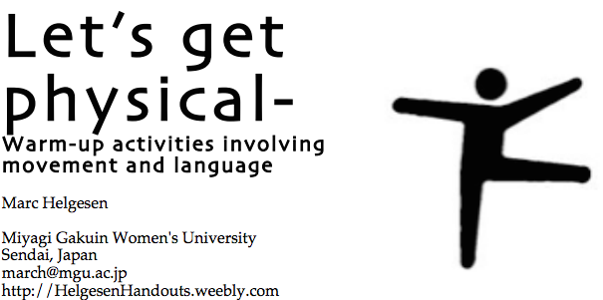
More ideas at
http://tinyurl.com/ELT-physical

