Slide 1
Energy breaks
Human beings were not designed to sit in desks all day. Energy breaks are a series of short, physical activities you can use to get your students moving and energized.
Walk & talk is simple. When students are doing a speaking/fluency activity, have them, in pairs, stand and walk around the room.
Afterwards, use slide 4 to point out that we all really should move more. By “meant to walk”, we are referring to the fact that we evolved over thousands of years. It has only been in the past 1-200 years that people walk so little.
© Marc Helgesen. Maybe freely used for non-commercial purposes.
For more, visit: www.HelgesenHandouts.weebly.com. Click on “Physical activity…”
This slide is for the teacher’s information. The student slide show starts with slide 2.

Slide 2
Energy break

Slide 3
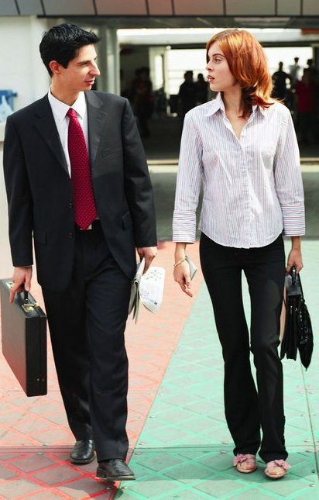
Walk &
Talk

Slide 4
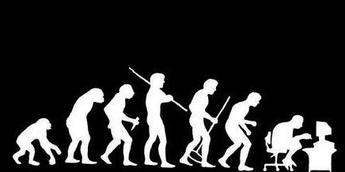
Humans are meant to walk
10 - 20 km/day
Source: Medina, J. (2014) Brain Rules.
Seattle, WA: Pear Press

Slide 5
Let’s move!

Slide 6
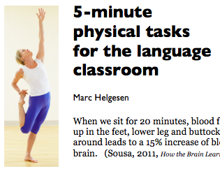
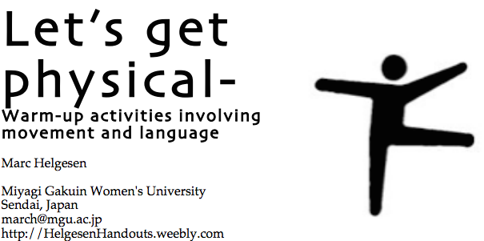
More ideas at
http://tinyurl.com/ELT-physical

