Slide 1
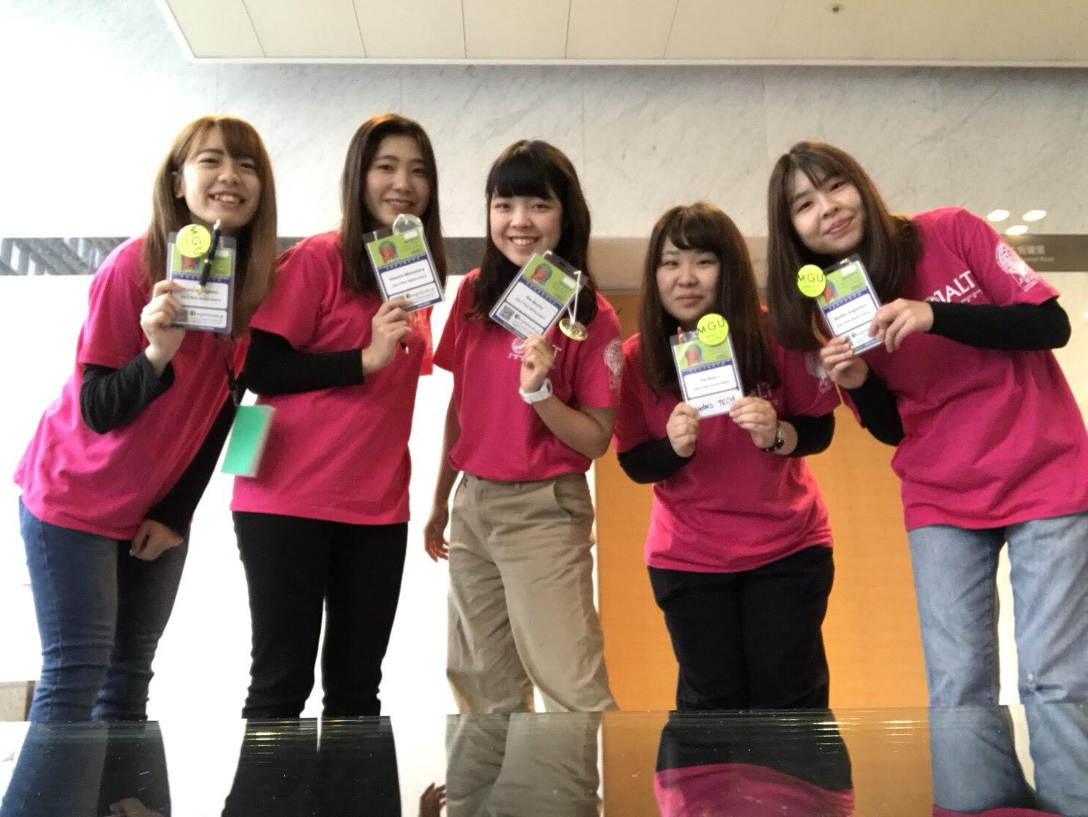
Please take a minute to thank the Pink Shirt interns.
Better yet, have a 2-3
minute conversation.
They help us so much.
Let’s appreciate them.

Slide 2
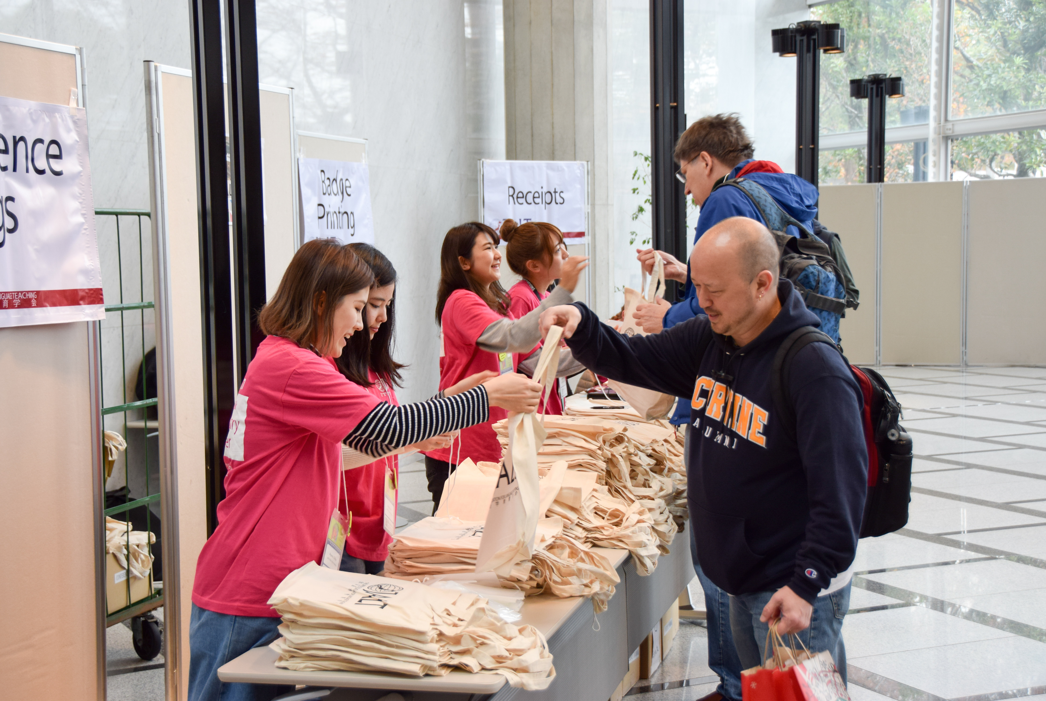
Please take a minute to thank the Pink Shirt interns.
Better yet, have a 2-3
minute conversation.
They help us so much.
Let’s appreciate them.

Slide 3
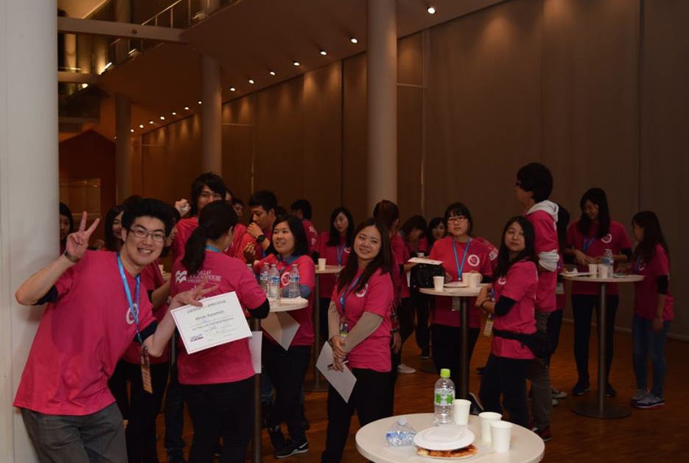
Please take a minute to thank the Pink Shirt interns.
Better yet, have a 2-3
minute conversation.
They help us so much.
Let’s appreciate them.

Slide 4
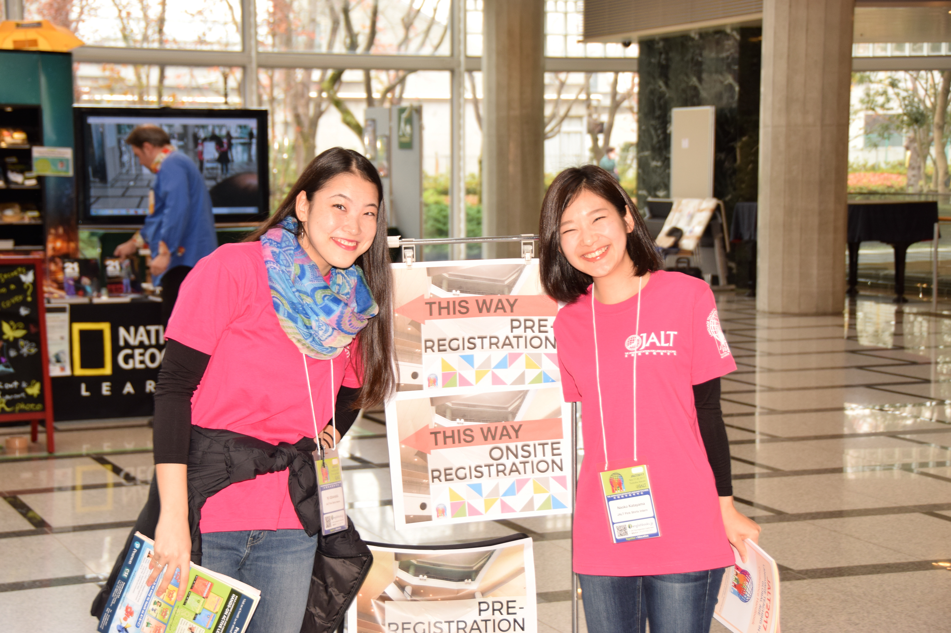
Please take a minute to thank the Pink Shirt interns.
Better yet, have a 2-3
minute conversation.
They help us so much.
Let’s appreciate them.

Slide 5
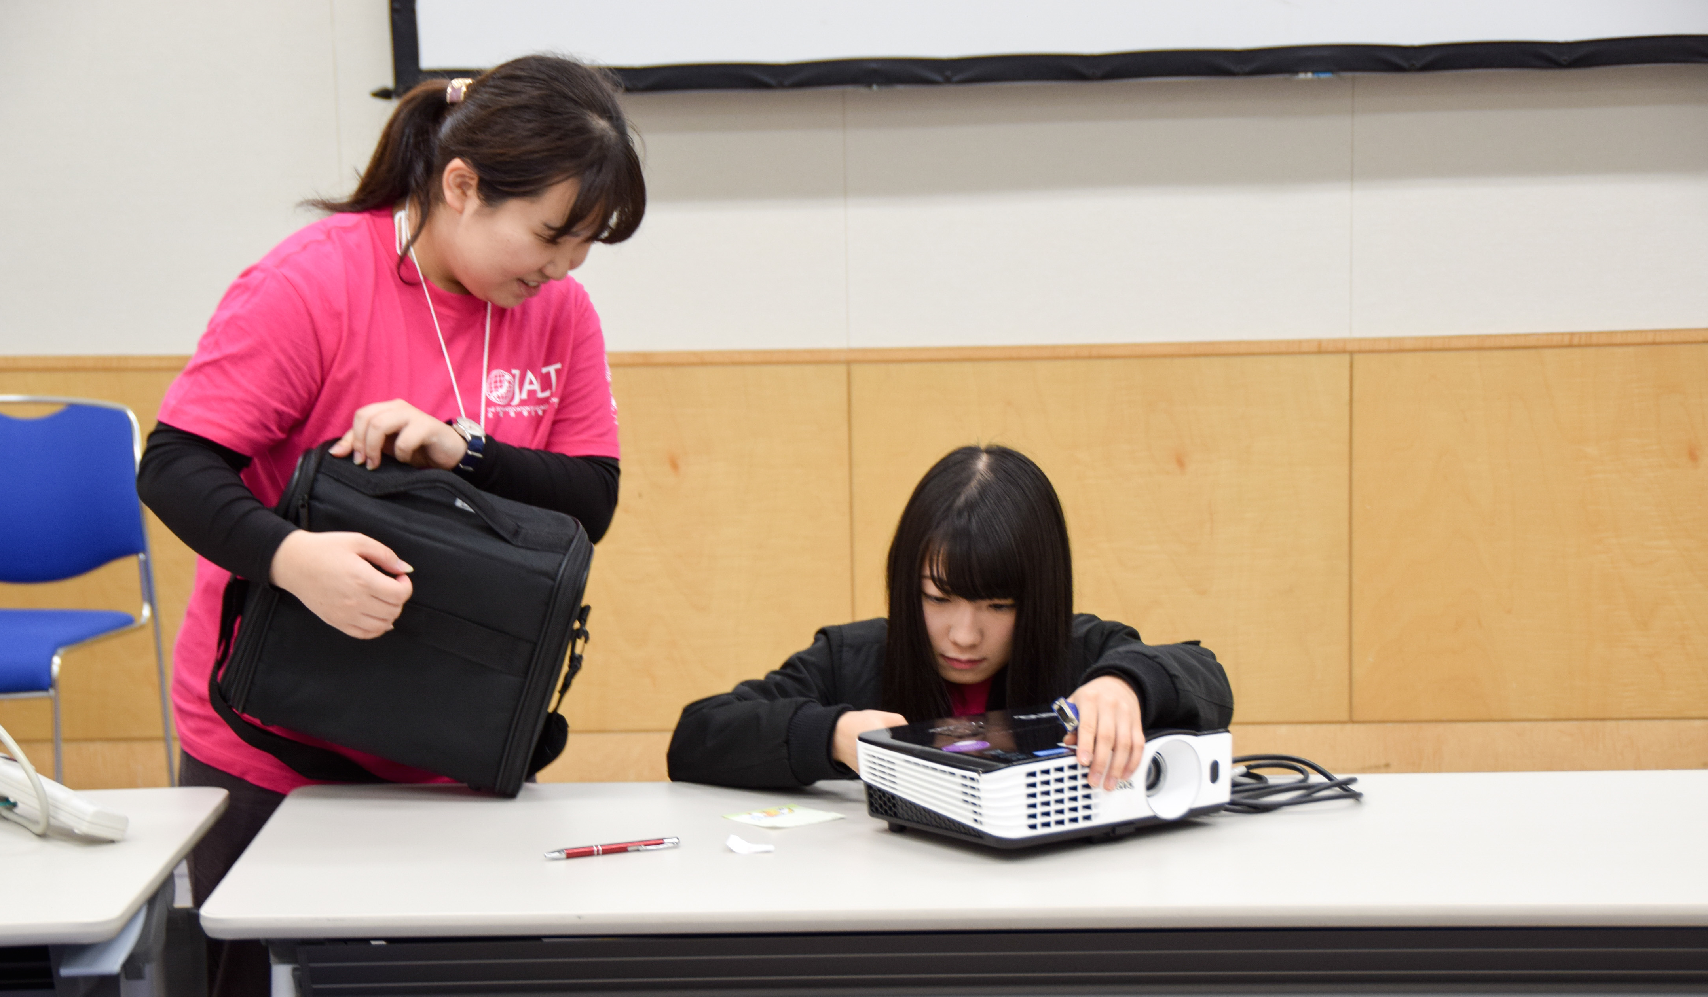
Please take a minute to thank Pink Shirt interns.
Better yet,
have a 2-3
minute
conversation.
They help us
so much.
Appreciate
them!

Slide 6
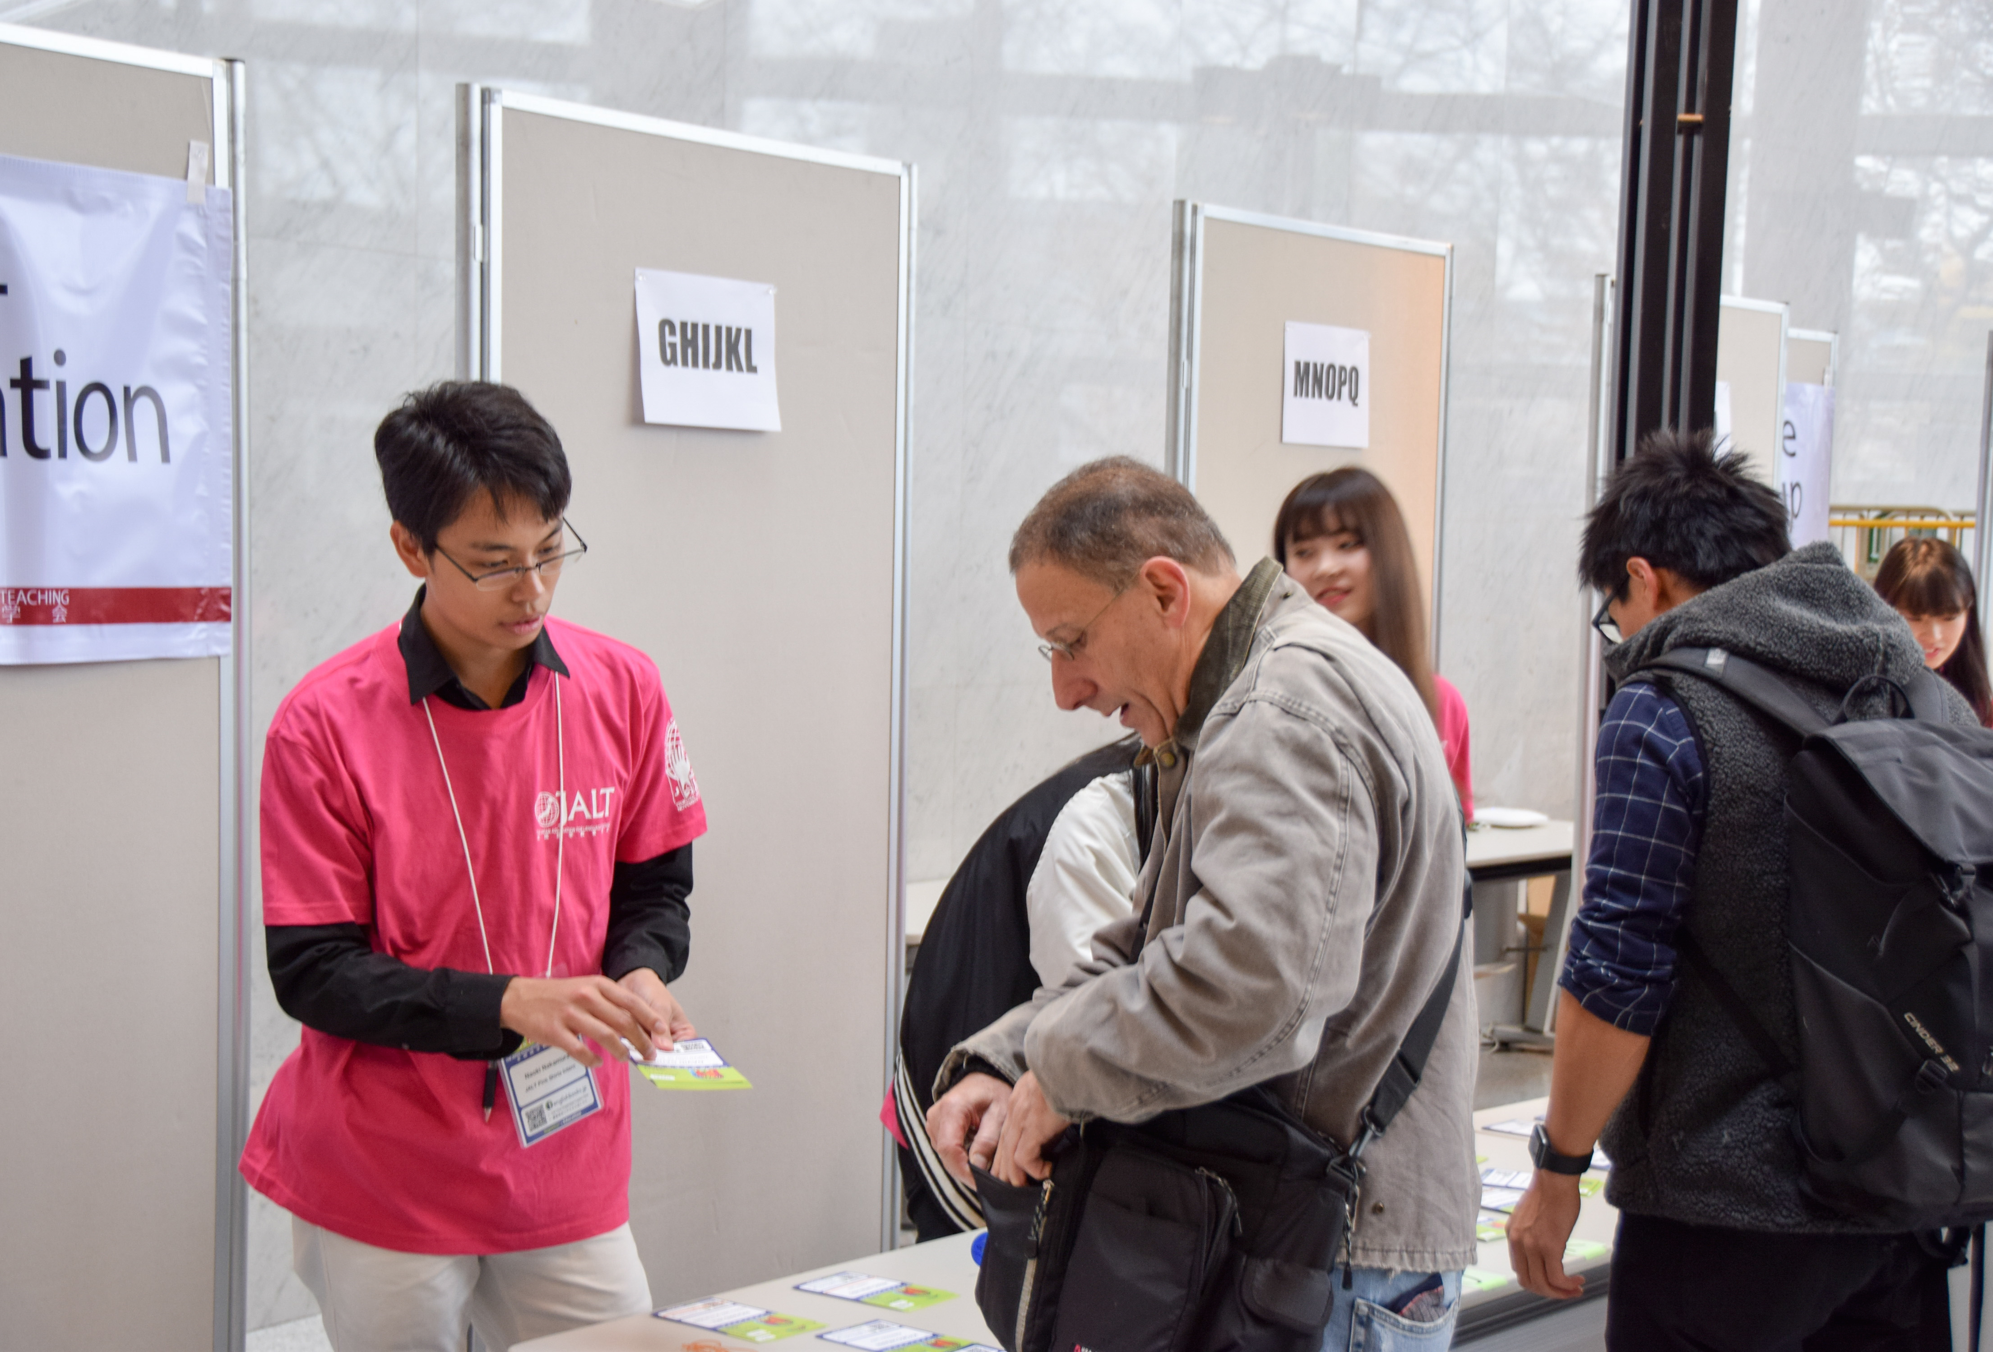
Please take a minute to thank the Pink Shirt interns.
Better yet, have a 2-3
minute conversation.
They help us so much.
Let’s appreciate them.

Slide 7
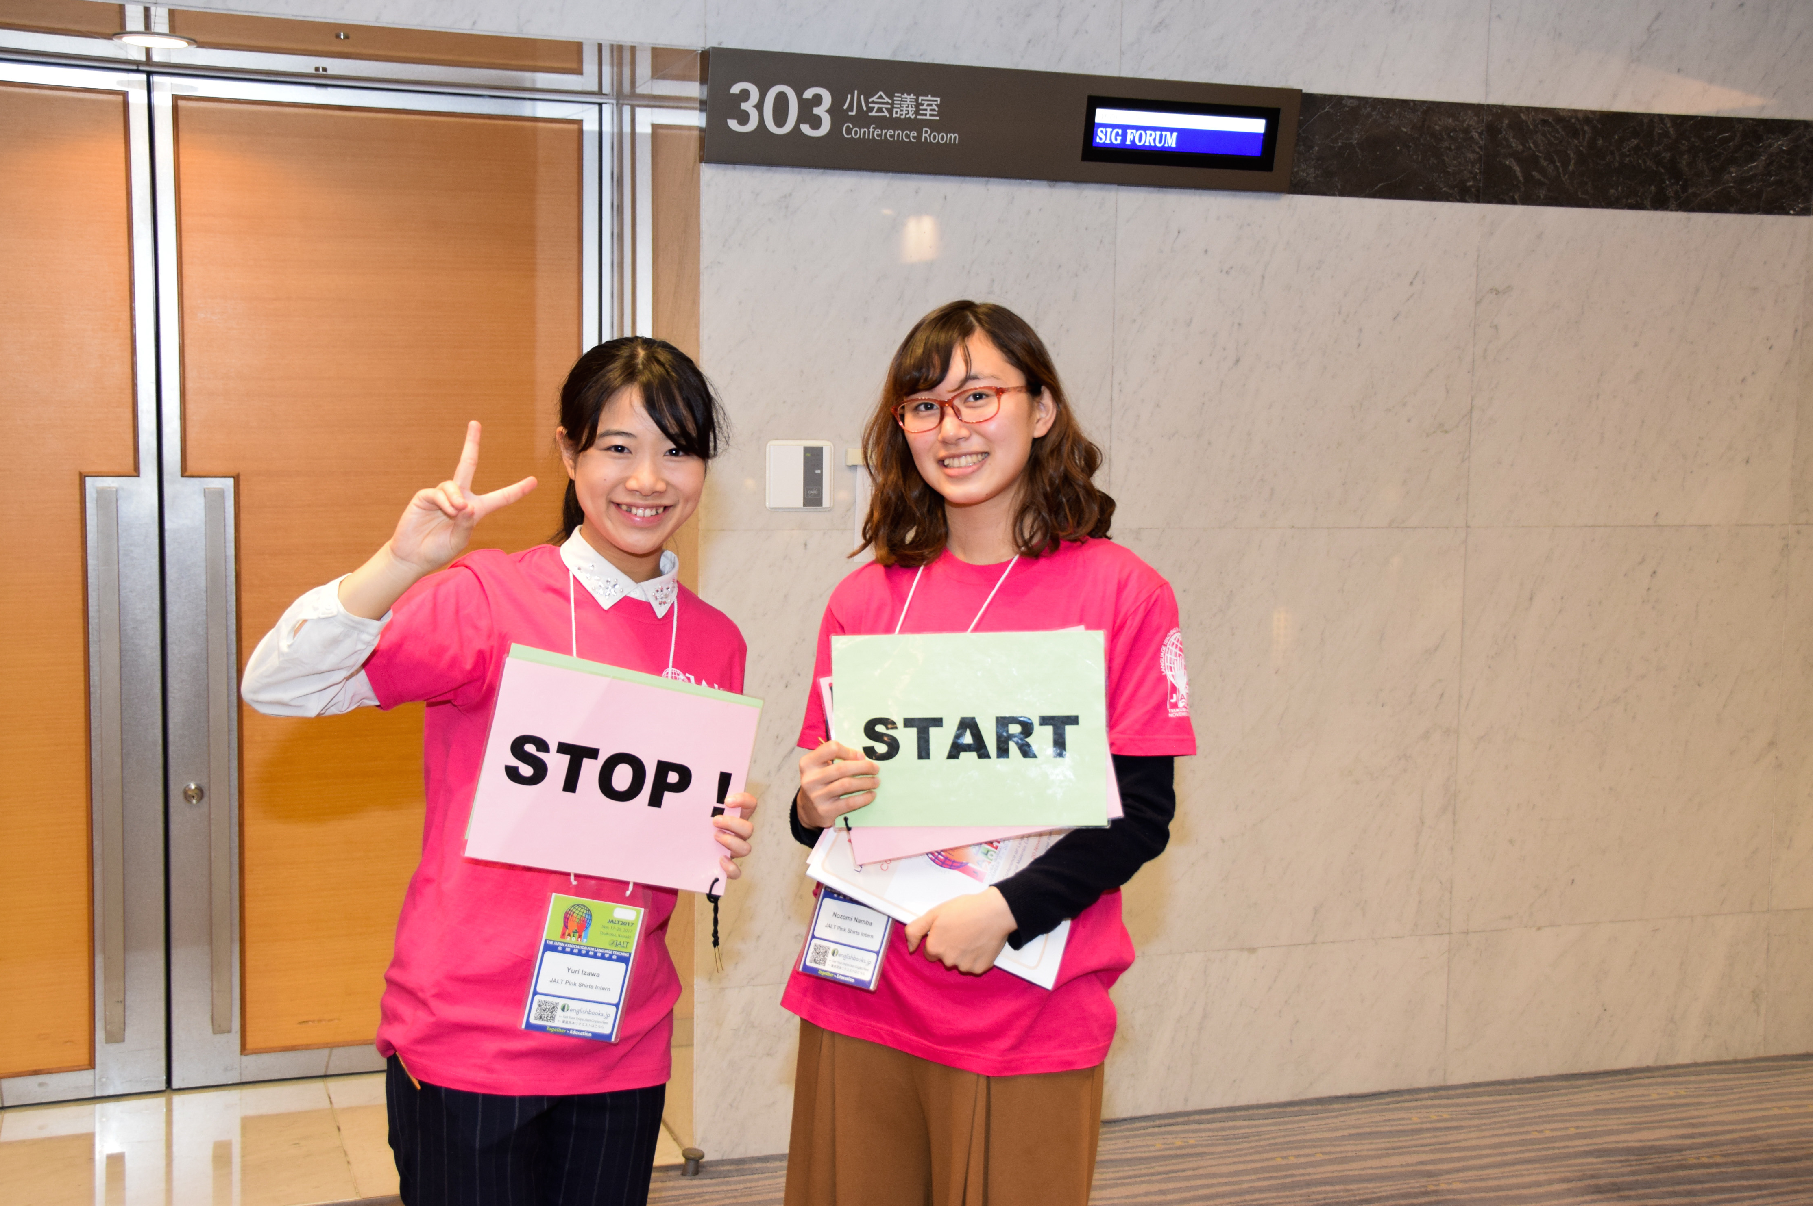
Please take a minute to thank the Pink Shirt interns.
Better yet, have a 2-3
minute conversation.
They help us so much.
Let’s appreciate them.

