Slide 1
Think Ahead:
Think ahead:

Slide 2
Think Ahead:
The power of
Task Planning
Think ahead:
Notes:
What is task planning.

Slide 3
What about real people,
speaking in real time?
Notes:
He’s speaking his mother tongue.

Slide 4
Next slide is Miss Teen South Carolina:
http://www.youtube.com/watch?v=lj3iNxZ8Dww

Slide 6
Don’t worry if it made
no sense to you.
It made no sense at all.

Slide 7
A story you know.
Notes:
Work with a partner.
You will remember/ retell a story you know. Work together to remember/ retell it.
If possible, do this in L2

Slide 8
Romeo & Juliet

Slide 9
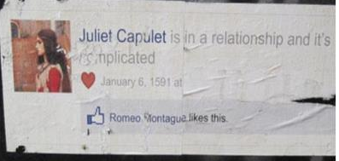

Slide 10
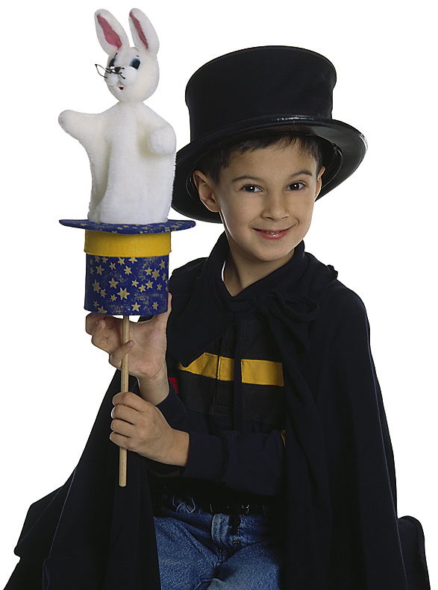
The problem:
Demanding
instant production
Notes:
Learned:
Way we learn to communicate is by communicating
More we communicate, more we learn
Talk NOW -- what do you like sports

Slide 11
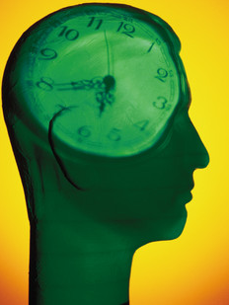
Think
time
Think
time
Thni
What do I
want to say?
How will I
say it?
Notes:
And taking 1-2 minutes to look over the task. Think:
What am I going to do? What do I want to say? How will I say it?
Increases fluency, accuracy, complexity, vocabulary variety. Background Music on the CD (3 tracks on each CD)

Slide 12
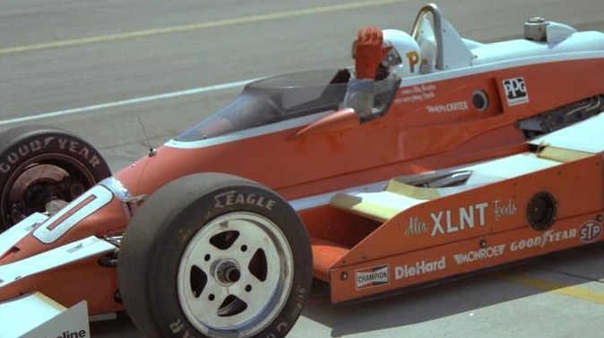
Think time
Increased
fluency
Notes:
Increased fluency:
This makes sense: You’ve been through what you want to say mentally. When you say it aloud, it is like saying it the second time -- so of course it is smoother.

Slide 13
Think time
Increased
fluency
Increased complexity
Notes:
Increased complexity:
Again, this makes sense. You are saying it for the second item. You put it together in a more precise way.

Slide 14
Think time
Increased
accuracy
Notes:
Increased accuracy.
Again, you’ve been through it. You say it better. Actually, accuracy tends to go up when you’ve done a language awareness task like the pronunciation first. If you don’t, you’ll still have the gains in fluency and complexity but not necessarily accuracy.

Slide 15
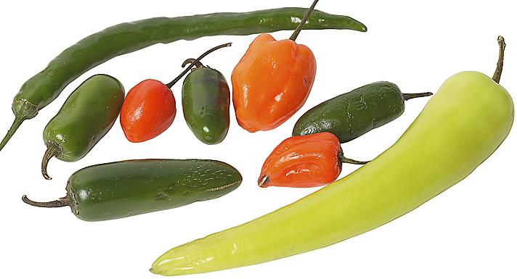
Think time
Greater
vocabulary variety
Notes:
Greater vocabulary variety. Vocabulary is not a matter of “the words I know” and “the words I don’t know.” There is also a group in the middle of “words I am learning”. We need to meet new words many time -- often up to 20 times -- before we can use them easily. “Think time” lets learners remember the words they are learning.

Slide 16
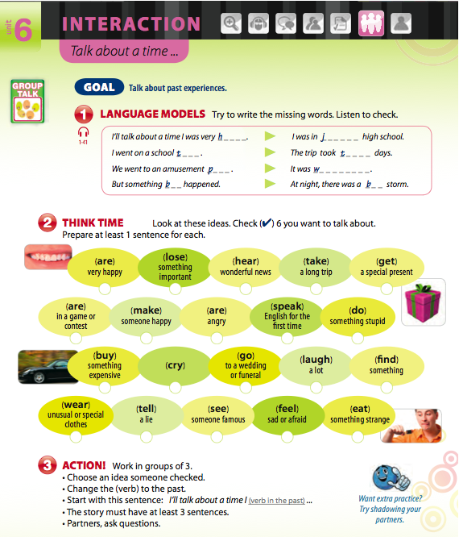

Slide 17
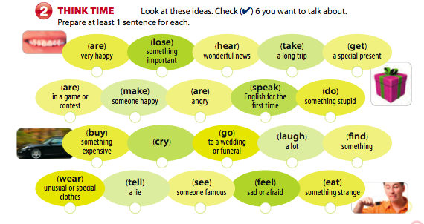
Notes:
½ the room – different task

Slide 18
The smilie scale J = interesting K = not bad but not great L = boring

Slide 19
Notes:
Notice – cant think of question without answer.
TASK PLANNING

Slide 20
Increased accuracy
sometimes
dog
dog
really
Fill in first. Listen to check.
Multiple possibilities.
Notes:
Notice – cant think of question without answer.
TASK PLANNING

Slide 21
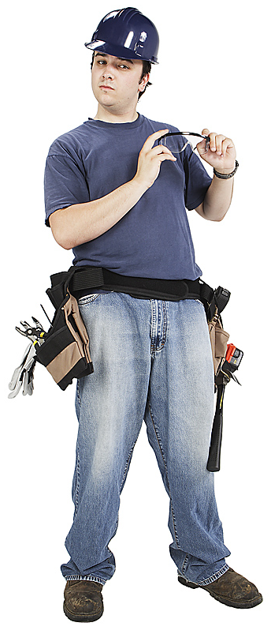
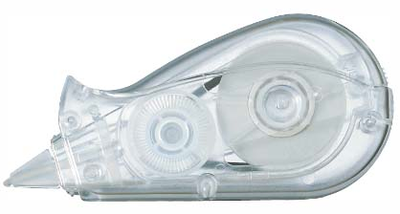
• Hint:
cloze target
grammar/vocabulary
Not every nth word
DIY –
Do it yourself.
Notes:
You may have learned in school that, for a cloze test, blank out every 7th or 9th, or Nth word. Find. This is NOT a test.
Your purpose is to focus attention on Form. – noticing the grammar. Noticing the vocabulary.

Slide 22
12
Increased accuracy
sometimes
FonF
Focus on Form
Descriptive knowledge
knowing that…
Procedural knowledge
knowing how…

Slide 23
12
Some (especially Mike Long) insist
FonF
Focus on Form
Reactive
is different than
FonFs
Focus on Forms

Slide 24
I don’t find Long’s position useful
With Japanese learners, we can anticipate the problems:
• L1 interference
• False beginners
Not doing FonF(s), lost opportunity for task planning.
Notes:
L1- comparatives. X yori, Y wa oki.
False beginners: You had better/ nani shita ho ga ii.

Slide 25
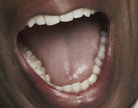
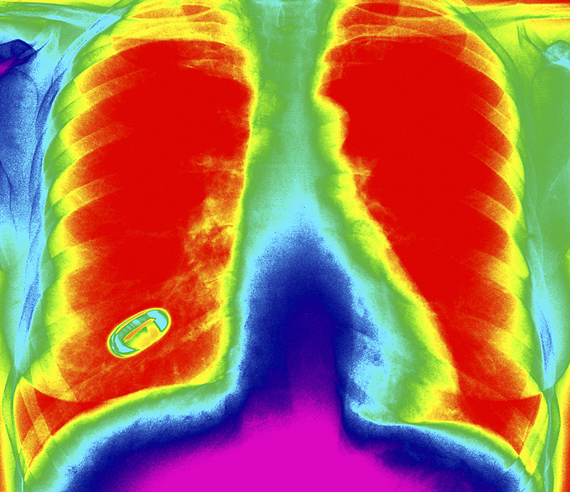
Where does pronunciation begin?
Notes:
25

Slide 26
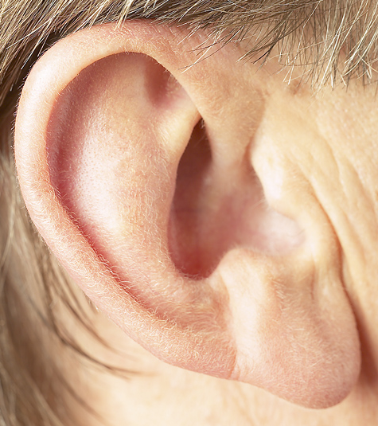
Where does pronunciation begin?
Notes:
26

Slide 27
Where does pronunciation begin?
The
mind
Notes:
27

Slide 28
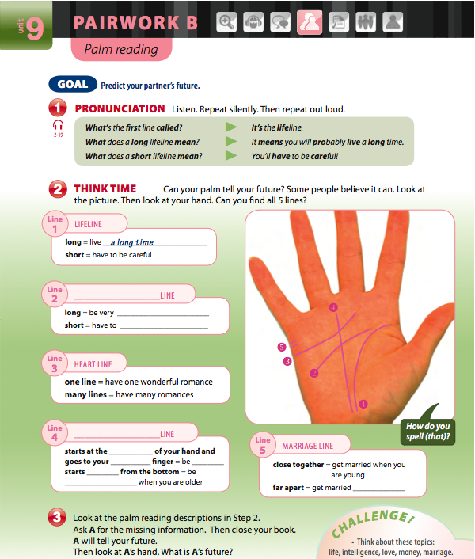

Slide 30
It means… you‘ll probably live a long time. you’ll have to be careful!
Notes:
L&R/ Silent L&R / Plug your ears
My voice / your voice / worst Ss voice / with joy
Close eyes: black on green (remember), chalkboard,
Underline, “ill” make it flash, etc.

Slide 31
Q: What’s this?
Pasta / Noodles?
Rubber bands?
These are
Mini-pronunciation
practice machines!

Slide 32
It means… you‘ll probably live a long time. you’ll have to be careful!
Notes:
My voice / your voice / worst Ss voice / with joy
Close eyes: black on green (remember), chalkboard,
Underline, “ill” make it flash, etc.

Slide 33
Pronunciation pattycake

Slide 34
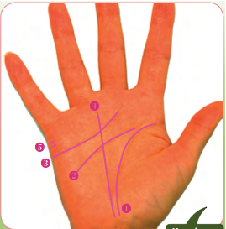

Slide 35
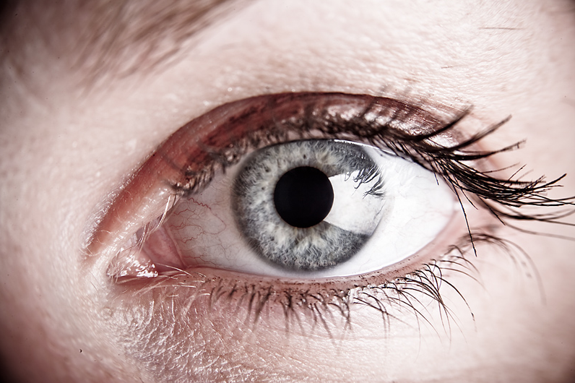
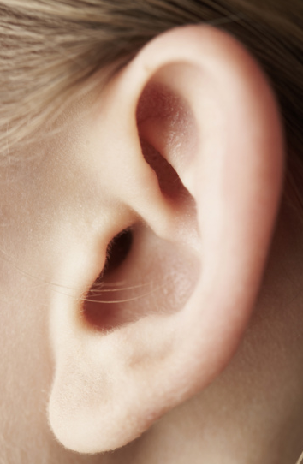
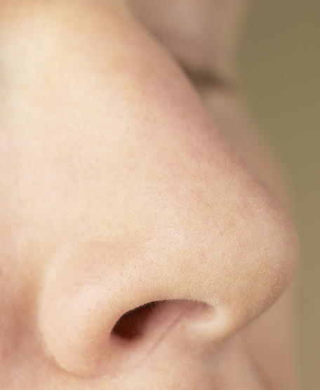
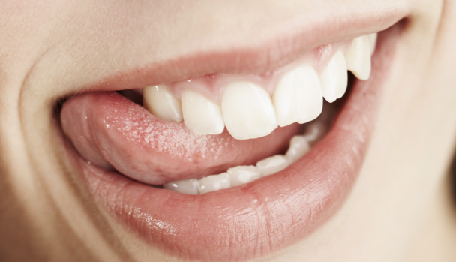
The senses
Visual sight
Auditory hearing
Haptic (tactile+kinethetic)
touch/feeling
Olfactory smell
Gustatory taste
S
Notes:
35

Slide 36
The senses
Visual
Auditory
Haptic
Olfactory
Gustatory
Notes:
36

Slide 37
To ensure fairness,
you will all take
the same test.
You all have to climb
that tree.
Notes:
37
Credit where credit is due:
borrowed this from Curtis Kelly
LEARNING STYLES!

Slide 38
preferred (primary) sensory modality? .
Main learning style/channel
Notes:
All are ALL

Slide 39
Next slide: Domino’s Pizza commercial
http://www.youtube.com/watch?v=kUoKi5RVwqI

Slide 41
preferred modality:
Take a test
Abiator style
http://tinyurl.com/learningstyletest
Notes:
41

Slide 42
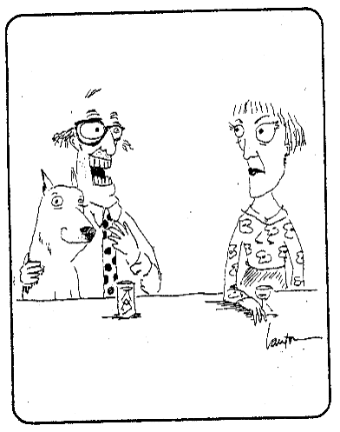
Well, maybe not Spike.
I’m quite visual and Spike
here is more on the nasal side
We all have ALL the senses
(barring a disability).
Notes:
42
All have all.
Not all equal. Visual trumps everything.
Driving, listening to music. Something happens, have to pay attention.
Blocks out music.
They think visual -- and visualizing -- may be why speaking on a
mobil phone when driving so dangerous.
2 people talking (in care) both watch.
On cell phone, you are imagining (visualizing) what the other person is saying.
(jumping back and forth between driving and thinkgin

Slide 43
Think
time
Think
time
Thni
What do I
want to say?
How will I
say it?
Notes:
And taking 1-2 minutes to look over the task. Think:
What am I going to do? What do I want to say? How will I say it?
Increases fluency, accuracy, complexity, vocabulary variety. Background Music on the CD (3 tracks on each CD)

Slide 44
Capacity hypothesis
Just and Carpenter, 1992
• Any learner's cognitive processes are in competition for limited processing space.
• listening to/reading something simple, no problem. - Space to spare.
• processing something with complex language (lexico-grammatical load) or content and/or SPEED--
Overload

Slide 45
Mr. Osborne, may I be excused?
My brain is full.
Larson, 1986

Slide 46
Memory
test
XCN
NNH
KFB
IYK
KSO
NYX

Slide 47
Memory
test

Slide 48
X
CNN
NHK
FBI
YKK
SONY
X
Memory
test
XCN
NNH
KFB
IYK
KSO
NYX
Notes:
Chucking/ grouping information
Think time lets Ss group thoughts
Credit: Dan Willingham Why students don’t like school

Slide 49
Balloons
Notes:
Circles (5-8) - hold hands. Can’t touch with with hands.
• animals (automatic think time)
• body parts: From Marc’s shoulder.
• job
• jobs that are dangerous / Jobs where you wear a uniform.
• free association: blue --> water --> swim --> olympics

Slide 50
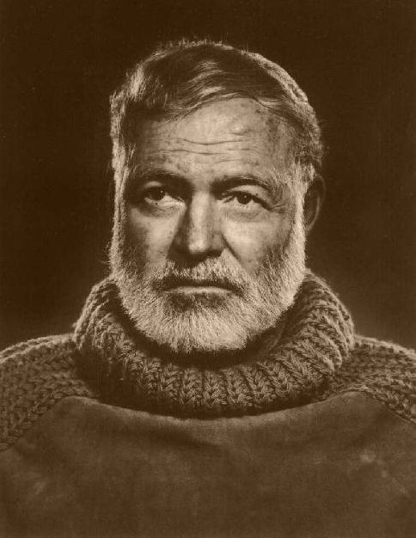
My life – in 6 words
For sale:
Baby shoes.
Never used.
Notes:
Not quite what I was planning.
Smith magazine

Slide 51
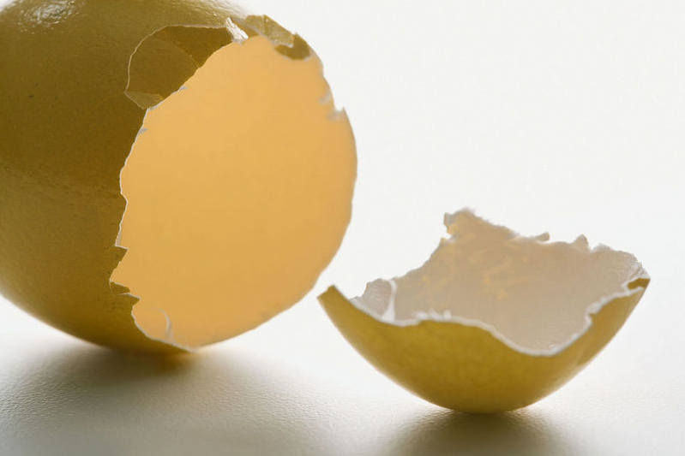
break

Slide 52
Line up
nonverbally
Notes:
MENTION CLASSROOM MANAGEMENT/GROUPING
Height
- birthday (Jan – December)
- time you got up today. (drop if no time)
- How long it took you to get here today

Slide 53
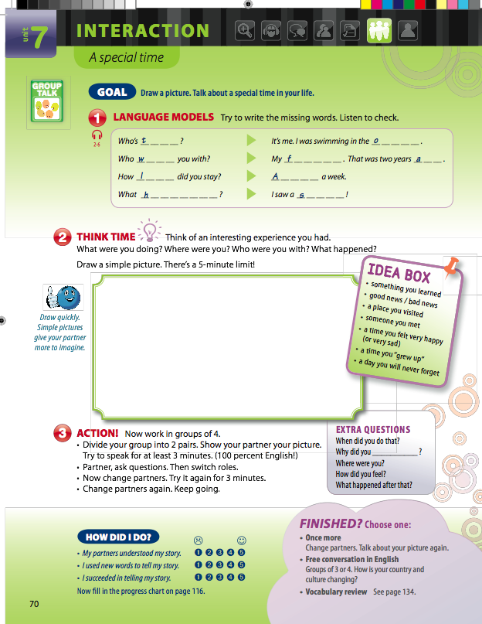
Notes:
53
Something different than I do in class – several activities with one task

Slide 54
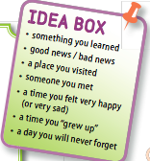
Notes:
54
As guided journey

Slide 55
Notes:
55
Do guided journey of this special time
As you draw, think about what you will say.

Slide 56
Notes:
56

Slide 57
Notes:
57

Slide 58
Mental Rehearsal
Mental Rehearsal
Practice:
speak silently or softly
Books:
open or closed
Notes:
58

Slide 59
Mental Rehearsal
Mental Rehearsal
Practice:
speak silently or softly
Watch
the movie in your mind
Notes:
59

Slide 60
Mental Rehearsal
Mental Rehearsal
Practice:
speak silently or softly
Listen to
the story in your mind
Notes:
60

Slide 61
Mental Rehearsal
Mental Rehearsal
Practice:
speak silently or softly
Practice:
Speak silently or softly
Notes:
61

Slide 62
Notes:
62
Think of question in L2
Don’t ask yet.
Notice: nuance same in L2 or not

Slide 63
Notes:
63

Slide 64
Task Recycling
Notes:
64

Slide 65
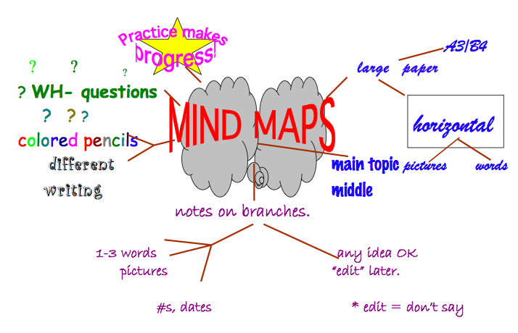

Slide 66
Mind maps & other graphic organizers

Slide 67
Seattle timesn
Hey! Pay attention
to this story
LOST YOUR MIND? More studies are being done of how people’s minds tend to.. Uh, what was it again? Oh yeah…wander.
By Malcolm Ritter, Associated Press
NEW YORK — Researchers are studying a pervasive psychological phenomenon in which oh man we've got to finish doing the taxes this weekend ... C'mon, admit it. Your train of thought has derailed like that many times. It's just mind-wandering. We all do it, and surprisingly often, whether we're struggling to avoid it or not.
Mainstream psychology hasn't paid much attention to this common mental habit. But a spate of new studies is chipping away at its mysteries and scientists say the topic is beginning to gain visibility.
Someday, such research may turn up ways to help students keep their focus on textbooks and lectures, and drivers to keep their minds on the road. It may reveal ways to reap payoffs from the habit.
Notes:
Researchers are studying a pervasive psychological phenomenon in which oh man we've got to finish doing the taxes this weekend ... C'mon, admit it. Your train of thought has derailed like that many times. It's just mind-wandering. We all do it, and surprisingly often, whether we're struggling to avoid it or not.
Mainstream psychology hasn't paid much attention to this common mental habit. But a spate of new studies is chipping away at its mysteries and scientists say the topic is beginning to gain visibility.
Someday, such research may turn up ways to help students keep their focus on textbooks and lectures, and drivers to keep their minds on the road. It may

Slide 69
Mind maps
You can do this alone or in groups of 2-3.
A group - please read/ think/ talk about the orange “Mind maps” handout.
Don’t look at the illustration.
B group - please read/ think/ talk about the orange “Mind maps” illustration.

Slide 70
Mind maps
Experiment:
Put away the paper.
Alone or with partners, how many ideas do you remember?
(say and count them)
Notes:
15 ideas (about – depends on how you count)

Slide 72
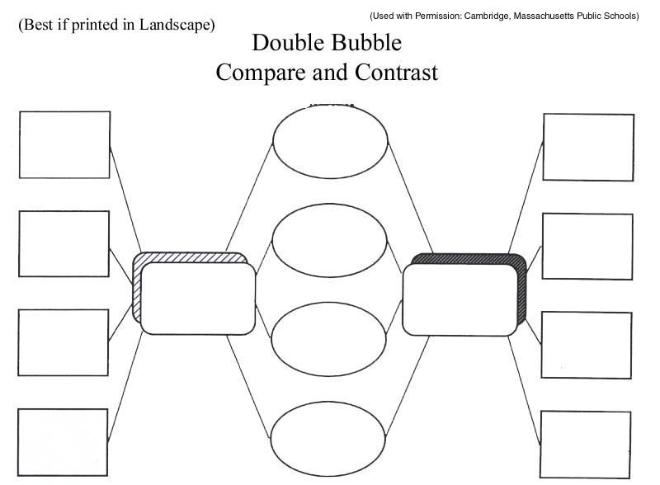
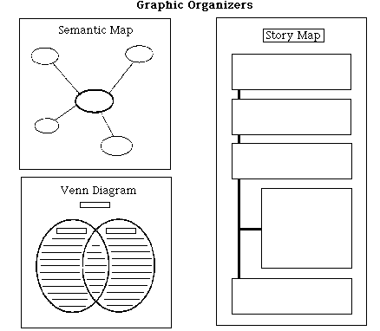
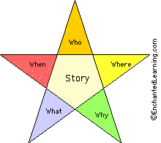
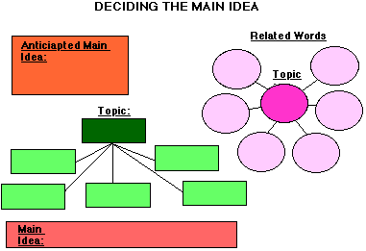
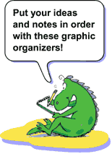
Graphic organizers
www.tinyurl.com/Mhmind-maps

Slide 73
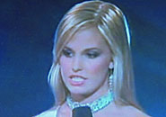
Remember Miss Teen South Carolina?
What if she had a little think time?

Slide 74
Next slide (Miss South Carolina redo) a cut from:
http://www.youtube.com/watch?v=fQKNvPn3V-8

Slide 76
Chance
favors the
prepared mind. -Louis Pasteur

Slide 77
Think Ahead:
That’s
Task Planning

Slide 78
Think Ahead:
Task planning
Pecha Kucha – review
Notes:
language policy
the chance to plan ahead
“Fluency planning” (bigger than that
As classes more communicative;
The way they learn, communicate
The more they communicate- more they learn
Therefore: communicate all the time;
A, B, Task. TALK. Now.
What do you like sports.ß

Slide 79
Next slide: Marc’s Task Planning PechaKucha
http://www.youtube.com/watch?v=OBB4WnaTpZo

Slide 81
Think Ahead:
Task planning
Pecha Kucha – talk to yourself
Notes:
language policy
the chance to plan ahead
“Fluency planning” (bigger than that
As classes more communicative;
The way they learn, communicate
The more they communicate- more they learn
Therefore: communicate all the time;
A, B, Task. TALK. Now.
What do you like sports.ß

Slide 82
Think Ahead:
Think time:
the power of task planning
Notes:
language policy
the chance to plan ahead
“Fluency planning” (bigger than that
As classes more communicative;
The way they learn, communicate
The more they communicate- more they learn
Therefore: communicate all the time;
A, B, Task. TALK. Now.
What do you like sports.ß

Slide 83
A story you know.
Notes:
Work with a partner.
You will remember/ retell a story you know. Work together to remember/ retell it.
If possible, do this in L2

Slide 84
Romeo & Juliet

Slide 85
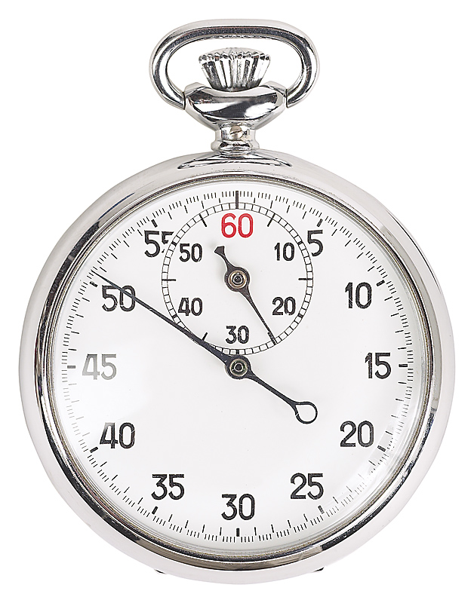
The problem:
Demanding
instant
production
Notes:
Learned:
Way we learn to communicate is by communicating
More we communicate, more we learn
Talk NOW -- what do you like sports

Slide 86
Think
time
Think
time
Thni
What do I
want to say?
How will I
say it?
Notes:
And taking 1-2 minutes to look over the task. Think:
What am I going to do? What do I want to say? How will I say it?
Increases fluency, accuracy, complexity, vocabulary variety. Background Music on the CD (3 tracks on each CD)

Slide 87
Think time
Increased
fluency
Notes:
The time used for “think time” is very valuable to learners at all levels.
These are the benefits of language planning:
Increased fluency:
This makes sense: You’ve been through what you want to say mentally. When you say it aloud, it is like saying it the second time -- so of course it is smoother.
Increased complexity:
Again, this makes sense. You are saying it for the second item. You put it together in a more precise way.
Increased accuracy.
Again, you’ve been through it. You say it better. Actually, accuracy tends to go up when you’ve done a language awareness task like the pronunciation first. If you don’t, you’ll still have the gains in fluency and complexity but not necessarily accuracy.
Greater vocabulary variety. Vocabulary is not a matter of “the words I know” and “the words I don’t know.” There is also a group in the middle of “words I am learning”. We need to meet new words many time -- often up to 20 times -- before we can use them easily. “Think time” lets learners remember the words they are learning.

Slide 88
Think time
Increased
fluency
Increased complexity
Notes:
The time used for “think time” is very valuable to learners at all levels.
These are the benefits of language planning:
Increased fluency:
This makes sense: You’ve been through what you want to say mentally. When you say it aloud, it is like saying it the second time -- so of course it is smoother.
Increased complexity:
Again, this makes sense. You are saying it for the second item. You put it together in a more precise way.
Increased accuracy.
Again, you’ve been through it. You say it better. Actually, accuracy tends to go up when you’ve done a language awareness task like the pronunciation first. If you don’t, you’ll still have the gains in fluency and complexity but not necessarily accuracy.
Greater vocabulary variety. Vocabulary is not a matter of “the words I know” and “the words I don’t know.” There is also a group in the middle of “words I am learning”. We need to meet new words many time -- often up to 20 times -- before we can use them easily. “Think time” lets learners remember the words they are learning.

Slide 89
Think time
Increased
accuracy
Notes:
The time used for “think time” is very valuable to learners at all levels.
These are the benefits of language planning:
Increased fluency:
This makes sense: You’ve been through what you want to say mentally. When you say it aloud, it is like saying it the second time -- so of course it is smoother.
Increased complexity:
Again, this makes sense. You are saying it for the second item. You put it together in a more precise way.
Increased accuracy.
Again, you’ve been through it. You say it better. Actually, accuracy tends to go up when you’ve done a language awareness task like the pronunciation first. If you don’t, you’ll still have the gains in fluency and complexity but not necessarily accuracy.
Greater vocabulary variety. Vocabulary is not a matter of “the words I know” and “the words I don’t know.” There is also a group in the middle of “words I am learning”. We need to meet new words many time -- often up to 20 times -- before we can use them easily. “Think time” lets learners remember the words they are learning.

Slide 90
Think time
Greater
vocabulary variety
Notes:
The time used for “think time” is very valuable to learners at all levels.
These are the benefits of language planning:
Increased fluency:
This makes sense: You’ve been through what you want to say mentally. When you say it aloud, it is like saying it the second time -- so of course it is smoother.
Increased complexity:
Again, this makes sense. You are saying it for the second item. You put it together in a more precise way.
Increased accuracy.
Again, you’ve been through it. You say it better. Actually, accuracy tends to go up when you’ve done a language awareness task like the pronunciation first. If you don’t, you’ll still have the gains in fluency and complexity but not necessarily accuracy.
Greater vocabulary variety. Vocabulary is not a matter of “the words I know” and “the words I don’t know.” There is also a group in the middle of “words I am learning”. We need to meet new words many time -- often up to 20 times -- before we can use them easily. “Think time” lets learners remember the words they are learning.

Slide 91
1-2 minutes of
Think time
Task Planning
Technique
# 1
Notes:
Notice – cant think of question without answer.
TASK PLANNING

Slide 92
Students choose
questions
Task Planning
Technique
# 2
Notes:
Notice – cant think of question without answer.
TASK PLANNING

Slide 93
Students choose
questions
Task Planning
Technique
# 2
Notes:
Notice – cant think of question without answer.
TASK PLANNING

Slide 94
Task Planning
Technique
# 3
The smilie scale
J = interesting K = not bad
but not great L = boring
Notes:
Notice – cant think of question without answer.
TASK PLANNING

Slide 95
Task Planning
Technique
# 4
Cloze language models
dog
dog
really
Fill in first. Listen to check.
Multiple possibilities.
Notes:
Notice – cant think of question without answer.
TASK PLANNING

Slide 96
Listen &
don’t repeat
Task Planning
Technique
# 5

Slide 97
Draw a picture
Task Planning
Technique
# 6
Notes:
As they draw, think. What do you want to say. How will you say it.?
No erasers – Jpz ss want it perfect. Take forever.
Bad art is good – more to explain

Slide 98
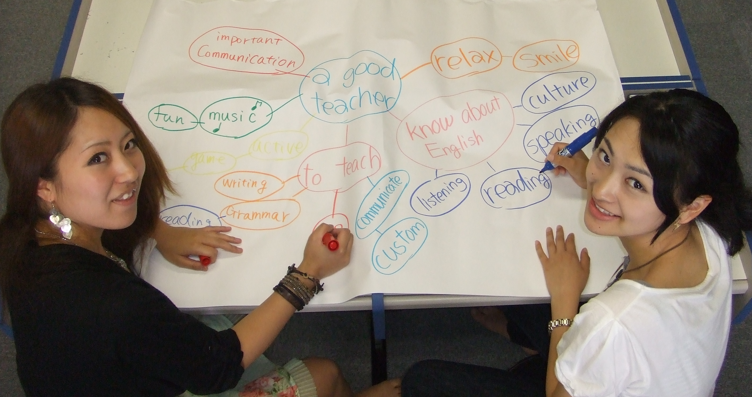
Make a mind-map
Task Planning
Technique
# 7

Slide 99
English please
Task Planning
Technique
# 8
Notes:
Whatever they are doing – a discussion, ER oral book reports,
First 2-3-4 minutes in Japanese, then go back, have the same discussion in English.
So they used the Japanese time to figure out what to say, again DEEPER than if they do it in Englsh right away

Slide 100
Task recycling
Task Planning
Technique
# 9
Notes:
Especially personalized content.
Change partners. It gets better .
Almost of of time. No matter how much we prepare, Language teaching is not an exact science. A lot of it is chance. Which reminds me of great words from Louis Pasteur .

Slide 101
Think Ahead:
Louis Pasteur: Chance
favors the prepared mind.

