Slide 1
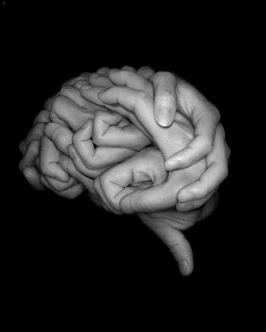

Slide 2
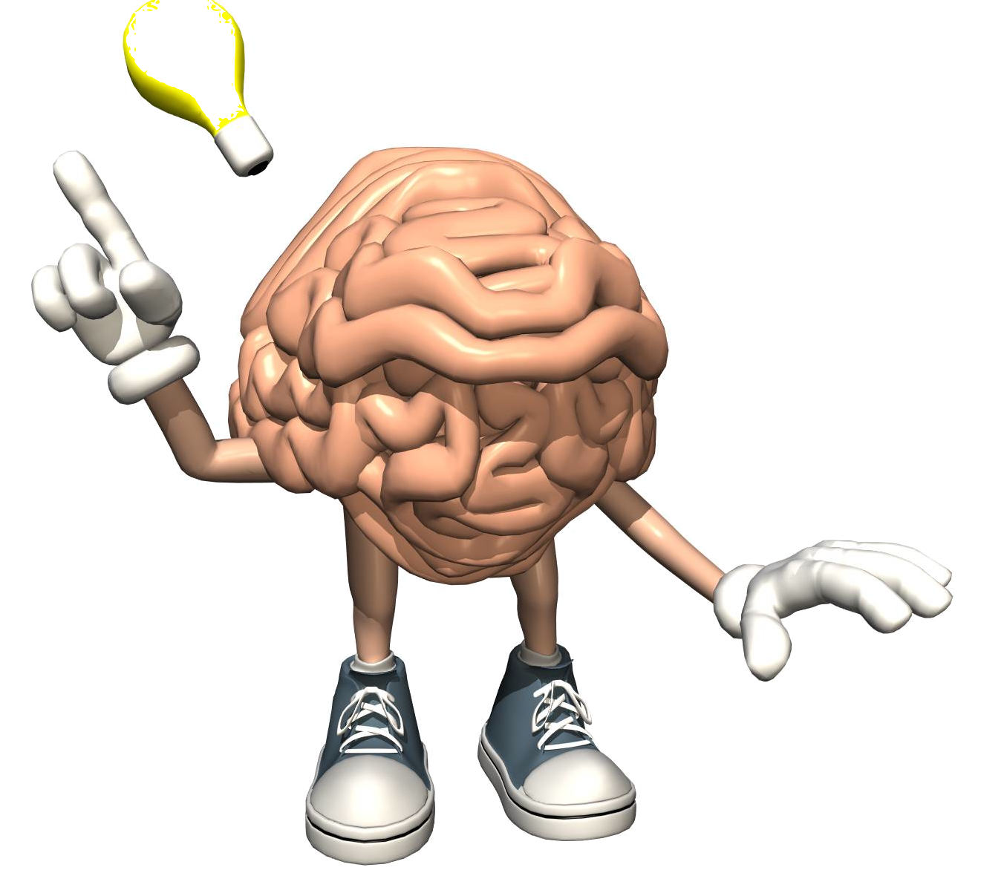

A students’ DIY guide for
making
classes more
brain-friendly

Slide 3
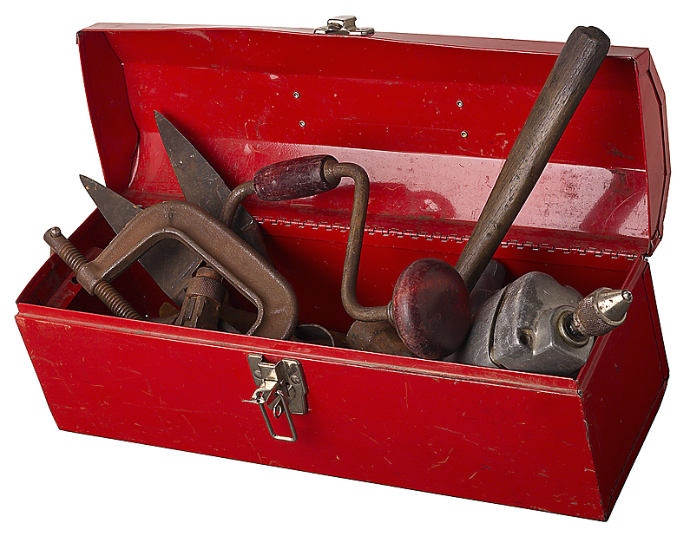
AKA
(Also known as)
a set of tools that you own.

Slide 4
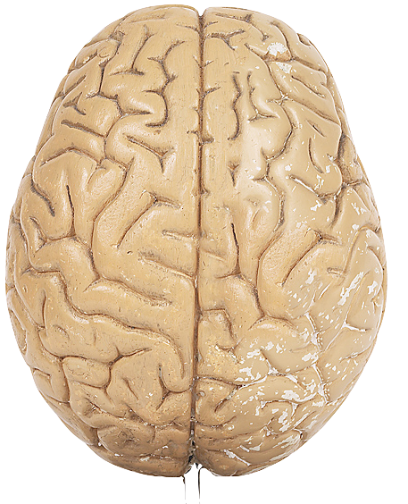
!
You are
interested in
English
&
brain science.
Wow!
Notes:
And so are the teachers here.

Slide 5


Slide 6
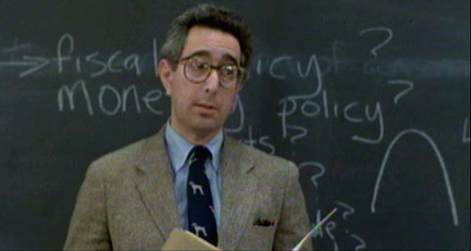

Slide 7
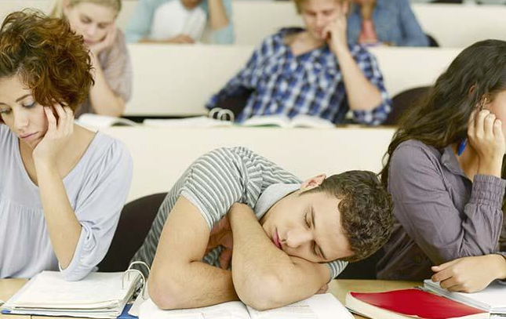

Slide 8
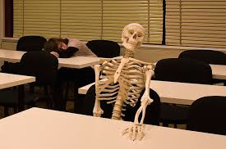
Notes:
I don’t think that is very good teaching.
Guess what – those teachers don’t care what I think. They are experts in their discipline.
They may not be experts in TEACHING. But in is none of my business.

Slide 9
But what if we could give you some tools?

Slide 10

In class

Slide 11

Studying
on your own

Slide 12
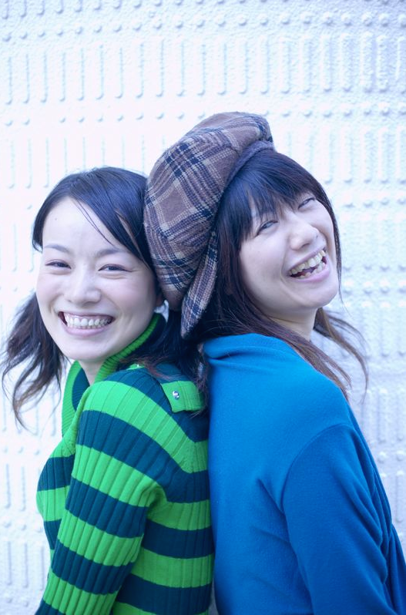
Taking
a break

Slide 13


Slide 14
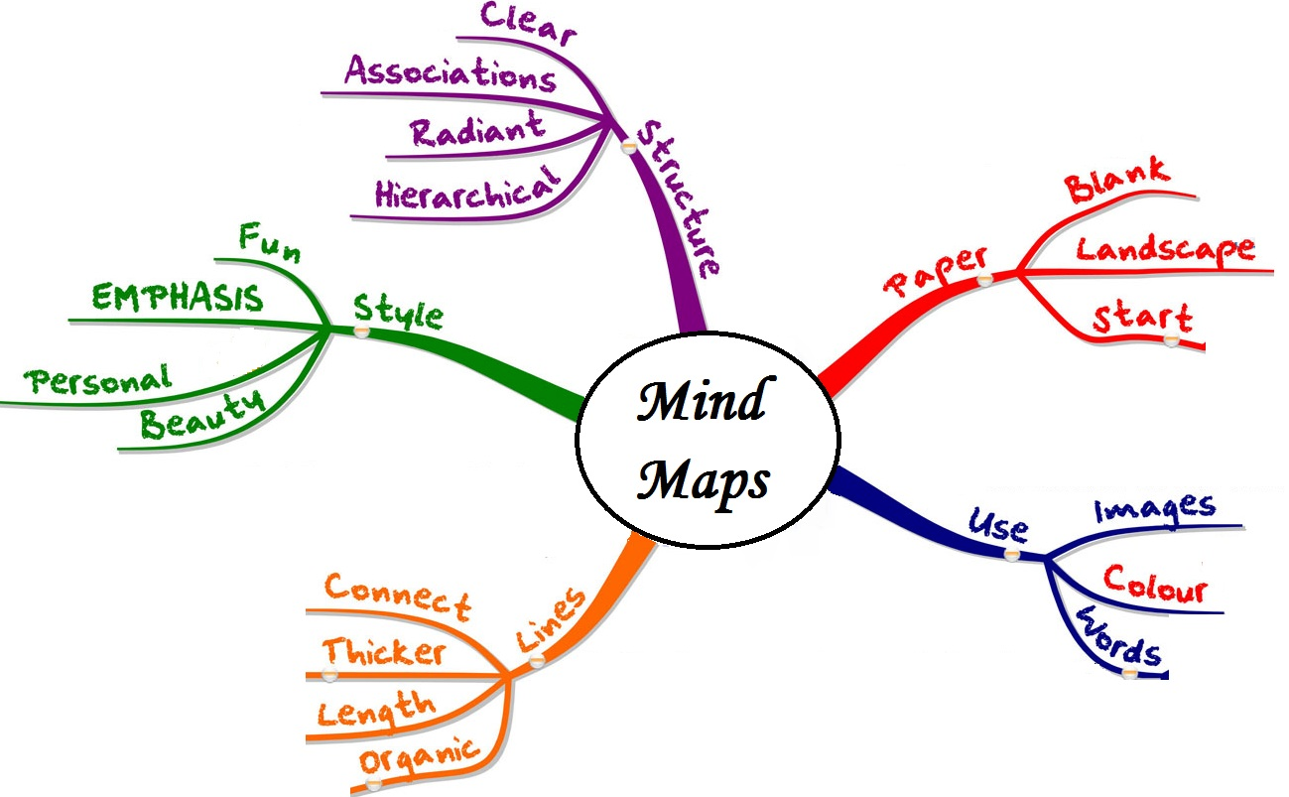

Slide 15
Your idea

Slide 16
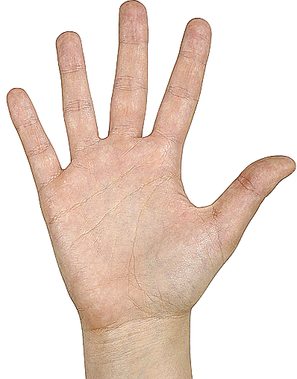

one
more
thing
Slow
down!

Slide 17
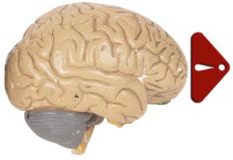
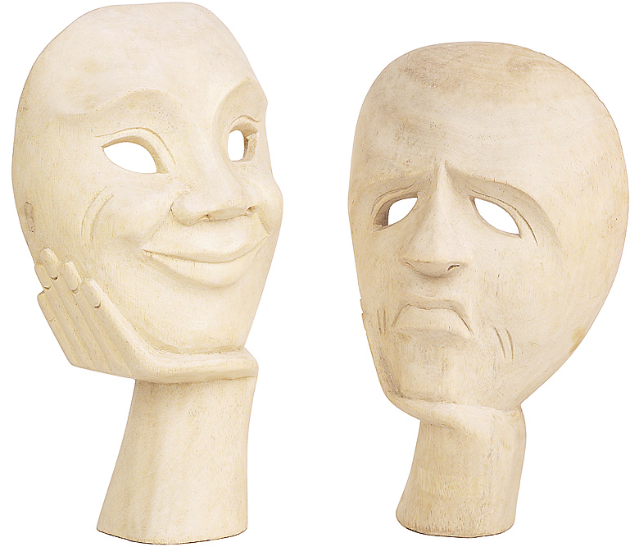
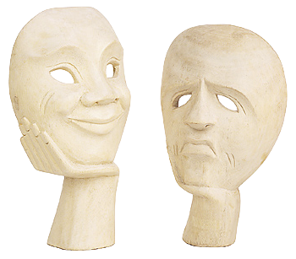
Go for
Emotion
Notes:
Hollywood loves emotion.
TV loves emotion.
Your ex-girlfriend/boyfriend loved emotion.
Publishers don’t like emotion.

Slide 18
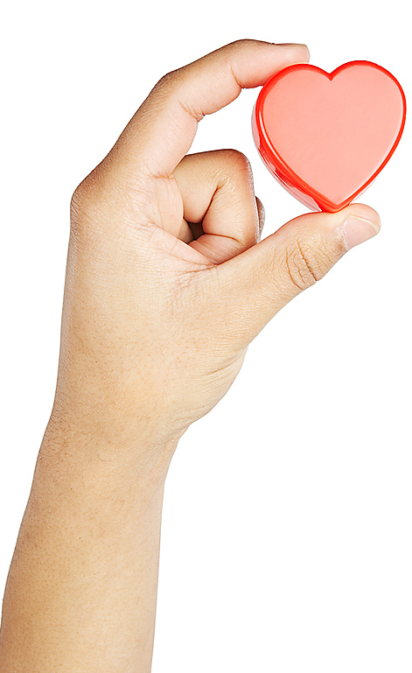
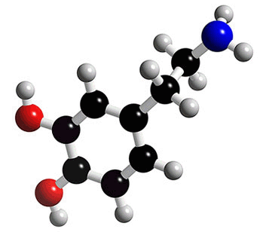
dopamine

Slide 19
memory &
motivation

Slide 20
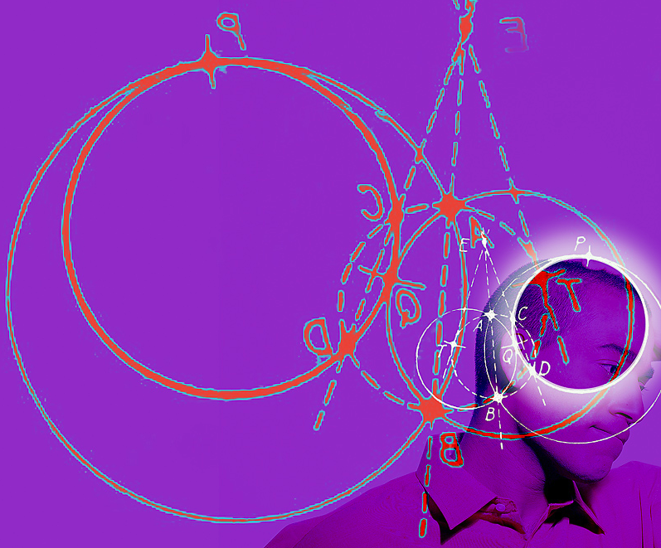
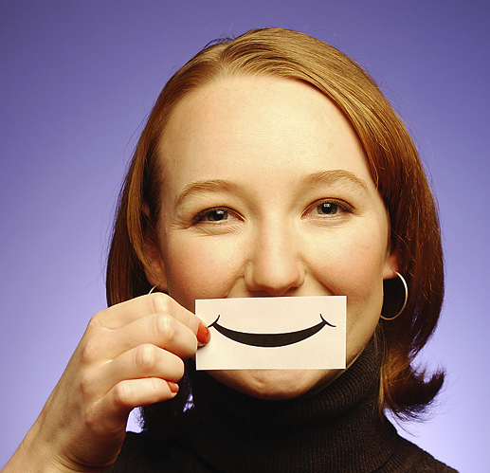
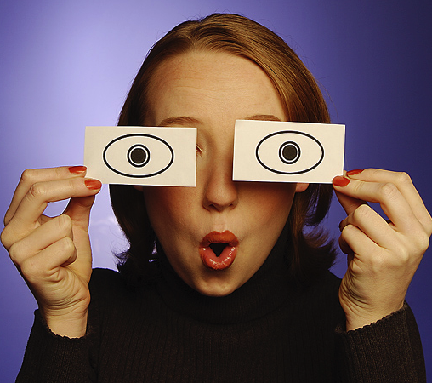
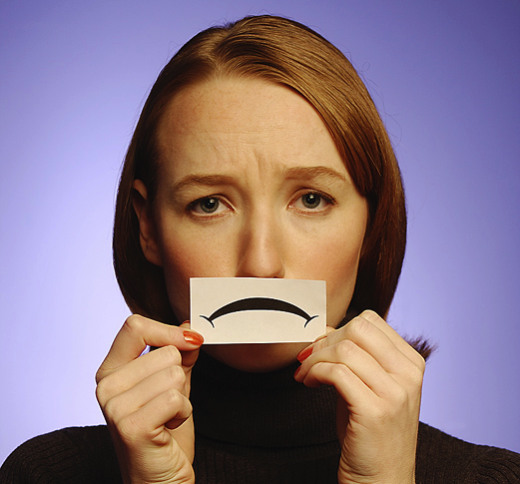
Emotion =
cognition
Pessoa, 2012

Slide 21
Emotion =
thinking/
understanding
Pessoa, 2012

Slide 22

Challenge
yourself
Notes:
When you have a choice.

Slide 23
When you have
a choice of tasks
go for interesting,
not easy
Notes:
When you have a choice.

Slide 24

Flow
Notes:
Mihály Csíkszentmihályi’s sense. That experience when we’re totally engaged with what we’re doing. Energized. Loose track of time. You are challenged. It something is too easy, you get bored. This is when you are totally part of the moment. Athletes talk about being “in the zone.”
As Teachers, sometimes. And classes, sometimes (I hope), but harder to orchestrate as a teacher. For many Ss, English isn’t a natural flow experience.
Bill Snyder (TC Columbia Uni – Tokyo) looking at identifying activities that are likely to produce flow. The topics related to happiness can be deeper so maybe likely to move some/many Ss there. (Think like kindness or good memories just naturally deeper than “what’s your favorite sport). Bill’s pointed out something like 4-3-2 might be more likely. You have a real challenge (double your speed), and it is personally produced content. Seems to

Slide 25
When you have
a choice of tasks
go for interesting,
not easy
Notes:
When you have a choice.

Slide 26
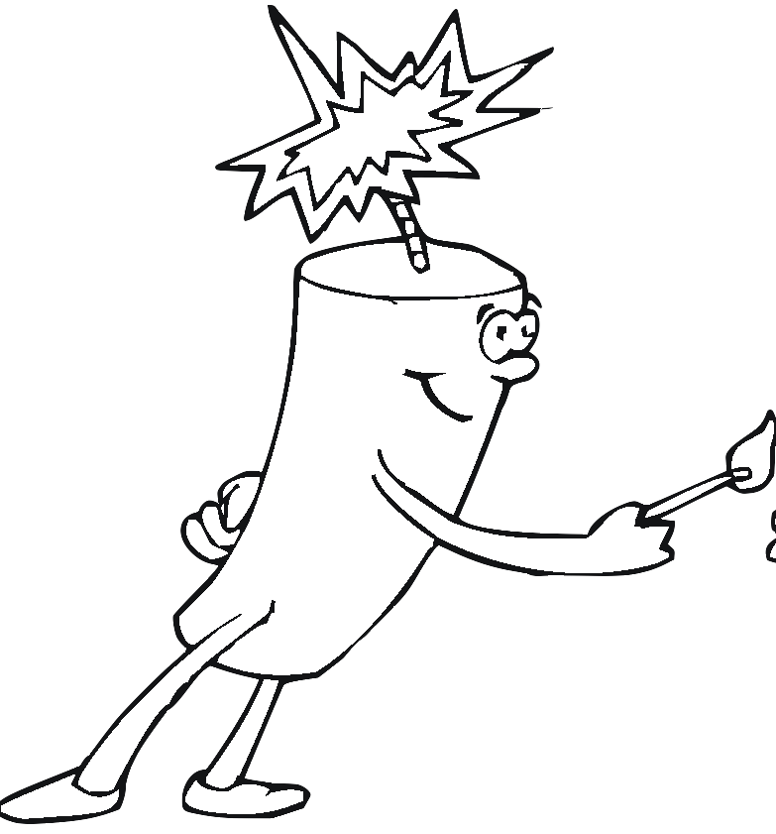


Add pictures to your
mind map notes
funny
fast

Slide 27
Notes: Rate the ideas
☺
😐
☹
Notes:
Add fart sounds to ☹
Do something challenging – if you think I’m crazy, ☹

Slide 28
Notes: How useful?
!!!
X
~

Slide 29

maybe
Notes:
Relaxes people.
Relaxed people learn up to 25% more.
Probably instrumental

Slide 30
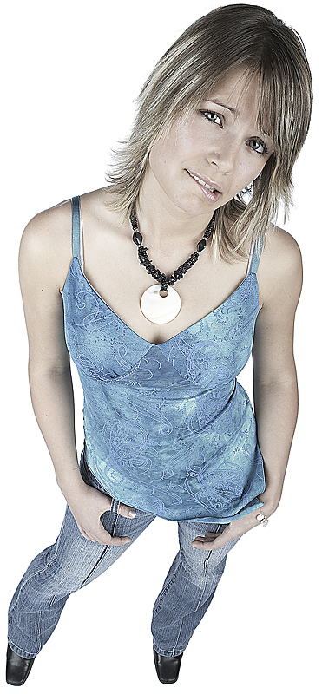

Interesting fact:
Relaxed people
do up to 25%
better on tests.
Jensen, 2008
Notes:
How does she look? (worried, nervous)
#2 - relaxed.

Slide 31

multi-
tasking
Notes:
2nd idea has to do with multi-tasking.
How much time do you spend multi-tasking each day.

Slide 32
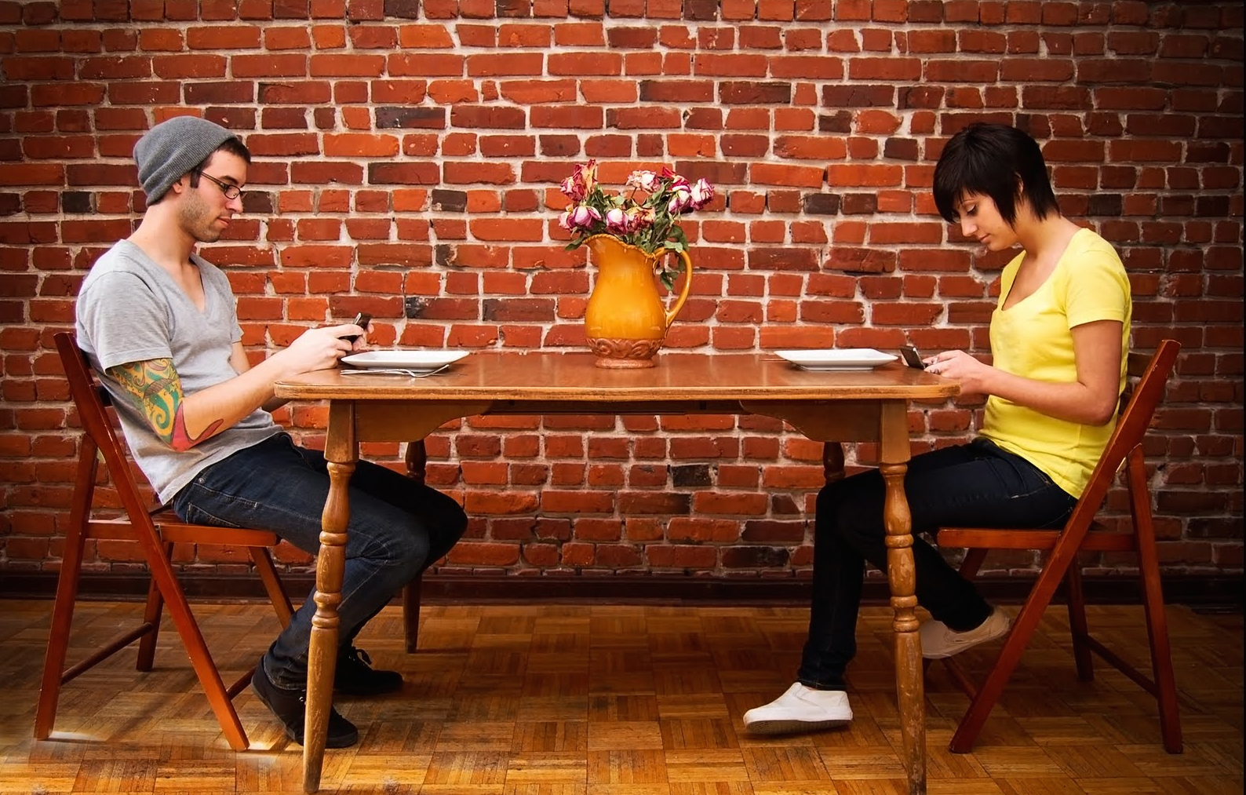
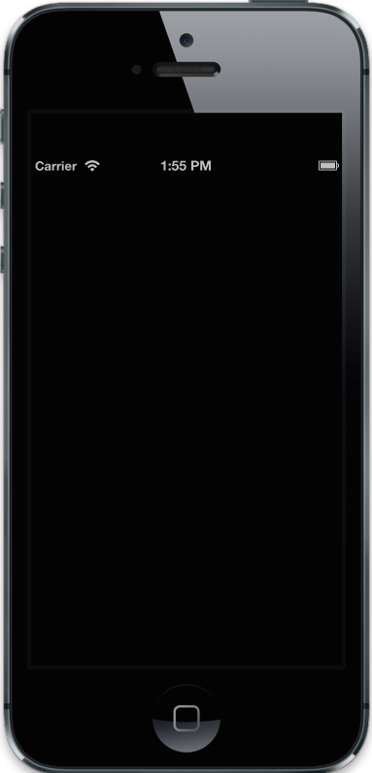
What R U doing?
Multi-
tasking

Slide 33
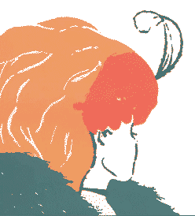

Slide 34
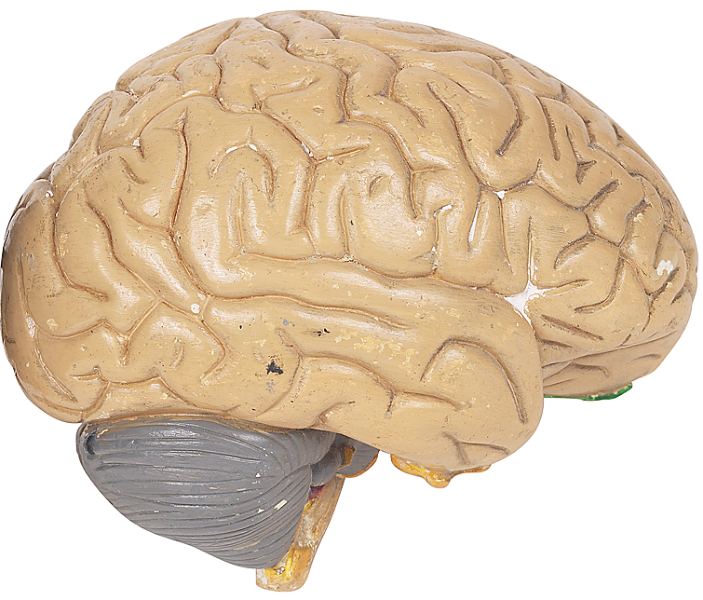
The
human
brain
can NOT
multi-task
Notes:
Not on COGNITIVE stuff. Yes, walk and talk. Walking isn’t cognitive.
You can’t THINK about 2 things at the same time.

Slide 35
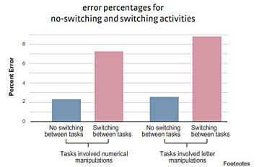
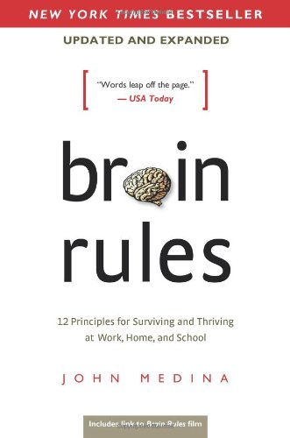
Notes:
Rogers and Monsell (1995) quoted on Brain rules website

Slide 36
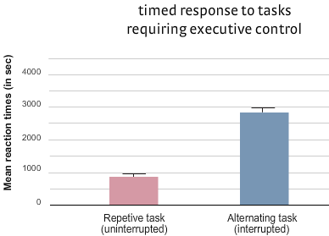
Notes:
Rogers and Monsell (1995) quoted on Brain rules website
When you try to write an email while doing a google search while making a phone call, it takes almost 3 time as much time.

Slide 37


Slide 38
The brain
can not
multi-
task
Notes:
When you study, turn off the other stuff.
Does that mea no breaks? NO. You need breaks. Take a break to walk or eat a piece of fruit or check email/facebook. JUST separate time. BTW, if you are stuck on a problem, good time for a break.

Slide 39

Repeat to remember

Slide 40
3 main ideas so far.
W
What else
do you
remember?
Notes:
Tell a partner.

Slide 41
Repeat to remember

Slide 42
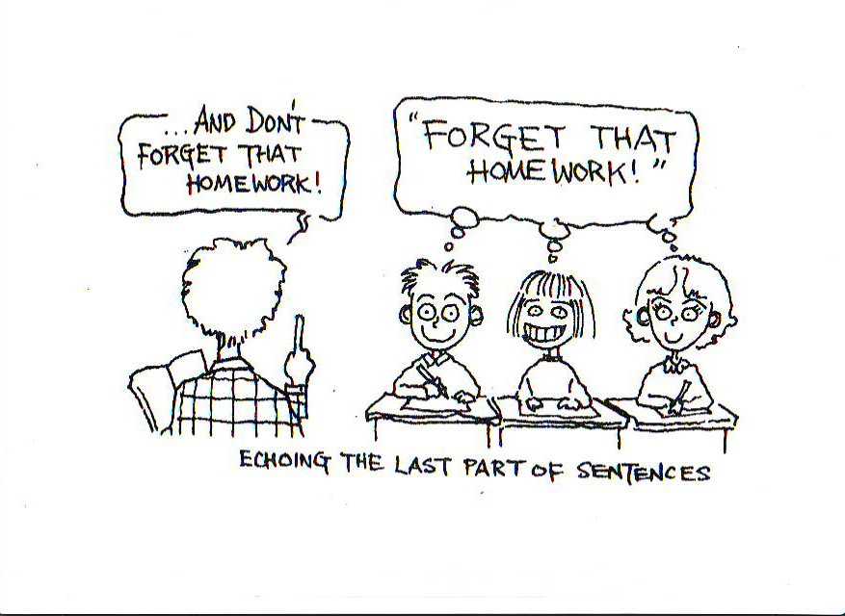
Shadowing
Cartoon courtesy Tim Murphey,
Language Hungry, Helbling Languages Publishing. Used by permission of author.

Slide 43

Silent
shadowing
Notes:
If the teacher is lecturing (just talking),
shadow silently (repeat silently).
This adds physical (haptic/kinesthetic) action plus additional auditory input.
And you are already watching so that is visual.

Slide 44
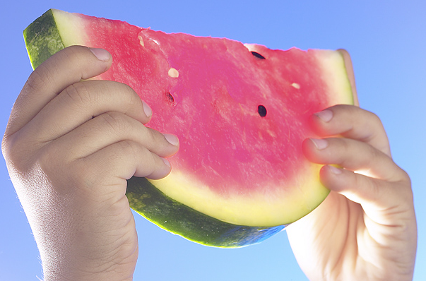
Spaced

Slide 46
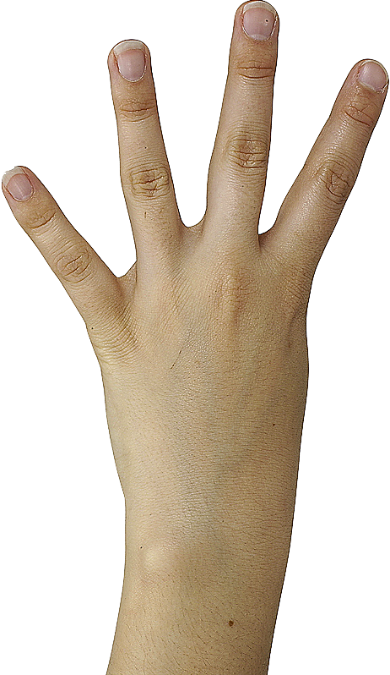

Slide 47
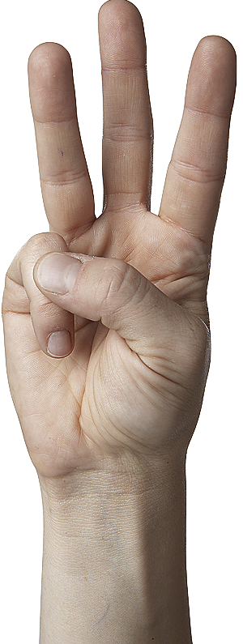

Slide 48


Slide 50
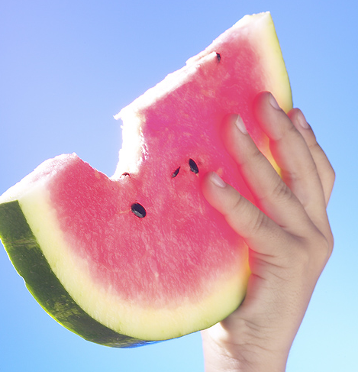
repetition

Slide 51
Spaced repetition

Slide 52
Spaced repetition

Slide 53
Spaced repetition
Key points
Tomorrow
After class
On the train/bus
Lunch time
Tonight

Slide 54
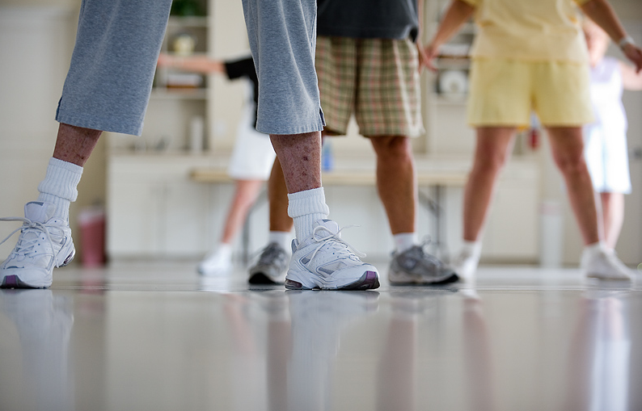
Move!

Slide 55
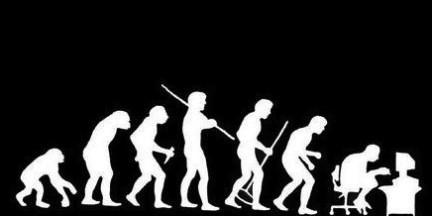
Humans are meant to walk
10 - 20 km/day
Notes:
Source: Medina, J. (2014) Brain Rules.
Seattle, WA: Pear Press

Slide 56
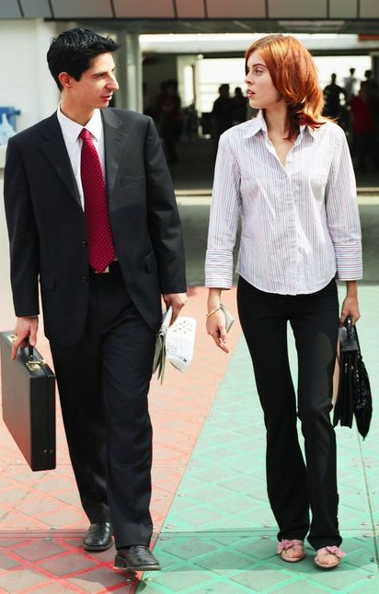
Walk &
Talk

Slide 57
Between
classes
Finding
partners
Lunch
time

Slide 58
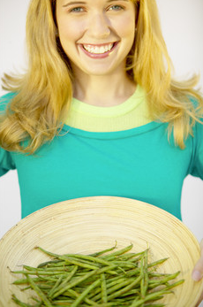
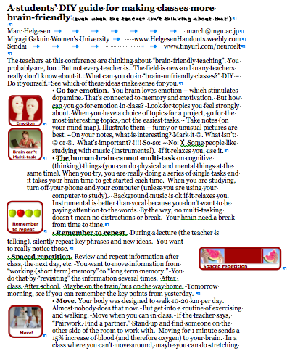
Come
and
get it!

Slide 59
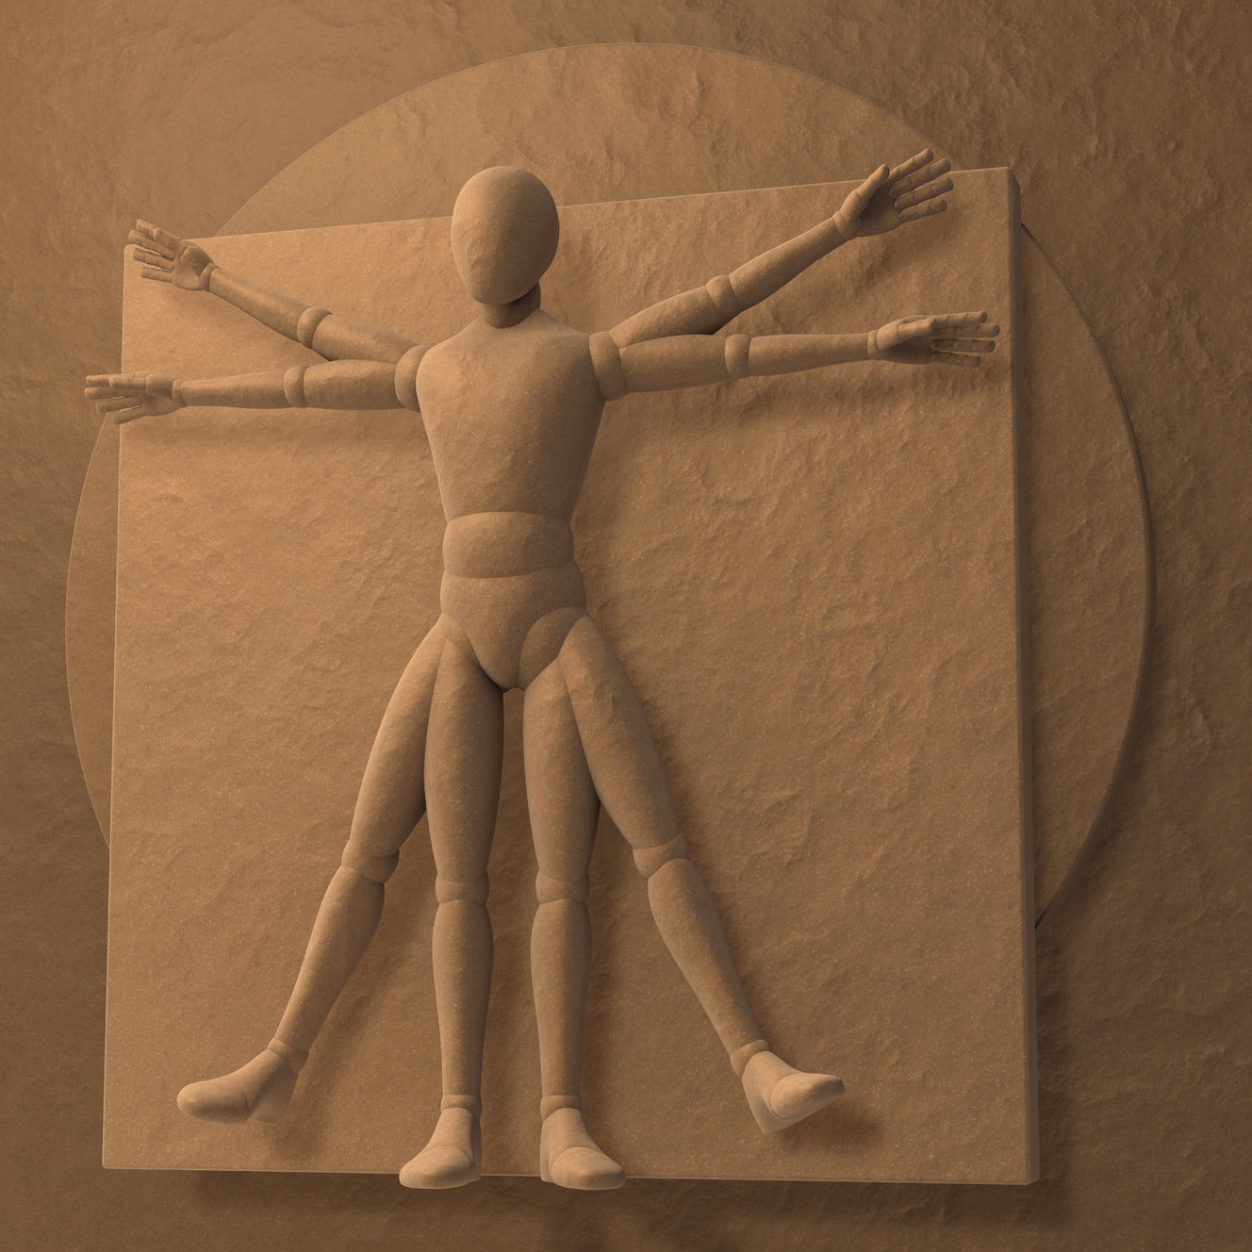
Your
body
is
like a
“second brain”
Notes:
Second brain: separate nervous system. So complex, like a 2nd brain.

Slide 60
Your
body
is
like a
“second brain”
Especially
the “gut”
where many
neurons are
located
Notes:
Second brain: separate nervous system. So complex, like a 2nd brain.

Slide 61
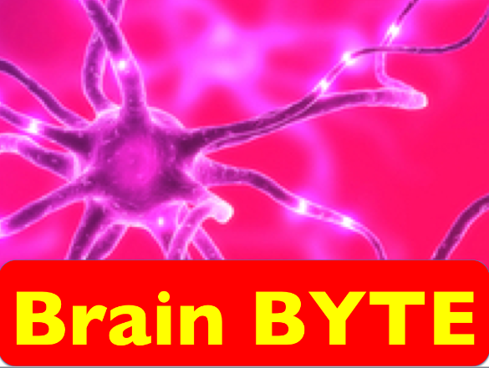
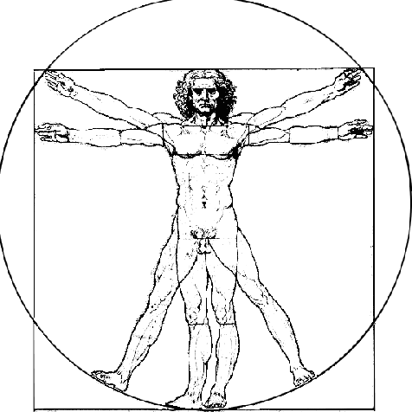
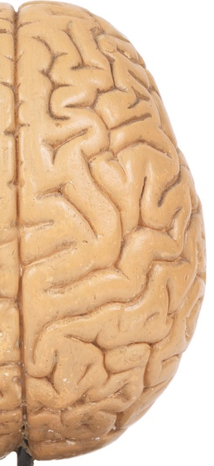
Your brain Your body
Neurons:
85 billion 500 million
Neurotransmitters
identified:
> 100 > 40
Dopamine production:
50% 50%
Serotonin production
5% 95%
Source: New Scientist & neuroscience
stuff.tumblr.com
Both affect blood flow
Notes:
http://neurosciencestuff.tumblr.com/post/38271759345/gut-instincts-the-secrets-of-your-second-brain

Slide 62
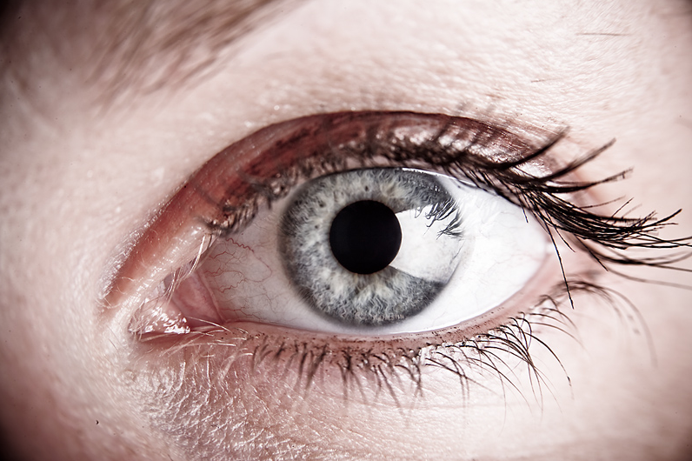
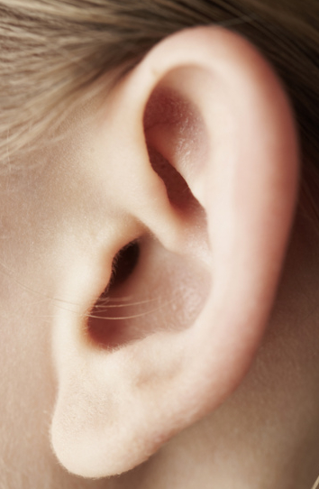
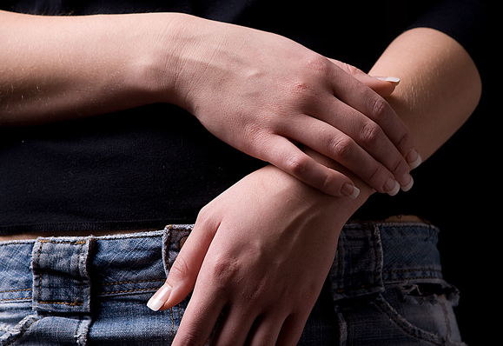
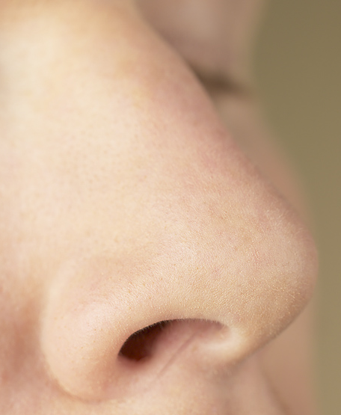
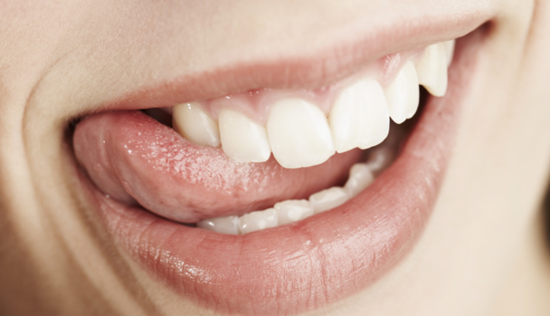
Use many senses

Slide 63


No PPT/ bad PPT
Imagine it!
Equality in
Girls’ Education
Notes:
Taking auditory input (hearing), adding visual.
70% of neuron connected to visual.

Slide 64
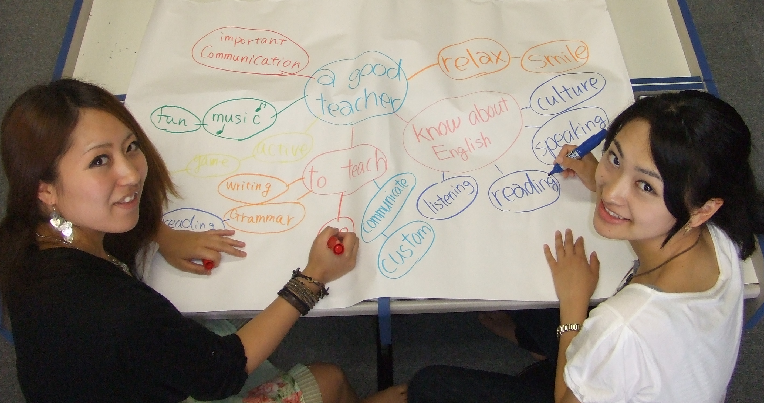
Use
Mind maps

Slide 65
Mind map
hints
use many
colors
Many
writing
STYLES
D
Draw
pictures
Key words
(memory
words)
- not
sentences

Slide 66

Learn to deal with
stress

Slide 67
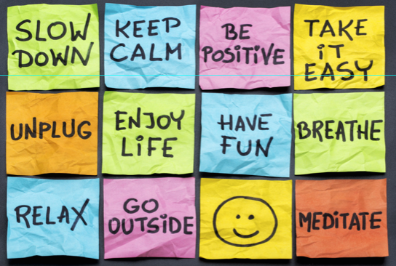

Slide 68
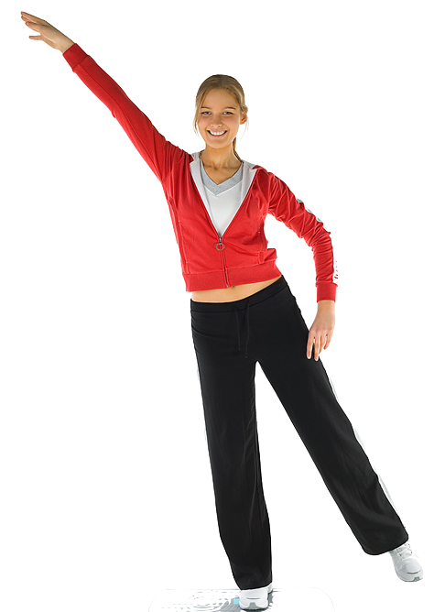
Exercise
3 times
a week.

Slide 69
Exercise
3 times
a week.

Slide 70
Exercise
3 times
a week.

Slide 71

Do sports

Slide 72


Slide 73

meditate

Slide 74


Slide 75


Yoga
Breathing
Before tests
Before job
interviews
Any time you
want to
control your
body/mind
Notes:
I teach for use before tests, (inc. TOIEC etc.
Normal breathing: 300-500 CC of air. 2500 CC of residual air. Trying to force that out. (ML)

Slide 76

Yoga
Breathing
Private,
in public.
Notes:
I teach for use before tests, (inc. TOIEC etc.
Normal breathing: 300-500 ML of air. 2500 ML of residual air. Trying to force that out.

Slide 77

Yoga
breathing
Insert video
in through
the nose
out though mouth
out though the mouth
Notes:
Pairwork, then teach other pair

Slide 78
Yoga
breathing
Insert video
OUT - 2-3-4-5-6
Hold - 2-3-4-5
IN - 2-3-4
out though mouth
Hold - 2-3-4-5
Notes:
Pairwork, then teach other pair

Slide 79

Break lectures into
10-min chunks
Notes:
I don’t literally mean 10 minutes.
That a good goal for teachers – but for you as a learner – when every you start to fade:

Slide 80

When you
find your
attention
fading
do something!

Slide 81

Airline exercises

Slide 82
Yoga
breathing
Insert video
out though mouth
Notes:
Pairwork, then teach other pair

Slide 83
Silent
shadowing
Notes:
If the teacher is lecturing (just talking),
shadow silently (repeat silently).
This adds physical (haptic/kinesthetic) action plus additional auditory input.
And you are already watching so that is visual.

Slide 84


A one-minute
“mental break”
is better than
zoning out.

Slide 85
Imagine a word or picture
Equality in
Girls’ Education

Slide 86
A
well-balanced
review.

Slide 87

Well balanced students
Notes:
• This conference – what you have learned so far
Or This room.

Slide 88


Slide 89
Well balanced students
Notes:
What you do (as teacher or when student – that was physical).

Slide 90

Get enough
Sleep

Slide 91

Teens need more sleep than older people.

Slide 92

Short
term
(working)
memory
during
sleep
→
Long
term
memory
more important than your uni. campus

Slide 93

Avoid “all-nighters /
late-nighters”
especially
before tests.

Slide 94

1 hour of sleep =
1 hour of studying

Slide 95

Pretty
smart

Slide 96

Pretty
smart
Top 10%

Slide 97

Less
than
7 hours
a night

Slide 98

Pretty
smart
tired
Bottom
9%
Source: Brain Rules, 2014

Slide 99


+34% productivity
26 minutes

Slide 100

How to get a
good night’s
sleep
http://campusmindworks.org/
students/self_care/sleep.asp
Notes:
http://campusmindworks.org/students/self_care/sleep.asp

Slide 101

No caffeine
after 3 pm

Slide 102

No
technology
30 minutes
before bed

Slide 103


Slide 104

Sleep only
1 hour
longer on weekends.

Slide 105
Spaced repetition
S
r
Notes:
Hollywood loves emotion.
TV loves emotion.
Your ex-girlfriend/boyfriend loved emotion.
Publishers don’t like emotion.

Slide 106
Brain can’t
Multi-task
Remember
to repeat
Emotion
Spaced
repetition
Move!
Senses
Deal with
stress
10-min chunks
Sleep
Notes:
Repeat to remember –
Remember to repeat
SPACED repetition

Slide 107

P
Thank you.
Achor 2010

