Slide 1
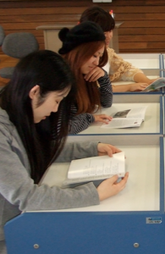
Rethinking
SSR

Slide 2
SSR
Sustained
Silent
Reading
(You too.)
Notes:
10-15 minutes of class time
Values reading
Practical thing – they bring books
Classroom management-
Unless you teach kids,

Slide 3

SSR
Sit
Still &
Read
Notes:
Unless you teach kids,

Slide 4
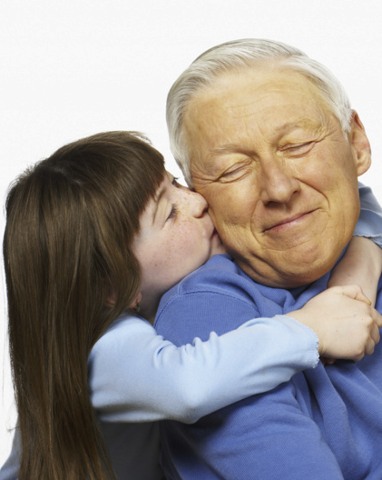
DEAR
Drop
Everything & Read
Notes:
Unless you teach kids,

Slide 5
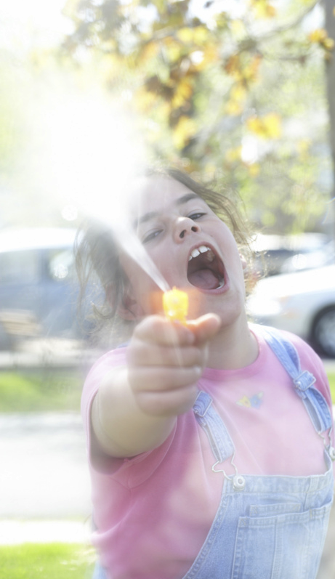
SQUIRT
Sustained
Quiet
UnInterrupted
Reading
Time
Notes:
Unless you teach kids,

Slide 6
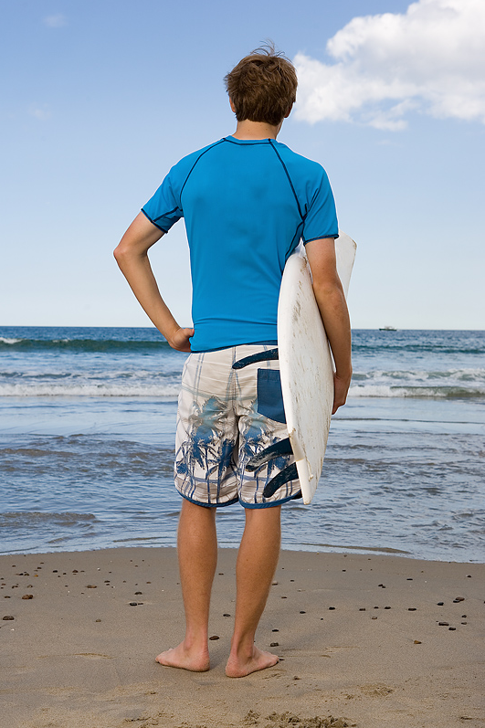
SURF
Sustained
Uninterrupted
Reading
for Fun
Notes:
Unless you teach kids,

Slide 7
SURF
Shut
Up
& Read
for Fun
Notes:
Unless you teach kids,

Slide 8

GRAB
Go
Read
A Book
Notes:
Unless you teach kids,

Slide 9
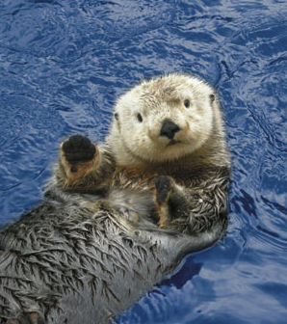
OTTER
Our
Time
To
Enjoy
Reading
Notes:
Unless you teach kids,

Slide 10
Rethinking
SSR
Sustained
Silent
Reading

Slide 11


Slide 12

Scaffolded
Silent Reading
Reading Teacher, 2008
Reutzel, et al.

Slide 13

Revisiting
Silent
Reading
Hiebert & Reutzel, eds.
International Reading Association, 2010
Notes:
Useful, interesting.
2 bits of caution -- Most chapters deal with kids, what we do is different than that.
Most deal with L1 learners (though some do include some ESL learners).

Slide 14


Notes:
National Reading Panel – established by US Congress to advices the Dept of Education.
Research evidence insufficent to offer “unqualified endorsement”
Said not enough “experimental evidence” for SSR.
Legitimately question a “education site” that uses “comic sans” on their website.
But it is an issue. Lots of correlation evidence – but not “controlled” studies.

Slide 15
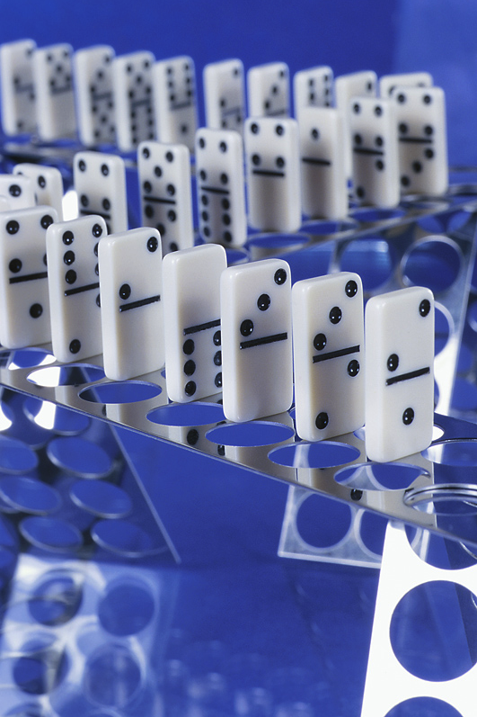
Difficult
to prove causality
Notes:
Can’t proved causality.

Slide 16
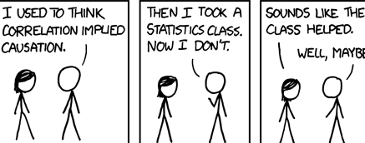

Slide 17


Slide 18
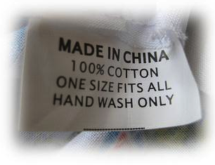


Slide 19


Slide 21

Notes:
That occasional student --- disorganized. (forgot my book), sleep deprived, just not with the program.
SSR is just fine for most students. How do we reach everyone – or at least almost everyone.

Slide 22
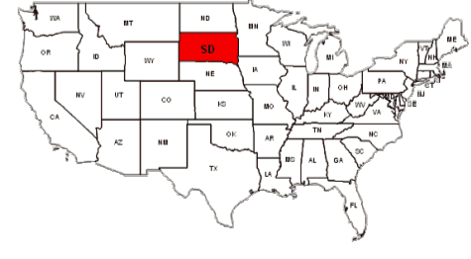

Slide 23
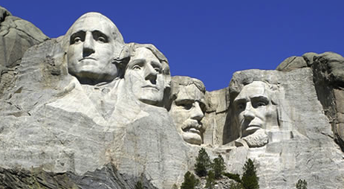

Slide 24
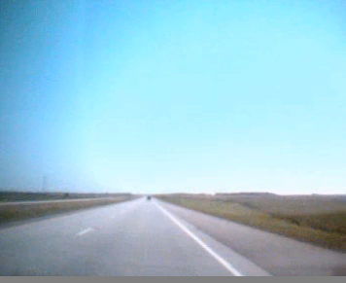
South Dakota…
the world's first drive-through sensory deprivation chamber.
- Bill Bryson
The Lost Continent

Slide 25
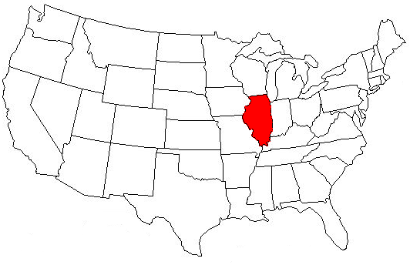

Slide 26
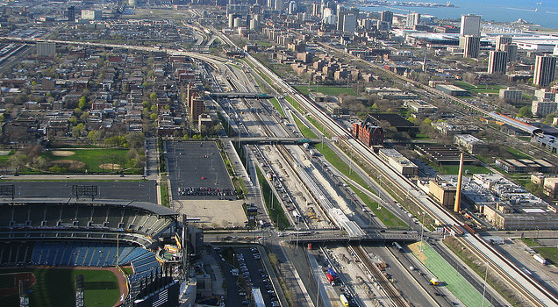

Slide 27
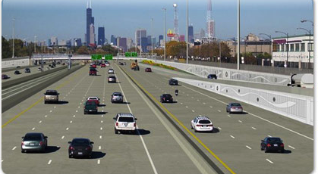
“See those tall buildings?
Aim for them.”

Slide 28
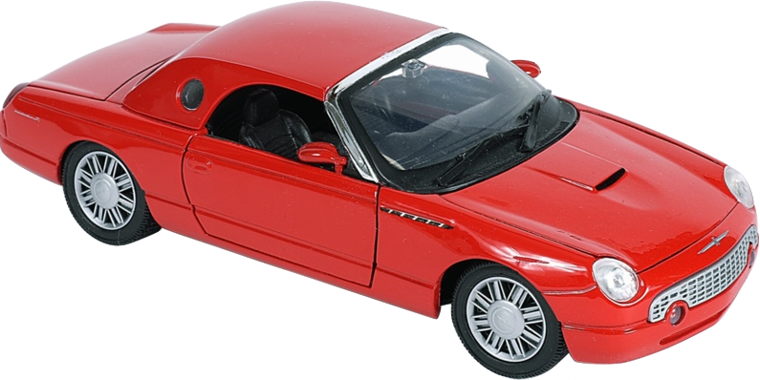
Notes:
Ray Reutzel, UTAH state uni . Asks, Would we ever use the same approach to driving as we do to reading (joke credit)

Slide 29
DEAR
Drop
Everything & Read
Notes:
Unless you teach kids,

Slide 30
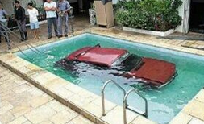
DEAD
Drop
Everything And Drive
Driving
School
Notes:
Ray Reutzel, UTAH state uni . Asks, Would we ever use the same approach to driving as we do to reading (joke credit)

Slide 31

“See that reading success?
Aim for it.”

Slide 32


Engaged
Silent Reading
Notes:
Emily Swan, Cassandra Coddington and John Guthrie

Slide 33

Mastery
goals
Notes:
Deeper understanding.

Slide 34
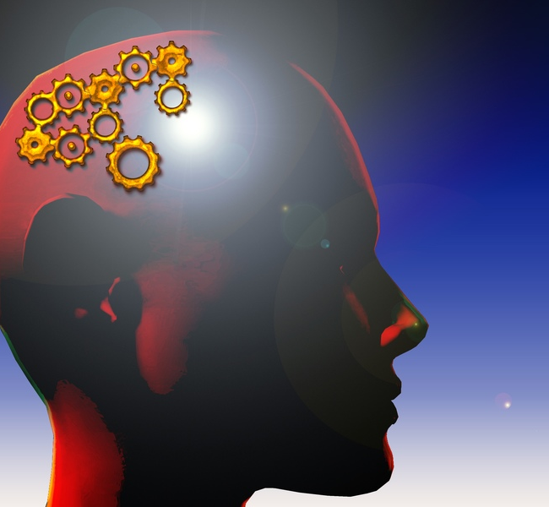

Barrett’s Taxonomy
Levels of comprehension
Mental Rehearsal
Practice:
speak silently or softly
1 Literal (lowest)
Notes:
Helen Keller Story

Slide 35
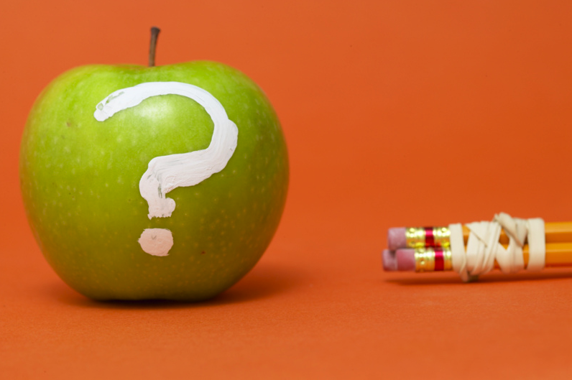
A question about questions:
What are
we testing,
really?
Notes:
So far, I worry I’ve been preaching to the choir – telling people who are already convinced that ER is good that ER is good.
Arguments for colleagues, who usually test comprehension through translation and/or comprehension question.
Not against easier – I do believe in balance. But we need to look at what we are really doing.
comprehension questions – there are better ways to test understanding.
But heard about the results of the HS test. Look at questions .

Slide 36
Reading Comprehension Check:
The glorfs drebbled quarfly.

Slide 37
Reading Comprehension Check:
The glorfs drebbled quarfly.
Q1a. (grammar analysis)
Which word is the subject?
A: glorfs

Slide 38
Reading Comprehension Check:
The glorfs drebbled quarfly.
Q1b. (grammar analysis)
Which is the verb?
A: drebbled

Slide 39
Reading Comprehension Check:
The glorfs drebbled quarfly.
Q1c. (grammar analysis)
What is the tense?
A: past (simple)

Slide 40
Reading Comprehension Check:
The glorfs drebbled quarfly.
Q1d. (grammar analysis)
What part of speech is “quarfly”?
A: adverb

Slide 41
Reading Comprehension Check:
The glorfs drebbled quarfly.
Q2. (meaning-based)
What did the glorfs do?
A: They drebbled.

Slide 42
Reading Comprehension Check:
The glorfs drebbled quarfly.
Q3. (meaning-based)
How did they do it?
A: Quarfly.
Notes:
6 questions. How many correct.
Congratulations – Correctly answered questions with zero meaning

Slide 43

Congratulations
You correctly answered
questions about a sentence
that has NO meaning.

Slide 44
Barrett’s Taxonomy
Levels of comprehension
Mental Rehearsal
5 Appreciation
4 Evaluation
3 Inference
Practice:
speak silently or softly
2 Reorganization
1 Literal (lowest)
Notes:
Helen Keller Story

Slide 45
What about assessment?
ER is for reading practice.
It isn’t always necessary to assess them.
- Rob Waring

Slide 46

Reading notebooks
My Reading

Slide 47
Reading for pleasure
Reaction Report - Basic
Include:
• what the book was about
• what you thought of it)
What happened?
------------------
Your opinion:
Write quickly.
10 minutes or less.
Good ☺ p Average 😐 p Poor ☹
Good ☺ p Average 😐 p Poor ☹
Notes:
ER is a new idea for most Ss (used to intensive/ yakudoku/ read & translate).
Nothing wrong with staring reports where they expect. NOTICE: YOUR OPINION! -- APPRECIATIO

Slide 48
Reading for pleasure
Reaction Report – Draw a picture
1. Draw a picture of a scene from the story. Don’t copy a picture. Draw one from your imagination.
------------------
2. Explain your picture. What is happening? What happened before this picture? What happened next?
3. Your opinion. What did you think of the book?
Good ☺ p Average 😐 p Poor ☹
Notes:
Dornyei and others point out: doing the same thing sucks
The motivation out of any class. (habituation)
Late May/ early June
Multiple intelligences: artistic knowledge,
kinesthetic (folks who draw)

Slide 49
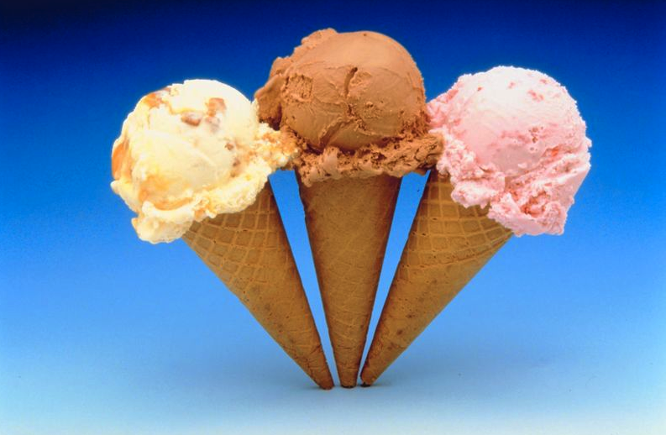
Choice & control

Slide 50
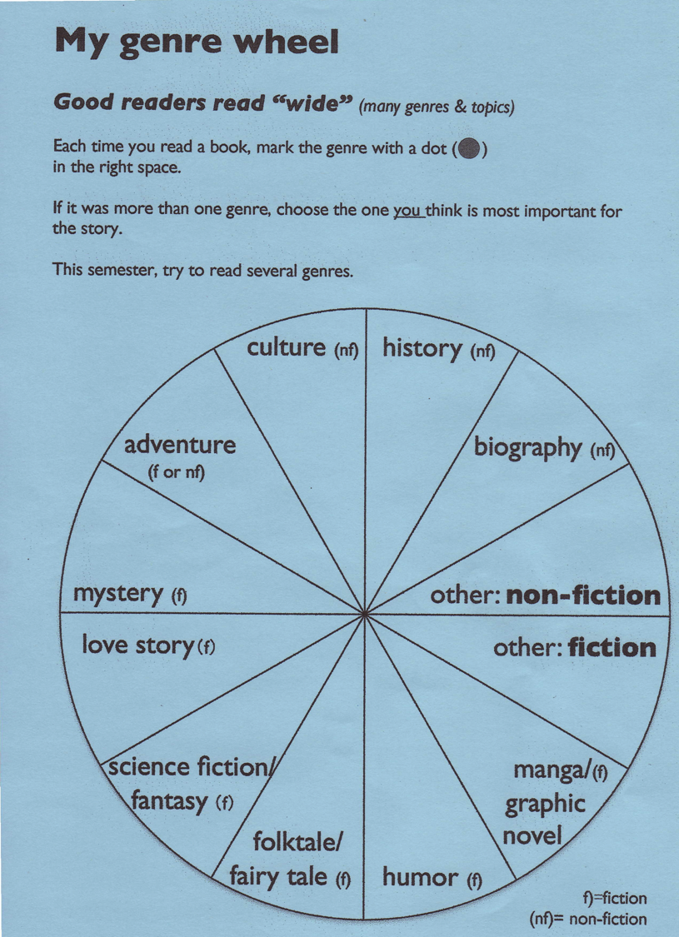

Slide 51

Notes:
Which genre? They decide. Sometimes clear. Reading book about Michael Jackson: That’s biography
Sometimes, there’s an adventure – with a love story. So Pirate of the Carribian might be an adventure (with a love story in it).
Romeo is a love story, with adventurous moments.
STUDENTS DECIDE --- They are EVALUATING. Higher level function.
You can (but I don’t) require a certain number of genre. I do encourage them to “Read wide”.
This is part of choice/control. Giving feedback.

Slide 52
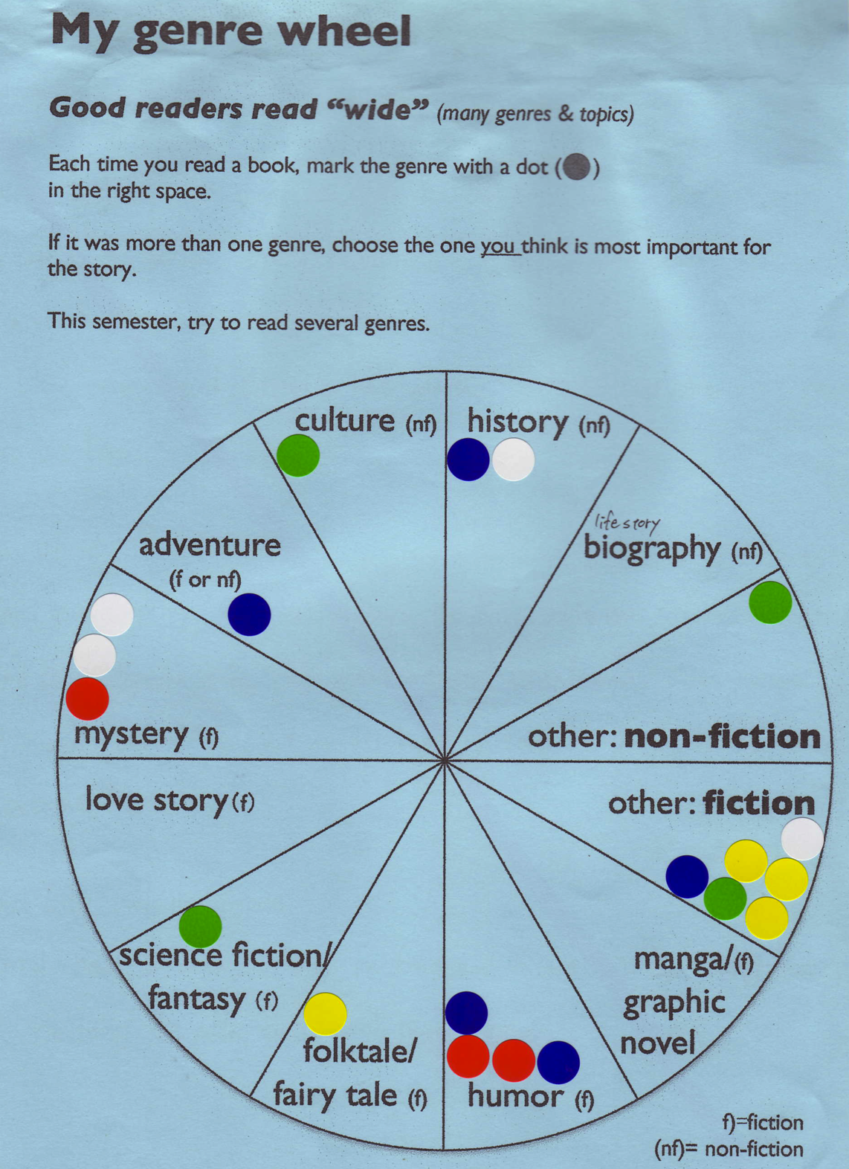
Notes:
Don’t require X-number of genres. Don’t need to. Most students do
Different genres, different vocab sets.
History – past tense, Time adverbials.
Manga/ graphic novels – direct speech.
Biography – indirect/reported speech.

Slide 53

Feedback sessions
Review what read
Ask about books
Student reads to you
Notes:
Student control doesn’t mean 100% -- feedback
Review what read – look at genre wheel.
Ask about books. What’s the story about. Check comprehension.
Read aloud – comprehension check.

Slide 54
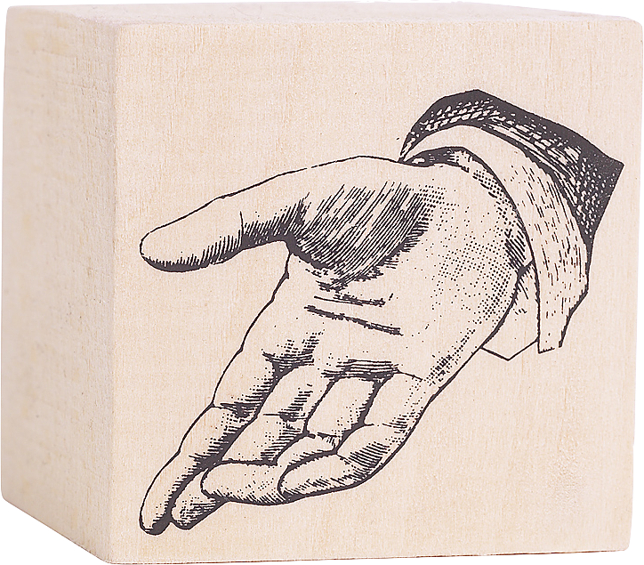
Content & task relevance

Slide 55
Reading notebooks
My Reading

Slide 56
Reaction Report - Your own questions
Before you read. Look through the book.
Find 3 pictures. Write a different question about each. Write 3 questions.)
• page Q1:
• page Q2:
After you read, answer your questions
Reaction Report: What was the book about?
What happened?
------------------
Your opinion:
Good ☺ p Average 😐 p Poor ☹
Notes:
false beginners.
Logical/mathmatical knowledge.

Slide 57
Reaction Report - The story and you
Think about the story. What happened?
What was the same as your life?
Your character? Your dreams? What is different?.
The story. My life.
------------------
Your opinion:
Good ☺ p Average 😐 p Poor ☹
Notes:
Mtpl: intrapersonal knowledge (know thyself)
Gulliver: I’ve never been around little people (yochien?)
Diana: she knew tradegy. So do I. last year my father died of cancer.

Slide 58

Interesting texts

Slide 59
Instant book report
I read (am reading) a book called ____.
It's a(n) _______________
(mystery, science fiction book,
love story, detective story, etc.)
It's about ______________.
The main characters are ____________.
(names, jobs, personalities)
In the story, there was a problem. ____.
 I liked/didn't like it because _______.
Notes:
THEY DO
1 minute- change

Slide 60

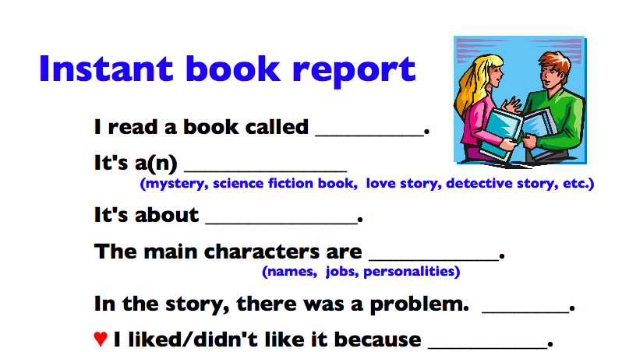
Notes:
I read a book called Bad Monkey.
It’s a… humor, crime, love… if you know Carl Hiaasen’s work. A weird story.
It’s about a sheriff in Florida. One reason Hiaasen’s books are weird is they happen in Florida.
In the story, some people are fishing, and they catch, a human arm” The fingers have been bent to… send a message.
He boss tells him to take to to Miami and give it to the Miami police. He does. They don’t want it. His boss says, “just get rid of it.” Well, he puts it in his freezer. And the story gets stranger. Oh, yeah, there is also a bad monkey named Driggs.

Slide 61
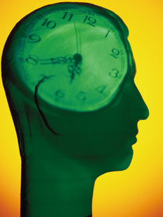

Think
time
Think
time
Thni
What do I
want to say?
How will I
say it?

Slide 62
Instant book report
I read (am reading) a book called ____.
It's a(n) _______________
(mystery, science fiction book,
love story, detective story, etc.)
It's about ______________.
The main characters are ____________.
(names, jobs, personalities)
In the story, there was a problem. ____.
 I liked/didn't like it because _______.
Notes:
THEY DO
1 minute- change
SPEND 15-20 minutes on SSR. Then do something with it.
Give a goal. A little pressure. You’ve got to be really reading. You’ve got to be paying attention.

Slide 63

Social collaboration
Notes:
Opportunities for social collaboration
The book report .

Slide 64
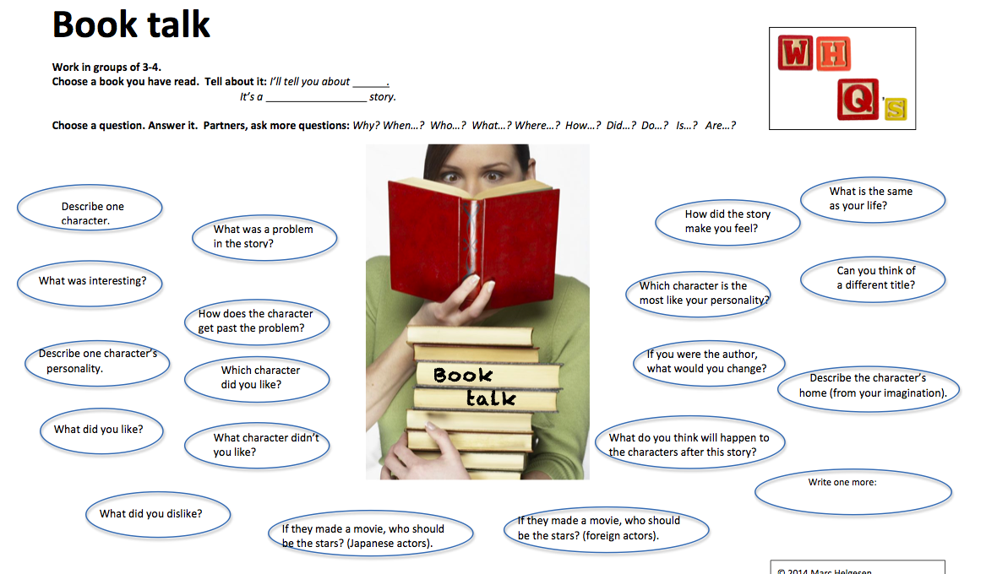

Slide 67

Encourage
success

Slide 68
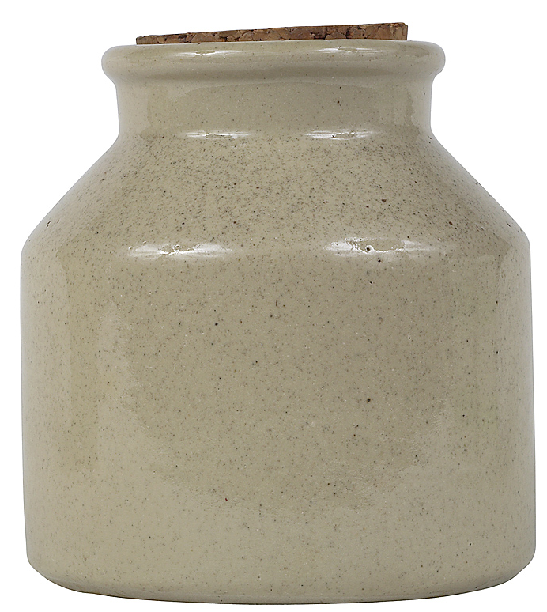
savo
savoring

Slide 69





My top five
 What are the five best books you read this term/year? Why?
Notes:
Interested in postive psychology. SAVORING
Actually do (about 1)
1 good book you’ve read this year/ recently.
Why was it good. As you talk, notice how you are thinking about the book.

Slide 70
A question about assessment:
How are
we grading,
really?
Notes:
Encourage success.
Just last week, talking to a teacher who just got a position at a “education university” (teacher training – used to call normal university)
Told to grade..

Slide 71
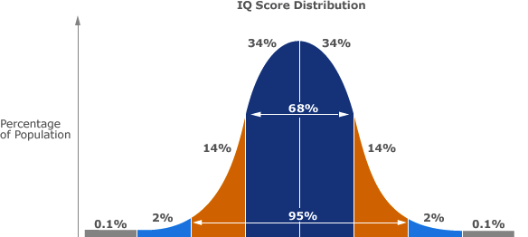
Bell curve/
Norm referenced test
Notes:
Compares students to each other.
Fine for TOEFL, TOEIC, etc. This is (click) of an IQ test.
We shouldn’t be comparing them to each other. Mastery testing is comparing them to the skills/ what they should be doing.

Slide 72


Slide 73
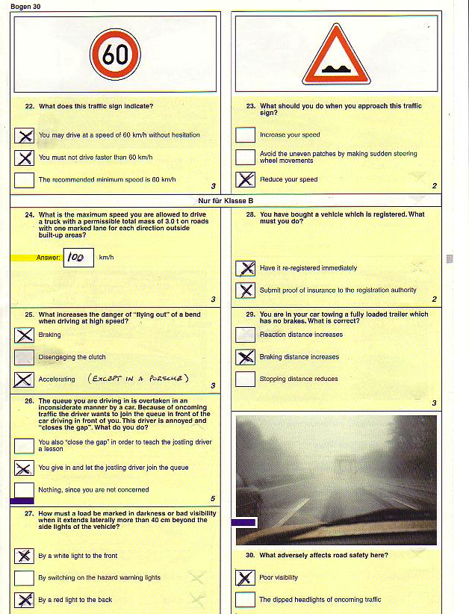
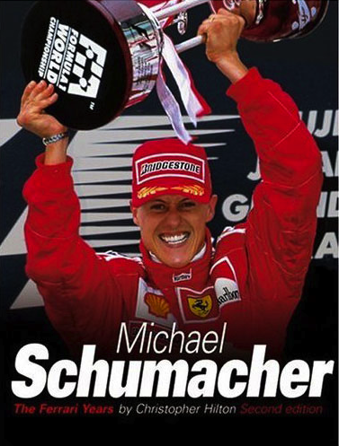
Notes:
Look over, guy in the next set is Michael Schumacher.
Retired now but perhaps the best formula one driver of all time.

Slide 74
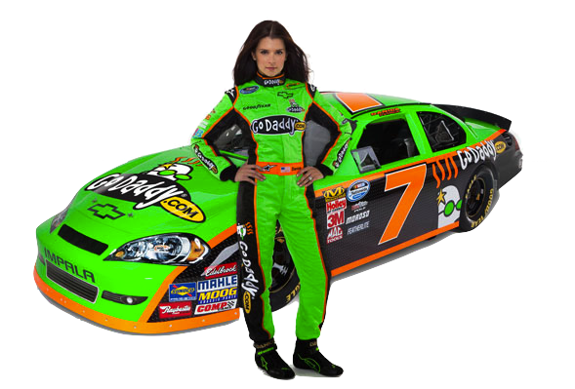
Notes:
Danica Patrick – probably best female driver in USA – now doing NASCAR
What just happened to the “population”.
Should you fail because you are being compared to them.
Makes no sense.

Slide 75
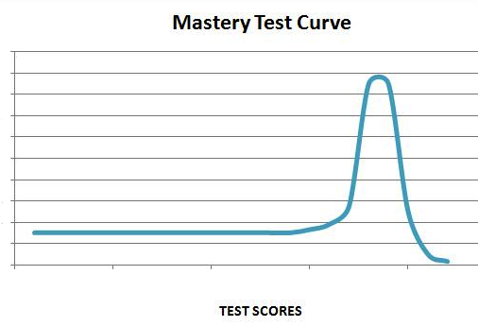
Mastery test/
criterion referenced test

Slide 76
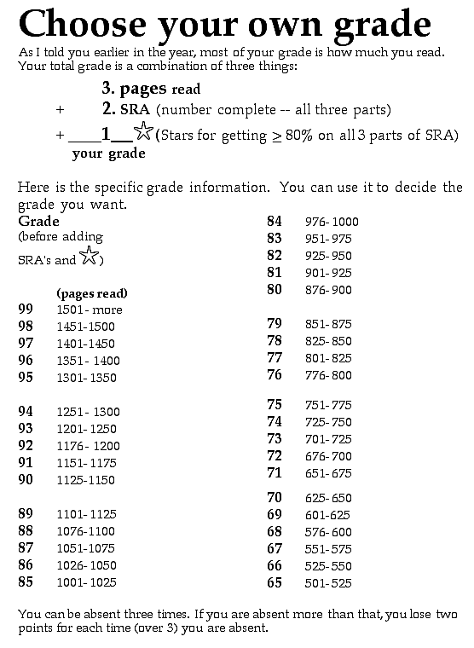

Slide 77
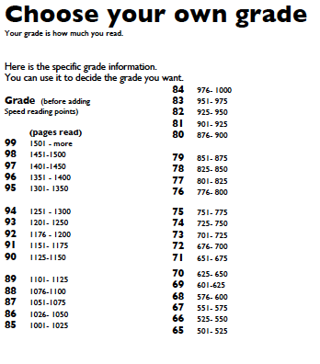

Slide 78


Notes:
Grades are external (extrinsic) motivation. We want reading to be intrinsically motivating. So the other activities. Book report, Sharing books. Book talk. Social interactions. Ss share what they are enjoying.

Slide 79
We all hope
SSR
does for all
students.
Notes:
Grades are external (extrinsic) motivation. We want reading to be intrinsically motivating. So the other activities. Book report, Sharing books. Book talk. Social interactions. Ss share what they are enjoying.

Slide 80


We all hope
SSR
does for all
students.
Notes:
Grades are external (extrinsic) motivation. We want reading to be intrinsically motivating. So the other activities. Book report, Sharing books. Book talk. Social interactions. Ss share what they are enjoying.

Slide 81

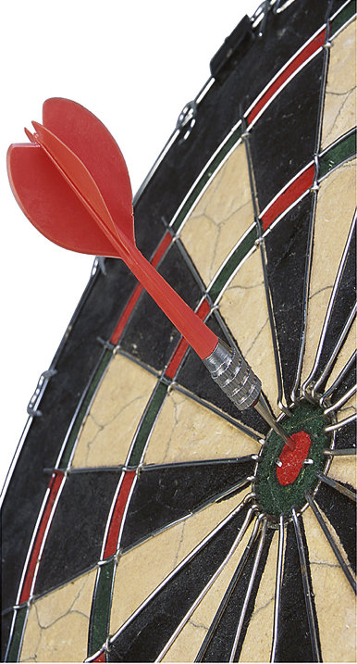
Mastery
goals
Notes:
Grades are external (extrinsic) motivation. We want reading to be intrinsically motivating. So the other activities. Book report, Sharing books. Book talk. Social interactions. Ss share what they are enjoying.

Slide 82
Mastery
goals
Deeper
understanding
Notes:
Grades are external (extrinsic) motivation. We want reading to be intrinsically motivating. So the other activities. Book report, Sharing books. Book talk. Social interactions. Ss share what they are enjoying.

Slide 83
Mastery
goals
Deeper
understanding
Notes:
Grades are external (extrinsic) motivation. We want reading to be intrinsically motivating. So the other activities. Book report, Sharing books. Book talk. Social interactions. Ss share what they are enjoying.

Slide 84
Choice &
control
Titles & genres
Feedback
Notes:
Grades are external (extrinsic) motivation. We want reading to be intrinsically motivating. So the other activities. Book report, Sharing books. Book talk. Social interactions. Ss share what they are enjoying.

Slide 85
Content &
Task relevance
Personalize
Notes:
Grades are external (extrinsic) motivation. We want reading to be intrinsically motivating. So the other activities. Book report, Sharing books. Book talk. Social interactions. Ss share what they are enjoying.

Slide 86
Interesting
texts
They decide.
Notes:
Grades are external (extrinsic) motivation. We want reading to be intrinsically motivating. So the other activities. Book report, Sharing books. Book talk. Social interactions. Ss share what they are enjoying.

Slide 87
Socal
collaboration
Reporting /
Sharing
Notes:
Grades are external (extrinsic) motivation. We want reading to be intrinsically motivating. So the other activities. Book report, Sharing books. Book talk. Social interactions. Ss share what they are enjoying.

Slide 88

Encouraging
success
Build it in.
Notes:
Through savoring,
Through grading

Slide 89

Encouraging
success
Just do it.
Notes:
Grades are external (extrinsic) motivation. We want reading to be intrinsically motivating. So the other activities. Book report, Sharing books. Book talk. Social interactions. Ss share what they are enjoying.

Slide 90
Revisiting
SSR
Engaged
Scaffolded
Sustained
Silent
Reading

Slide 91

Thank you.
Creative Commons : PHOTOSof.org
Notes:
http://photosof.org/view/open_book_with_love_heart_in_folded_pages-wide.htm

Slide 92
Content & task relevance

Slide 95

We hope
SSR
does for all
students.
Notes:
Grades are external (extrinsic) motivation. We want reading to be intrinsically motivating. So the other activities. Book report, Sharing books. Book talk. Social interactions. Ss share what they are enjoying.

Slide 96
Mastery
goals
Deeper
understanding
Notes:
Grades are external (extrinsic) motivation. We want reading to be intrinsically motivating. So the other activities. Book report, Sharing books. Book talk. Social interactions. Ss share what they are enjoying.

Slide 97
Choice &
control
Title & genre
Feedback
Notes:
Grades are external (extrinsic) motivation. We want reading to be intrinsically motivating. So the other activities. Book report, Sharing books. Book talk. Social interactions. Ss share what they are enjoying.

Slide 98
Interesting
texts
They decide.
Notes:
Grades are external (extrinsic) motivation. We want reading to be intrinsically motivating. So the other activities. Book report, Sharing books. Book talk. Social interactions. Ss share what they are enjoying.

Slide 99
Socal
collaboration
Reporting /
Sharing
Notes:
Grades are external (extrinsic) motivation. We want reading to be intrinsically motivating. So the other activities. Book report, Sharing books. Book talk. Social interactions. Ss share what they are enjoying.

Slide 100
Encouraging
success
Build it in.
Notes:
Grades are external (extrinsic) motivation. We want reading to be intrinsically motivating. So the other activities. Book report, Sharing books. Book talk. Social interactions. Ss share what they are enjoying.

Slide 101
Encouraging
success
Just do it.
Notes:
Grades are external (extrinsic) motivation. We want reading to be intrinsically motivating. So the other activities. Book report, Sharing books. Book talk. Social interactions. Ss share what they are enjoying.

Slide 102

Notes:
Grades are external (extrinsic) motivation. We want reading to be intrinsically motivating. So the other activities. Book report, Sharing books. Book talk. Ss share what they are enjoying.

Slide 103
SSR
Sit
Still &
Read
Notes:
Unless you teach kids,

Slide 104
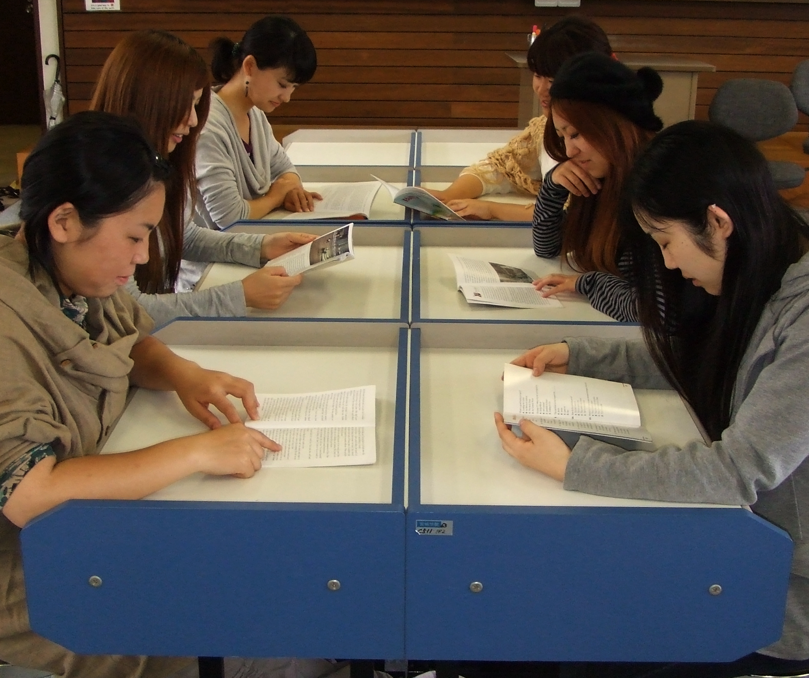
SSR
Sustained
Silent
Reading
(You too.)
Notes:
10-15 minutes of class time
Values reading
Practical thing – they bring books
Classroom management-
Unless you teach kids,

Slide 105
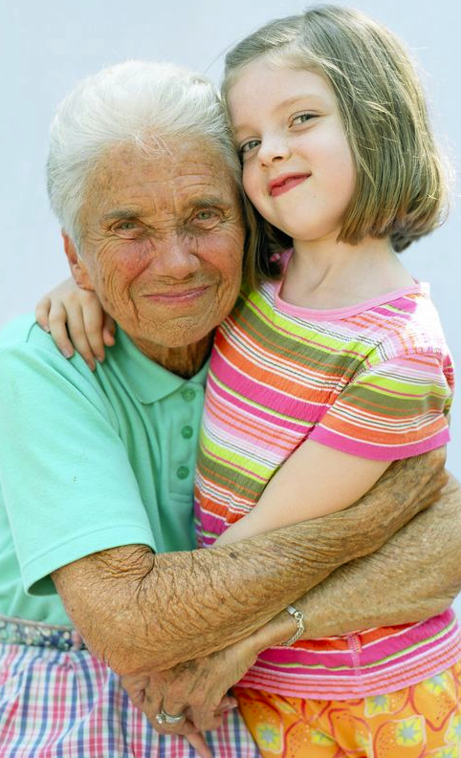
DEAR
Drop
Everything & Read
Notes:
Unless you teach kids,

Slide 106
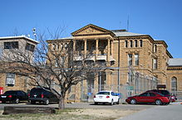

Slide 107


Slide 108
A few questions about questions:
When do
students see
the questions?
Notes:
We usually don’t bother with comprehension questions in ER.
Yes, ooks often have them (but that is publishers wanting to be everyything to everyone. There are much, much better ways to check comprehension than test-like questions. BUT. Tests are important. And the new results are troubling for many teacher. So a quick look. A few questions about questions.

Slide 109
Mastery
goals
Deeper
understanding
Notes:
Grades are external (extrinsic) motivation. We want reading to be intrinsically motivating. So the other activities. Book report, Sharing books. Book talk. Social interactions. Ss share what they are enjoying.

Slide 110
Mastery
goals
Deeper
understanding
Notes:
Grades are external (extrinsic) motivation. We want reading to be intrinsically motivating. So the other activities. Book report, Sharing books. Book talk. Social interactions. Ss share what they are enjoying.

Slide 111
Barrett’s Taxonomy
Levels of comprehension
Mental Rehearsal
5 Appreciation
4 Evaluation
3 Inference
Practice:
speak silently or softly
2 Reorganization
1 Literal (lowest)
Notes:
Helen Keller Story

Slide 112
Barrett’s Taxonomy
Levels of comprehension
Mental Rehearsal
5 Appreciation
4 Evaluation
3 Inference
Practice:
speak silently or softly
2 Reorganization
1 Literal (lowest)
Notes:
Helen Keller Story

Slide 113
Reading for pleasure
Reaction Report - Basic
Include:
• what the book was about
• what you thought of it)
What happened?
------------------
Your opinion:
Write quickly.
10 minutes or less.
Good ☺ p Average 😐 p Poor ☹
Good ☺ p Average 😐 p Poor ☹
Notes:
ER is a new idea for most Ss (used to intensive/ yakudoku/ read & translate).
Nothing wrong with staring reports where they expect. NOTICE: YOUR OPINION! -- APPRECIATIO

Slide 114
Reading for pleasure
Reaction Report – Draw a picture
1. Draw a picture of a scene from the story. Don’t copy a picture. Draw one from your imagination.
------------------
2. Explain your picture. What is happening? What happened before this picture? What happened next?
3. Your opinion. What did you think of the book?
Good ☺ p Average 😐 p Poor ☹
Notes:
Dornyei and others point out: doing the same thing sucks
The motivation out of any class. (habituation)
Late May/ early June
Multiple intelligences: artistic knowledge,
kinesthetic (folks who draw)

Slide 115
Reading for pleasure
Reaction Report - Basic
Include:
• what the book was about
• what you thought of it)
What happened?
------------------
Your opinion:
Write quickly.
10 minutes or less.
Good ☺ p Average 😐 p Poor ☹
Notes:
ER is a new idea for most Ss (used to intensive/ yakudoku/ read & translate).
Nothing wrong with staring reports where they expect. NOTICE: YOUR OPINION! -- APPRECIATIO

Slide 116
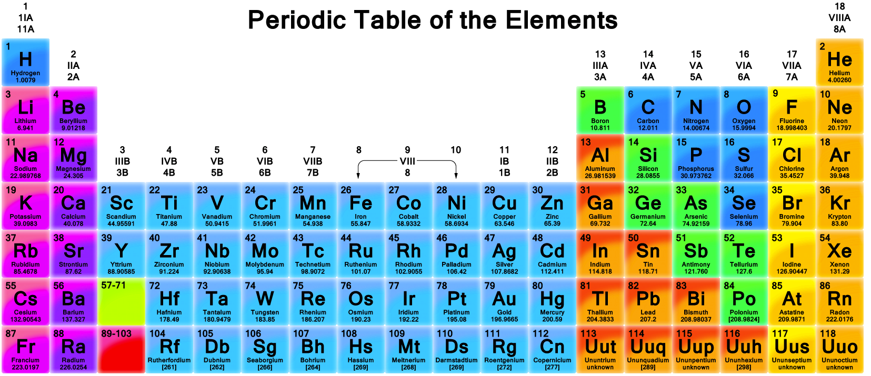
Pure science

Slide 117
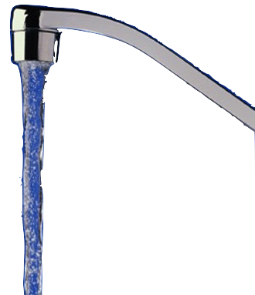


H²
O

Slide 118
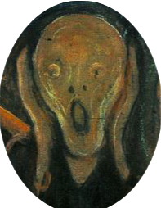

O
MG
!=
Notes:
No, really Magnesium Oxide (MgO).

Slide 119
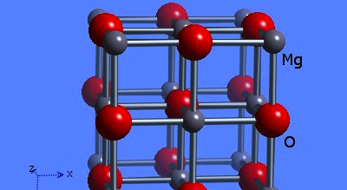
No you don’t.
You get MgO
Notes:
Magnesium Oxide

Slide 120
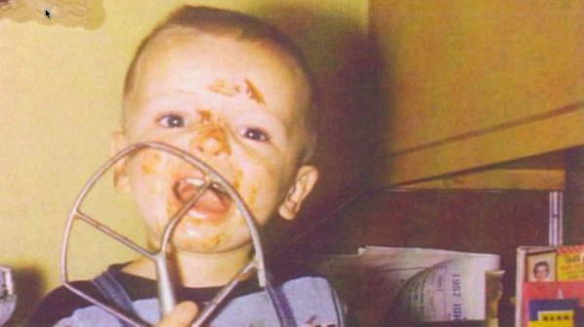
is messy
Applied science
is
messy
Notes:
Humans- Can’t control all the variables.
We can’t do causality (cause & effect).
We can do corrolation --- these things go together .
And they go together regularily.

Slide 121
Difficult
to prove causality
Notes:
Can’t proved causality.

Slide 122
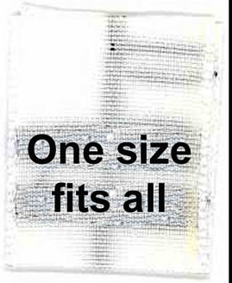

Slide 123
Notes:
Grades are external (extrinsic) motivation. We want reading to be intrinsically motivating. So the other activities. Book report, Sharing books. Book talk. Ss share what they are enjoying.

