Slide 1
Energy breaks
Human beings were not designed to sit at desks all day. Energy breaks are a series of short, physical activities you can use to get your students moving and energized.
Neuroscience Love Song
The song and video are from National Public Radio.
URL: https://www.youtube.com/watch?v=VbFchFe1Nfo
The writer and artist is Adam Cole.
If you don’t understand some of the other slides, listen to this 11-minute podcast with the information that was used to make the other slides. https://www.npr.org/2020/02/13/805670712/is-this-love-or-am-i-gonna-fight-a-lion
“Skunk Bear” (at the beginning of the video) was the name of an NPR science program on YouTube.com
For more, visit: www.HelgesenHandouts.weebly.com. Click on “Physical activity…”
This slide is for the teacher’s information. The student slide show starts with slide 2.

Slide 2
Writer and artist:
Adam Cole

Slide 4
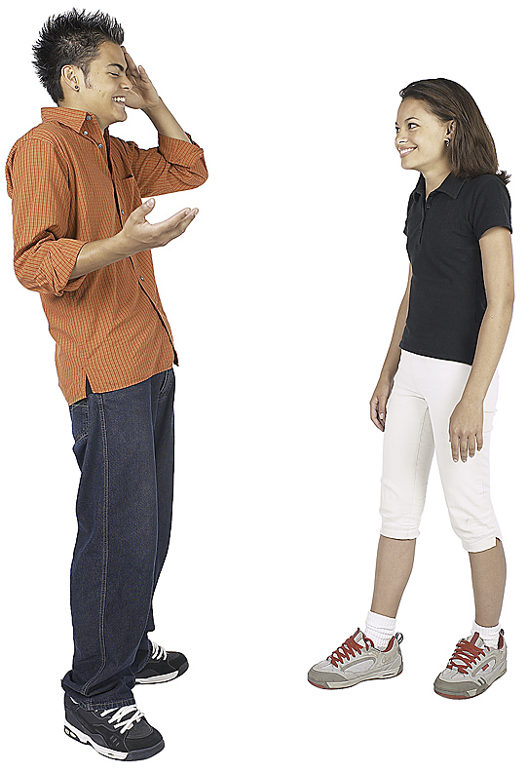
A little
brain
science
about
falling
in
love

Slide 5
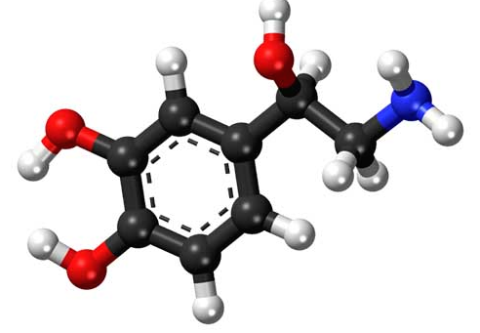
Norepinephrine
Fight OR flight
(run away)

Slide 6
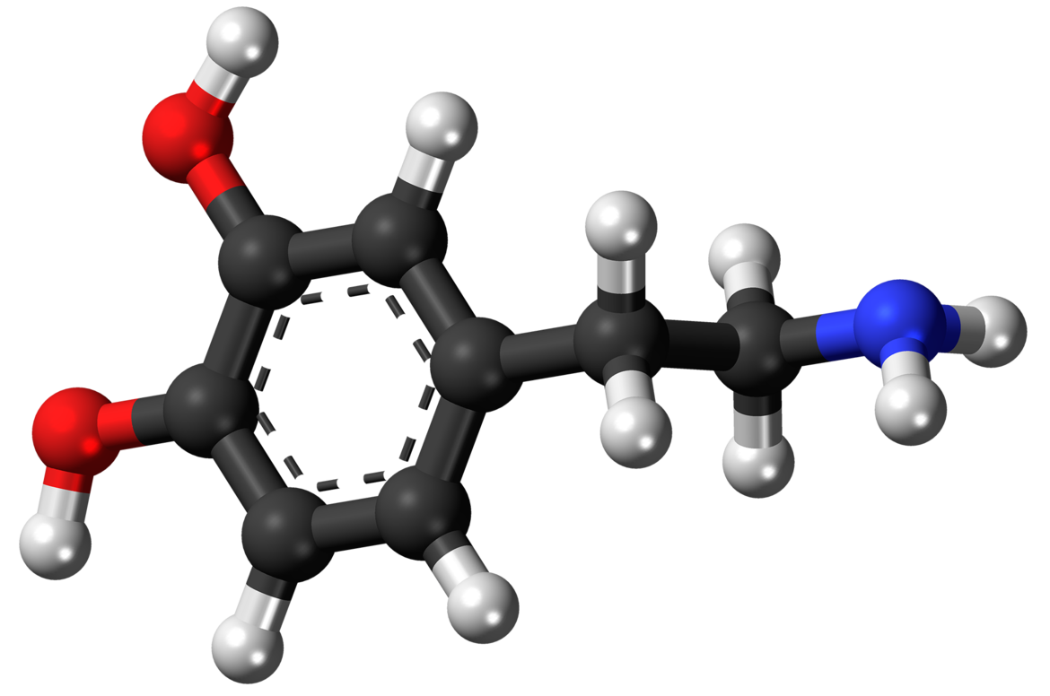
Dopamine
Anticipation
reward
stronger

Slide 7
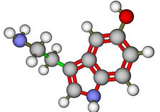
Serotonin
Mood regulator
drops

Slide 8
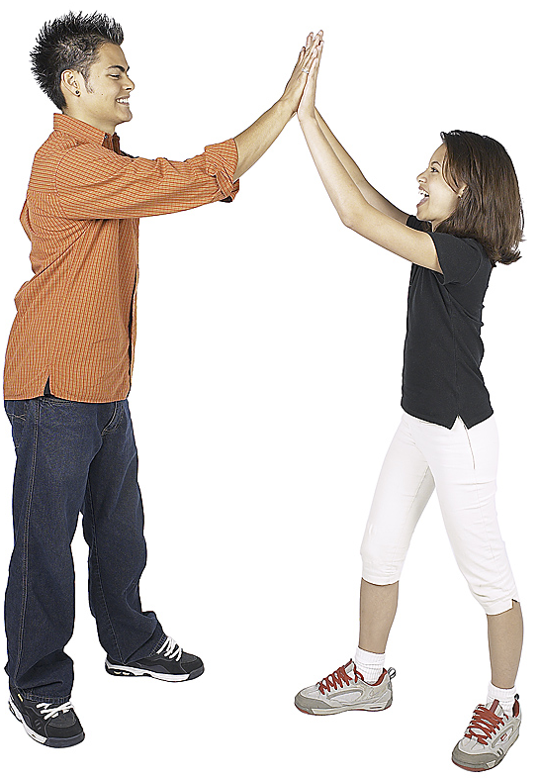
Staying in love
Staying in love
Serotonin
goes back up

Slide 9
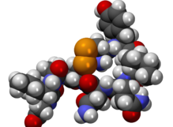
Oxytocin
The cuddle chemical
The hugging hormone
The potion of devotion

Slide 10
Oxytocin
Physical touching
Social bonding
Trust

Slide 11
Norepinephrine
Stand up.
Maybe think of a time you fell in love.
Move with the people around you.
Sing along.

Slide 13
Let’s move!

Slide 14
Thank you
.org

Slide 15
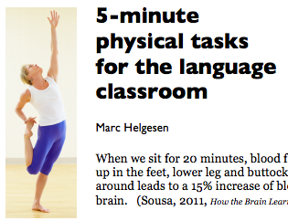
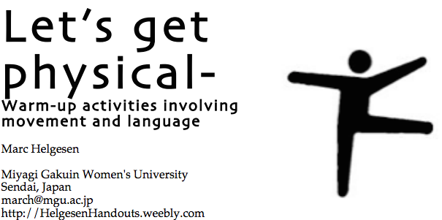
More ideas at
http://tinyurl.com/ELT-physical

