Slide 1
Energy breaks
Human beings were not designed to sit in desks all day. Energy breaks are a series of short, physical activities you can use to get your students moving and energized.
Note – I teach in a all-women’s university so physical contact is not
a problem. If you have co-ed classes, make sure the student are confortable with the idea and have the option of opting out.
Positive peer neck massage invites students to choose a positive statement about learning English and repeating it while giving a short neck massage to a peer. Research shows that when people are told which positive statement (affirmation) to say, it can have negative results with learners with low self esteem. That’s why they choose their own.
Slides 15 and 16 give information on relaxation and oxytocin, sometimes called “the hugging hormone.”
© Marc Helgesen. May be freely used for non-commercial purposes.
For more, visit: www.HelgesenHandouts.weebly.com. Click on “Physical activity…”
This slide is for the teacher’s information. The student slide show starts with slide 2.
Thanks to Tim Murphey for sharing this with me.

Slide 2
Energy break

Slide 3
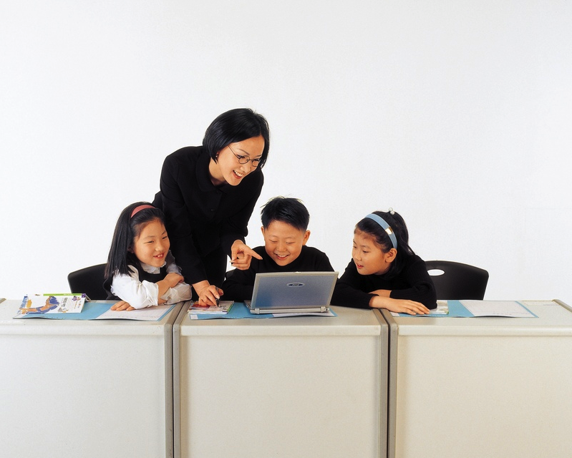

Slide 4
Things “good English
learners” say to themselves. Rost 2005
Learning English
makes me feel good.

Slide 5
Things “good English
learners” say to themselves. Rost 2005
Learning English
is my passion.

Slide 6
Things “good English
learners” say to themselves. Rost 2005
I believe
I’m a good student.

Slide 7
Things “good English
learners” say to themselves. Rost 2005
I’m hungry
for English.

Slide 8
Choose one you like.
Learning English
makes me feel good.
Learning English
is my passion.
I believe I’m a good student.
I’m hungry for English.

Slide 9
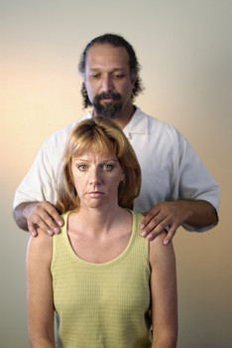
OK, this activity is a little strange.
Positive
peer neck
massage
Notes:
Make circles before click

Slide 10
Make a circle or line of 8-10.
Learning English…
Massage your partner’s neck
& shoulders.
Repeat your
sentence
many times.
Notes:
Make circles before click

Slide 11
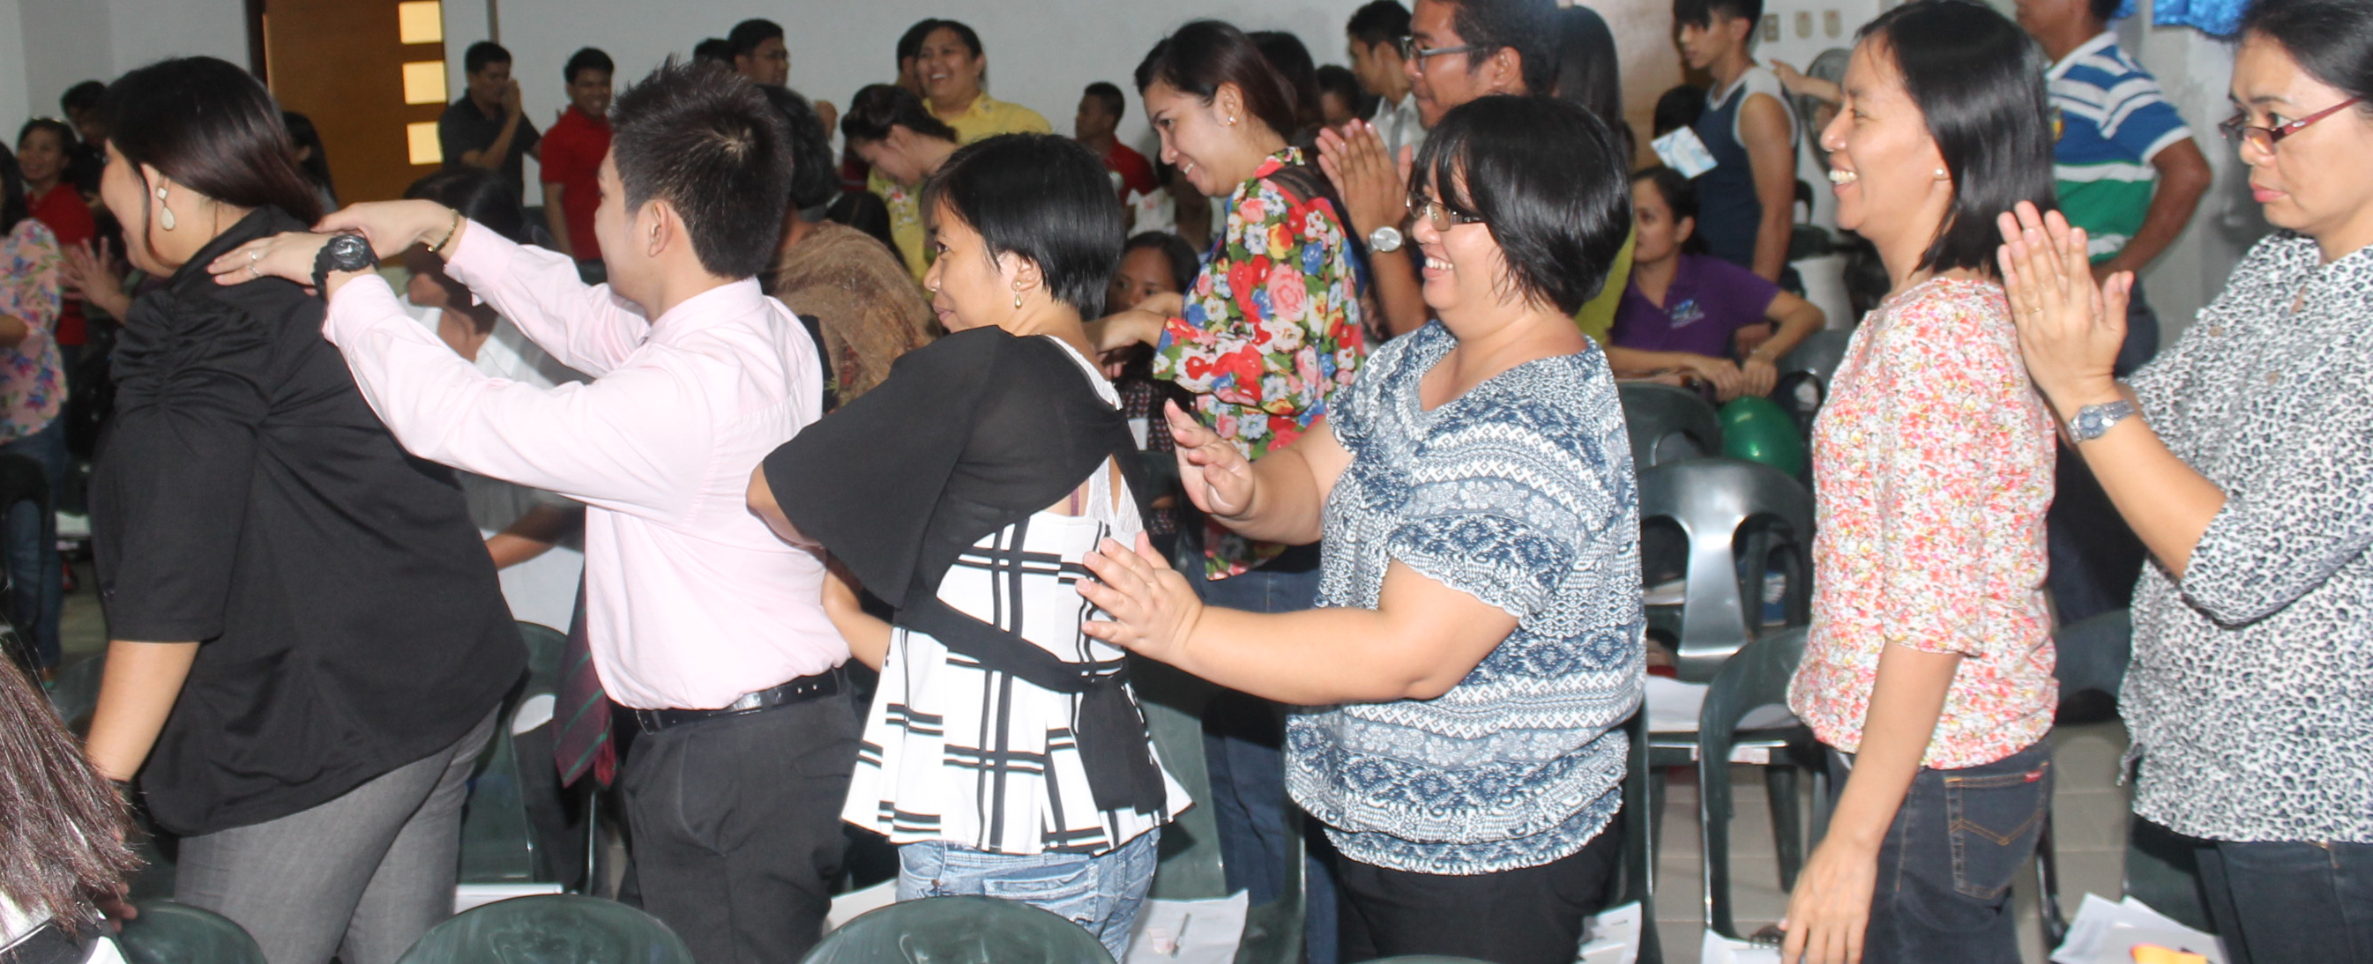
Positive peer
neck massage

Slide 12
Sorta like this

Slide 13
Sort of like this
Learning English is..
I believe..
…my passion ..
…hungry for English ..
…feel good ..

Slide 14
Partner, ENJOY.
Learning English…
J
Notes:
Make circles before click

Slide 15
Choose one you like.
Learning English
makes me feel good.
Learning English
is my passion.
I believe I’m a good student.
I’m hungry for English.

Slide 16
Partner, ENJOY.
Learning English…
J
After a minute
or so, turn
around.
Massage a new
Partner.
Notes:
Make circles before click

Slide 17
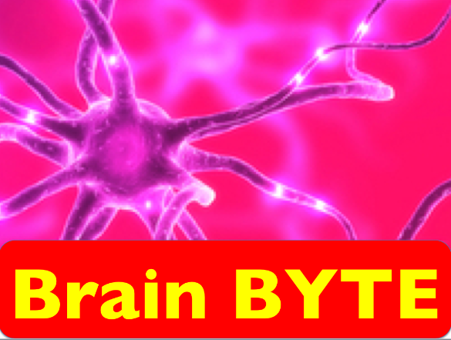
Interesting fact:
Relaxed people
do up to 25%
better on tests.
Source:Jensen, E. Brain-based learning. (2008)
Thousand Oaks, CA: Corwin Press.
Notes:
How does she look? (worried, nervous)
#2 - relaxed.

Slide 18
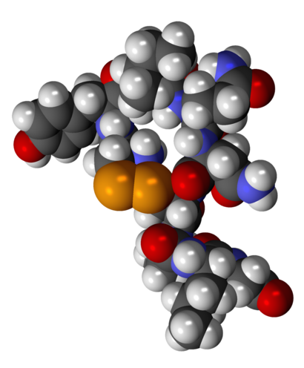
Appropriate, wanted
touching releases
oxytocin. It is related
to bonding, increasing trust
and reducing fear.
Source: http://psychcentral.com/
lib/about-oxytocin/0001386
Notes:
How does she look? (worried, nervous)
#2 - relaxed.

Slide 19
Let’s
move!

Slide 20
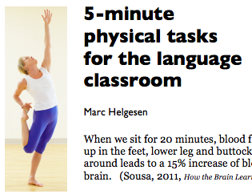
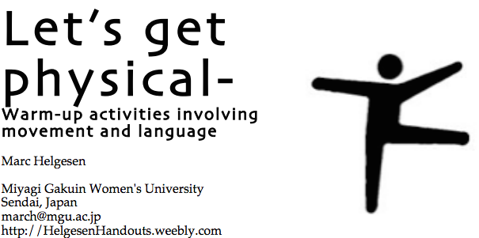
More ideas at
http://tinyurl.com/ELT-physical

