Slide 1
12
Increased accuracy
sometimes
FonF
Focus on Form

Slide 2
Increased accuracy
sometimes
dog
dog
really
Fill in first. Listen to check.
Multiple possibilities.
Notes:
Notice – cant think of question without answer.
TASK PLANNING

Slide 3
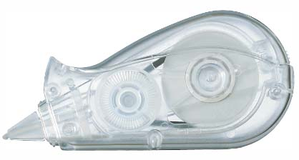
• Hint:
cloze target
grammar/vocabulary
Not every nth word
DIY –
Do it yourself.
Notes:
You may have learned in school that, for a cloze test, blank out every 7th or 9th, or Nth word. Find. This is NOT a test.
Your purpose is to focus attention on Form. – noticing the grammar. Noticing the vocabulary.

Slide 4
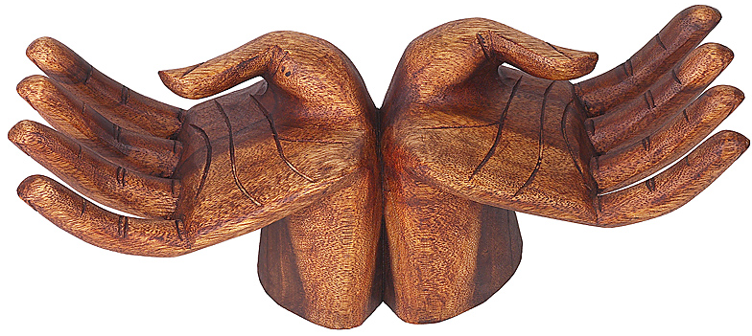
Learning by doing

Slide 5
French proverb:
The way to
become a
blacksmith,
blacksmith
is to be a
blacksmith.
Notes:
Know “blacksmith” (kind of out of date word). People who made horseshoes, etc.
The way..
You don’t “learn about” blacksmithing, You do things blacksmiths do.

Slide 6
French proverb:
The way to
become a
blacksmith,
blacksmith
is to be a
blacksmith.
Photo: wwwdebharkness.com
Notes:
Just to be fair about this.

Slide 7
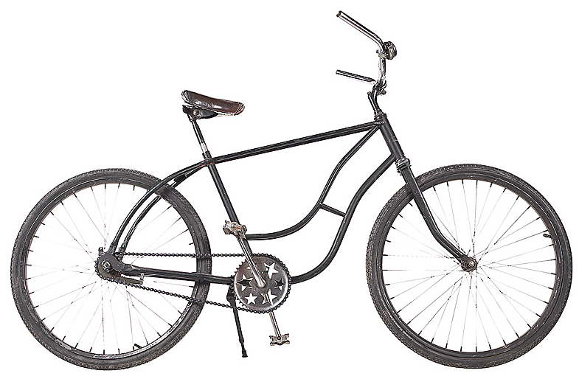
Can you…
How did you learn?
Notes:
Can you ride a bicycle? (show of hands).
How did you learn? (don’t wait for response here)

Slide 8
Did you
read
a book?
How to
ride a bicycle by Harley Pedal
A crash course
Notes:
An instruction manual.
Something that explained it.
Then you are ready to go. (next slide)

Slide 9
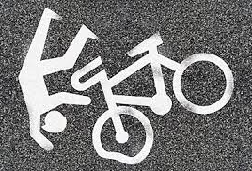
Notes:
No. Because riding a bicycle isn’t something you learn about. You learn by doing.

Slide 10
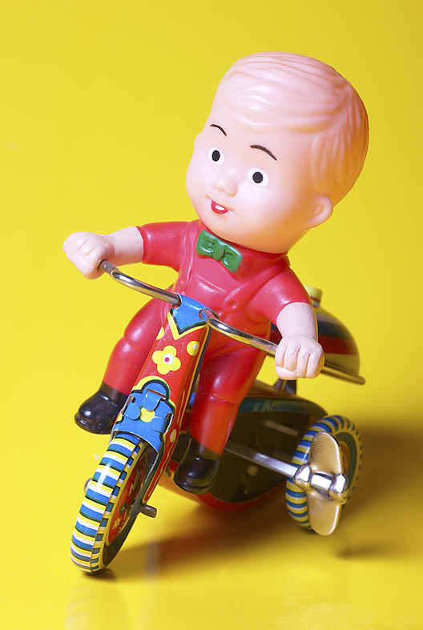
You
practiced.
And probably
got some
coaching.
Notes:
Coaching - short bits of advice,
more “modeling” that explaining

Slide 11
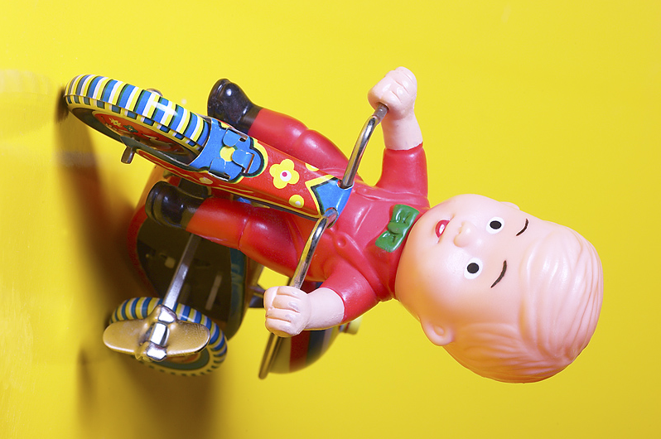
You practiced.
And probably made some mistakes..
Notes:
Coaching - more “modeling” that explaining

Slide 12
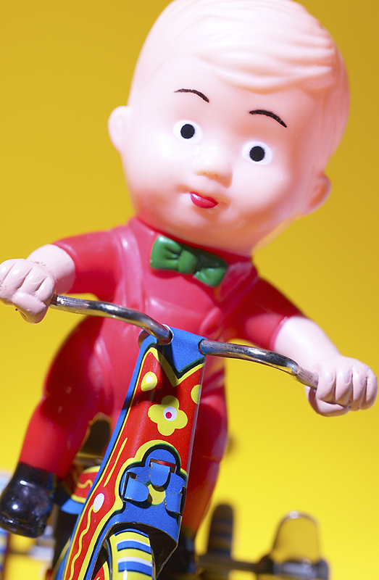
You
practiced
some
more.

Slide 13
You
practiced
and got
better.

Slide 14
You
practiced.

Slide 15
Eventually:
Wow!
No problem!

Slide 16
Learning by doing

Slide 17
12
Increased accuracy
sometimes
FonF
Focus on Form

Slide 18
12
Increased accuracy
sometimes
FonF
Focus on Form
Descriptive knowledge
knowing that…
Procedural knowledge
knowing how…

Slide 19
12
Some (especially Mike Long) insist
FonF
Focus on Form
Reactive
is different than
FonFs
Focus on Forms

Slide 20
I don’t find Long’s position useful
If we know the learners language, we can anticipate the problems:
• L1 interference
• False beginners
Not doing FonF(s), lost opportunity for task planning.
Notes:
L1- comparatives. X yori, Y wa oki.
False beginners: You had better/ nani shita ho ga ii.

Slide 21
Learning by doing
Noticing
while using English

Slide 22
Learning by doing
FonF helps them notice

