Slide 1
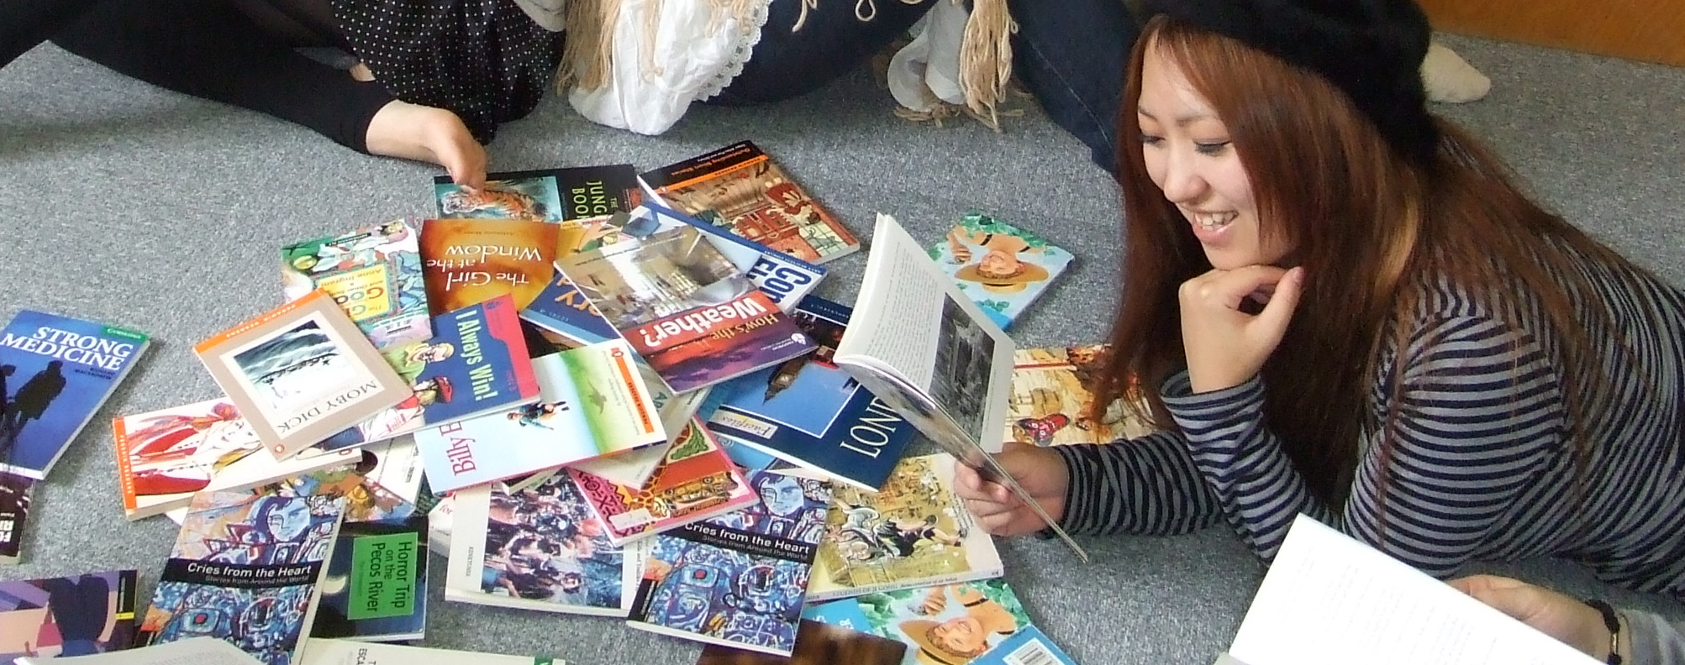
E R

Slide 2
Extensive Reading

Slide 3
Effective Reading
Notes:
Intro (excited/ delighted)
Who are you?
Univ/college. HS. JHS. Kids. Conversation schools
Doing ER now?
Know a lot? New to ER?

Slide 4
Exciting Reading
Notes:
Intro (excited/ delighted)
Who are you?
Univ/college. HS. JHS. Kids. Conversation schools
Doing ER now?
Know a lot? New to ER?

Slide 5
Enjoyable Reading
Notes:
Intro (excited/ delighted)
Who are you?
Univ/college. HS. JHS. Kids. Conversation schools
Doing ER now?
Know a lot? New to ER?

Slide 7
Today’s presentation is brought to you by the letters:
E
and R

Slide 8
ER:
reading
a lot of easy, enjoyable books.
Notes:
That’s not just ELT,
That’s you.
read a newspaper this morning, that’s EF.
read a book a month? That’s ER
Trying to give Ss the Native or fluent/accomplished learner advantage

Slide 11
Intensive Extensive
Slow Fast
Skill building Fluency building (skim, scan, study)
Test focus Pleasure focus
Notes:
NO “good” bad categories.
Not about which is right.
About balance

Slide 12
Intensive Extensive

Slide 13
Intensive Extensive

Slide 14
Intensive Extensive

Slide 15
Intensive Extensive

Slide 16
Intensive Extensive

Slide 17
Intensive Extensive

Slide 18
Intensive Extensive

Slide 19
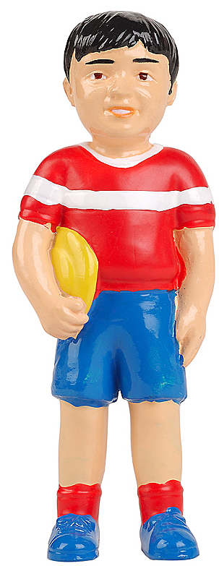
Mark
Marc

Slide 20
Intensive Extensive

Slide 21
Intensive Extens e
Slow Fast
Skill building Fluency building
Test focus Pleasure focus

Slide 22
What is
Extensive
Reading?
Notes:
ER
Not just ELT
Read a newspaper every morning. That’s ER
Read a book or 2 a month. That’s ER
You are a teacher. You read a lot. That means you’re smart. Makes you smart.
Sharing this with Student.

Slide 23
多読
楽読
Notes:
Takoku - reading a lot
Raku-doku - Junko Yamanaka
Raku - fun (tanoshi)
Easy - raku
“Read only easy and enjoyable books and you will have read many books without knowing because they are fun to read, and as a result your reading ability and even English ability in general will have gone up.

Slide 24
Notes:
Takoku - reading a lot
Raku-doku
Raku - fun (tanoshi)
Easy - raku
“Read only easy and enjoyable books and you will have read many books without knowing because they are fun to read, and as a result your reading ability and even English ability in general will have gone up.ß

Slide 25
楽
読
Notes:
Takoku - reading a lot
Raku-doku
Raku - fun (tanoshi)
Easy - raku
“Read only easy and enjoyable books and you will have read many books without knowing because they are fun to read, and as a result your reading ability and even English ability in general will have gone up.ß

Slide 26
ER:
reading
a lot of easy, enjoyable books.
Notes:
That’s not just ELT,
That’s you.
read a newspaper this morning, that’s EF.
read a book a month? That’s ER
Trying to give Ss the Native or fluent/accomplished learner advantage

Slide 27
The benefits of ER
Increased
Reading
ability
Notes:
Thank you Captain Obvious
Elley & Mangubhai ‘81, Elley ’91, Mason & Krashen ’97

Slide 28
The benefits of ER
Increased
Reading
ability
+ affect &
motivation
Notes:
Increased affect/motivation Elley ‘91, Cho & Krashen ’94, Rodrigo ‘95
Improved vocabulay Rodrigo ‘95, Haifiz & Tudor ’90,
Improved listening ability Cho & Krashen ‘94

Slide 29
The benefits of ER
Increased
Reading
ability
+ vocabulary
Notes:
Increased affect/motivation Elley ‘91, Cho & Krashen ’94, Rodrigo ‘95
Improved vocabulay Rodrigo ‘95, Haifiz & Tudor ’90,
Improved listening ability Cho & Krashen ‘94

Slide 30
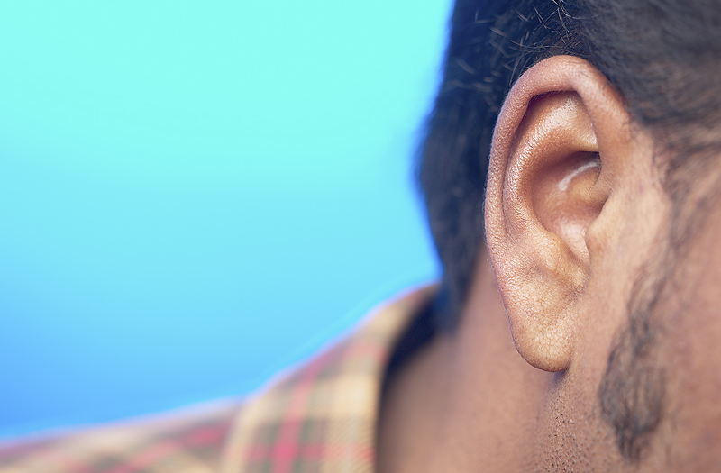
Increased affect/motivation
Elley ‘91, Cho & Krashen ’94, Rodrigo ‘95
Improved vocabulary
Rodrigo ‘95, Haifiz & Tudor ’90,
Improved listening ability
The benefits of ER
Increased
Reading
ability
+ listening
ability
Notes:
Increased affect/motivation Elley ‘91, Cho & Krashen ’94, Rodrigo ‘95
Improved vocabulay Rodrigo ‘95, Haifiz & Tudor ’90,
Improved listening ability Cho & Krashen ‘94

Slide 31
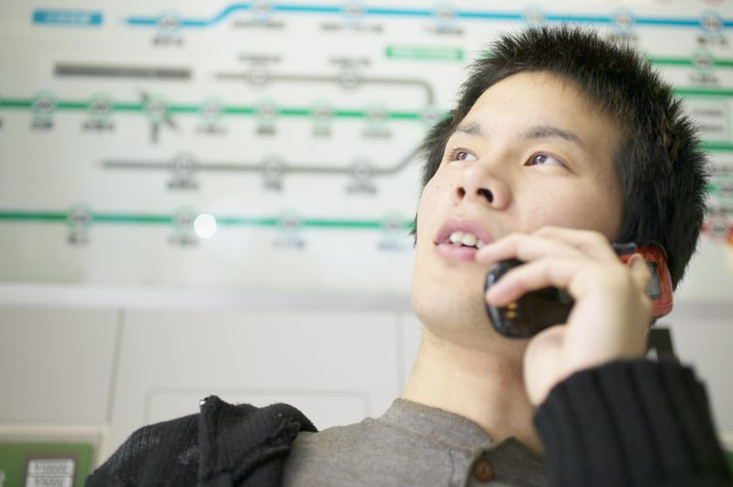
The benefits of ER
Increased
Reading
ability
+ speaking
ability
Notes:
Increased speaking ability Cho & Krashen ‘94
Facilitates acquisiton Lai ‘93, Hafiz & Tudor ’89
Spelling improvement Day & Swan ‘91, Polak & Krashen ‘88, Krashen ‘88

Slide 32
The benefits of ER
Increased
Reading
ability
+ spelling
Notes:
Increased speaking ability Cho & Krashen ‘94
Facilitates acquisiton Lai ‘93, Hafiz & Tudor ’89
Spelling improvement Day & Swan ‘91, Polak & Krashen ‘88, Krashen ‘88

Slide 33
The benefits of ER
Increased
Reading
ability
facilitates
acquisition
Notes:
Increased speaking ability Cho & Krashen ‘94
Facilitates acquisiton Lai ‘93, Hafiz & Tudor ’89
Spelling improvement Day & Swan ‘91, Polak & Krashen ‘88, Krashen ‘88

Slide 34
The benefits of ER
.
Your love life improves.
Your skin clears up.
You win the lottery.
You find the meaning of life.
You lose weight.
Or at least you could read
about those things.
Notes:
Increased speaking ability Cho & Krashen ‘94
Facilitates acquisiton Lai ‘93, Hafiz & Tudor ’89
Spelling improvement Day & Swan ‘91, Polak & Krashen ‘88, Krashen ‘88

Slide 35
ER:
reading
a lot of easy, enjoyable books.

Slide 36
ER:
reading
a lot of easy, enjoyable books.

Slide 37
reading
Time spent reading.
not answering questions
writing reports
translating
Notes:
They might do those things, but not as the main task.

Slide 38
ER:
reading
a lot of easy, enjoyable books.

Slide 39
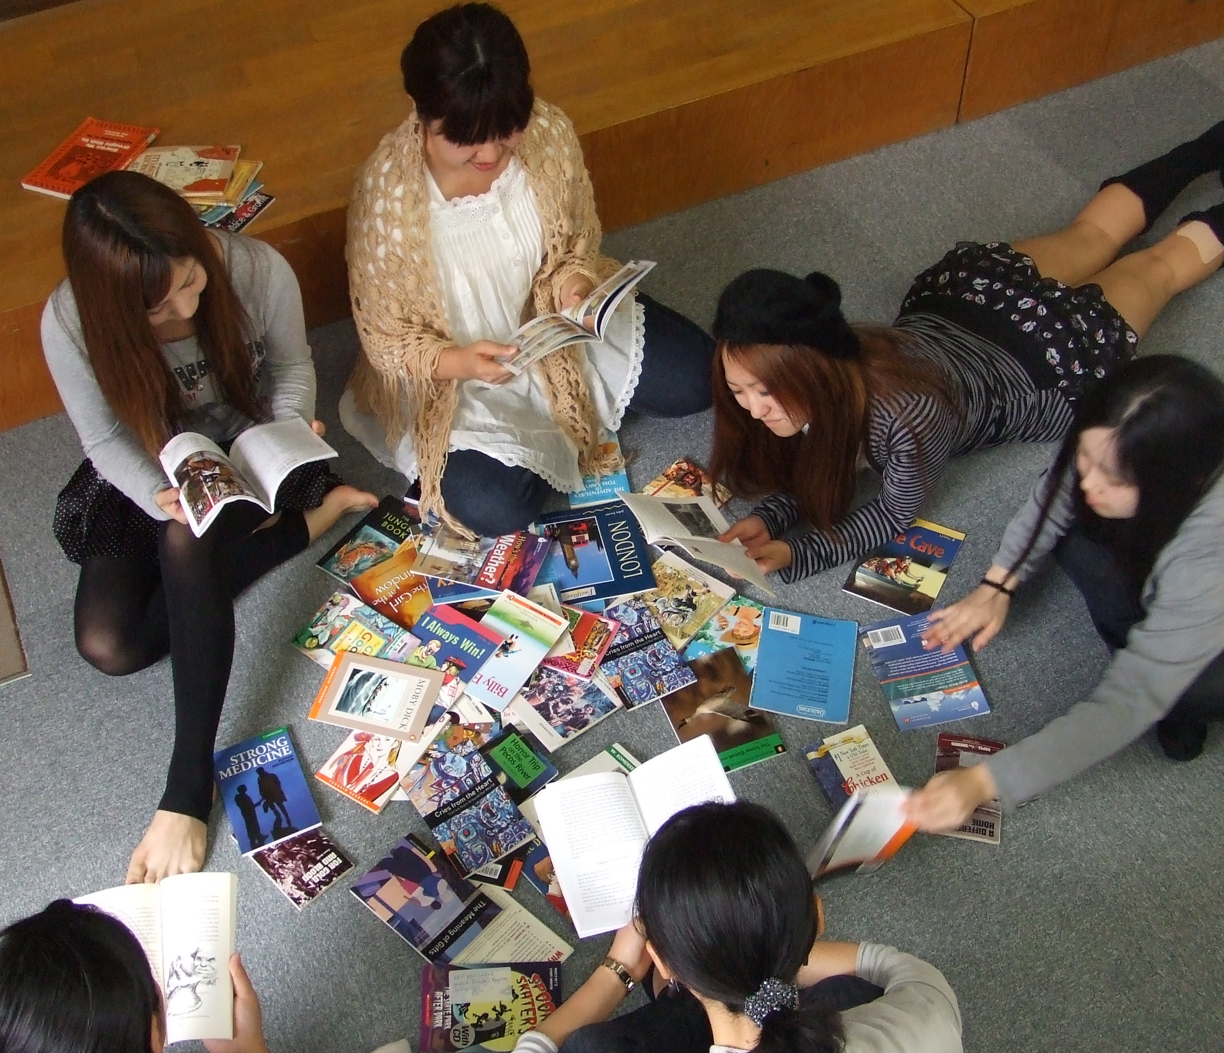
a lot
Notes:
Many many, not just one book per year/term
Varies.
1 book a week -- common
My Ss ^ 500 pages a term (1000 year). 500 gets them a C. Average is 650 or so.
Beniko Mason (Intl Buddhist univ. Osaka. Does research with Stephen Krashen) require 1000 pages /term. Average 650 or so. You decide.
Point. Lots of books

Slide 40
ER:
reading
a lot of easy, enjoyable books.

Slide 41
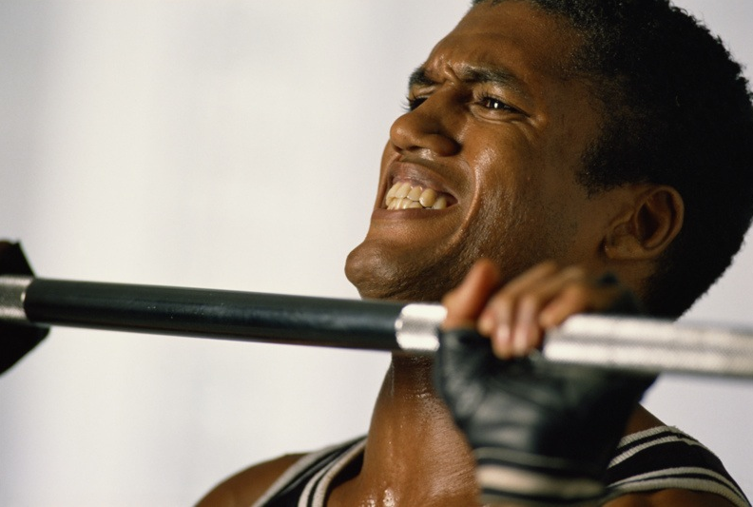
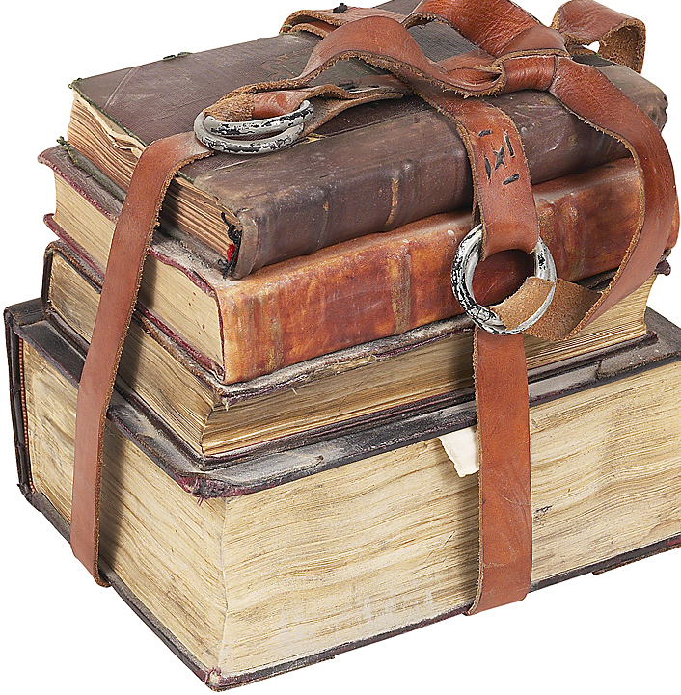
No reading pain,
no reading gain.
ER
The macho rule of reading
Notes:
Credit Richard Day

Slide 42
Easy
is good

Slide 43
Easy
Comprehensible input (Krashen)
i + 1
Reading fluency level (Day)
i minus 1

Slide 44
Easy
…builds speed
…builds fluency
…builds understanding
Notes:
Mentally translate (Ss are doing)
Notice your attention

Slide 45
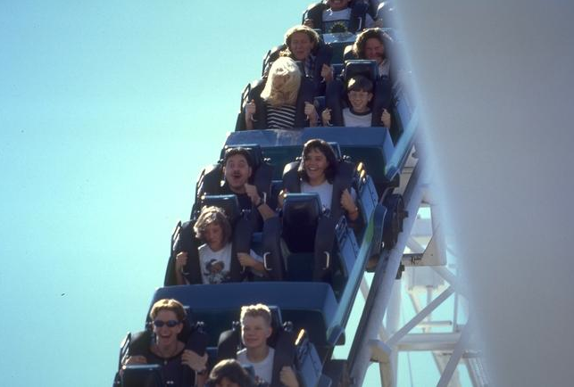
The need
for
speed
Notes:
Hard to explain,
Easy to demonstrate

Slide 46
もし

Slide 47
本

Slide 48
を

Slide 49
読む

Slide 50
とき

Slide 51
に

Slide 52
、

Slide 53
一語

Slide 55
一語

Slide 56
読んで

Slide 57
行く

Slide 58
なら

Slide 59
全体

Slide 60
の

Slide 61
意味

Slide 62
を

Slide 63
理解

Slide 64
する

Slide 65
こと

Slide 66
は

Slide 67
できない

Slide 68
でしょう

Slide 69
。

Slide 71
When you read slowly,
one word at a time,
as you are doing now,
it is easy to understand
the meaning of each word,
but it is very difficult to
understand the real
meaning of the text.

Slide 72
The need for speed
Don’t
understand
much
Read slowly
Don’t
read
much
Don’t enjoy
reading
Notes:
Credit Richard Day

Slide 73
The need for speed
Understand
more
Read faster
Read
more
Enjoy reading

Slide 74
Easy
is good

Slide 75
ER:
reading
a lot of easy, enjoyable books.

Slide 76
enjoyable
Their interests
Self-selected
Like L¹ reading
Notes:
Books usually self-selected.

Slide 77
ER:
reading
a lot of easy, enjoyable books.

Slide 78
books
How do we
bring the books
back to class?
Notes:
Books usually self-selected.

Slide 79
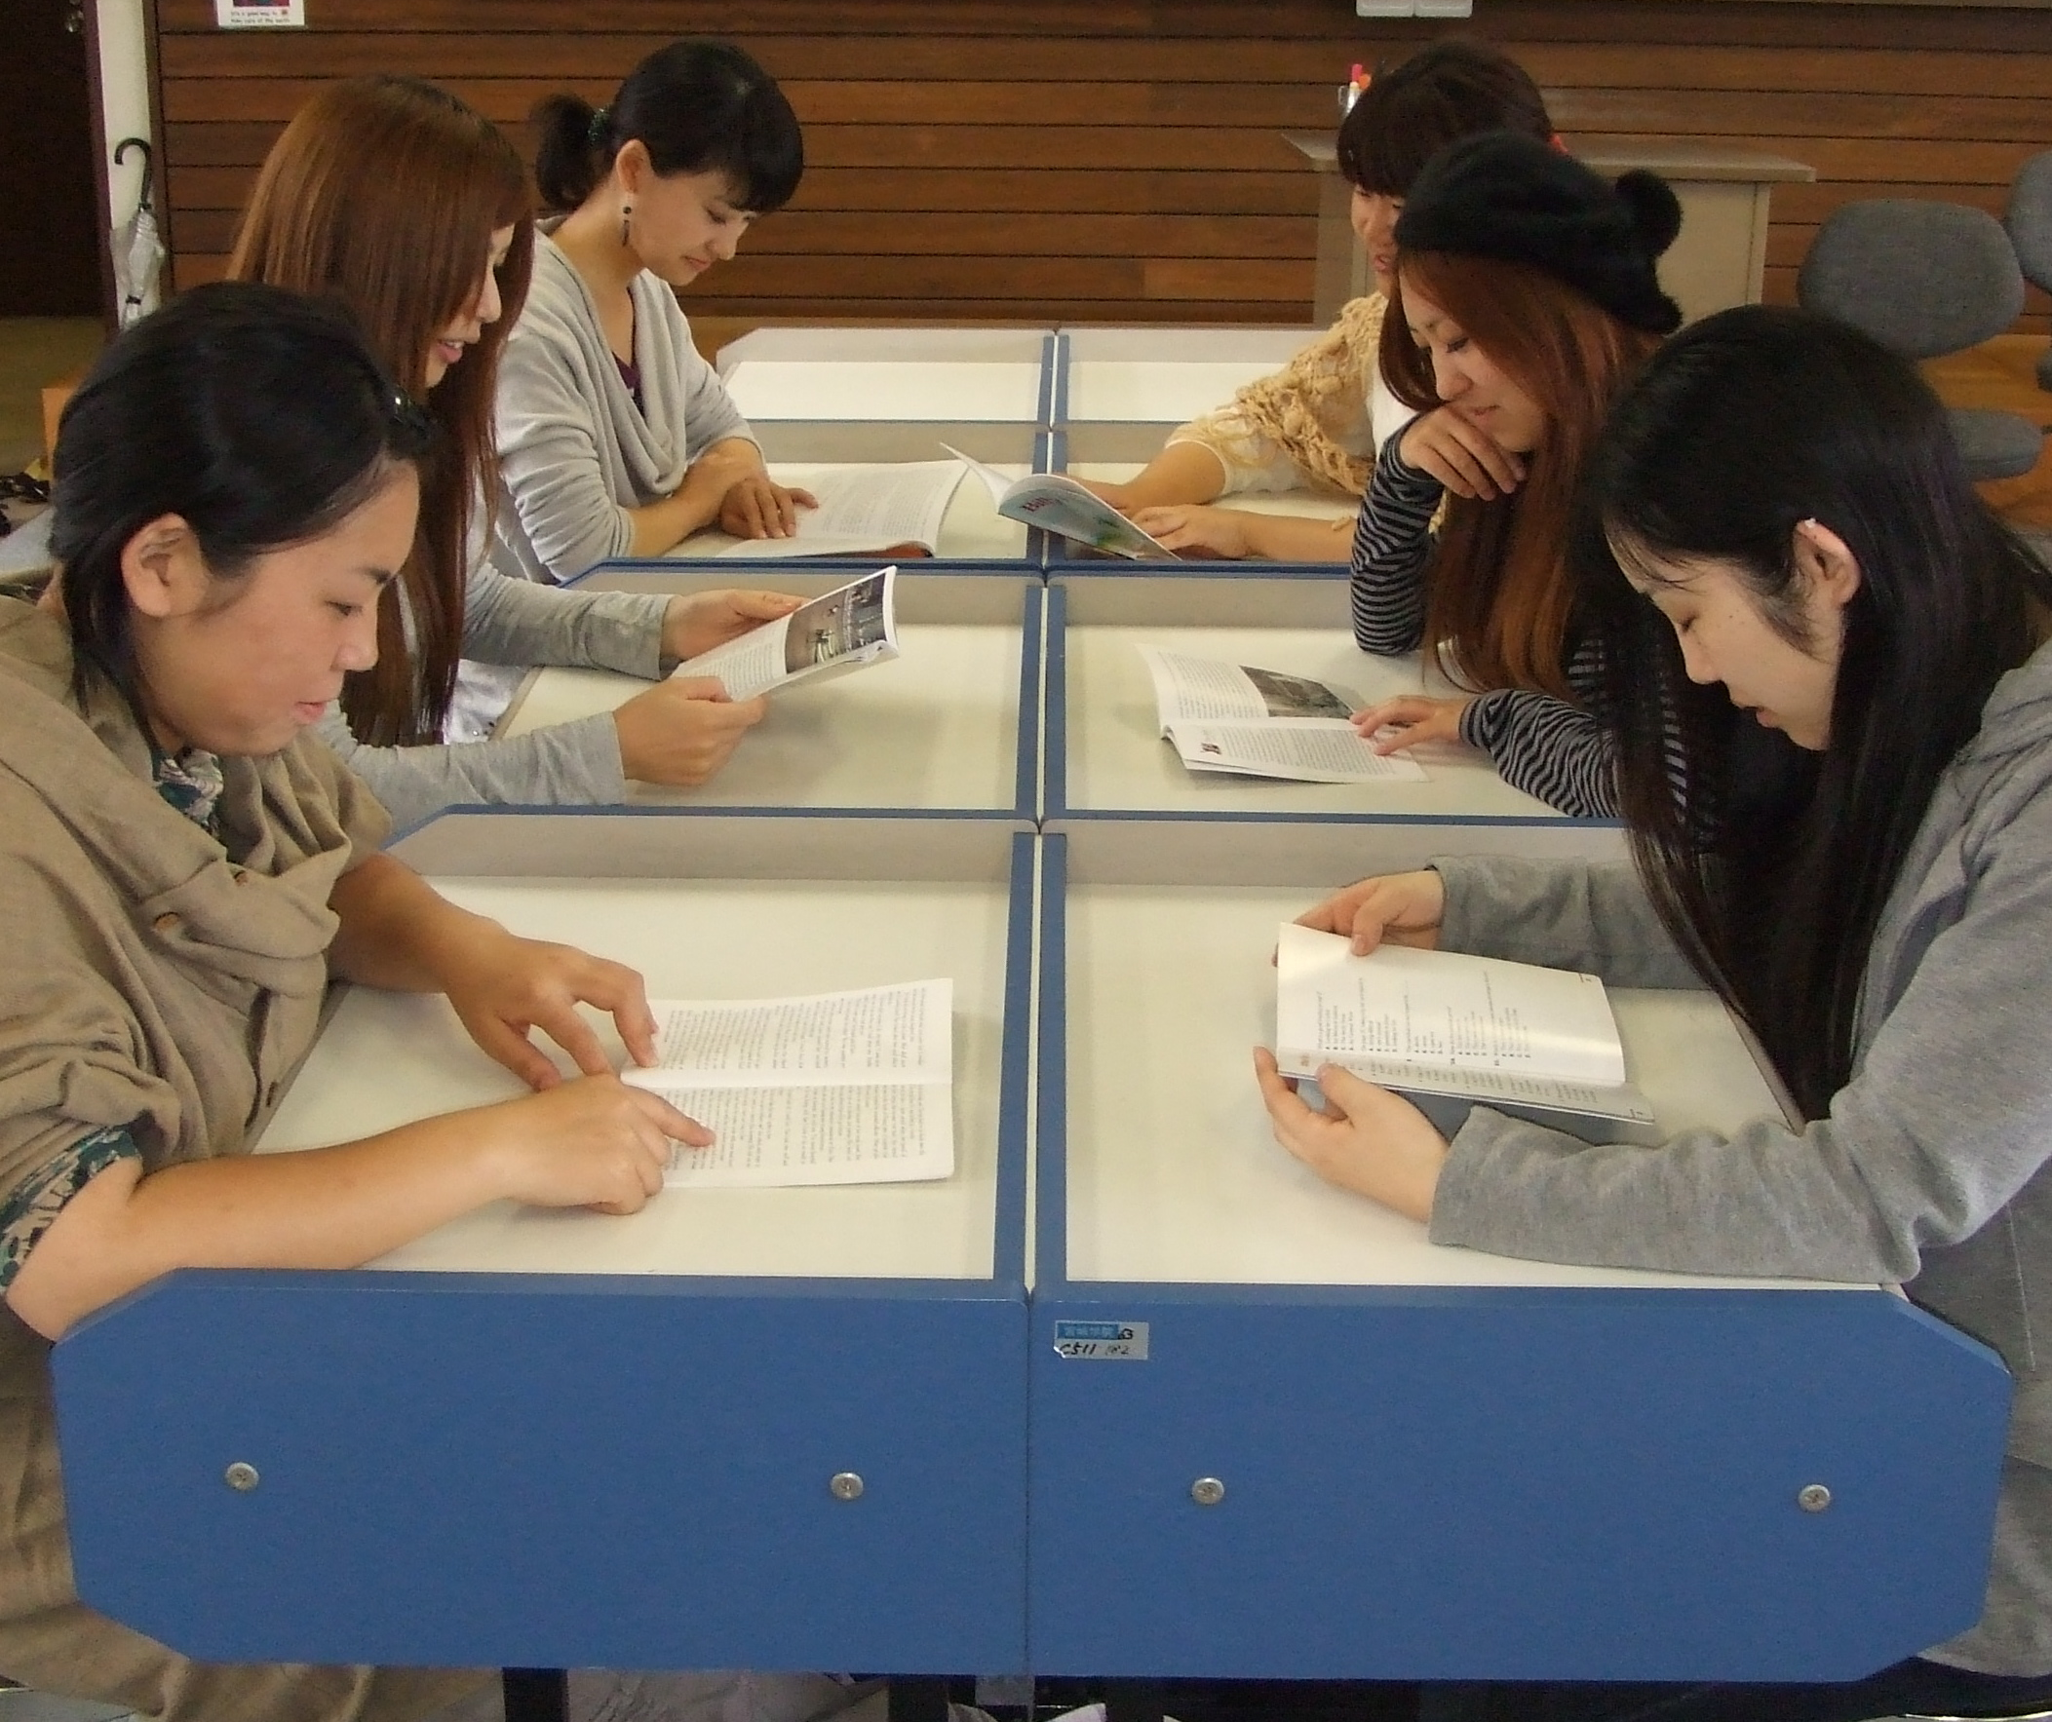
SSR
Sustained
Silent
Reading
(You too.)
Notes:
10-15 minutes of class time
Values reading
Practical thing – they bring books
Classroom management-
Unless you teach kids,

Slide 80
SSR
Sit
Still &
Read
Notes:
Unless you teach kids,

Slide 82
Instant book report
I read (am reading) a book called ____.
It's a(n) _______________
(mystery, science fiction book,
love story, detective story, etc.)
It's about ______________.
The main characters are ____________.
(names, jobs, personalities)
In the story, there was a problem. ____.
 I liked/didn't like it because _______.
Notes:
THEY DO

Slide 83
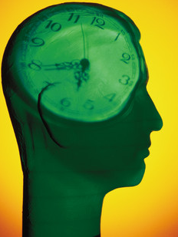
Think
time
Think
time
Thni
What do I
want to say?
How will I
say it?

Slide 84
Instant book report
I read (am reading) a book called ____.
It's a(n) _______________
(mystery, science fiction book,
love story, detective story, etc.)
It's about ______________.
The main characters are ____________.
(names, jobs, personalities)
In the story, there was a problem. ____.
 I liked/didn't like it because _______.
Notes:
THEY DO
1 minute- change

Slide 85
Show a picture
Explain it.
Partners, ask (5)question.
Notes:
Change partnersTHEY DO

Slide 86
My top five
 What are the five best books you read this term/year? Why?
Notes:
Actually do (about 1)
1 good book you’ve read this year/ recently.
Why was it good. As you talk, notice how you are thinking about the book.

Slide 87
Notes:
Idea from TOM FERRELL Poster, casting/ explain why
Doesn’t have to be movie tie-in. Any book/
If already movie – do as a Japanese version
Honor- Students casts you as Romeo against her Juliet (vis versa).
^^ You mean – we’re gonna die?
Could be worse. Could cast you as Babe. Or Jaws.

Slide 88
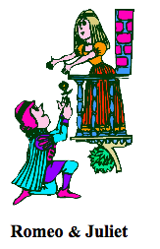
Notes:
you as Romeo against her Juliet (vis versa).
^^ You mean – we’re gonna die?
Could be worse. Could cast you as Babe. Or Jaws.

Slide 89
Reading notebooks

Slide 90
Reading for pleasure
Reaction Report - Basic
Include:
• what the book was about
• what you thought of it)
What happened?
------------------
Your opinion:
Write quickly.
10 minutes or less.
Good ☺ p Average 😐 p Poor ☹
Good ☺ p Average 😐 p Poor ☹
Notes:
ER is a new idea for most Ss (used to intensive/ yakudoku/ read & translate).
Nothing wrong with staring reports where they expect. NOTICE: YOUR OPINION! -- APPRECIATIO

Slide 91
Reading for pleasure
Reaction Report – Draw a picture
1. Draw a picture of a scene from the story. Don’t copy a picture. Draw one from your imagination.
------------------
2. Explain your picture. What is happening? What happened before this picture? What happened next?
3. Your opinion. What did you think of the book?
Good ☺ p Average 😐 p Poor ☹
Notes:
Dornyei and others point out: doing the same thing sucks
The motivation out of any class. (habituation)
Late May/ early June
Multiple intelligences: artistic knowledge,
kinesthetic (folks who draw)

Slide 92
Reaction Report - Your own questions
Before you read. Look through the book.
Find 3 pictures. Write a different question about each. Write 3 questions.)
• page Q1:
• page Q2:
After you read, answer your questions
Reaction Report: What was the book about?
What happened?
------------------
Your opinion:
Good ☺ p Average 😐 p Poor ☹
Notes:
Teaches previewing (schema activation)
Japanese false beginners.
Logical/mathmatical knowledge.

Slide 93
Reaction Report - The story and you
Think about the story. What happened?
What was the same as your life?
Your character? Your dreams? What is different?.
The story. My life.
------------------
Your opinion:
Good ☺ p Average 😐 p Poor ☹
Notes:
Mtpl: intrapersonal knowledge (know thyself)
Gulliver: I’ve never been around little people (yochien?)
Diana: she knew tradegy. So do I. last year my father died of cancer.

Slide 94
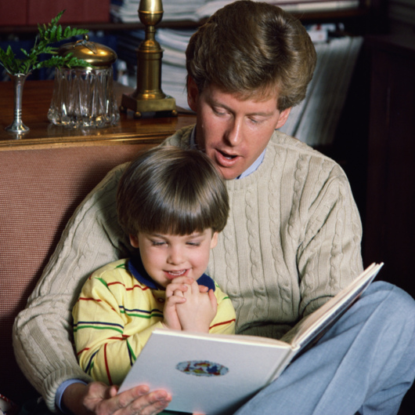
How did you learn to read?
Notes:
Mama & papa & teachers
reading to you.

Slide 95
Extensive Reading
& Listening
Use the
CD/Mp3

Slide 96
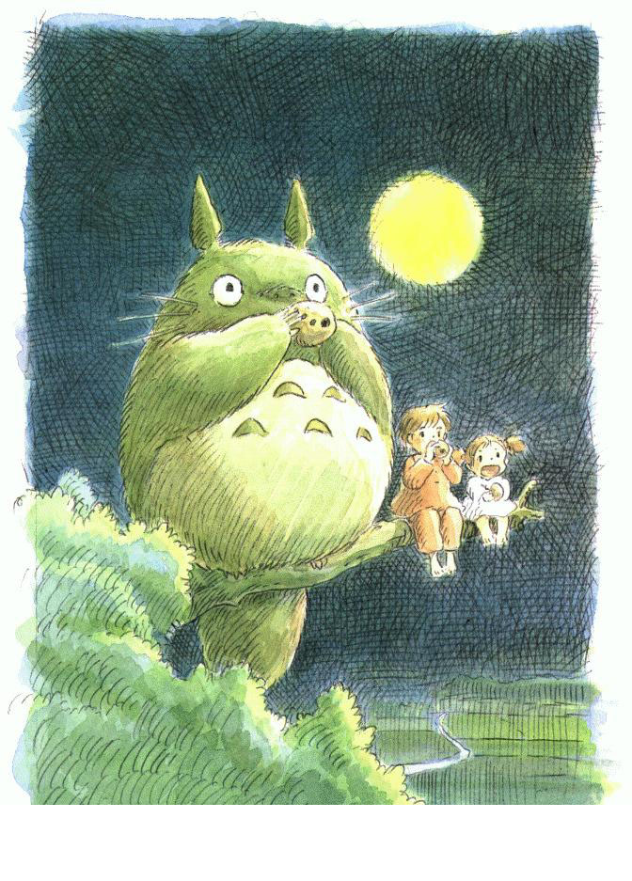
Extensive Reading
& Listening
DVDs
English with
English subtitles

Slide 97
Extensive Reading
& Listening

Slide 98
Extensive Reading
& Listening
on the web

Slide 99
Music videos
Youtube: lyrics
Notes:
Two windows: One for video
One for lyrics
Also, English Karaoke
Youtube.com: music english subtitles

Slide 101
Music:videos & Google:
“song title” lyrics
Notes:
Two windows: One for video
One for lyrics
Also, English Karaoke
Youtube.com: music english subtitles

Slide 103
Podcasts:
a4esl.org
Notes:
Means “activities for esl” 20 new podcasts. Also voice of America

Slide 104
Extensive Reading
& Listening
Use the
CD/Mp3
Notes:
In the library. Vinyl packs.
Some books tell you the website for the mp3 file

Slide 105
Sakai-sensei’s 3 Rules
1. No dictionaries
2. If you don’t know a word, ignore it
3. If it’s boring, stop reading
Sakai Kunihiro
Denki Tsushin Univ., Tokyo
Notes:
Kunihiro Sakai Denki Thsushin University, Tokyo. Famous reading teacher

Slide 106
1. No dictionaries
They cause frustration
They don’t help you remember
Choose books you can enjoy without a dictionary!
Notes:
Thank might be too strict. Don’t over use. But…

Slide 107
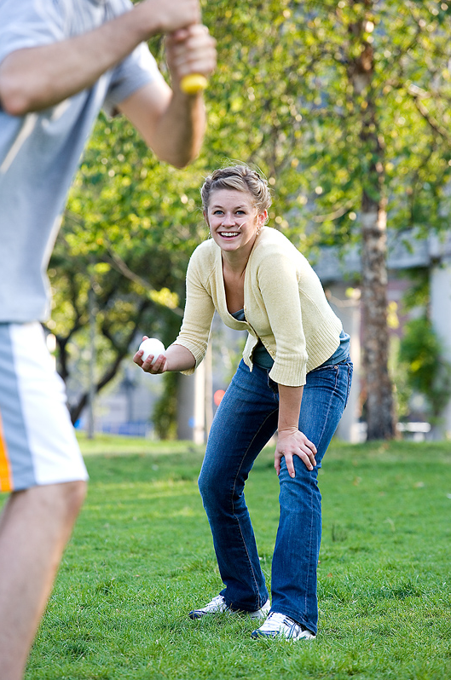
The baseball rule
Strike #1.
Don’t worry.
Just skip it.
Notes:
Thank might be too strict. Don’t over use. But maybe use the baseball rule.

Slide 108
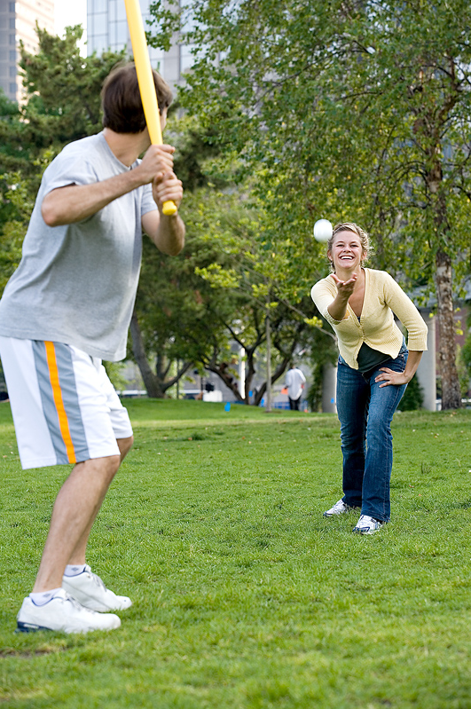
The baseball rule
Strike #2.
Guess.
Notes:
Look at the words around it. Maybe it means…

Slide 109
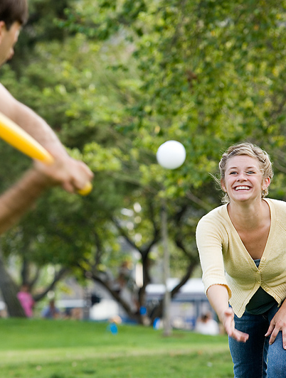
The baseball rule
Strike #3.
Look it up in
your dictionary.
Notes:
Meet it a 3rd time, still don’t know. Go ahead and look it up.

Slide 110
2. If you don’t know a word, ignore it!
Concentrate on what you DO know
Read faster, and read more
Choose books you can enjoy skipping through!

Slide 111
3. If it’s boring, stop reading
Don’t try too hard
There are many other books.
Stop reading.
Chose a different book.

Slide 112
Why ER?
Research is clear.
Statistics are convincing.
Methodology is valid.

Slide 113
Research is clear.
Statistics are convincing.
Methodology is valid.
But most of us don’t teach
research, statistics or methodology

Slide 114
We teach people.

Slide 115
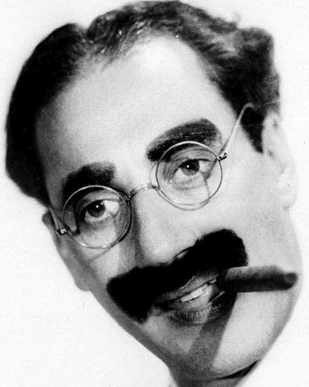
Outside of a dog, a book
is man’s best friend.
a person’s
Inside a dog,
It’s too dark to read
- Groucho Marx

Slide 116
Thank you.

Slide 118
These are extra slides I use in other versions of this workshop.ß If you are working with a non-Japanese group, you may want to replace the long word-by-word sentence with the English one in this set.

Slide 119
Extensive Reading
& Listening
Dramatic
reading
Notes:
1st by teacher,
Then S→ S

Slide 120
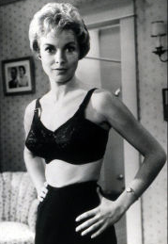
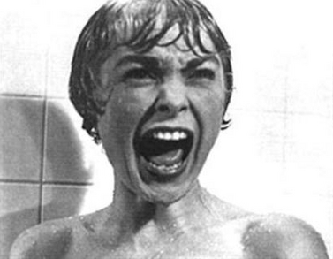
Notes:
Background:
Hitchcock: color/vs. BW
Marion Crane, steals money. Feeling bad.
In class, copies for Ss to follow along
You may want to close your eyes, imagine

Slide 121
Extensive Reading
& Listening
Dramatic
reading
Notes:
1st by teacher,
Then S→ S

Slide 122
When

Slide 123
you

Slide 124
read

Slide 125
slowly,

Slide 126
one

Slide 127
word

Slide 128
at

Slide 129
a

Slide 130
time,

Slide 131
as

Slide 132
you

Slide 133
are

Slide 134
doing

Slide 135
now,

Slide 136
it

Slide 137
is

Slide 138
easy

Slide 139
to

Slide 140
understand

Slide 141
the

Slide 142
meaning

Slide 143
of

Slide 144
each

Slide 145
word,

Slide 146
but

Slide 147
it

Slide 148
is

Slide 149
very

Slide 150
difficult

Slide 151
to

Slide 152
understand

Slide 153
the

Slide 154
real

Slide 155
meaning

Slide 156
of

Slide 157
the

Slide 158
text.

Slide 159
Notes:
It’s by Tom Robbins – the famous novelist (Even cowgirls get the blues).
It’s a …. (gee, what kind of book). I could say “humorous fantasy” (at one point, when Robbins introduces the “beer fairy”, well that’s fantasy (as far as I know)
But, as Robbins says, “A children’s book for grown-ups/ A grown-up book for Children.
The main character is Gracie. She’s a 5-year-old girl (almost 6).
She’s interested in why her dad and her uncle Moe drink that yellow stuff every night.
Dad has no interest in her questions.
Uncle Moe, -- happy to explain. Things you and I probably didn’t know.
The Hops – they only use the female part of the flowers. Uncle Moe speculates that’s why guys like it so much.
And ancient Egyptians made beer.
In the story there was a problem. (many actually. That’s the point).
For example, In Sunday school, Gracie’s teacher asked, “Why were the Egyptians so mean to the Israelites?” Gracie’s answer: Maybe they didn’t want to share their beer.
Not sure I’d use this story as an “Instant book report” example (probably would). But 2 points:
Think time. & the support of the structure.

