Slide 1
This presentation is © 2018 Marc Helgesen. Previous versions are © 2006- 2018 Marc Helgesen. All rights reserved. It may be used by teachers with their students. It by NOT be used for teacher training in commercial ways without the specific permission of Marc Helgesen. Any such use is illegal, a copyright violation and unethical. marchelgesen@gmail.com Most of the photographs are © clipart.com. They are used under license.

Slide 2
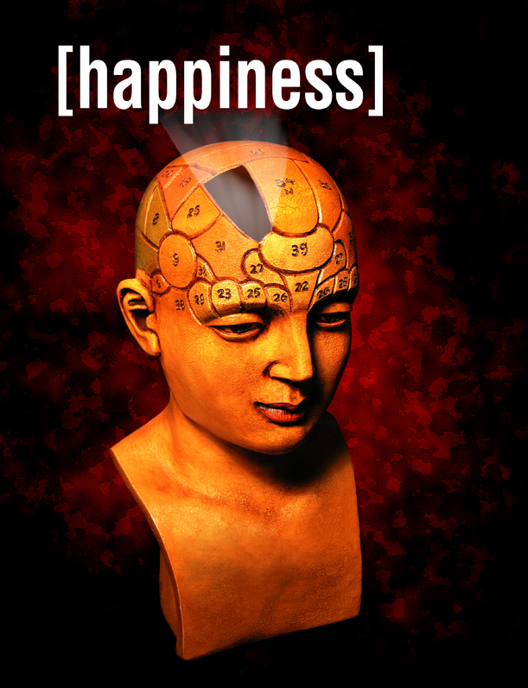
io
S
ELT & the science of
Marc Helgesen
November 2016
Notes:
B4 check – dancing bear/ laugh / timer
Excited, delighted.
Who are you?
Postive psychology

Slide 3
S
ELT & the science of
Positive
psychology
in the
language classroom
Notes:
Excited, delighted.
Who are you?
1st part: What is Positive psychology
2nd part: How connect that to ELT – also language and cross cultural connections.
Then a break and “Happiness 2.0”
You may think: Wait. Have to teach speaking, listening, reading, and writing? Now I’m responsible for happiness.
Not really. It can be a tool. But any teaching… (next slide)

Slide 4
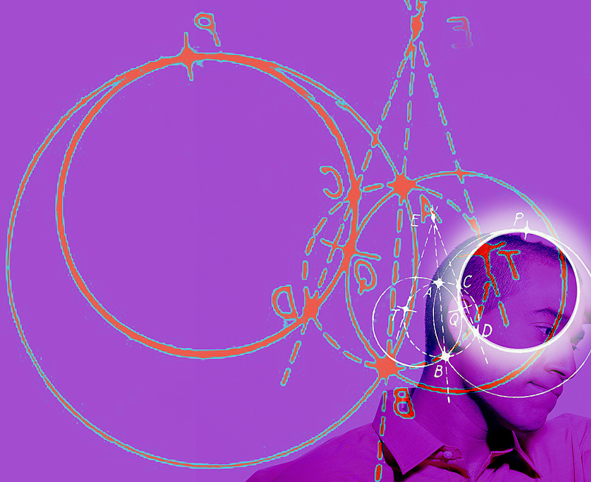
Educational
psychology
Notes:
Share some insight from positive psychology and can inform our teaching.
Start: how does happiness work?

Slide 5
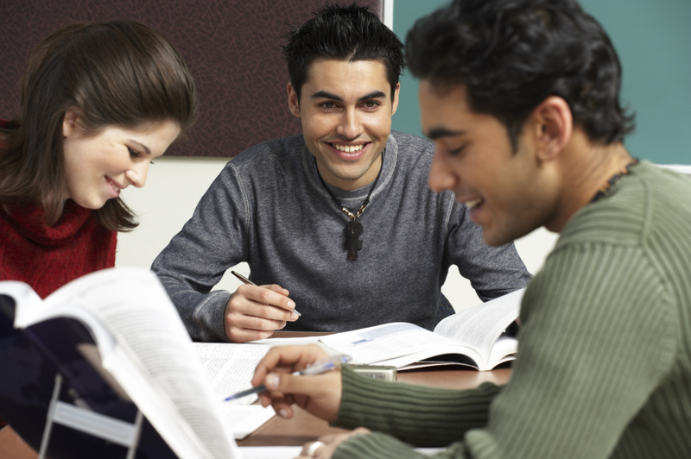
Happy students
Learn more
Work longer
More enthusiasm
http://www.centreforconfidence.co.uk/pp/overview.php?p=c2lkPTImdGlkPTAmaWQ9NA==
http://www.theage.com.au/ Don’t worry, be happy. May 8, 2006
Notes:
Learn more
Work longer at problem solving
Approach tasks with more enthusiasm.
http://www.centreforconfidence.co.uk/pp/overview.php?p=c2lkPTImdGlkPTAmaWQ9NA==
http://www.theage.com.au/ Don’t worry, be happy. May 8, 2006

Slide 6
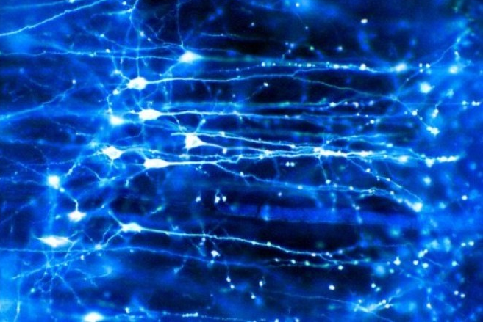
seritonin
Learning centers
Achor 2010
Notes:
Brain is full of chemical – serotonin, enDORFin, dopamine

Slide 7
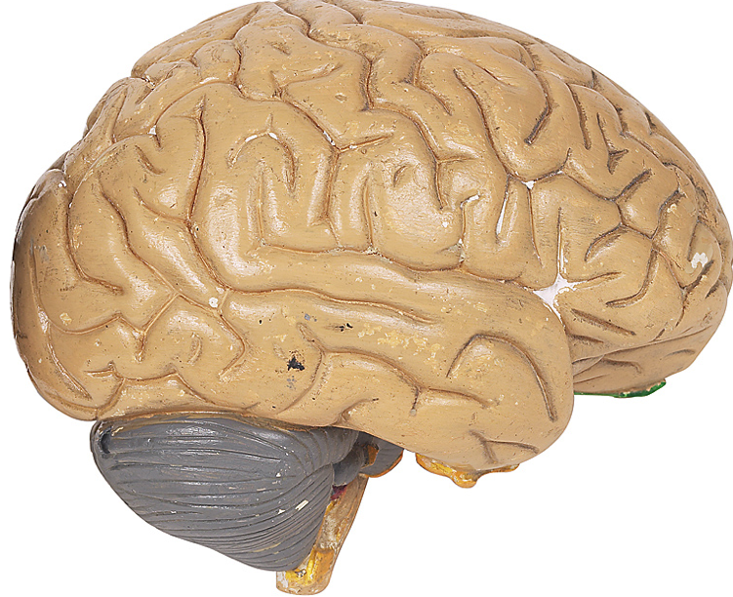
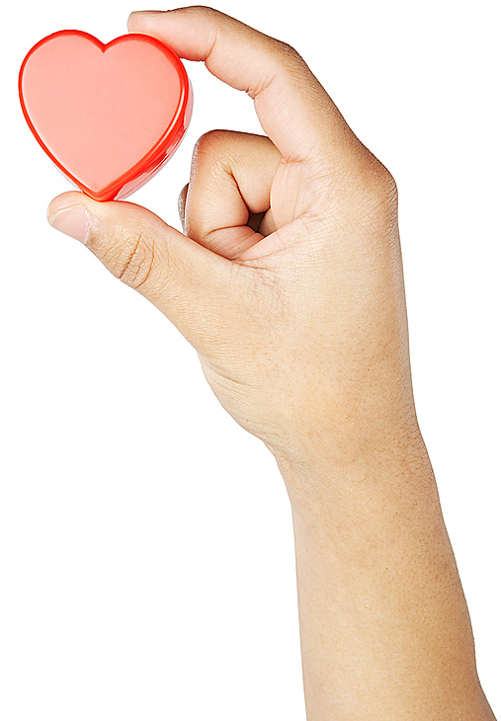
How does
happiness work?
Notes:
50% set point. Goes up/down, comes back. Mpls twins studies
10% - circumstances.
40% - intentional activity – our decisions.
40% --

Slide 8
Set point
50%ß
Notes:
Set point. Not about tennis.
Up and down, come back.
Like dieting.

Slide 9
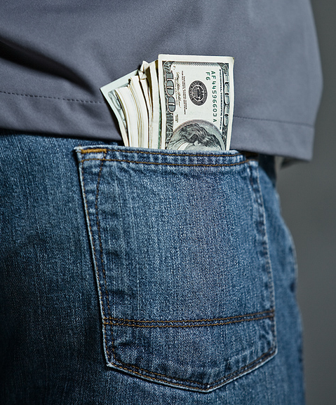
Circumstances
Notes:
Set point. Up and down, come back.

Slide 10
Circumstances
gender
occupation
age
income
home
Marital status
Sickness/
health
where you live
where you grew up
personal history
family history
The slings and arrows of outrageous fortune

Slide 11
Circumstances
10%
Notes:
Set point. Up and down, come back.

Slide 12
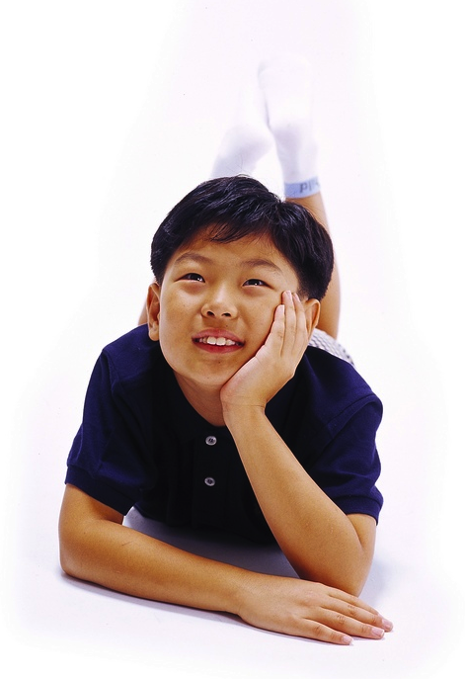
Intentional activity
40%
Notes:
Set point. Up and down, come back.

Slide 13
Intentional activity
40% vs. 10%
What we do is 4 times more
important
than our circumstances.
(400% more!)

Slide 14
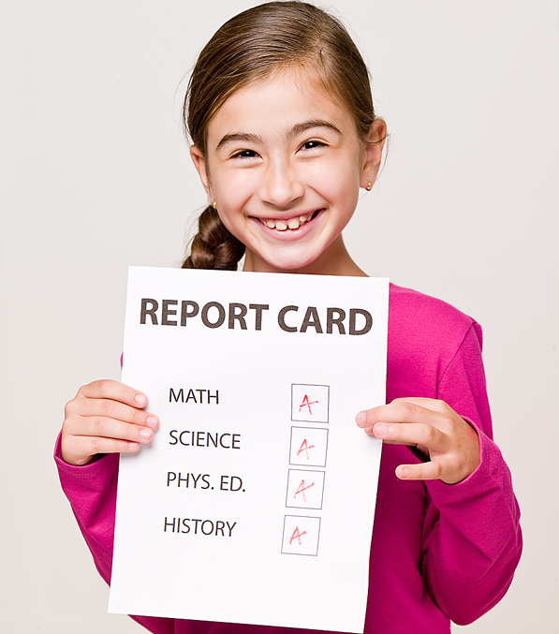
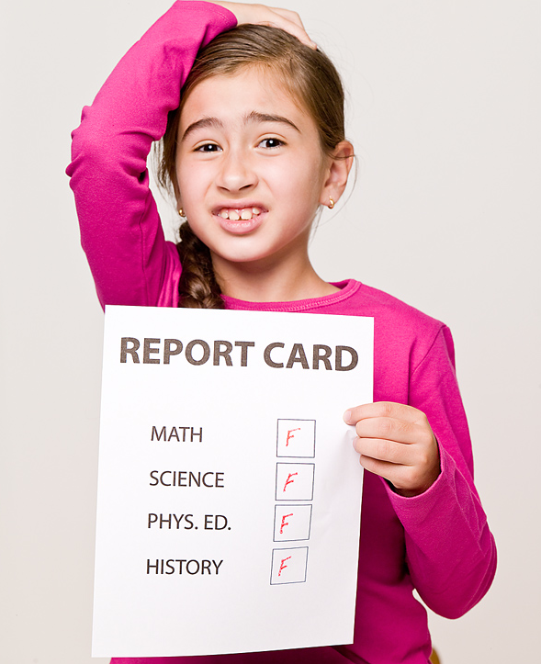
Intentional Activity = 40%
In teaching, the difference between
99%
A
59%
F
Notes:
In Teaching Terms: Difference between 100% and 60%. Or even…

Slide 15
What is Positive
Psychology?
S
Notes:
Positive psychology

Slide 16
Traditional psychology
S
Mental
illness
Notes:
Mental illness
Important : depression (ustsu byo), mental disease

Slide 17
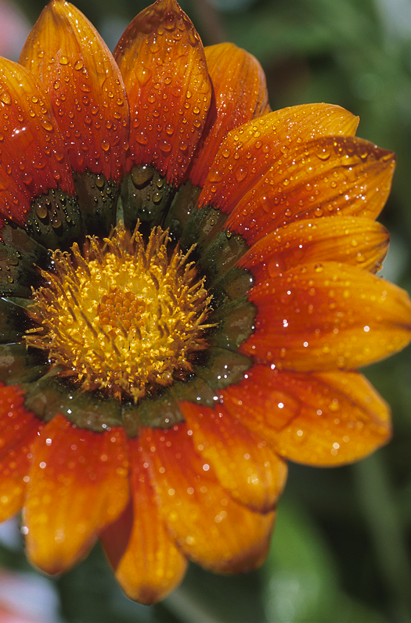
Positive psychology
S
Mental
illness
Mental
health
Notes:
Positive psychology

Slide 18
Why part of ELT?
Doesn’t have to be.
Not like vocabulary / grammar/ functions/
reading/ speaking/ etc.

Slide 19
Why part of ELT?
Any teaching
includes
educational
psychology

Slide 20
Happy students
Learn more
Work longer
More enthusiasm
http://www.centreforconfidence.co.uk/pp/overview.php?p=c2lkPTImdGlkPTAmaWQ9NA==
http://www.theage.com.au/ Don’t worry, be happy. May 8, 2006
Notes:
Learn more
Work longer at problem solving
Approach tasks with more enthusiasm.
http://www.centreforconfidence.co.uk/pp/overview.php?p=c2lkPTImdGlkPTAmaWQ9NA==
http://www.theage.com.au/ Don’t worry, be happy. May 8, 2006

Slide 21
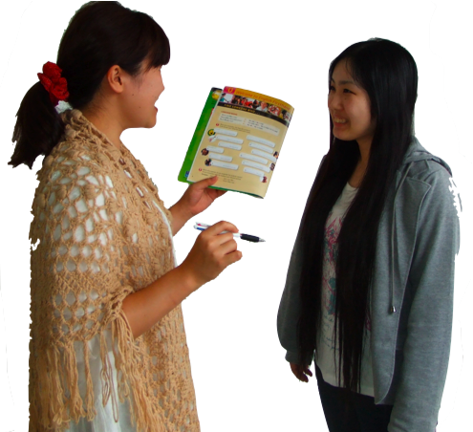
Why part of ELT?
Engaging, personalized,
multi-sensory
activities
Notes:
Engaging activities. Engagement can lead to flow. Involvement, investment.

Slide 22
Engaging, personalized, multi-sensory activities
Storm & Tecott 2005) in Willis in Sousa, 2010
Notes:
Engaging activities. Engagement can lead to flow. Involvement, investment.
Storm & Tecott 2005) in Willis in Sousa, 2010

Slide 23
Engaging activities
Focus,
memory,
motivation
Storm & Tecott 2005) in Willis in Sousa, 2010
Notes:
Dopamine ---
Engaging activities. Engagement can lead to flow. Involvement, investment.
Storm & Tecott 2005) in Willis in Sousa, 2010

Slide 24
Why part of ELT?
The “education
pressure cooker”
Notes:
For many students: educational pressure-cooker. Positive self-esteem/ positive self-regard often missing.

Slide 25
Why part of ELT?
We don’t just teach English.
We teach people.
Humanistic Language Teaching

Slide 26
Why part of ELT?
Not magic answer
& the keys
to English
Notes:
Not Harry Potter and the Keys to English

Slide 27
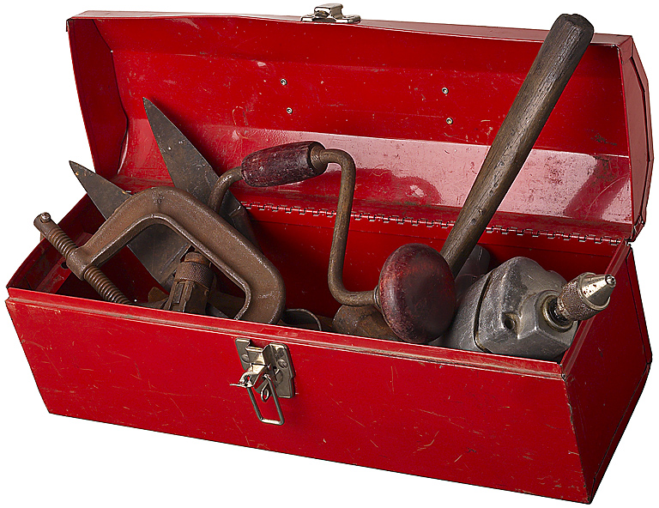
Why part of ELT?
Set of tools
The more tools we have,
the better our work.

Slide 28
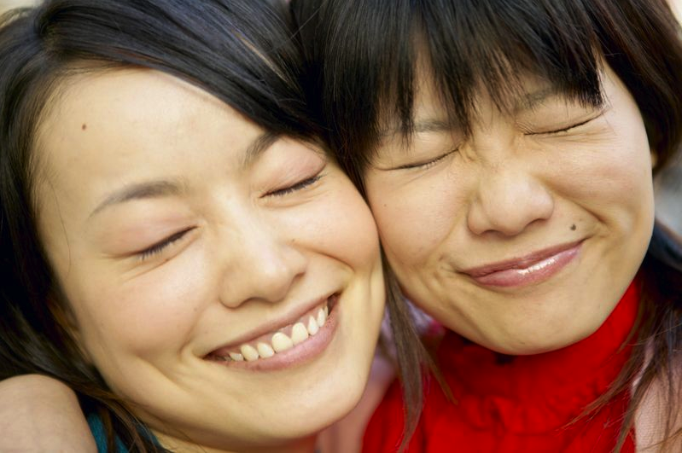
Positive psychology is about finding out what happy, mentally healthy people do.
Notes:
Behaviorally, cognitively

Slide 29
How to we get the information to our students?
Scientists know.
l
☺

Slide 30
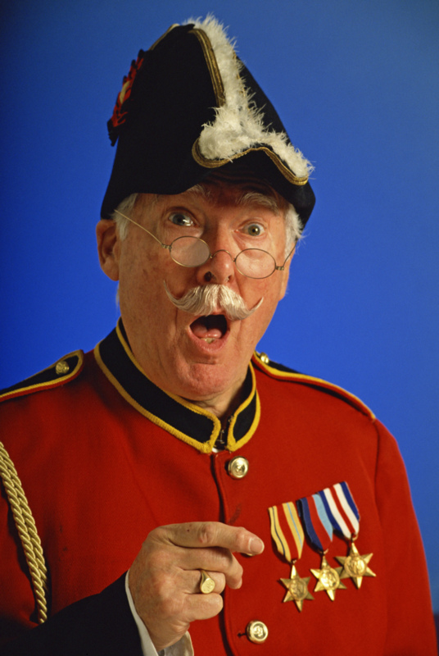
Dictation
If you use
dictation,
does that make
you a dictator?

Slide 31
Dictation
What number?
What’s your sentence?
Write it.
Notes:
Do #1 as example
Remember good things in your life

Slide 32
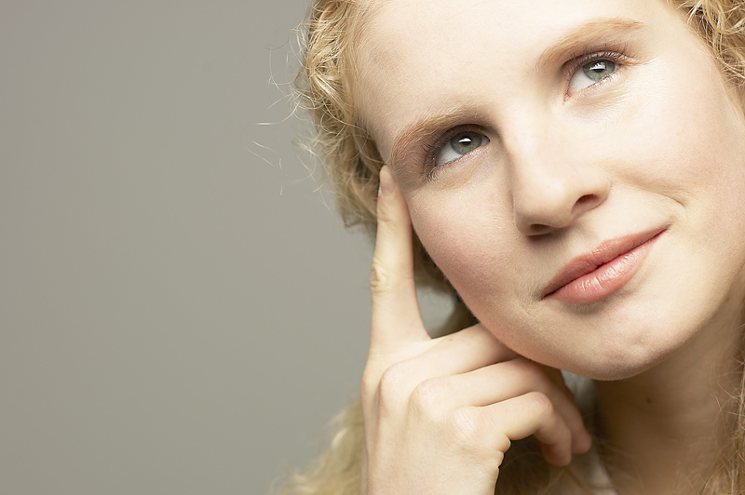
Remember
good things
Notes:
Count your blessings

Slide 33
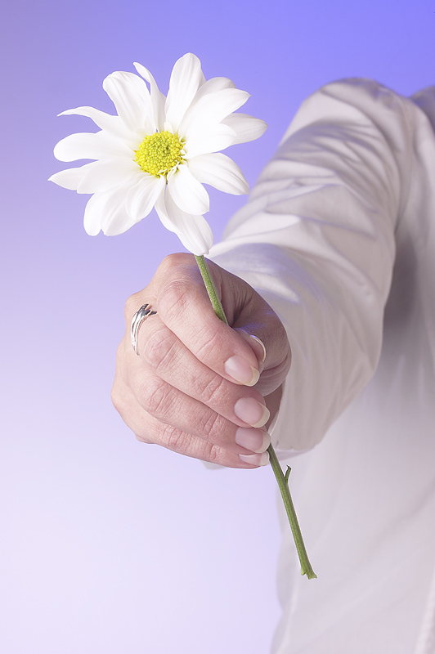
Say,
“thank you.”

Slide 34
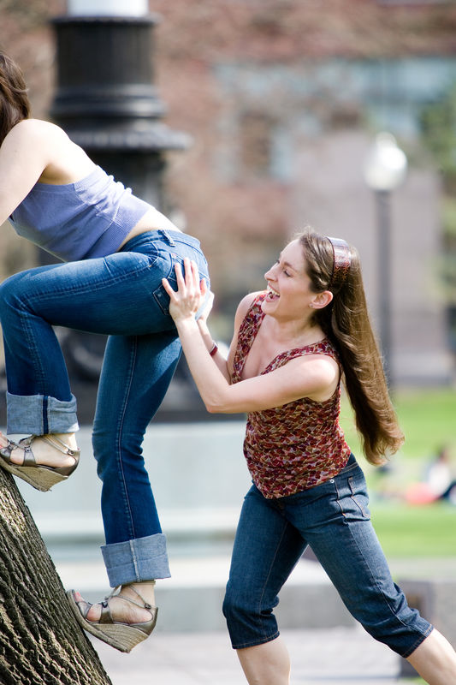
Do kind things

Slide 35
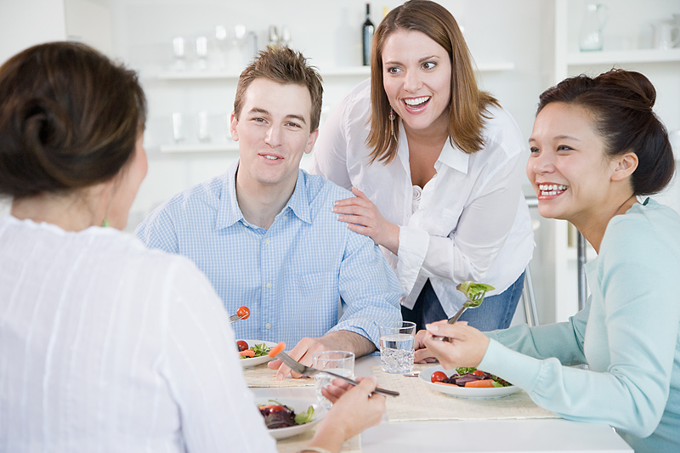
Friends & family
Notes:
Take time for family and friends.

Slide 36
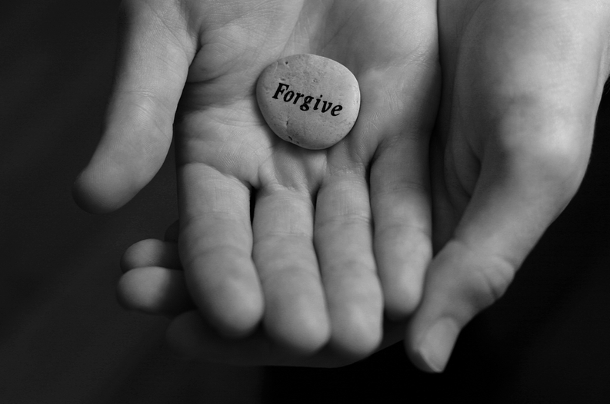
Forgive
Forgive
Notes:
Forgive others. Forgive yourself.

Slide 37
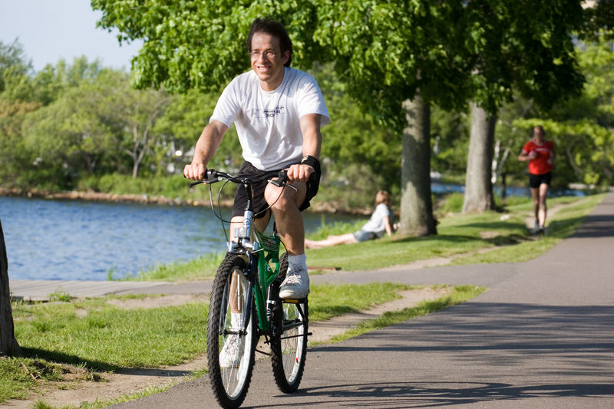
Stay healthy
Notes:
Stay healthy. Take care of your health and body.

Slide 38
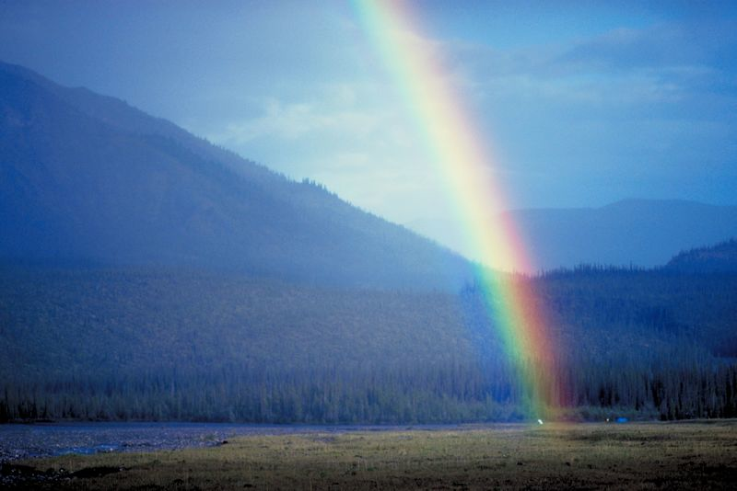
Notice good things
Notes:
This is different than remember. This is real time. English teacher: Remembering is past tense. This is present, present simple, present continuous. RIGHT Now

Slide 39
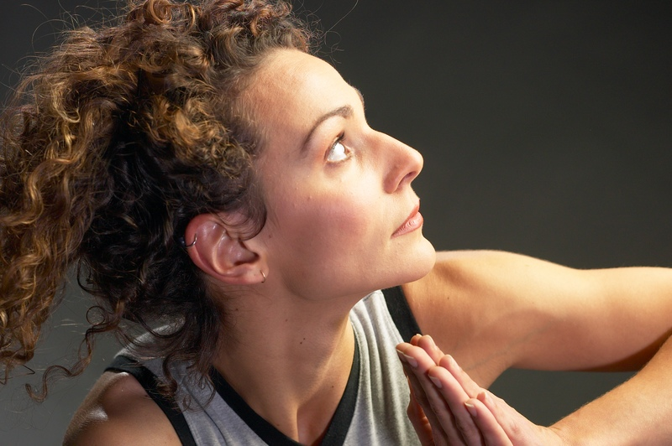
Deal
with problems
Notes:
Happy people, when they run into negative experiences, know they will pass.

Slide 40
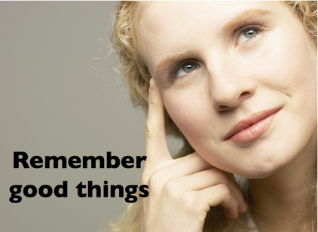
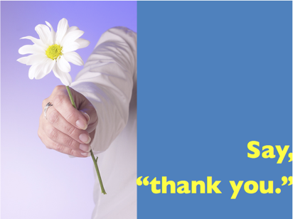
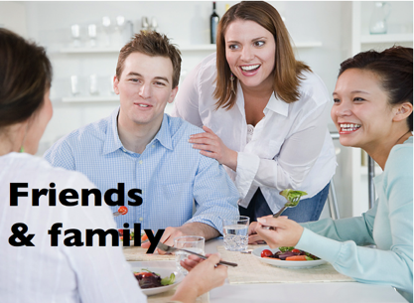
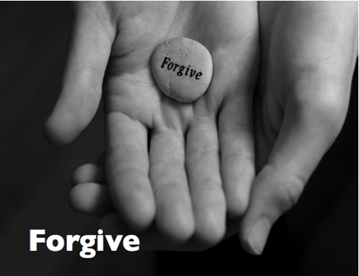
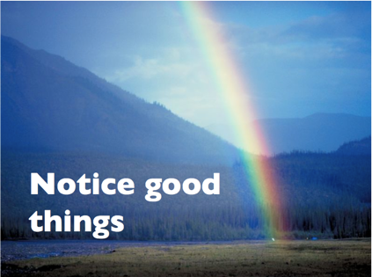
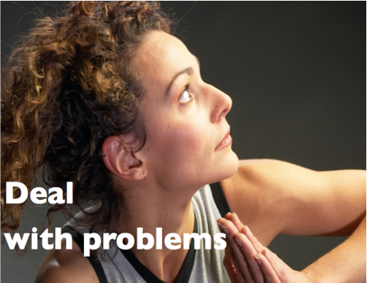
Topics
To be
happy
Grammar
Functions
Sonja Lyubomirsky, UC Riverside

Slide 41
.com
Notes:
Next, how to introduce those
8 ideas into the elt classroom
You don’t have to remember. Download

Slide 42
.com
Notes:
Next, how to introduce those
8 ideas into the elt classroom
You don’t have to remember. Download

Slide 43
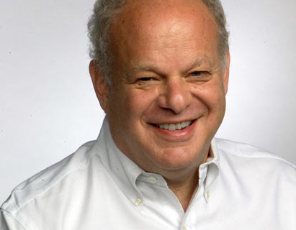
PERMA

Slide 44
P
E
R
M
A
ositive Emotion
ngagement
elationships
eaning
ccomplishment
Notes:
Wellbeing 2.0

Slide 45
Flourish
P
E
R
M
A
ositive Emotion
ngagement
elationships
eaning
ccomplishment
Notes:
Wellbeing 2.0

Slide 46
Flourish
P
E
R
M
A
ositive Emotion
Notes:
Wellbeing 2.0

Slide 48
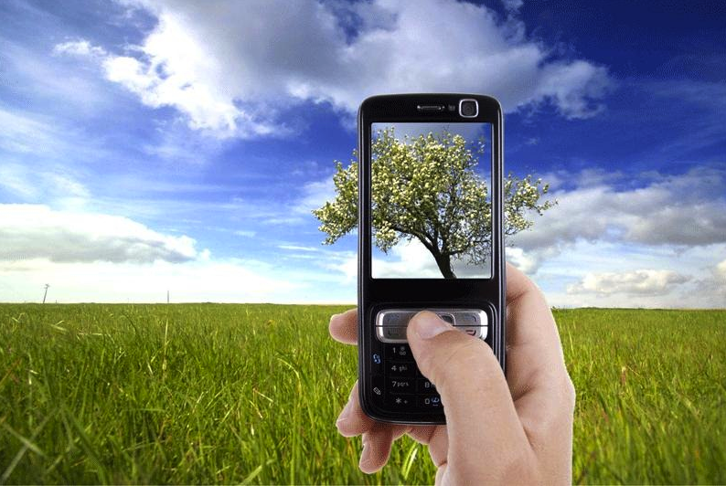
X¹
X
5 pictures: Good things
in Marc’s life
Notes:
What would your pictures be?
Photo credit:http://propakistani.pk/2012/07/26/how-to-check-if-your-cell-phone-pictures-are-being-monitored/

Slide 49
BBQ

Slide 50
’
Discourse strategy
Keep the conversation going
Notes:
“Active – Constructive” responses – They help the partner mentally recreate the emotion
-- good psychologically
-- good conversation strategy

Slide 51
’
Active Constructive
Responses
Notes:
“Active – Constructive” responses – They help the partner mentally recreate the emotion
-- good psychologically
-- good conversation strategy

Slide 52
’
Your partner got a job promotion.
Active
Constructive
Wow. Great.
Tell me all
about it.
Passive
Constructive
Wow. Great.
That’s nice.
Active Destructive
Oh. Now you are
going to be even
busier than now.
Passive Destructive
That’s nice.
What’s for dinner?
Notes:
“Active – Constructive” responses – They help the partner mentally recreate the emotion
-- good psychologically
-- good conversation strategy
Promotion - Active constructive – Wow. Tell me all about it.
Passive constructive – That’s nice.
Passive destructive – That’s nice. What’s for dinner.
Active destructive – Oh great. Now you’re going to be even busier.

Slide 54
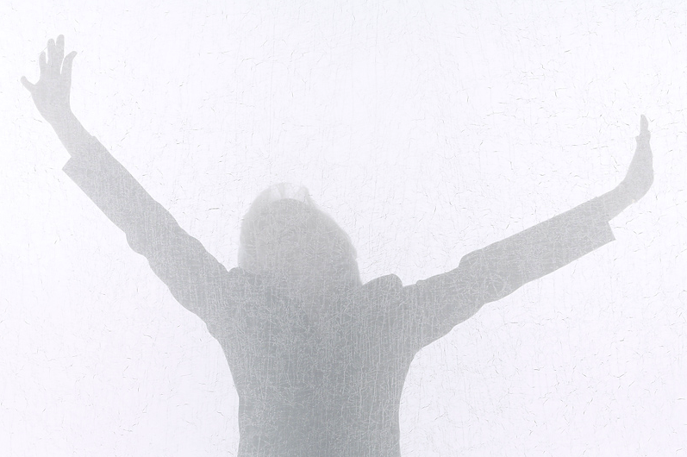
Positive
Emotion
classroom
connect to language
Notes:
Happiness activities –
Easy to do in the classroom
Easy to connect to language – vocabulary, grammar, language functions.

Slide 55
Flourish
P
E
R
M
A
ngagement
Notes:
Wellbeing 2.0

Slide 56
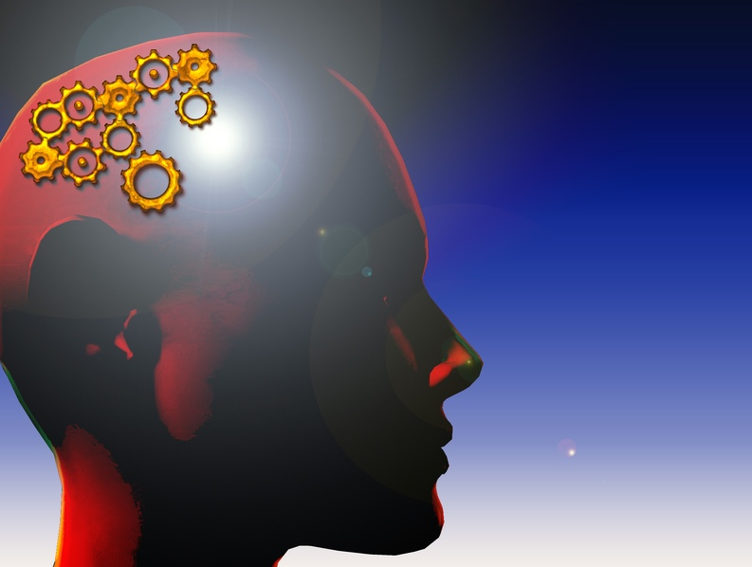
Engagement
Notes:
Engagement – getting student, not just studying English, but really involved. Really USING English.

Slide 57
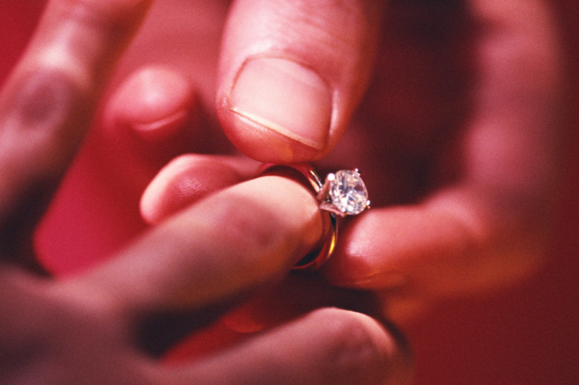
Engagement
Notes:
Engagement – konyaku? No, different meaning.
Although similar – there’s involvment, commitment, I feels really good, and there is PASSION

Slide 58
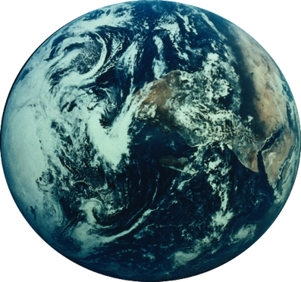
Thank you to the world
 How many languages
can you say “thank you” in?
• Why do you want to say
thank you to each country/language?
Notes:
Shu-kri-yaa

Slide 59
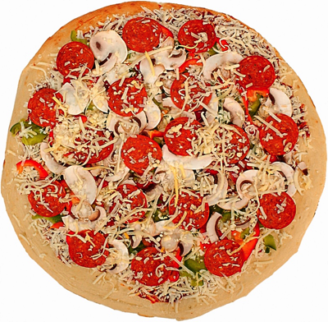
Thank you to the world
• Why do you want to say
thank you to each country/language?
I want to say “grazie” to Italy.
They gave the world some
great art.
And pizza.
Notes:
Shu-kri-yaa

Slide 60
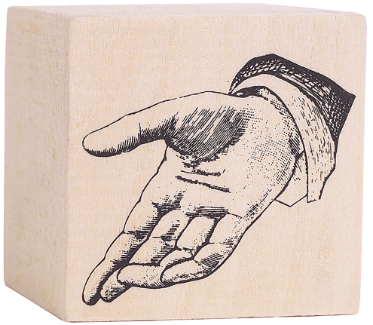
Thank you to the world
I want to say
“ ”
to Vietnam for…
Cám ơn!
Notes:
Gam un/ (“un” rhymes with “sun”

Slide 61
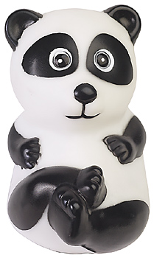
Thank you to the world
I want to say
“ ”
to China for…
谢谢
Notes:
She-she (xi-xi

Slide 62
Thank you to the world
I want to say
“ ”
to (country) for…
Notes:
Gahnsabnida

Slide 63
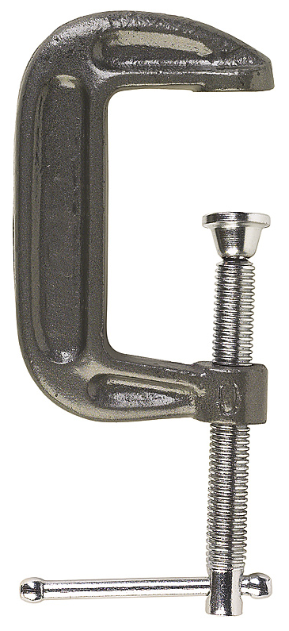
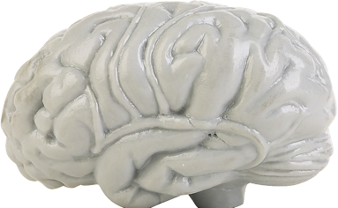
challenge
difficulty
Notes:
Drill --- easier harder

Slide 64
I wanna be a schwa.
It’s never stressed.

Slide 65
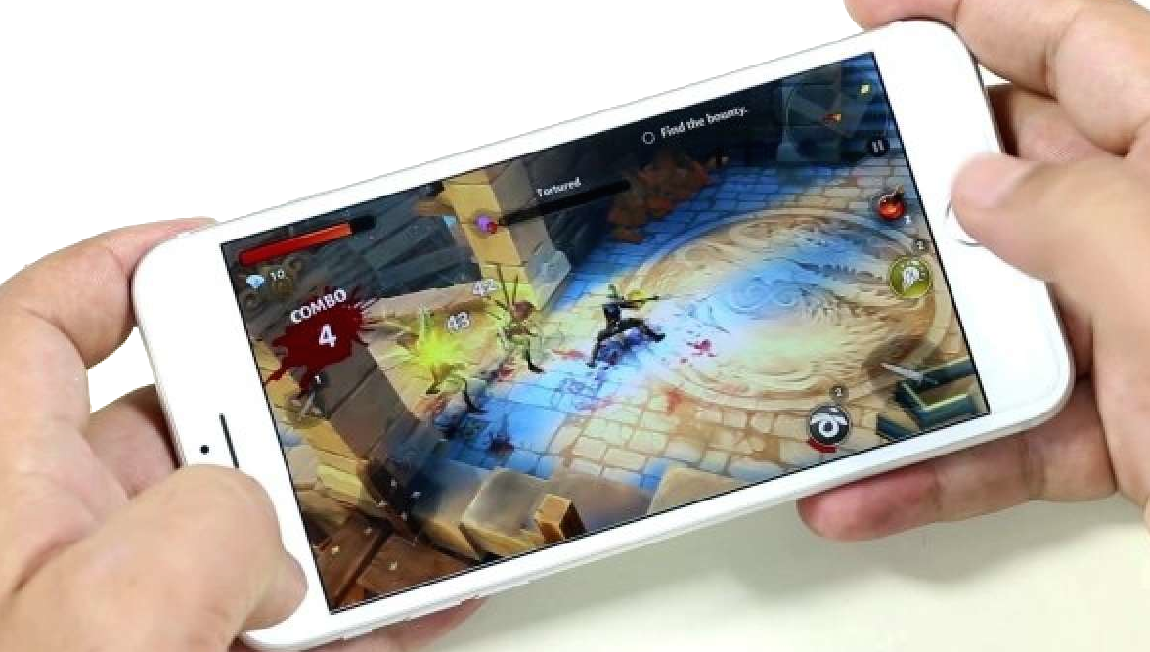
Stress but
small rewards/
dopamine
Notes:
Masters of challenge?

Slide 66
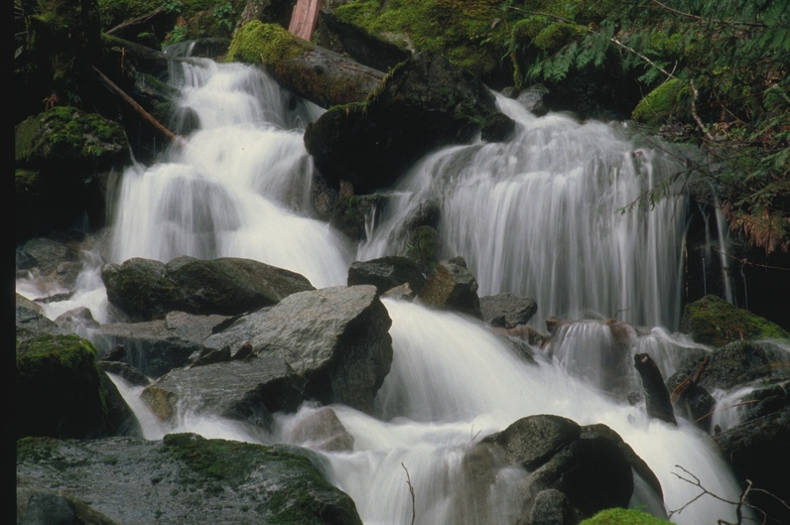
Flow
Notes:
Mihály Csíkszentmihályi’s sense. That experience when we’re totally engaged with what we’re doing. Energized. Loose track of time. You are challenged. It something is too easy, you get bored. This is when you are totally part of the moment. Athletes talk about being “in the zone.”
As Teachers, sometimes. And classes, sometimes (I hope), but harder to orchestrate as a teacher. For many Ss, English isn’t a natural flow experience.
Bill Snyder (TC Columbia Uni – Tokyo) looking at identifying activities that are likely to produce flow. The topics related to happiness can be deeper so maybe likely to move some/many Ss there. (Think like kindness or good memories just naturally deeper than “what’s your favorite sport). Bill’s pointed out something like 4-3-2 might be more likely. You have a real challenge (double your speed), and it is personally produced content. Seems to

Slide 67
Boredom
Flow
Skill
Anxiety
Challenge
Based on: Csikszentmihalyi, (2008)
Flow: The Psychology of Optimal Experience. Harper Perennial, P. 74

Slide 68
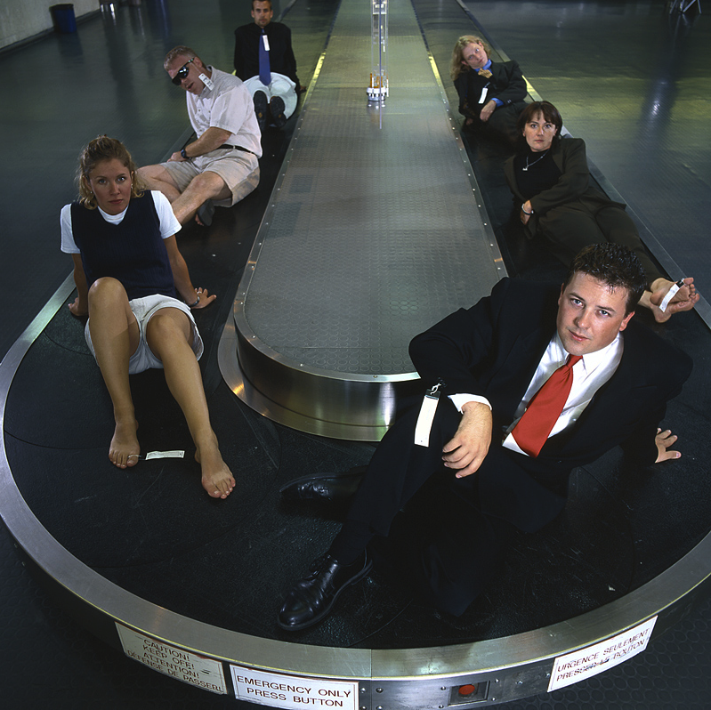
Carousel
AKA: 4-3-2
or
Fluency workshop
Carousel
A→B ４^{：００}
A→C ３^{：００}
A→D ２^{：００}

Slide 69
Boredom
¸
Flow
Skill
·
¶
Anxiety
Challenge

Slide 70
Flourish
P
E
R
M
A
elationships
Notes:
Wellbeing 2.0

Slide 71
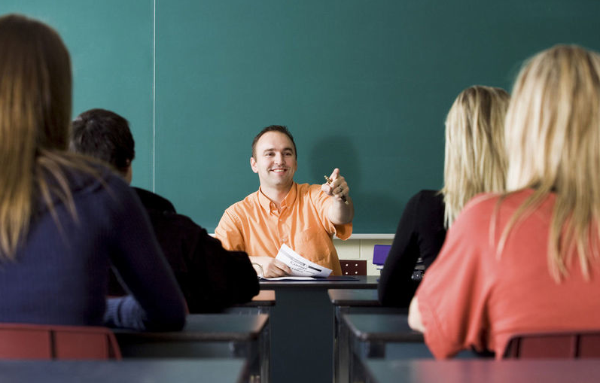
Relationships
Notes:
Bill Milliken (works with troubled teenagers) (Author: The last dropout
“Programs don’t change people. Relationships do.”

Slide 72
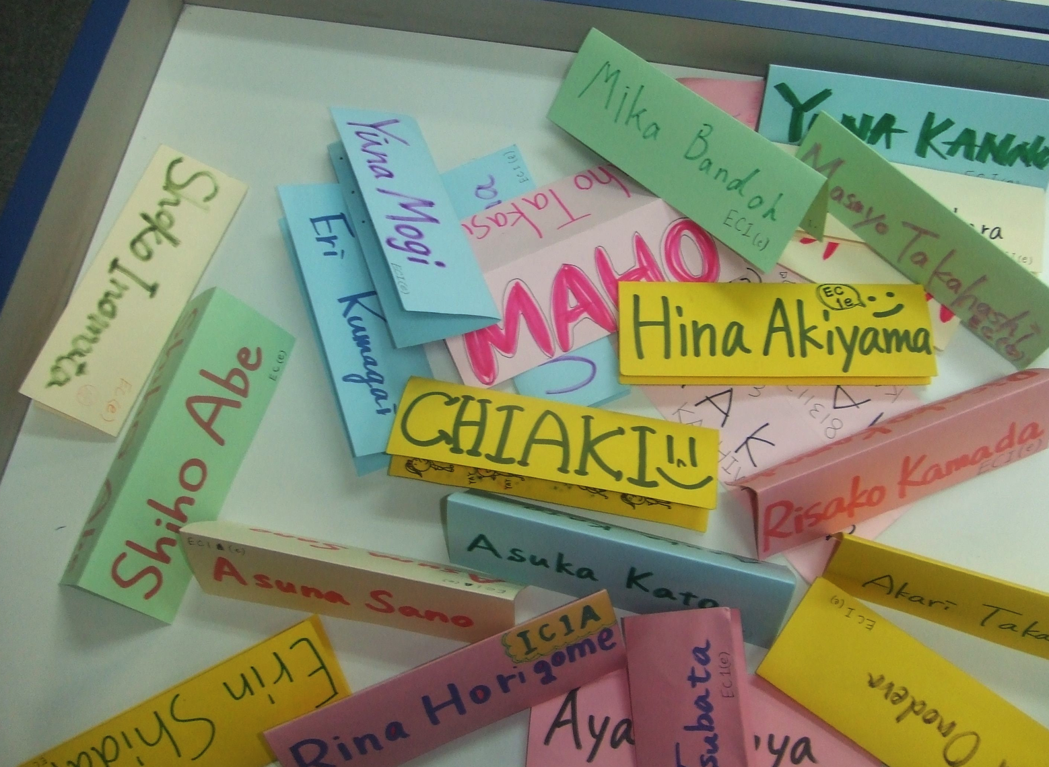
Try to
learn
names

Slide 73
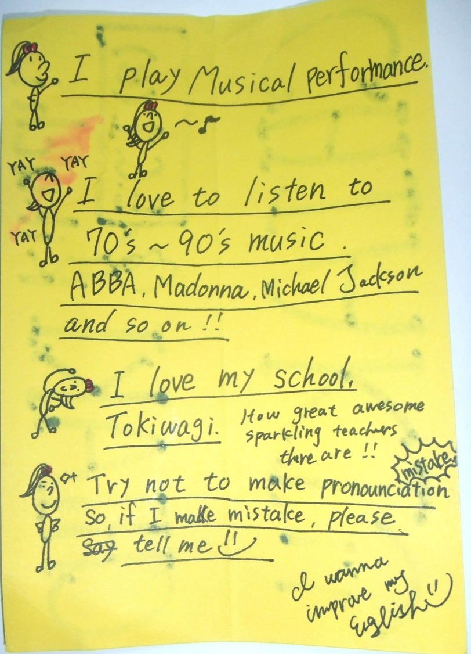
Try to
learn
names

Slide 74
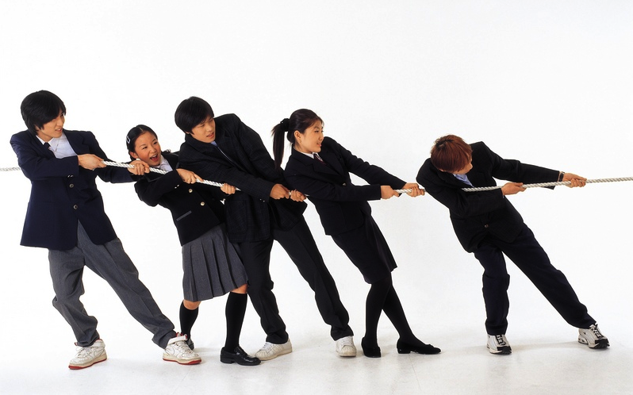
Build rapport
Notes:
Pulling together – metaphor
Actually, doing physical activity a good way.

Slide 75
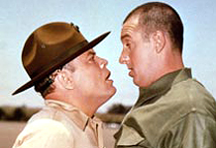

Slide 76
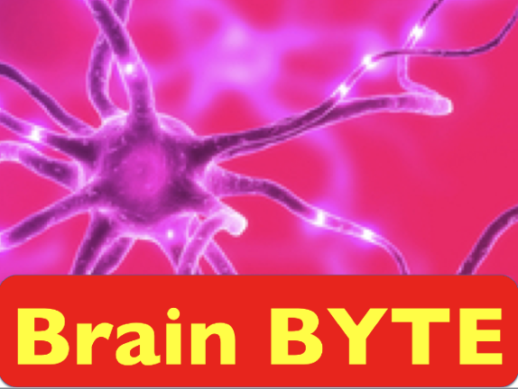
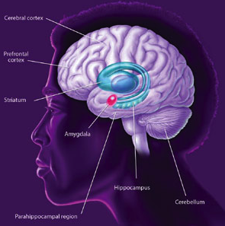
Notes:
Amygdala – emotions/ stress
Stress not bad – necessary and part of life. Some stress - motivating
But TOO much stress debilitating
FLIGHT vs Fight response

Slide 77
Notes:
Served us well. Thousands of years ago, you ancestors, met a sabertooth tiger – made the right decision.
Did not think, “nice kitty”

Slide 80
3000
1595
Notes:
After 9-11, a lot of people quit flying. Even though cars are always more dangerous than planes.
Sept 2001 to Sept 2002. 1595 people died in car accidents because they weren’t flying.
Fear makes us stupid
No teacher thinks Ss are terrorists. (some JHS boys we’re not sure about but…)

Slide 82
Overstressed / threatened
Fear
overrides
new learning
(reflexive vs.
reflective)
Willis in Sousa 2010
Notes:
Amydgala hijack.

Slide 83
Experiment

Slide 84
Rapport builder #1:

Slide 85
Calm, relaxed students
learn up to 25% more
Jensen, 2008
Notes:
Think about entrance exams.
In that room, feeling stress, cuts off the blood to your brain.
I teach my students yogic breathing to help with tests, job interviewss, etc.

Slide 86
Flourish
P
E
R
M
A
eaning
Notes:
Wellbeing 2.0

Slide 87
Meaningful
Personalize
Notes:
Connect it to something important., what’s your favorite sport/movie, singer, etc. Nothing wrong with that
2 JHS lessons story -- This is a pen, vs. What musician do you like? AKB48. What fruit do you like? Watermelon. Coming from their hearts.
Textbook story. Guy wins lottery. Daughter – very bright, really good school. But…his mom has cancer. Editor: can’t – house needs a new roof. ^^ most happiness activities are.

Slide 88
Someone special
Think of someone special in your life.
A family member
Someone who
helped you
A special teacher

Slide 89
Gratitude letter
I want to thank you…
Notes:
Standard activity. I learned about it from something Martin Seligman wrote (U. Pennsylvania). Christopher Peterson (U. of Michigan) worked with Seligman, now u. of Michigan. Korean Student: we do that every year.

Slide 90
Mom or dad
A special teacher
A coach
A special friend
Who would you write to? Why?

Slide 91
Notes:
Standard activity. I learned about it from something Martin Seligman wrote (U. Pennsylvania). Christopher Peterson (U. of Michigan) worked with Seligman, now u. of Michigan. Korean Student: we do that every year.

Slide 94
Someone special
• Why are they special?
What did they do?
Why do you want to say thank you?
 Tell your partner.
How could you thank them?
Will you?
Notes:
Can do just as speaking. Fine. Now Something different.

Slide 95
Flourish
P
E
R
M
A
ccomplishment
Notes:
Wellbeing 2.0

Slide 96
Accomplishment

Slide 97
Set goals
Notes:
Kind of think it depends on the goal. 17 years ago, I quit smoking. I had been a chain smoker. Turned 40, thought, “Marc, you’re a teacher. You live by your voice. What are you doing?” So I quit. I did the mental preparation – lists of advantages, visualization, etc. Got “the patch”. But part of my strategy was to tell everyone I knew – so I would totally lose face if I started again. This was a couple weeks before TESOL. Later I found out my editor had told everyone, “be careful around Marc. He’s going to be really bitchy. “ It worked.
Since learner about the Sivers thing, have done the goal setting, just as a personal – visualization activity, not a speaking task.

Slide 98
b
Notes:
True story – I tell my Ss 500 yen = 20 ringhet
My wife usually doesn’t come to conferences –somehow doesn’t find hanging out with English teachers the most exciting thing in the world (hard for me to understand) unless someplace really cool

Slide 99
Memory check
P
E
R
M
A
ositive Emotion
ngagement
elationships
eaning
ccomplishment
Notes:
Wellbeing 2.0
Exit? 110

Slide 100
Remember
good things
Notes:
Count your blessings

Slide 101
Notice good things
Notes:
In the present –
mindfulness

Slide 102
Anticipation

Slide 104
savo
savoring

Slide 105
savoring

Slide 108
1
simplify

Slide 109
Flourish
P
E
R
M
A
ositive Emotion
ngagement
elationships
eaning
ccomplishment

Slide 110
Thank you.
Achor 2010

