Slide 1
This presentation, DIY Neuro-ELT: Making your textbook more brain friendly was created by Marc Helgesen and Curtis Kelly.
It is © 2014 by Helgesen and Kelly. Parts of it may be used for non-profit educational purposes as long as the source is identified. If possible, also give viewers this URL: www.tinyurl.com/NeuroELT.
Most photographs are © Clipart.com and are used under license. Textbook examples are from English Firsthand by Helgesen, et al. (© Pearson Asia), Active Skills for Communication, Kelly and Sandy (© Cengage), Writing from Within, Kelly and Gargagliano (© Cambridge University Press). All are used with permission.
Other photos and videos were found on the Internet. If we are using any material not intended for public use, please let us know and we will remove it.

Slide 2
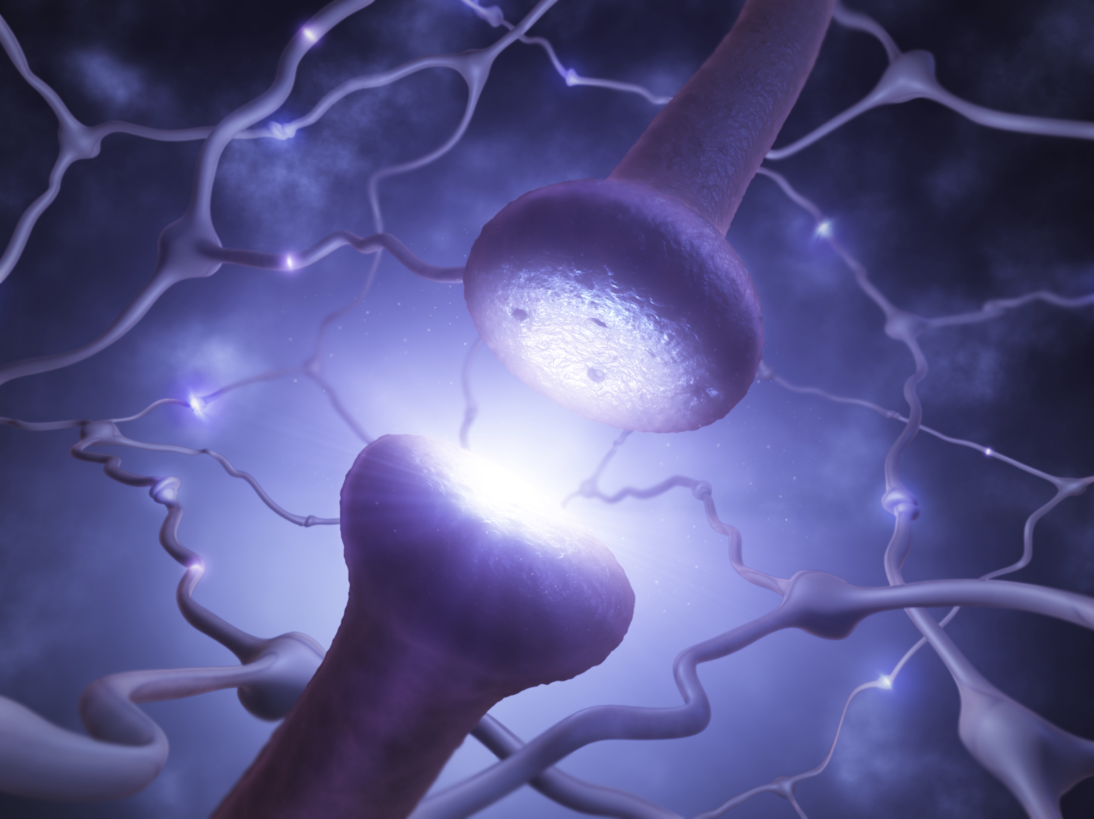
DIY
Neuro-ELT

Slide 3
Making your textbook more brain-friendly
Notes:
WHO are you?
This session: Curtis Kell y and I.
FAB 2 and 3 – great. More interest in mond ay morning
--how do we do this in real classes, without ho urs to prepare.
Wrote a handout. Then this sessions

Slide 4
Part 2

Slide 5
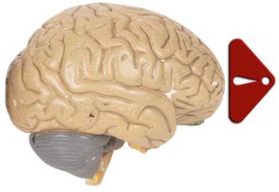
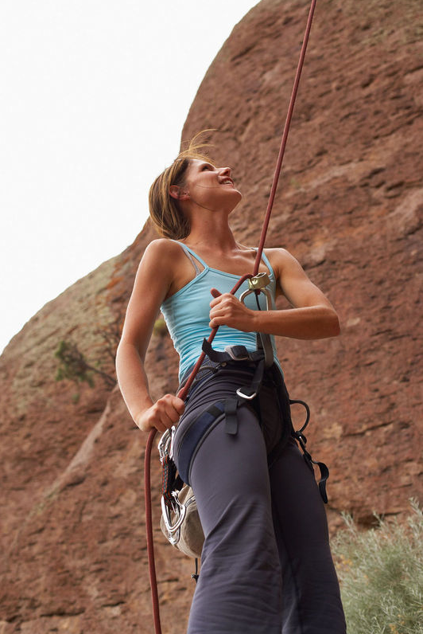
The brain needs
challenge

Slide 6
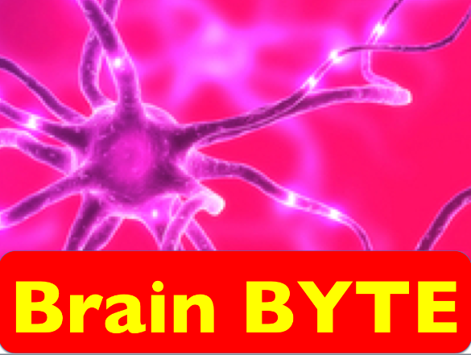
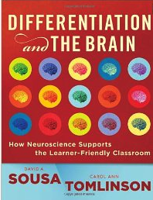
The brain
needs
challenge
“Work that interests students
will necessarily be at an
appropriate challenge level.”
- D. Sousa & C.A.Tomlinson
Differentiation and the Brain
Notes:
Too easy – not interesting
Too difficult – can’t do.

Slide 7



Slide 8
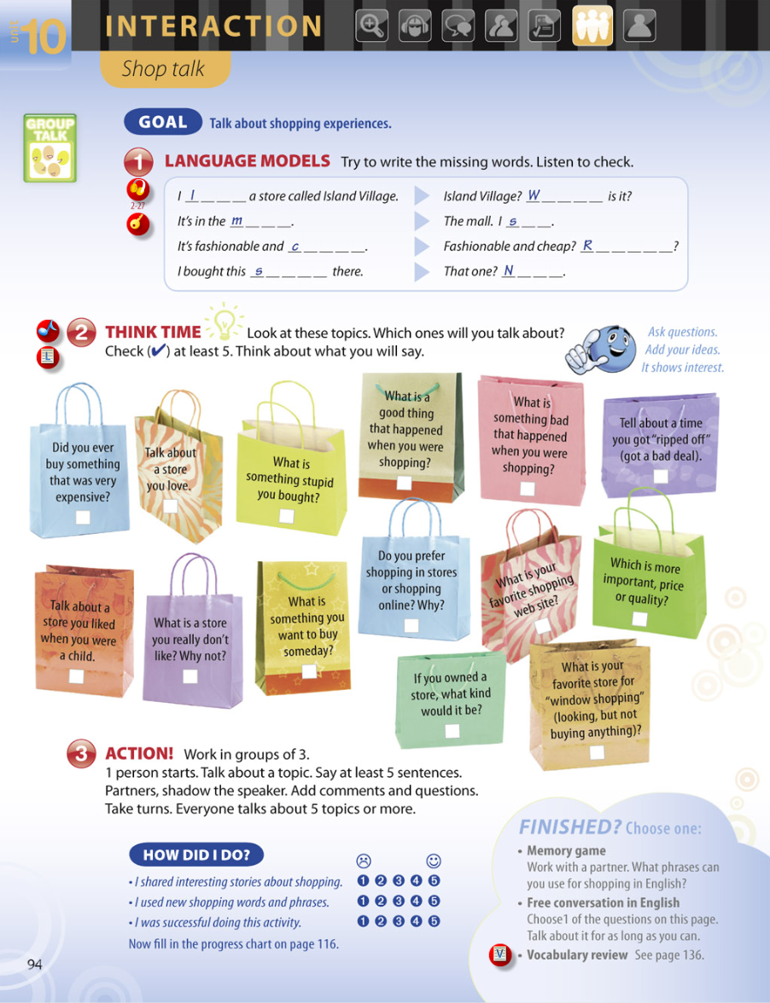
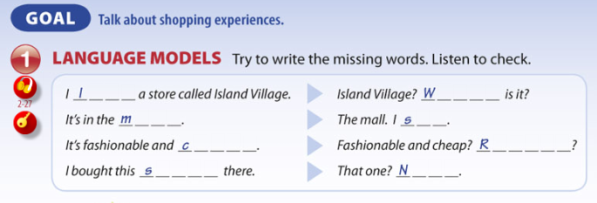
ß
l o v e
W h e r e
m a l l
s e e
c h e a p
R e a l l y
s h i r t
N i c e
Notes:
Who found the joke?
David Sousa - humor good/ sarcasm bad

Slide 9
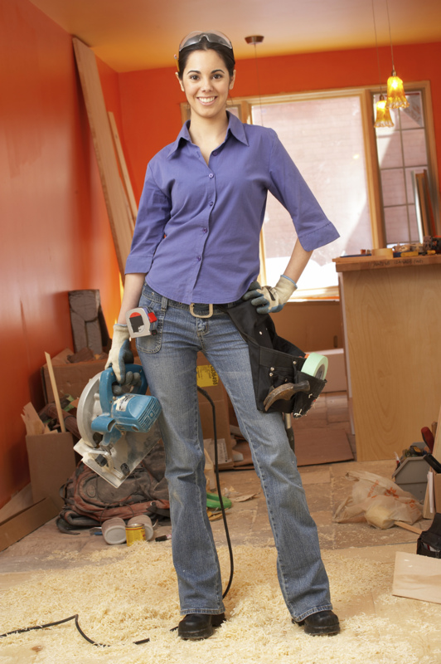
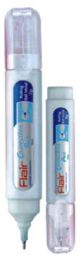
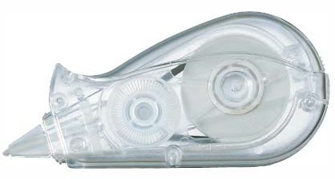
DIY – Do it yourself
Challenge
Cloze target vocabulary/ grammar
Have students add extra vocabulary
Notes:
Hint- not every 9th word

Slide 10
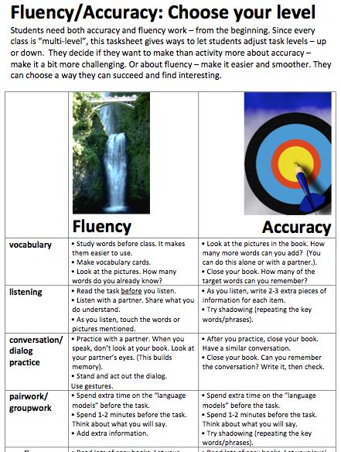
DIY – Do it yourself
Challenge
From my website
Notes:
In the words of St. Nike, just do it.

Slide 11
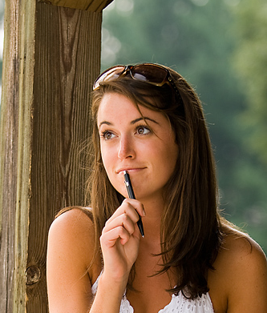
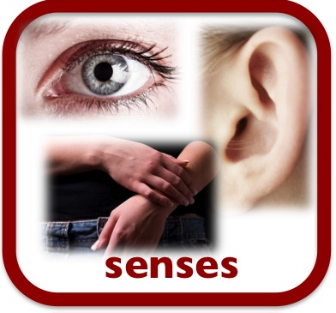


That specific lesson

Slide 12
Dialog
How can we
get them to
process the
meaning first?
A: What’s your last name, Luis?
B: Garcia.
A: How do you spell that?
B: G-A-R-C-I-A
A: Did you say G-A-R-C-I-A?
B: Yes, that’s right.
A: Ok. What’s your cell phone number?
B: It’s 090-555-1212
A: Can you say that again?
B: Sure. 090-555-1212.
Notes:
Causing deep processing

Slide 13
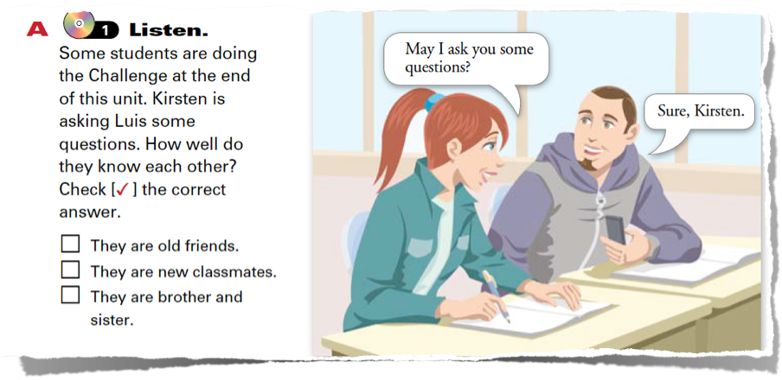
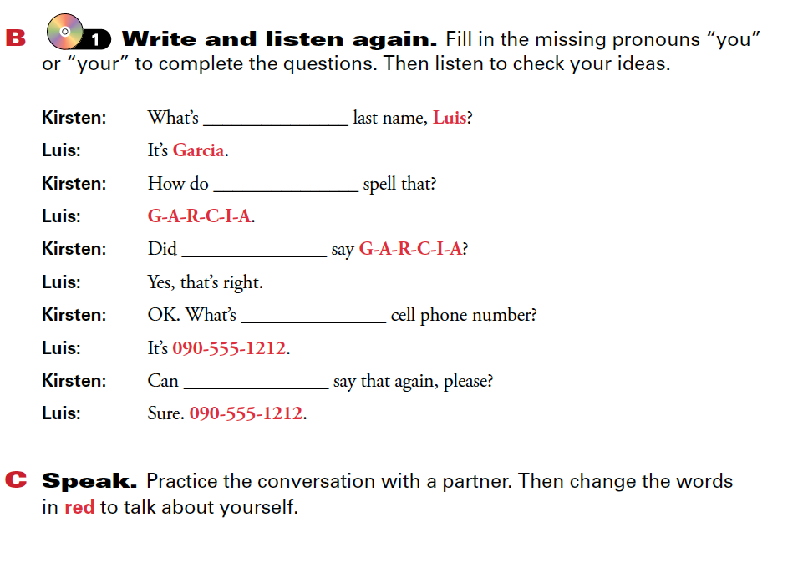
deep processing
Active Skills for Communication (Cengage)

Slide 14
Notes:
Have you ever Truth Lie game for Challenge

Slide 15

Let learners create

Slide 16
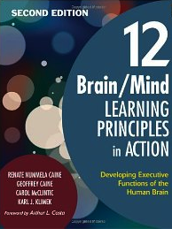
Creative
intelligence
“The ability to see how to do
things or think about something
in multiple ways.”
- Caine, et al
12 Brain/Mind Learning
Principles in Action

Slide 17
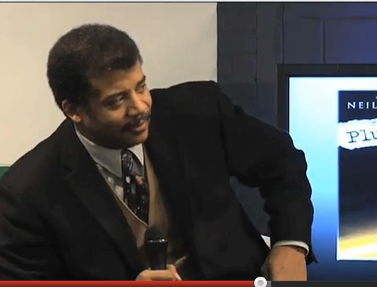
Notes:
Neill DeGrasse Tyson

Slide 18
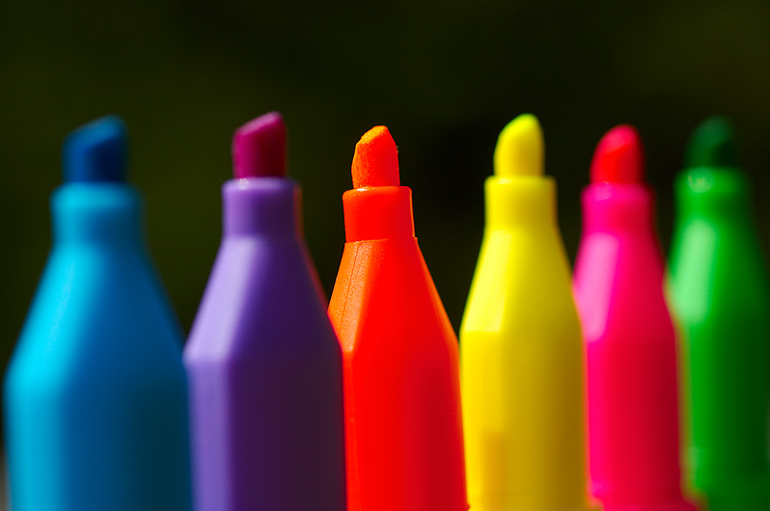
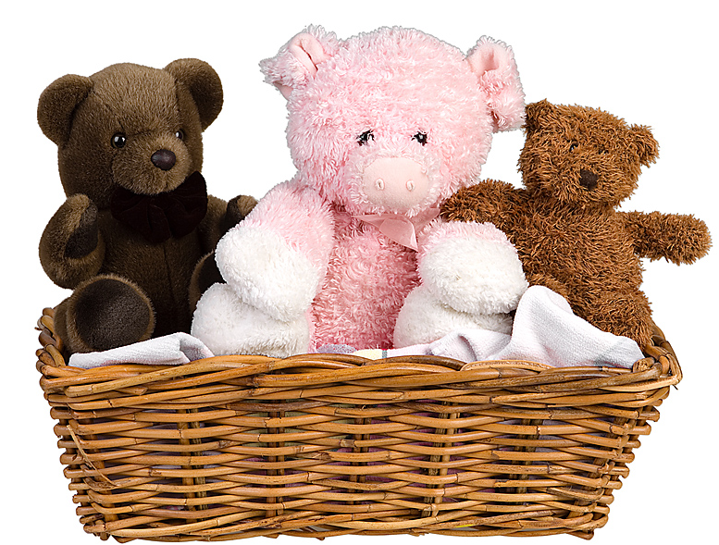

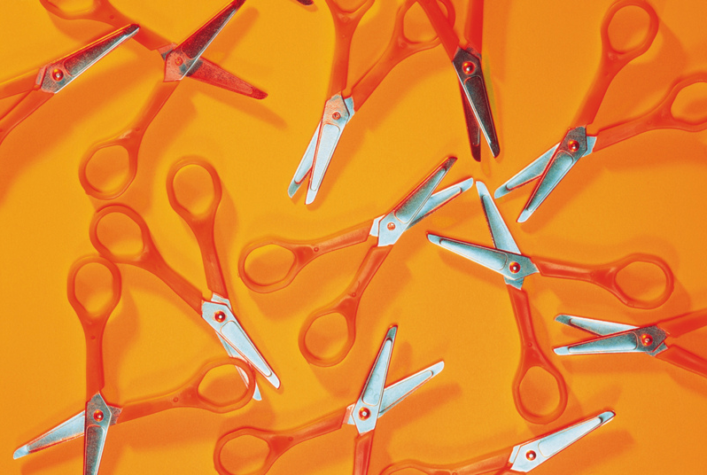

Let learners create

Slide 19
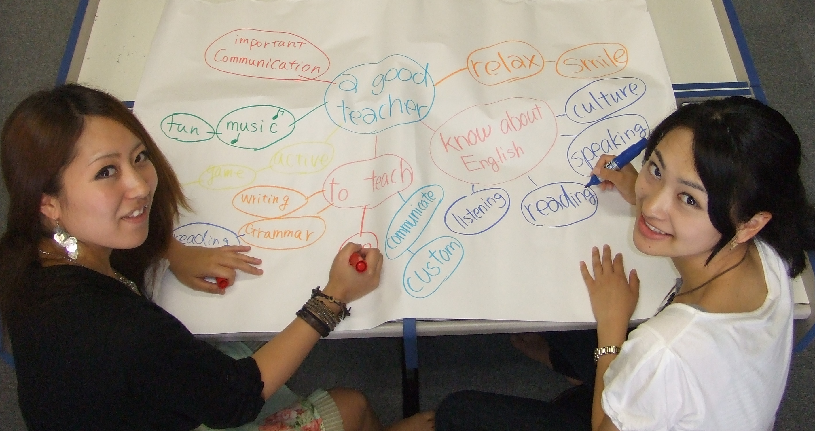
Let learners create

Slide 20
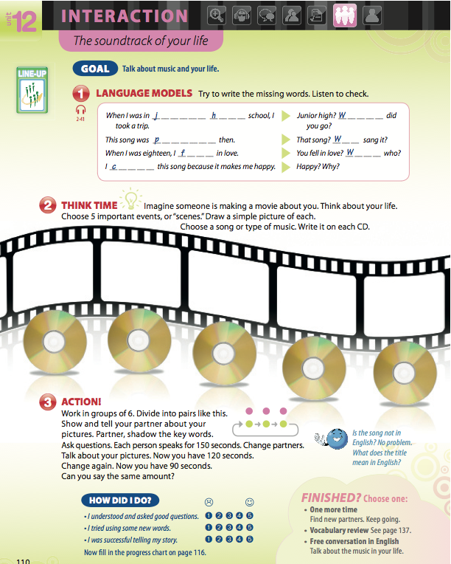
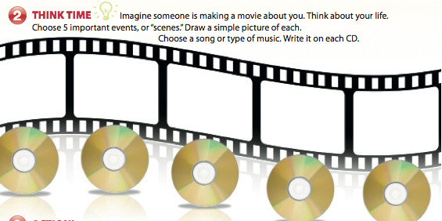

Slide 21
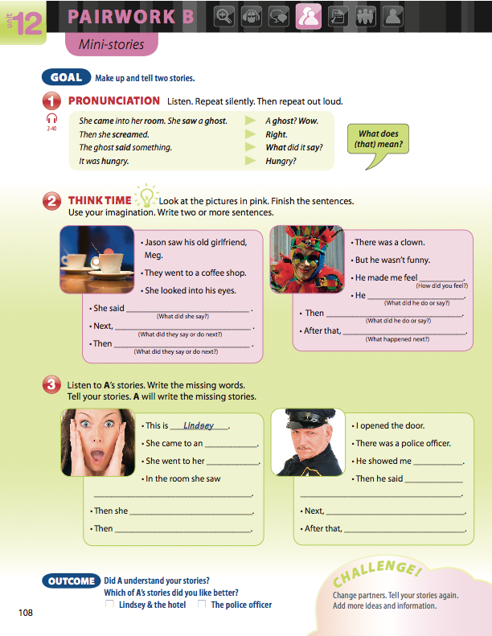
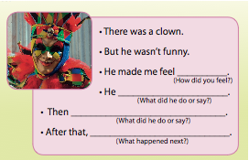

Slide 22
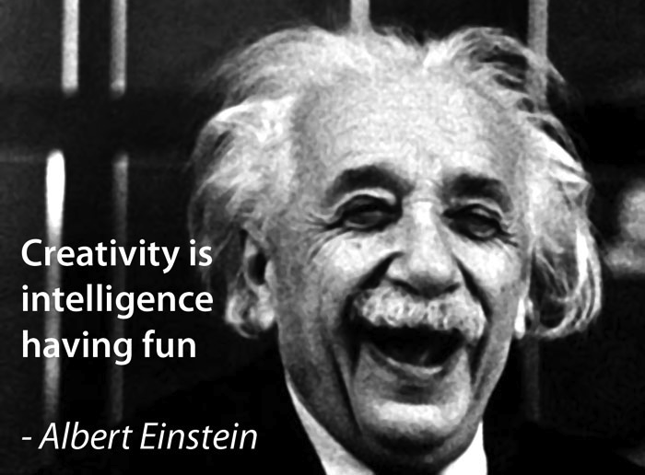

Slide 23
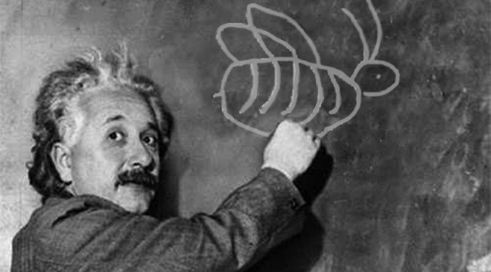
Play
is the highest form of
research.
- Einstein

Slide 24
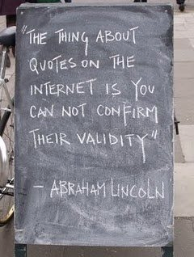

Slide 25
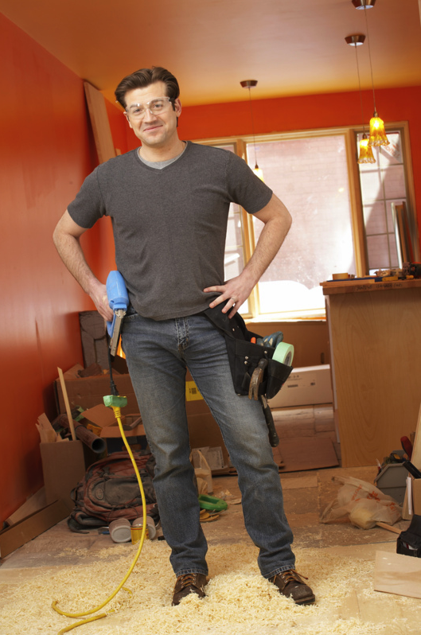
DIY – Do it yourself
Creativity
Get art supplies
(markers, colored paper, glue)
Let them do more than write.
Mindmaps
Notes:
In the words of St. Nike, just do it.

Slide 26
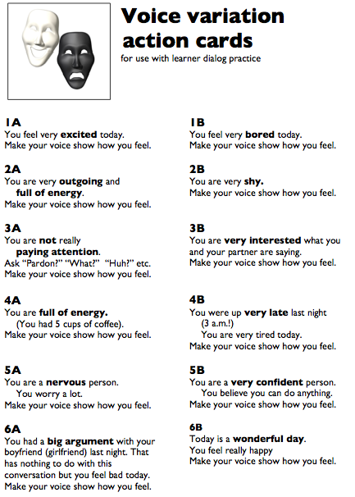

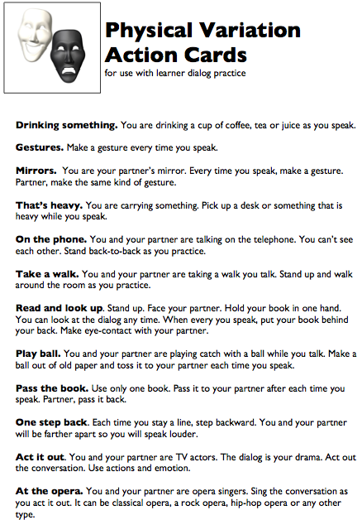
DIY – Do it yourself
Ceativity
Add some
drama
Go to my website
Notes:
In the words of St. Nike, just do it.

Slide 27
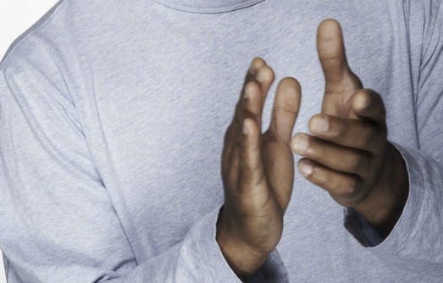
Praise
effort
effort
not ability / intelligence

Slide 28
Praise effort
Not ability
/ intelligence
Students praised for effort:
90% chose more challenging tasks.
Notes:
Clinical studies

Slide 29
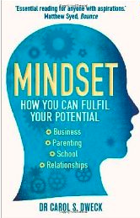
Praise effort
Not ability
/ intelligence
Students praised for ability:
avoided more challenging tasks.
They didn’t want to make mistakes.
Carol Dweck
Notes:
Carol Dweck - Stanford

Slide 30
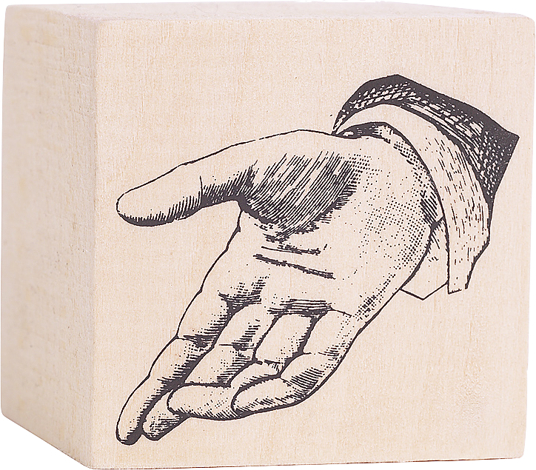
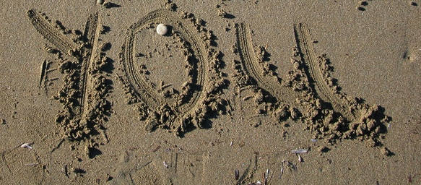
Personalize

Slide 31
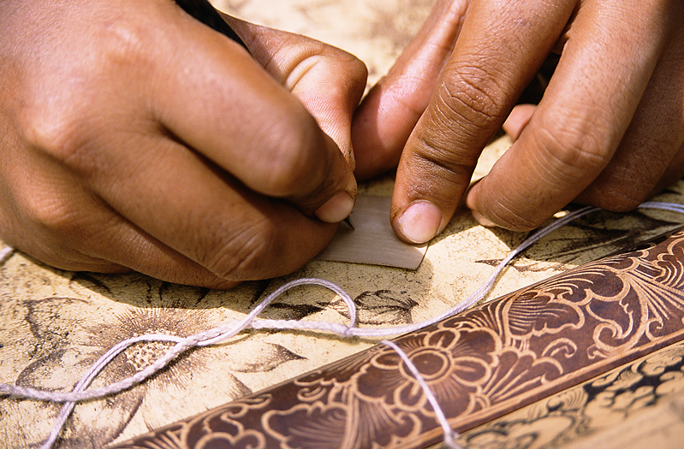
Personal experience
increases memory
- Caine, et al.
12 Brain/Mind Learning
Principles in Action

Slide 32

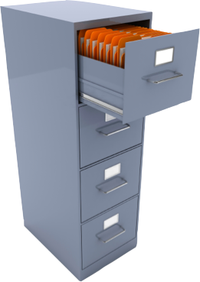

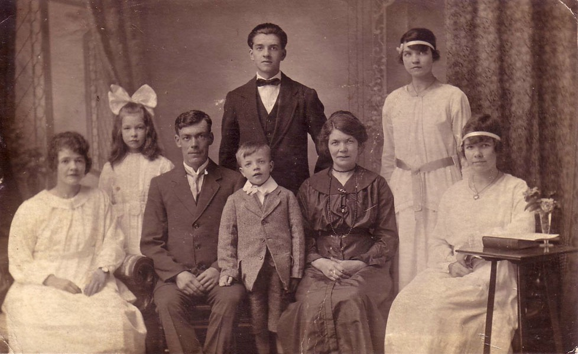
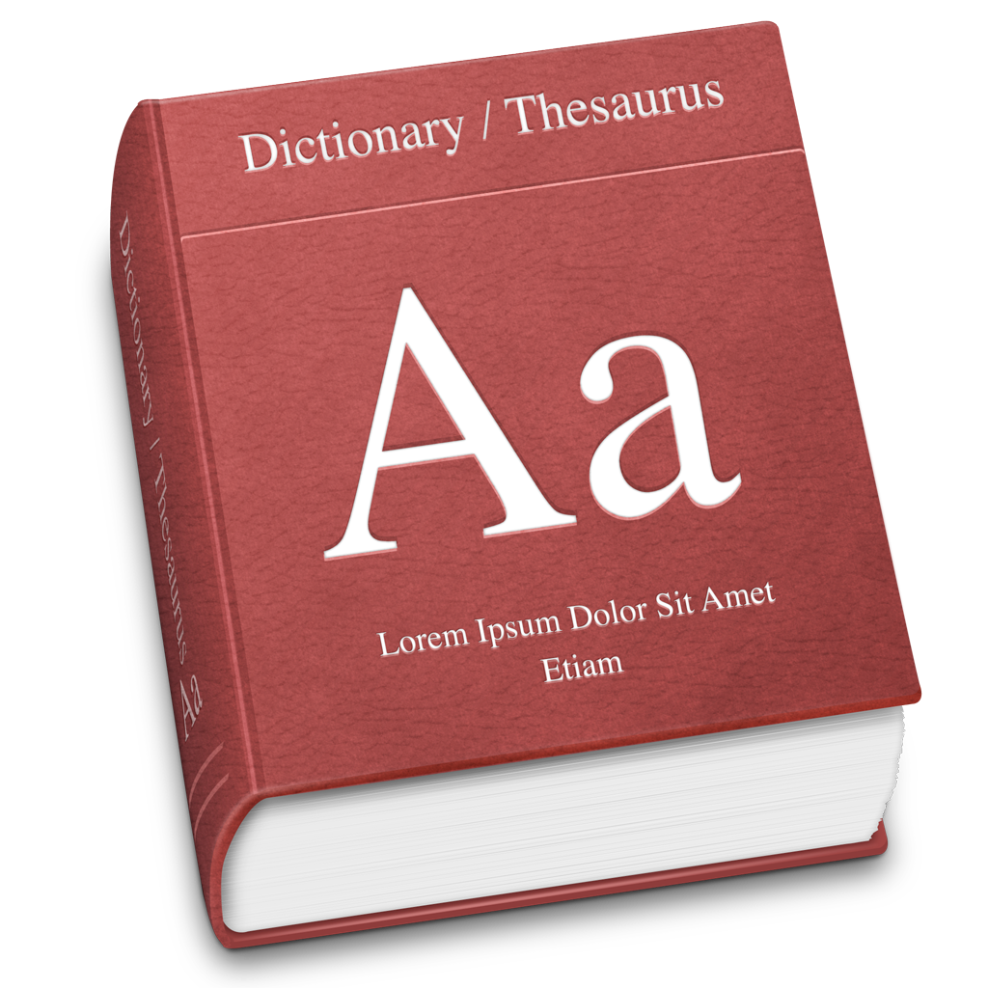
How do we encode memories?

Slide 33
The sole purpose of memory is to imagine the future.
Daniel Schacter, Harvard, at 2013 ICCNS

Slide 34
The sole purpose of memory is to simulate the future.
Daniel Schacter, Harvard, at 2013 ICCNS

Slide 35
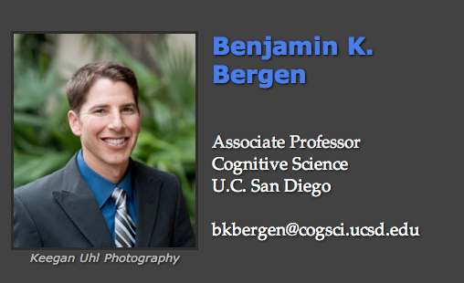

Language processing

Slide 36
Language processing

Slide 37
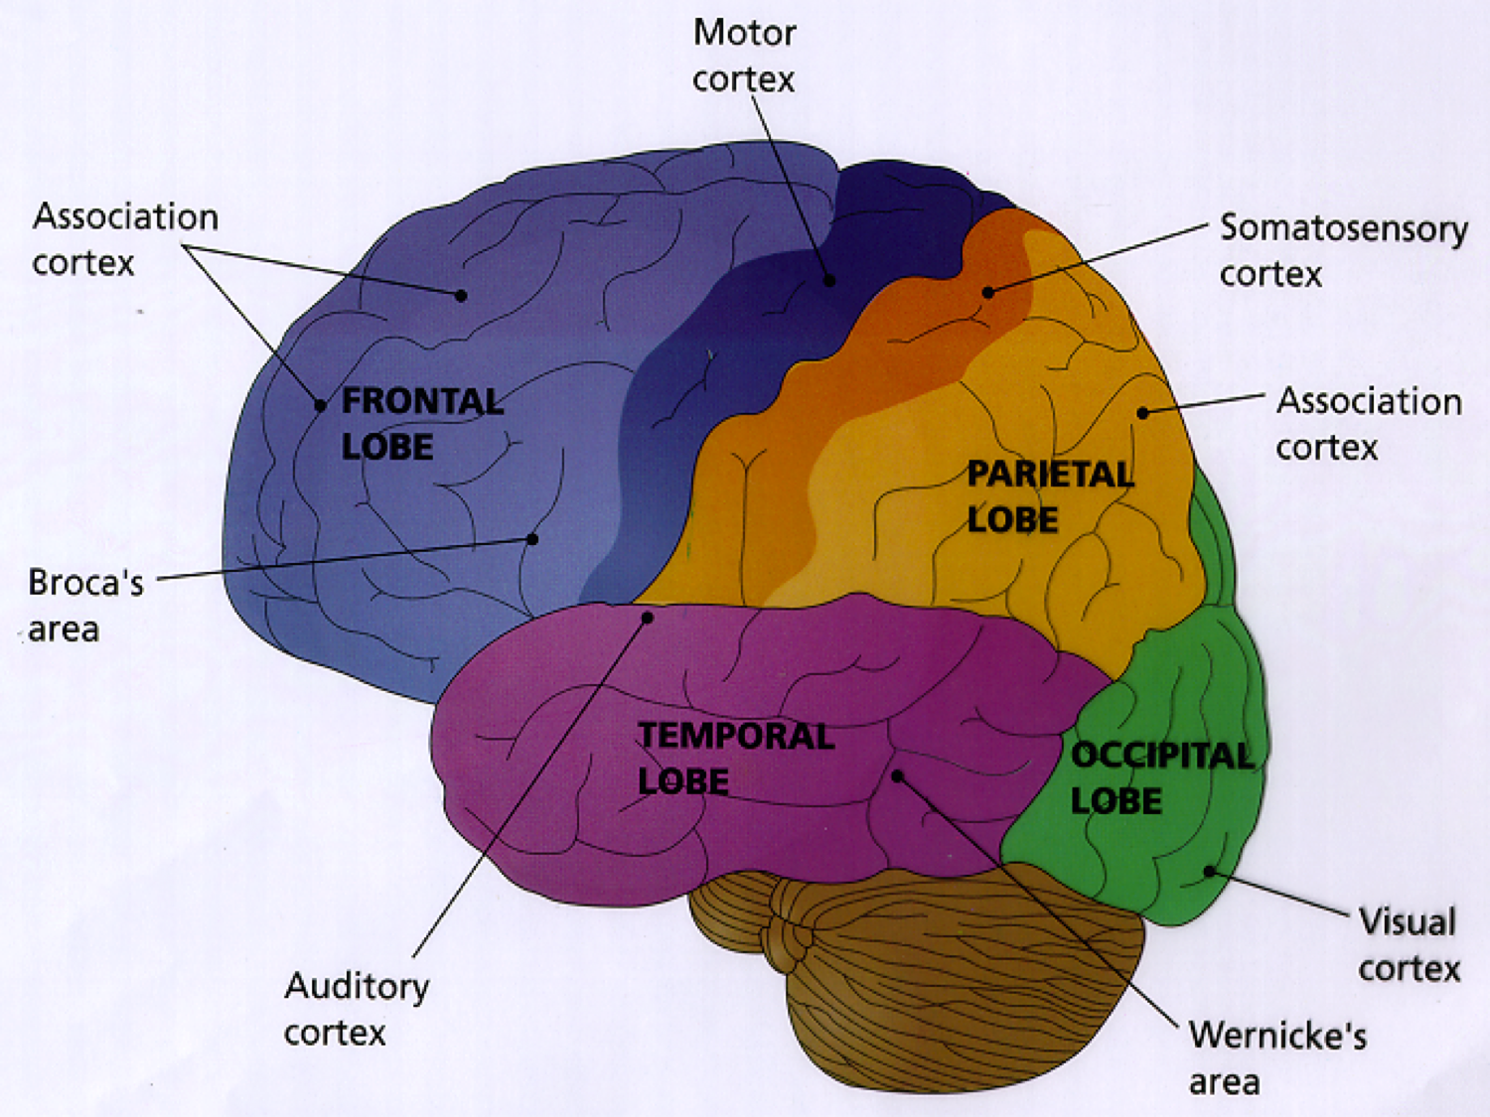
Notes:
Puts parts together
Open a door.
Open the door.

Slide 38
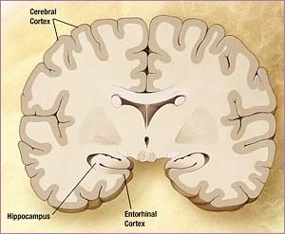
Simulating
running? standing?
Notes:
I’d like you to simulate
Close your eyes
The dog jumped over the wall.
run & jump? stand & jump?

Slide 39
Simulating
inside? outside?
Notes:
I’d like you to simulate
Close your eyes
The dog jumped over the wall.
run & jump? stand & jump?

Slide 40
Simulating
stone wall? other?
Notes:
I’d like you to simulate
Close your eyes
The dog jumped over the wall.
run & jump? stand & jump?

Slide 41
Simulating
cliff on other side of wall?
Notes:
I’d like you to simulate
Close your eyes
The dog jumped over the wall.
run & jump? stand & jump?

Slide 42
Simulating
big? little?
Notes:
I’d like you to simulate
Close your eyes
The dog jumped over the wall.
run & jump? stand & jump?

Slide 43
Simulating
perspective?
Notes:
I’d like you to simulate
Close your eyes
The dog jumped over the wall.
run & jump? stand & jump?

Slide 44
Simulating
Notes:
I’d like you to simulate
Close your eyes
The dog jumped over the wall.
run & jump? stand & jump?

Slide 45

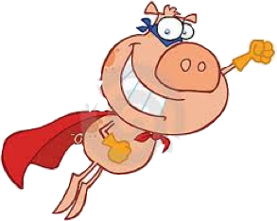

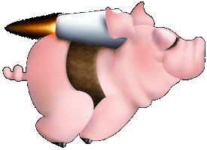
Notes:
What does a Flying Pig look like?`

Slide 46
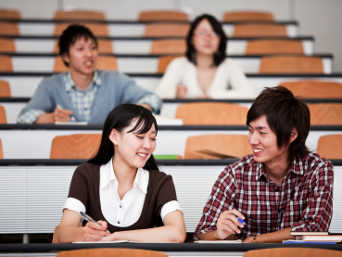
Simulating
Offshoot for Learners
Vocabulary lists?
Stories!
Experiential education
Notes:
8 min

Slide 47
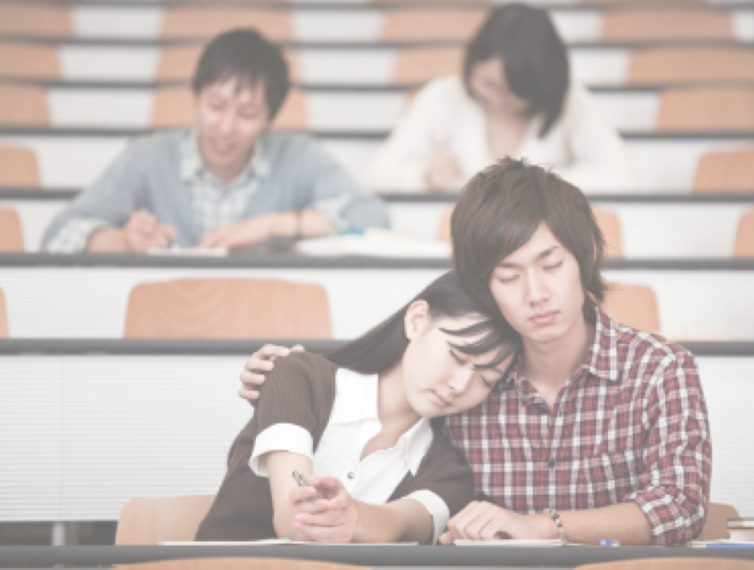
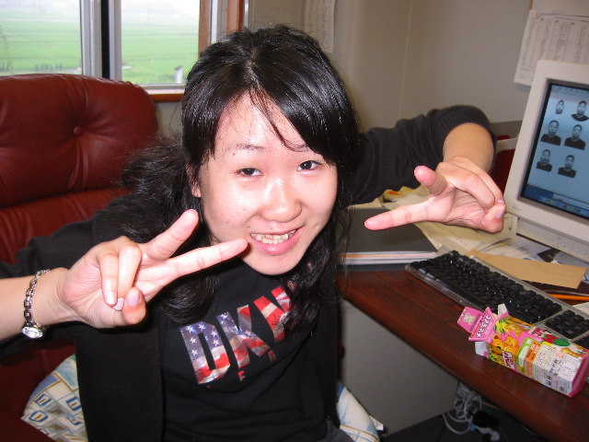
Language
Form
Make Meaning
Notes:
Maybe the biggest change will be changing the way we study languge.
What is at the core of language. Is it form? No. Since it is a property of the brain, then the important thing is learning how the brain processes it. How the brain makes meanings from words. Just looking at form, to understand language, is like trying to learn how to drive by just looking at the car’s shape. No, it is time for a revolution in our thinking and today I’m going to give it to you.

Slide 48
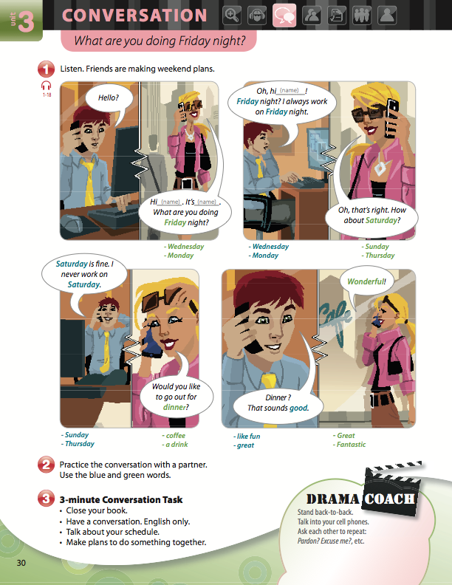


Slide 49
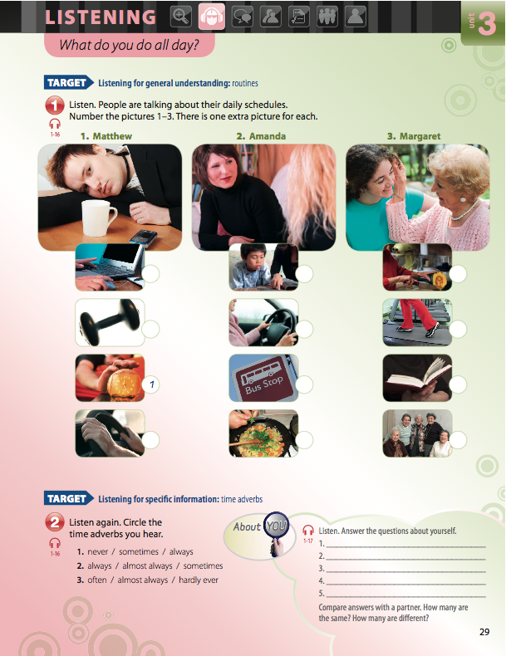
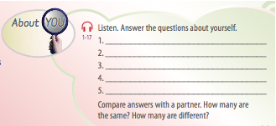

Slide 50

ride the wave
Making Friends

Slide 51


Slide 52
ride the wave
Making Friends

Slide 53




Making Friends
Active Skills for Communication
(Cengage)
Notes:
Personalization?

Slide 54
DIY – Do it yourself
Personalize
Add personal info. to pair- & groupwork
Add “about you” to listening
Take dialogs further
Notes:
In the words of St. Nike, just do it.

Slide 55
DIY – Do it yourself
Personalize
Close you books. Talk about this topic
– use your own ideas and information.
Notes:
In the words of St. Nike, just do it.

Slide 56


That specific lesson

Slide 57



Slide 58
DIY
Neuro-ELT

Slide 59








emotion
choice
novelty
senses
challenge
creativity
personalization
Notes:
Repeat to remember –
Remember to repeat
SPACED repetition

Slide 60

DIY –
Do it yourself.
Just do it.
Notes:
In the words of St. Nike, just do it.

Slide 61








¶
Memory 3x3
Write 3 “take-aways.”

Slide 62
·
Memory 3x3
Quiz your partner.

Slide 63
¸
Memory 3x3
Plan your recycling.
Notes:
Recycling could be review.

Slide 64
A promise
emotion
choice
novelty
senses
challenge
creativity
personalization
Notes:
Novelty -- good for your brain.
Choice
Challenge & creativity
Personalized, multi-sensory
Your emotion – your brain.

Slide 65

P
Thank you.
Achor 2010

