Slide 1
Energy breaks
Human beings were not designed to sit in desks all day. Energy breaks are a series of short, physical activities you can use to get your students moving and energized.
Body clocks has learners work in pairs. They pantomime times. Partners guess.
Use slides 6 and 7 to make the point that we use many senses to learn. Slides 8 and 9 point our the usefulness of multi-sensory learning for memory and creativity.
© Marc Helgesen. May be freely used for non-commercial purposes.
For more, visit: www.HelgesenHandouts.weebly.com. Click on “Physical activity…”
This slide is for the teacher’s information. The student slide show starts with slide 2.

Slide 2
Energy break

Slide 3
Body clocks

Slide 4
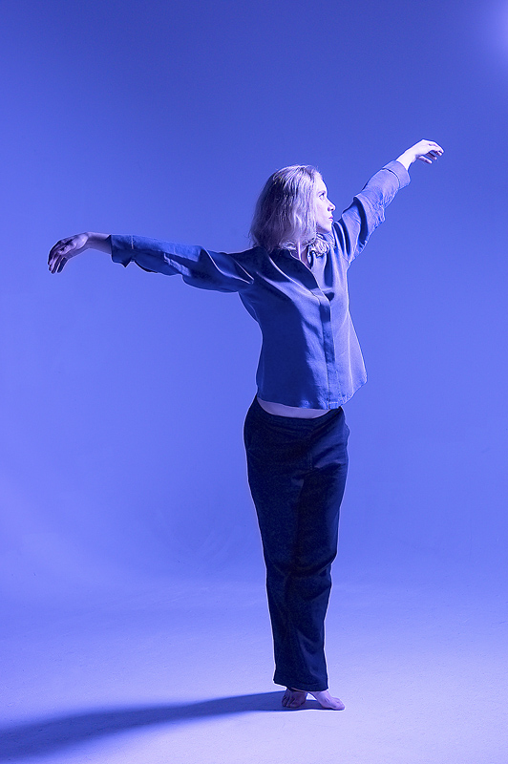
You are
a clock.
12
9 3
6
Notes:
4

Slide 5
What time did you
12
9 3
6
…get up today?
…go to bed last night?
…get up last Sunday?
4. …leave for school?
5. …get to school?
6. …work or do homework? x:xx to x:xx
7. …eat dinner.
8. …wish you could get up every day?
.
Notes:
5

Slide 6
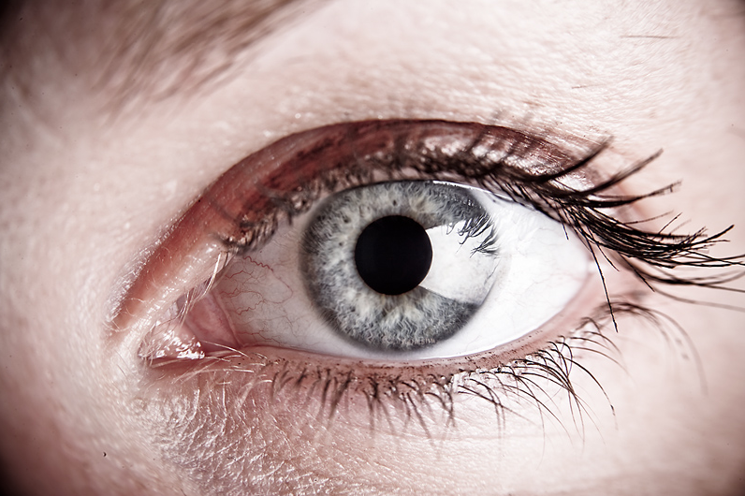
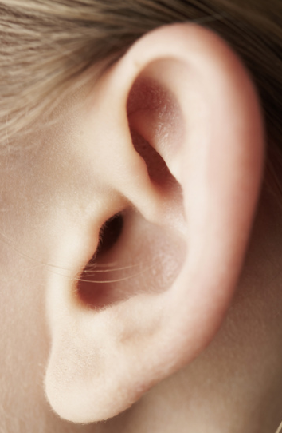
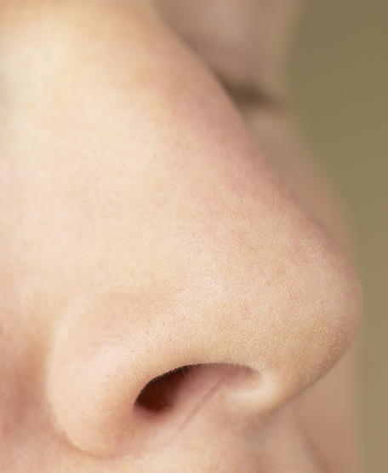
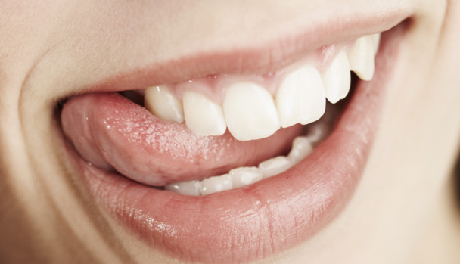
You have 5 senses
Visual sight
Auditory hearing
Haptic (tactile+kinethetic)
touch/feeling
Olfactory smell
Gustatory taste

Slide 7
Body clocks uses 3:

Slide 8
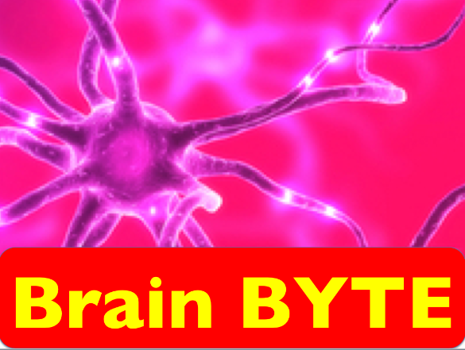
When you get
multi-sensory
input, you
remember more.
Source: Medina, J. (2014) Brain Rules. Seattle, WA: Pear Press

Slide 9
When you get
multi-sensory
input,
you are 50-75% more creative at problem solving
Source: Medina, J. (2014) Brain Rules. Seattle, WA: Pear Press

Slide 10
Let’s move!

Slide 11
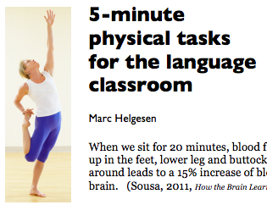
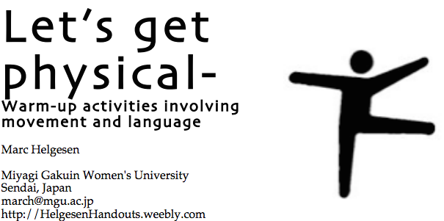
More ideas at
http://tinyurl.com/ELT-physical

