Slide 1
Energy breaks
Human beings were not designed to sit in desks all day. Energy breaks are a series of short, physical activities you can use to get your students moving and energized.
5 right here, right now is an exercise activity. Student think of 5 (or more) physical exercises they can do in the classroom (i.e., not is a open). Then they do the exercises in pairs. When a partner wants to change the exercise, they make an “X” with their arms and start the new one
Slides 17-19 introduce the idea of the “Body as the 2nd brain”. Vocabulary: Neurons are brain cells. Neurotransmitters chemicals in the brain that help neurons connect. Dopamine is the neurotransmitter that, among other things, builds memory and motivation. Serotonin effects mood and happiness. Source for slide 19: http://neurosciencestuff.tumblr.com/post/38271759345/gut-instincts-the-secrets-of-your-second-brain
© Marc Helgesen. May be freely used for non-commercial purposes.
For more, visit: www.HelgesenHandouts.weebly.com. Click on “Physical activity…”
This slide is for the teacher’s information. The student slide show starts with slide 2.

Slide 2
Energy break

Slide 3
5
right here,
right now.

Slide 4
What are 5
exercises you
could do right
here,
right now?

Slide 5
Your
ideas:

Slide 6
Here are
some more.

Slide 7
jumping

Slide 8
balancing

Slide 9
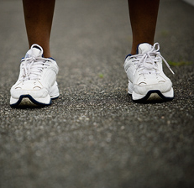
running
in place

Slide 10
touching
your
toes

Slide 11
doing
squats

Slide 12
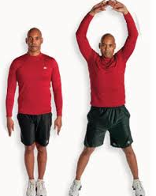
jumping
jacks
Courtesy pixshark

Slide 13
stretching

Slide 14
Work with
a partner.
Do an
exercise.
Partner,
match it.

Slide 15
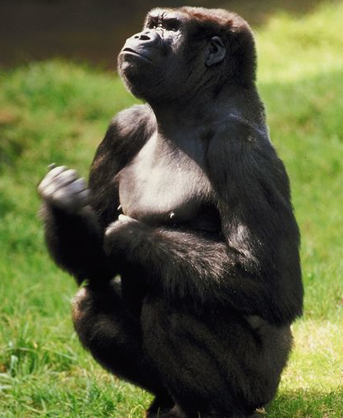
Partner, when you
want to change…

Slide 16
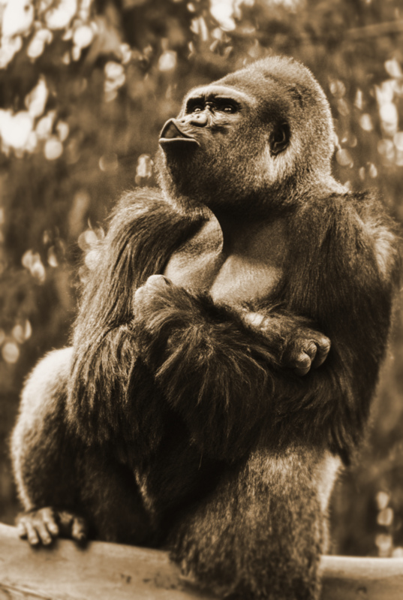
make an
“ X “ with
your arms.
You start
the next
one.

Slide 17
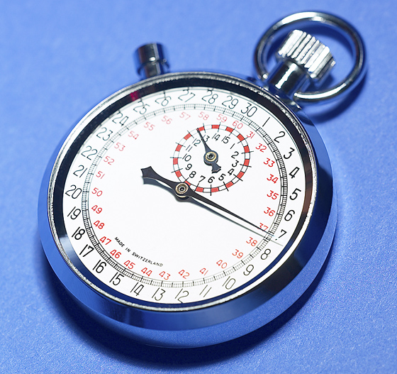
Do this for
1 minute.

Slide 18
Why move
in English
class?

Slide 19
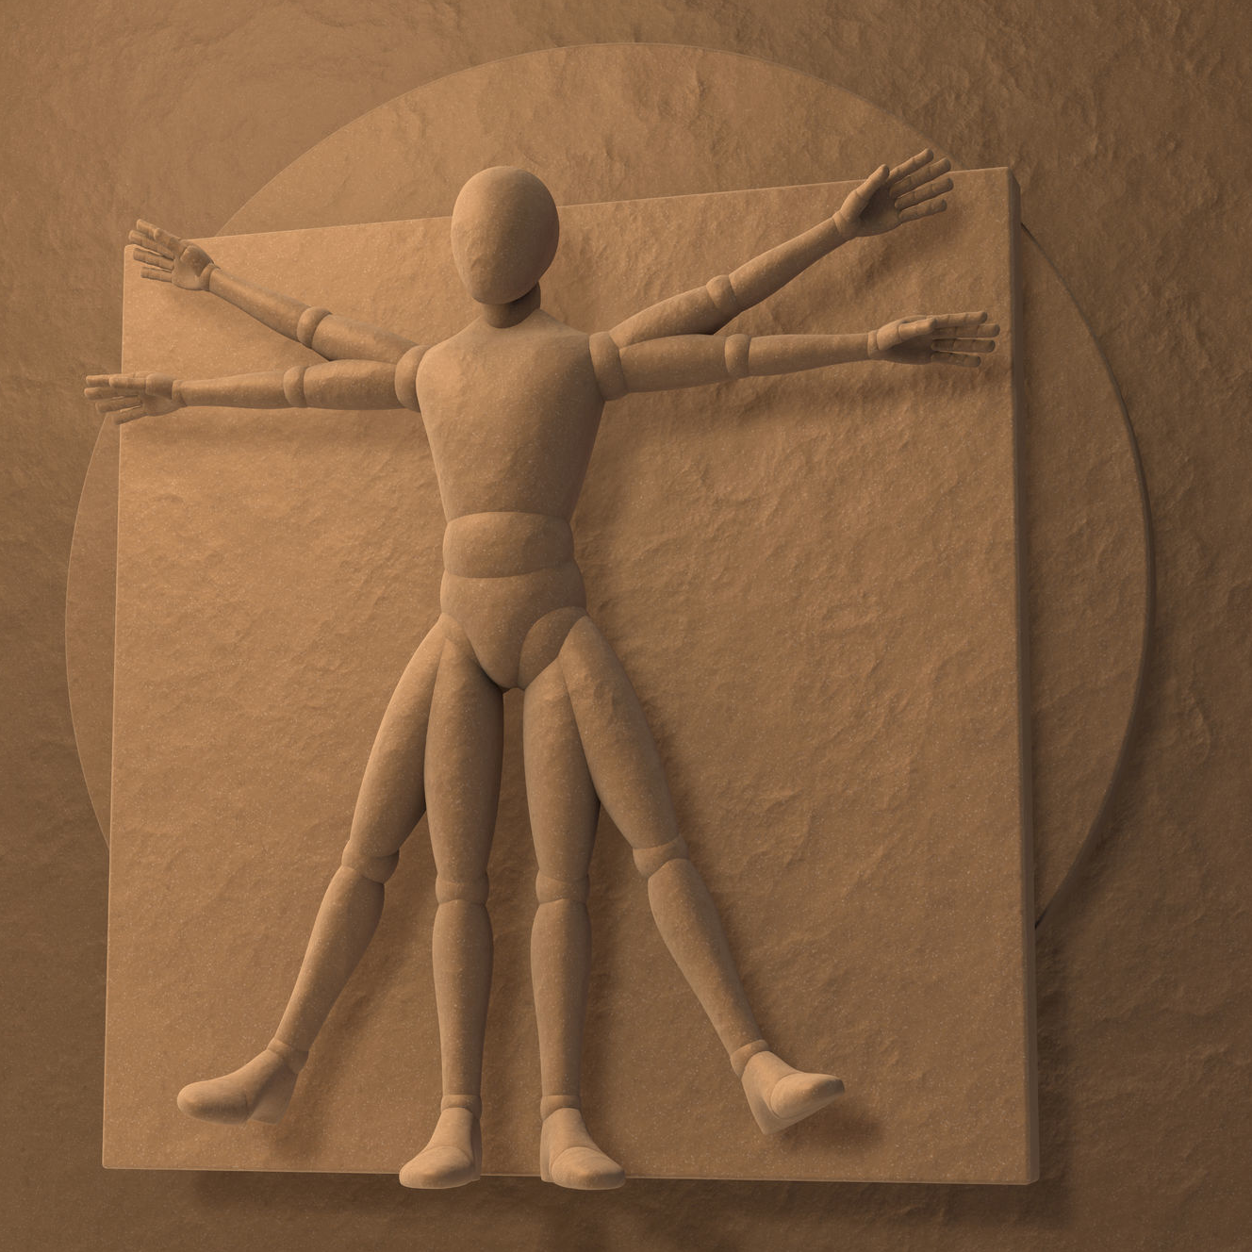
Your
body
is
like a
“second brain”
Notes:
Second brain: separate nervous system. So complex, like a 2nd brain.

Slide 20
Your
body
is
like a
“second brain”
Especially
the “gut”
where many
neurons are
located
Notes:
Second brain: separate nervous system. So complex, like a 2nd brain.

Slide 21
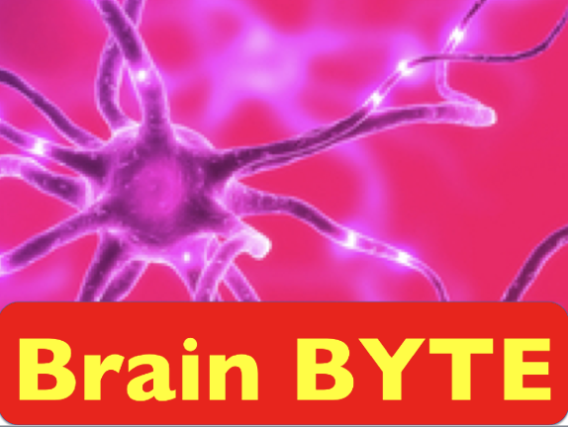
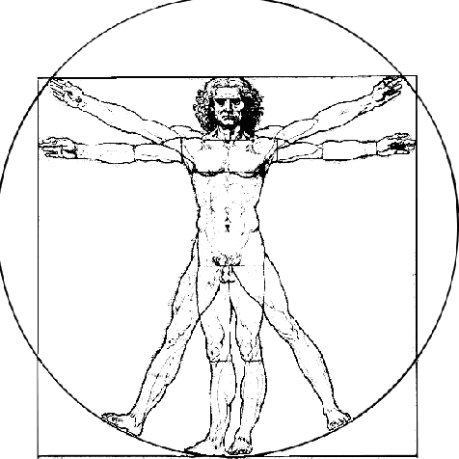
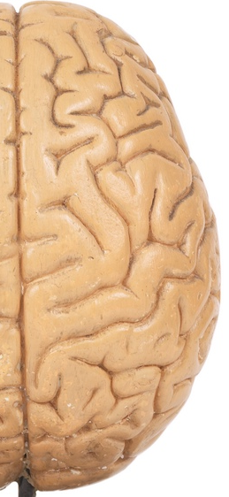
Your brain Your body
Neurons:
85 billion 500 million
85,000,000,000
Neurotransmitters
identified:
> 100 > 40
500,000,000
Dopamine production:
50% 50%
Serotonin production
5% 95%
Source: New Scientist & neuroscience
stuff.tumblr.com
Both affect blood flow
Notes:
http://neurosciencestuff.tumblr.com/post/38271759345/gut-instincts-the-secrets-of-your-second-brain
(8byaku 5-ju oku. Body, 5 oku

Slide 22
Let’s move!

Slide 23
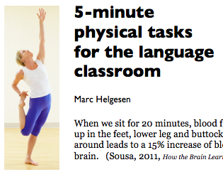
More ideas at
http://tinyurl.com/ELT-physical

