Slide 1
English in
A fresh look at drills, dialogs and dictations
© 2013 Marc Helgesen march@mgu.ac.jp
May be used for not-for-profit educational purposes but please acknowledge the source.
Most artwork from www.clipart.com
Used with permission.

Slide 2
English in
A fresh look at drills, dialogs and dictations

Slide 3
English in
A fresh look at drills, dialogs and dictations

Slide 4
English in
Drills
Dictations
Dialogs
Rethinking
Traditional Tasks
Notes:
S

Slide 5
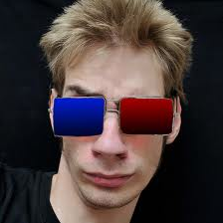
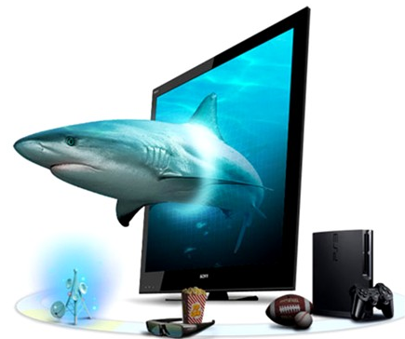

Slide 6
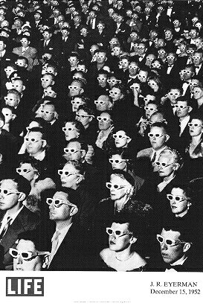
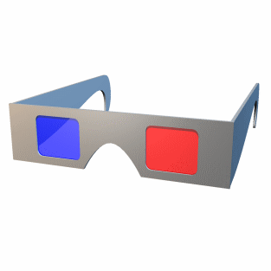
English in
Depth
Different view
Diverse choices

Slide 7
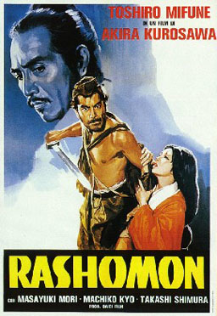

Slide 8
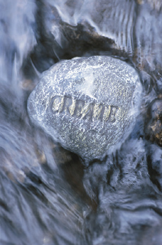
Creative thinking
may simply be
realizing that
there is no particular virtue in doing things the way they have always been done.
- Rudolf Flesch
Educator/philosopher
Notes:
USEFUL THOUGHT

Slide 9
Truth in packaging:
I have no answers.
All I have is some questions.
But they are
interesting questions.

Slide 10
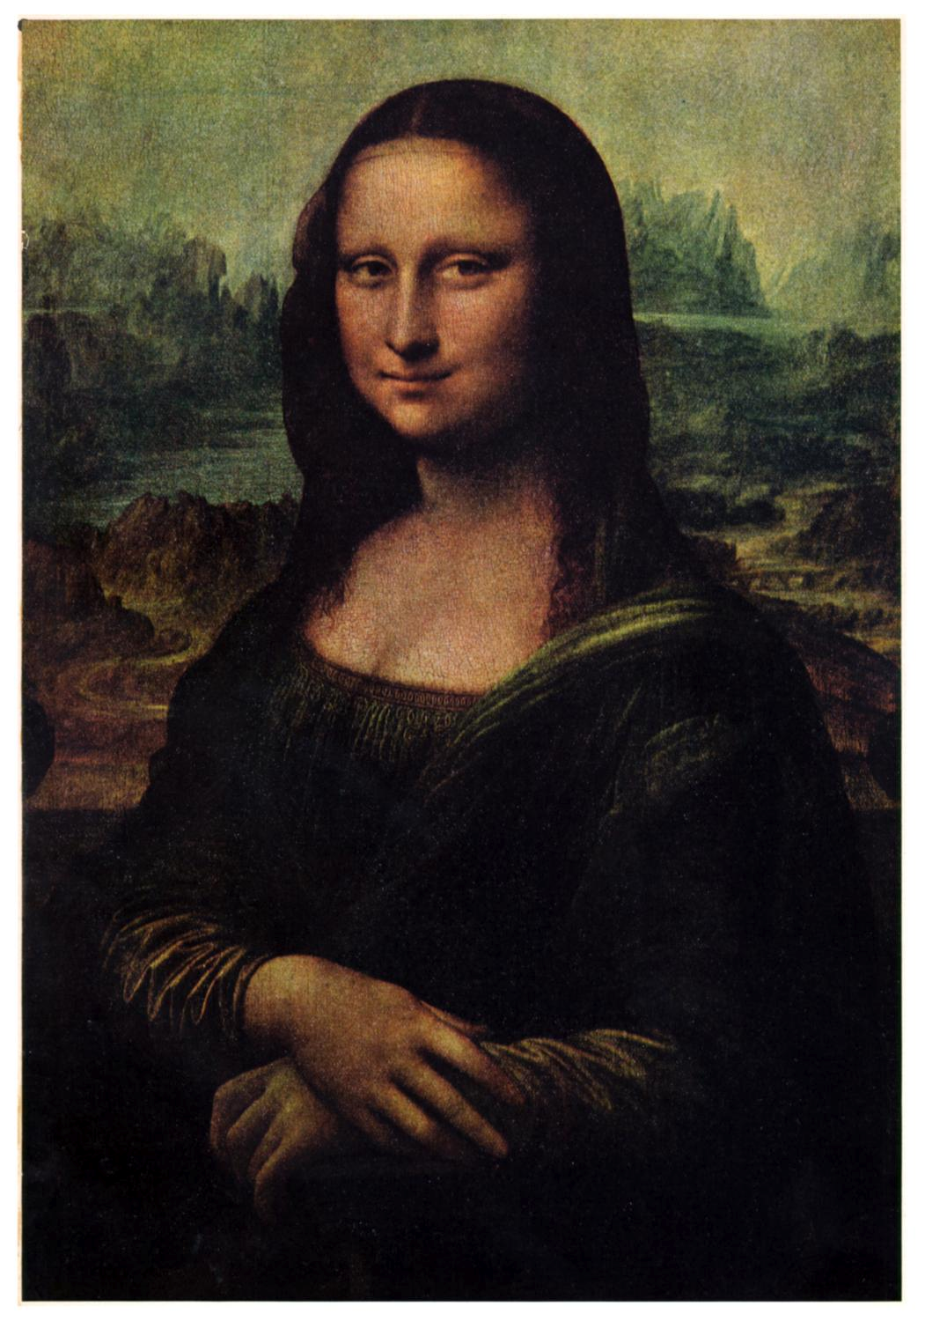
What traditional tasks do you use?
I’m asking.
Drills
Dictations
Dialogs
Oral reading
Translation
Pronunciation work
Pairwork
Drama technique
Guided visualization
Inner voice
Why?
Who decides
what’s traditional
& what’s cool?

Slide 11
Choose one traditional task you basically like (even though it is “out of date”)
Drills
Dictations
Dialogs
Oral reading
Translation
Pronunciation work
Pairwork
Drama technique
Guided visualization
Innervoice
Many people criticize it.
What are their objections?
It is x. Tasks should be y.
Dictation is very bottom-up.
Tasks should be more balanced.

Slide 12
Traditional task: dictation
Dictation is very bottom-up.
Yesterday was a lousy day.
I got a plate and missed breakfast.
Yesterday was a lousy day.
I got up late and missed breakfast.
Tasks should be more balanced.

Slide 13
Traditional tasks
Put the idea in
the back of your mind..
You know -
Somehow it is useful.
Why?
Let it grow.
Evolve.

Slide 14
Drills
What do you like?
What do you dislike?
Focused practice
1st time you say something - tough
Students can do
Boring
No thinking
/understanding

Slide 15
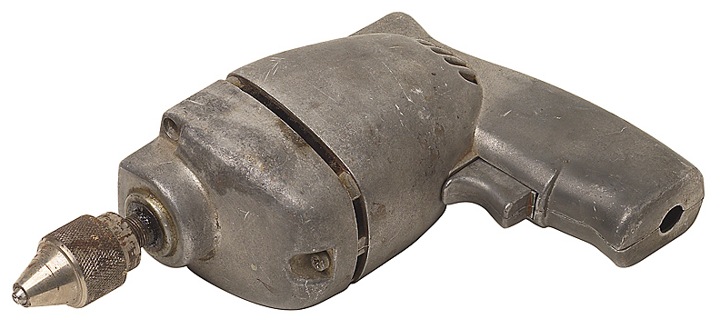
Drill
a tool for boring
- Peter Viney

Slide 16
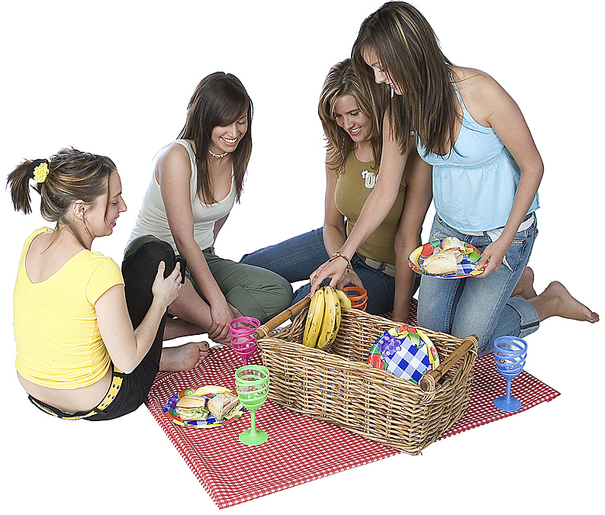
ABC picnic

Slide 17
ABC picnic
If you bring the apples,
I’ll bring the bananas.
If you bring the bananas,
I’ll bring the cake.
If you bring the cake

Slide 18
ABC travel
We’re going to go Alaska,
Then we’re going
to go Bangkok.
We’re going to go Bangkok,
Then we’re going
to go Cebu
Notes:
Denmark, Egypt, ete. (going to future)
18

Slide 19
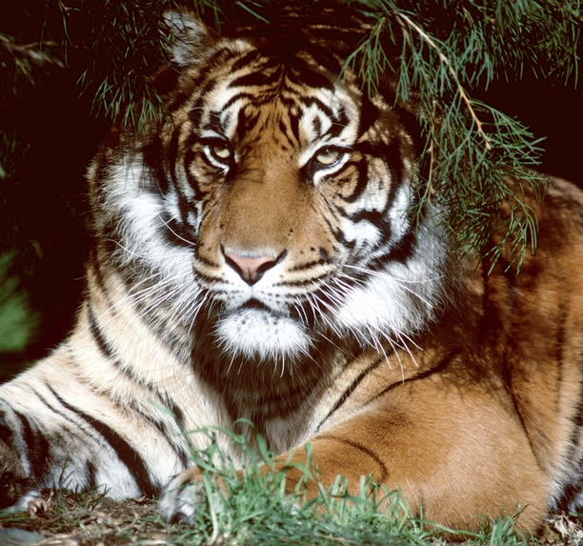
ABC nouns
You have an album.
I have a book.
You have a book.
I have a cat.
You have a cat.,t.
Notes:
Denmark, Egypt, etc. (going to future)
19

Slide 20
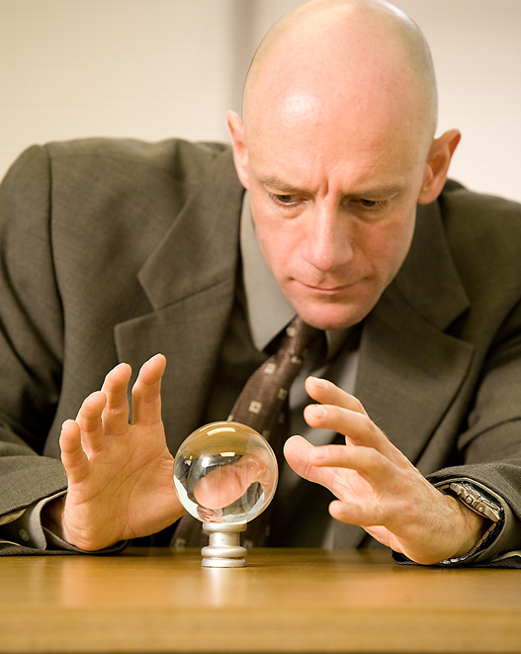
Is it a _______? Right! OR No, It‘s er than a . No, It’s more than a .
Animal

Slide 21
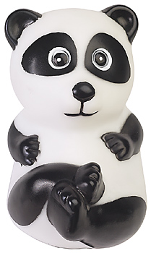

Slide 22
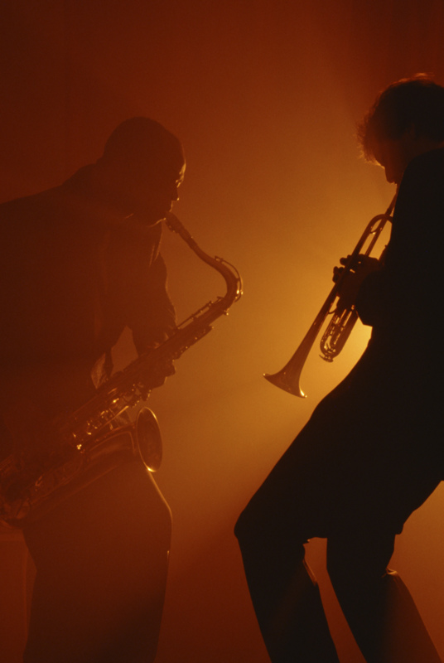
Jazz chant
Jazz chant

Slide 23
Excuse me.
Where’s the bank?

Slide 24
Excuse me. Where’s the bank?
Go down this street to the corner
and then turn right.
Go down that street to Main Street, and then turn left.
When you get to the park,
you’ll see it on your right.

Slide 25
Did you say…
I go down this street to the corner
and then turn right.
I go down that street
to Main Street,
and then turn left.
When I get to the park,
I’ll see it on my left?

Slide 26
Right.
•Left?
No, right!
•Not left?
Go right!
•Oh, right!
YEAH!

Slide 27
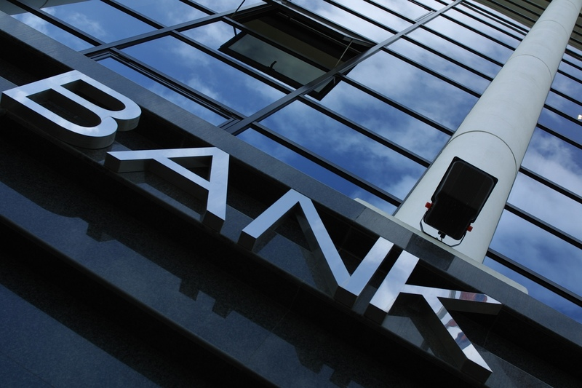
?

Slide 28
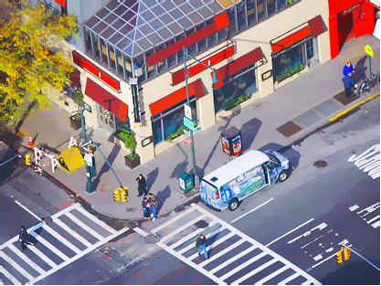

Slide 29
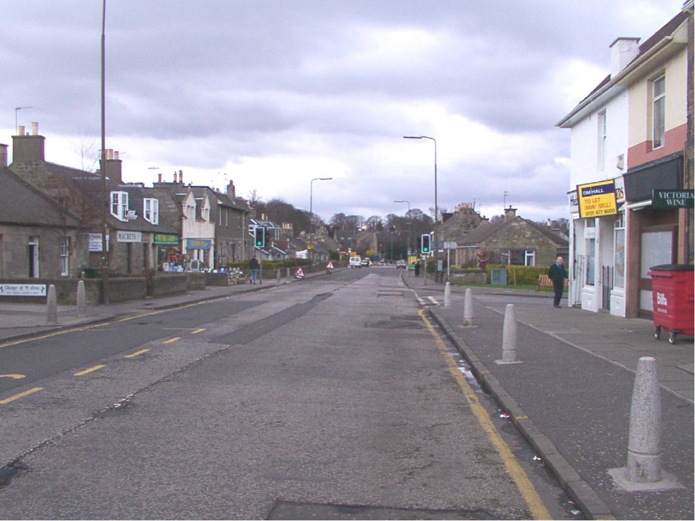

Slide 30
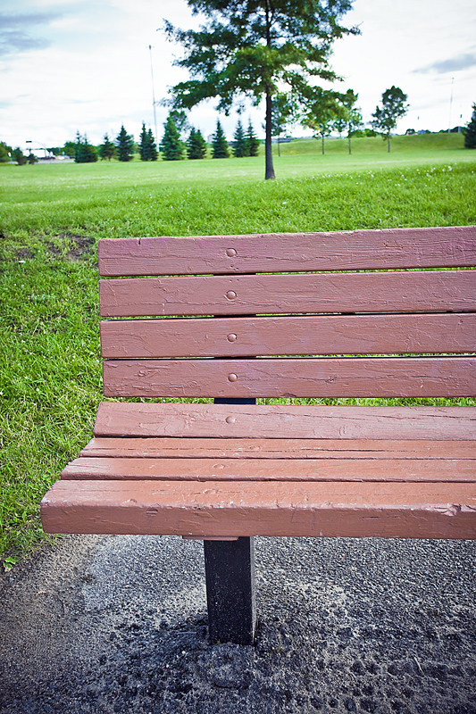
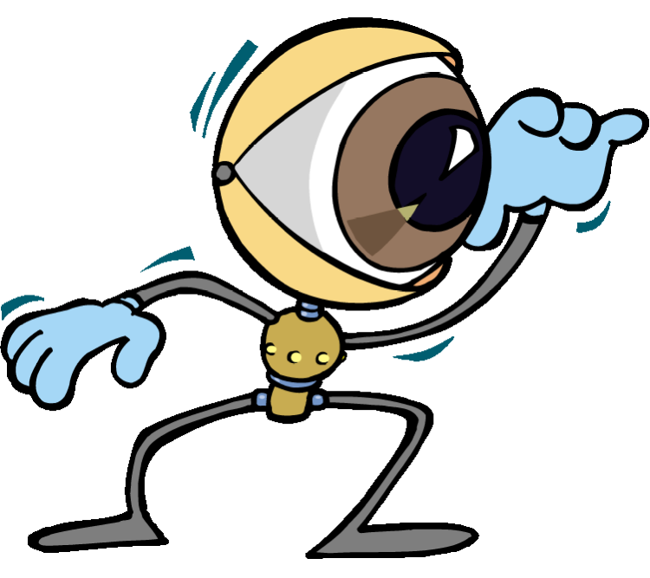

Slide 31
?

Slide 35
Notes:
Right Left?
No, right Not left?
Go right. Oh right!
Yeah!

Slide 37
This one is somewhat experimental
By which I mean:
A little weird
Notes:
37

Slide 38
Blindfold directions
Notes:
38

Slide 39
Blindfold directions
Turn right/left.
Go straight (__ steps).
A little farther./Not so far.
STOP!
Put your hand down/up/
to the left/right
Turn around.
Notes:
39

Slide 40
Well balanced students
Notes:
40
• Describe the room (prepositions and adjectives0)
OR
• Your next vacation plans. (going to/ will future)

Slide 41
Next weekend (or vacation)
Who…?
Where…?
What...?
When…?
Why…?
How…?
I’m going to…
I will probably…
I might…
Notes:
41
• Describe the room (prepositions and adjectives0)
OR
• Your next vacation plans. (going to/ will future)

Slide 42
Drills - the options
When do students respond?
Where do substitutions come from?
Precede pair-/group work with drill of the target forms?
Self-drill as mental rehearsal

Slide 43
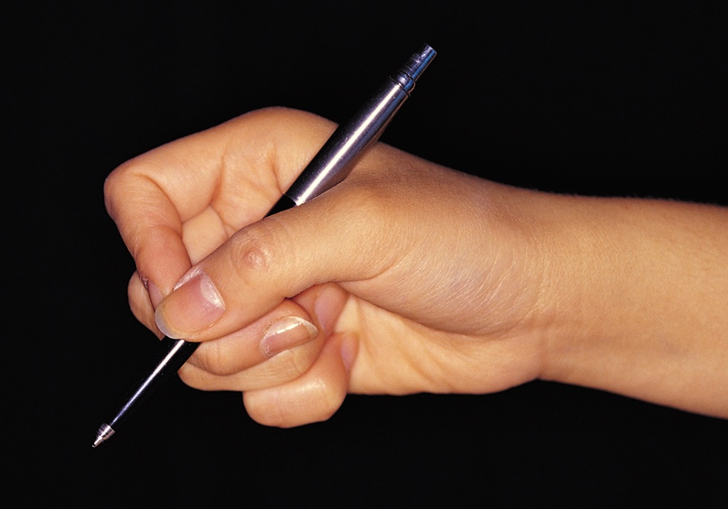
Dictation
tinyurl.com/EnglishIn3D

Slide 44
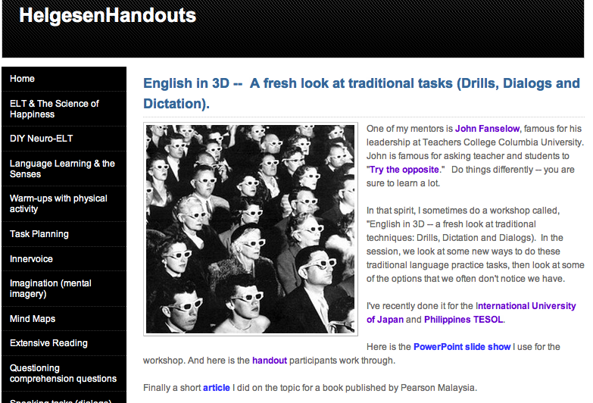
.weebly.com

Slide 45
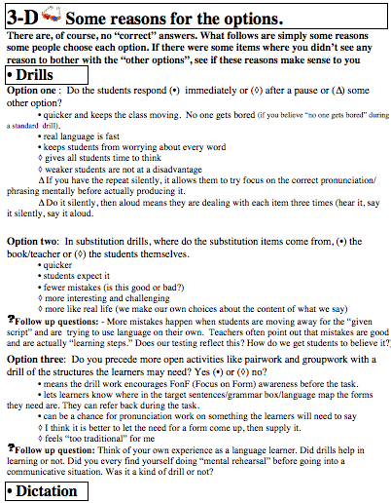

Slide 46
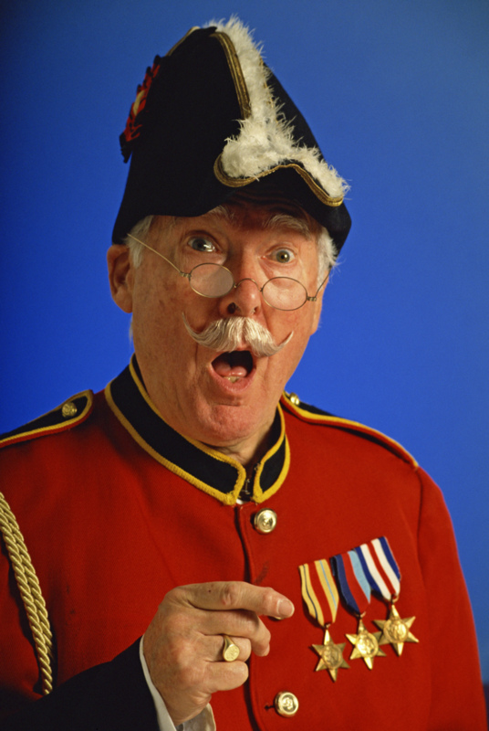
Dictation
If you use
dictation,
does that make
you a dictator?

Slide 47
Dictation
What do you like?
What do you dislike?
accuracy
intensive listening
boring
don’t have to
understand
very “bottom up”

Slide 48
Dictation: example
Notes:
A road went through a forest. A woman was walking down the road.
Suddenly she saw a man. He was wearing a shirt, pants and a hat. He smiled and said something.

Slide 49
Dictation: example
A long road went through a .
A was walking down
the road. Suddenly she saw a .
He was wearing a shirt,
, and a hat.
He and said,
long
“”22
“ ”

Slide 50
A, Look at your handout. What do you need to know? Tell B. B, go to the poster outside. Read and remember as much as you can. Come back. Tell A. Change roles and keep going. Right! OR No, It‘s er than a . No, It’s more than a .
Read & run

Slide 51
Read & run

Slide 52
Tell a lie
Write 4 sentences
about yourself.
3 true. 1 is a lie.
Walk around. Dictate your sentences.
Partners, only write 1 -- the lie.
Write: I don’t think (name) [sentence]
Were you right?
Notes:
I got my driver’s license when I was 14 years old.
In Thailand, I went swimming with elephants.
In HS, my favorite class was English.
This is my 3rd set of teeth, and they are real.

Slide 53
Tell a lie
Write 4 sentences
about yourself.
3 true. 1 is a lie.
Write:
I don’t think (name) [sentence]
Notes:
I got my driver’s license when I was 14 years old.
In Thailand, I went swimming with elephants.
In HS, my favorite class was English.
This is my 3rd set of teeth, and they are real.

Slide 54
When I was ___ years old, I…
In (HS/JHS, etc.), …
In (place/year), I…
(one more sentence – past)_

Slide 55
right
hard
blue
old
cool
cheap
oPPosite
dictation
Notes:
Hard – soft , difficult
Blue – orange (color wheel), happy
Old – new/ young
Cool – warm/ uncool/ old-fashioned
cheap – expensive/ costly // good (high quality)

Slide 56
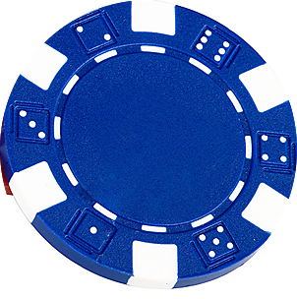
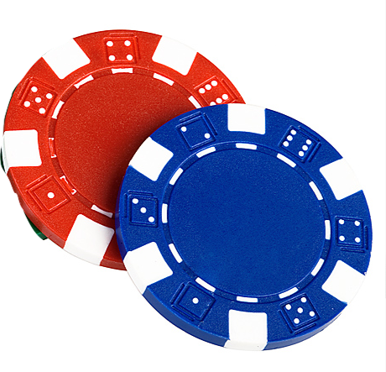
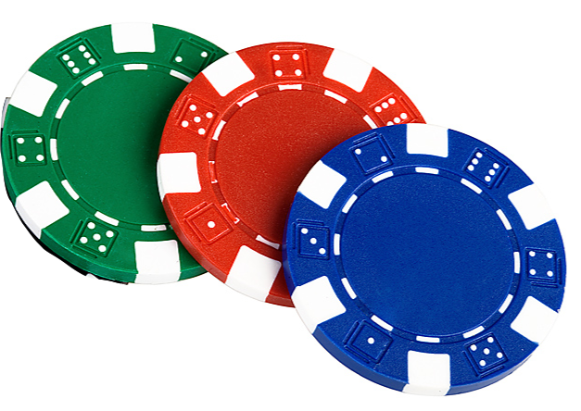
Match game (scoring)
right
hard
blue
old
cool
cheap
Same word = 1
Different word
Same meaning = 2
Different word
Different meaning = 3
Notes:
Right = wrong
Right = wrong/ incorrect / mistake 2 points
Right = wrong / left

Slide 57
Dictation - the options
Who dictates?
Do they write exactly what they hear or something else?
In cloze, when do they write?

Slide 58
Dialogs

Slide 59
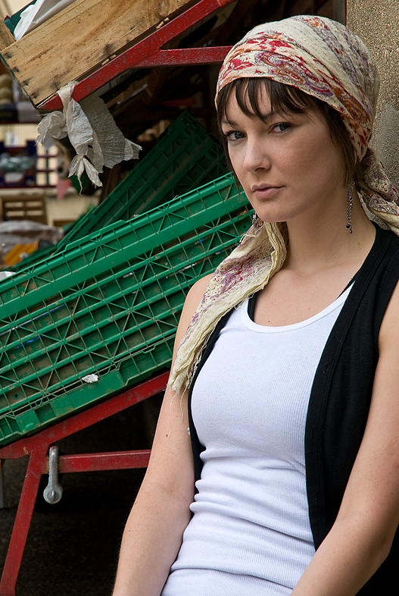

Slide 60
Dialogs
What do you like?
What do you dislike?
context
accurate
show discourse
story is interesting
frozen speech
Don’t have to
understand
Students don’t
have to listen
maybe

Slide 62
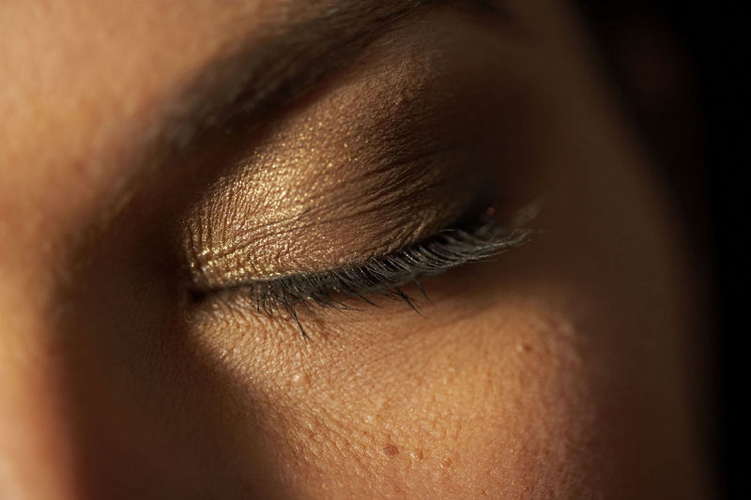
innervoice
Notes:
62

Slide 64
Copy in the center of a large sheet of paper
More space to write

Slide 65
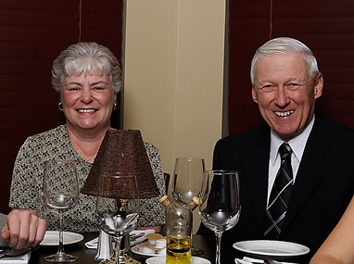
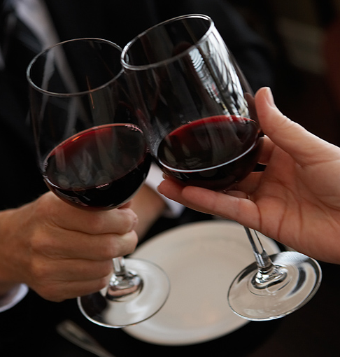
Dinner Conversation
✰ Decide your
character.
• Listen. Imagine
the innervoice.
 Notice the language of your
innervoice.
Translate it. Is the nuance the same?

Slide 66
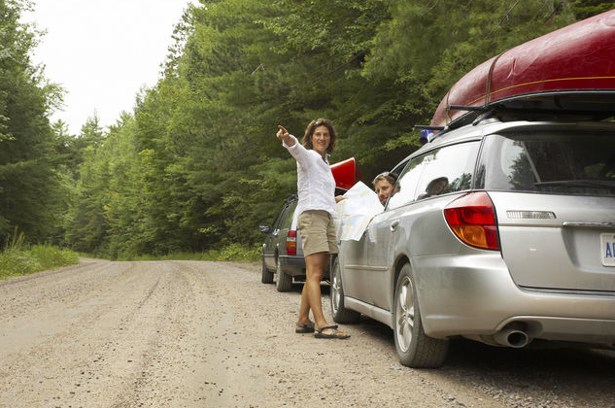
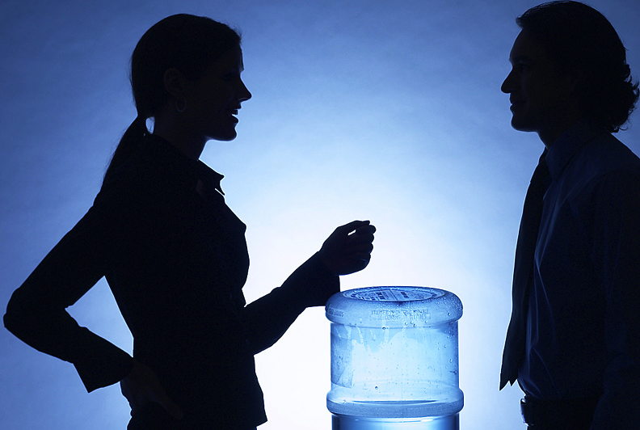
Interaction types
Transactional
- moving information
Interactional
- social interaction
Notes:
Transactional -- lots of activities (info gaps
Interactional - not as much

Slide 67
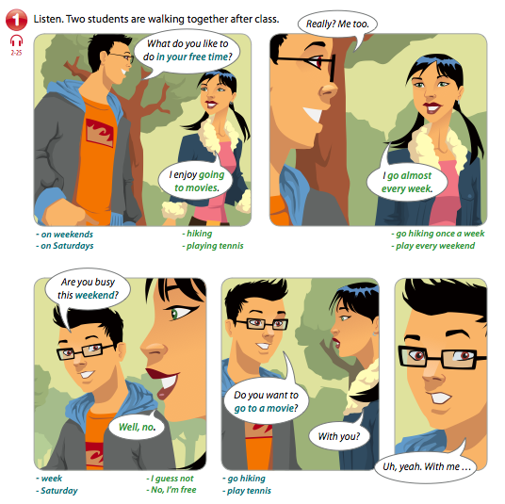
5
Notes:
L&R vs. Silent L&R

Slide 69
What do you like to do in your free time? I enjoy going to movies. Really? Me, too. I go almost every week. Are you busy this weekend? Well, no. Do you want to go to a movie. With you? Uh, yeah. With me.

Slide 70
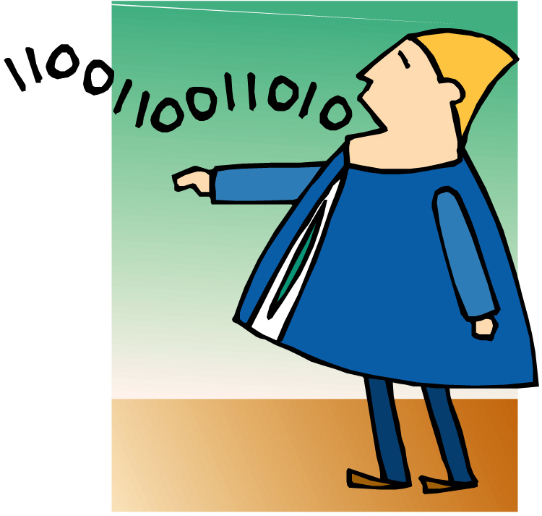
The human recording

Slide 71
5
Notes:
L&R vs. Silent L&R

Slide 72
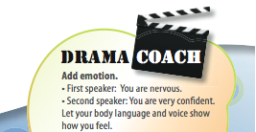

Slide 73
variations
Dialog

Slide 76
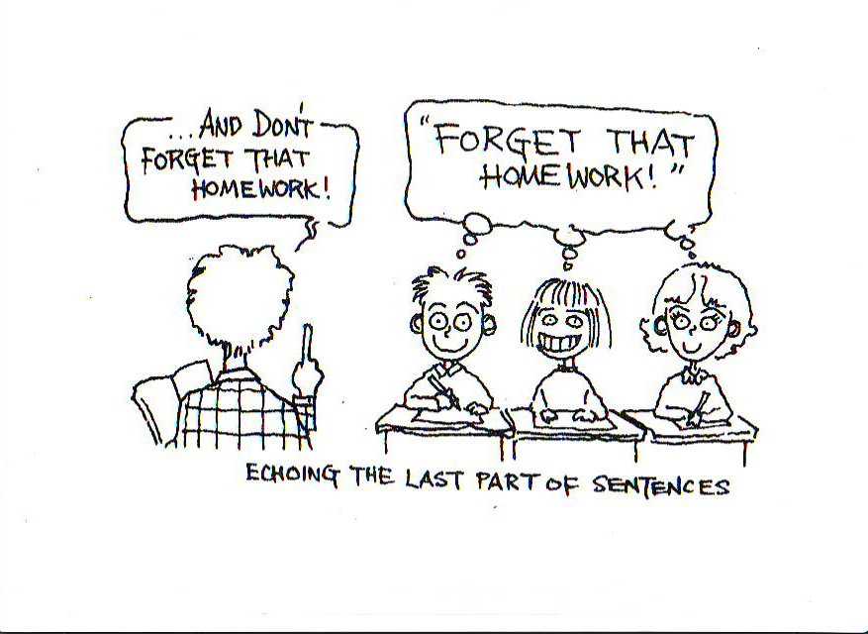
Shadowing
Cartoon courtesy Tim Murphey,
Language Hungry, Helbling Languages Publishing. Used by permission of author.

Slide 77
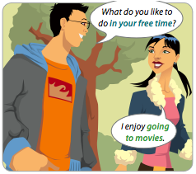
Types of shadowing
What do you like to do in
your free time?
/
What do you
like to do in
your free time?
What do you /
like to do / in
your free time?
My free time?
/
My free time?
Why do you ask?
Full
Slash
• Silent
•Key word/ last word
Add comment/ question
Notes:
Handouts

Slide 79
Dialogs - the options
Sit or stand/move?
Voices “regular” or changed?
What happens next?
Focus on what characters are
saying or something else?
Notice your own Innervoice.
How often is it different that what you say aloud?

Slide 80
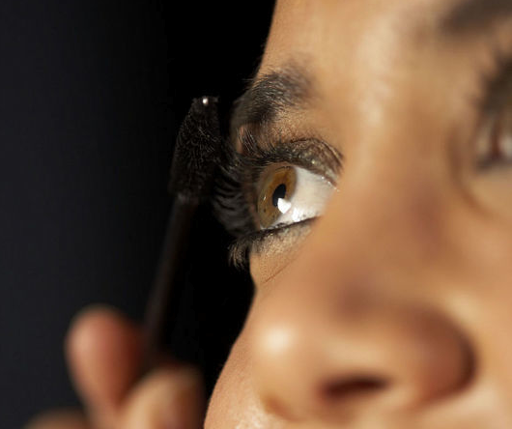
Challenge

Slide 81
Challenge
3 objects.
Use one (or more) to make a drill, a dictation or a dialog.

Slide 82
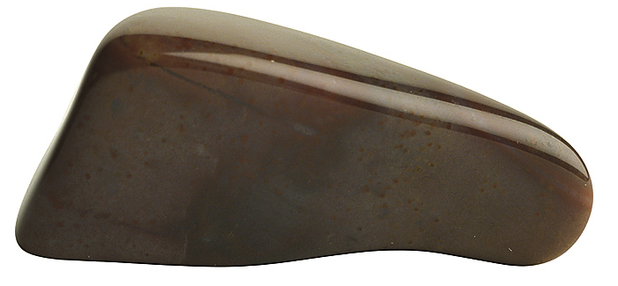
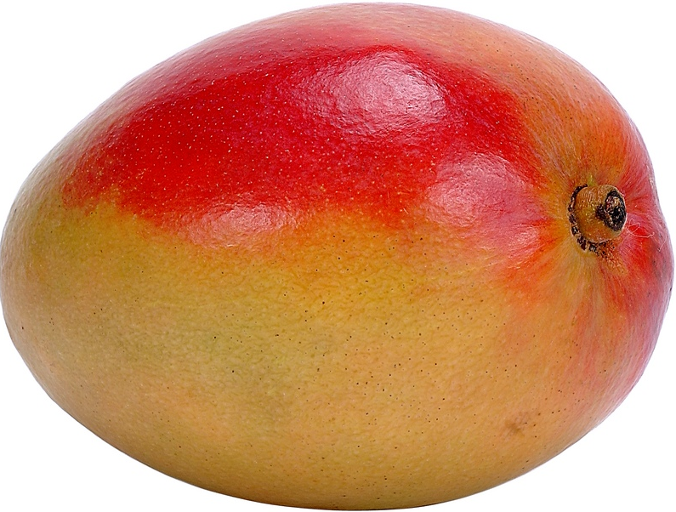
Challenge

Slide 83
This is a pen.
not
v
(I) use it to….
for…ing…
have, need, want
Notes:
Ss – groups of 4-6. Each takes one thing from pen case.
Imagine it is something different.
Doctors use it to give me medicine. Nurses have it to take blood.

Slide 85
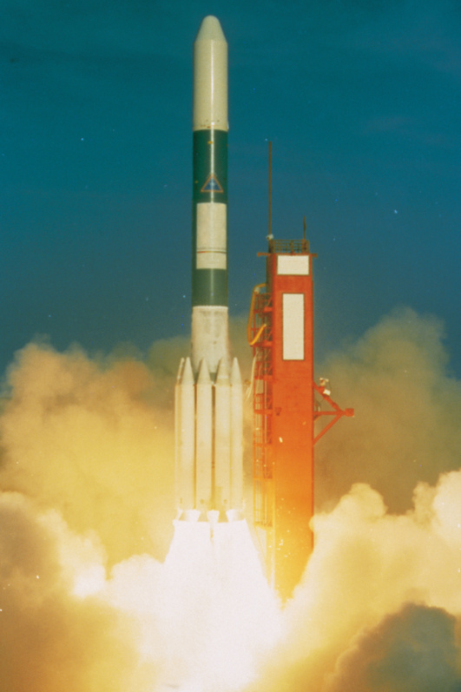

Slide 86
encil
Connected words
p
e
n
can’t rase
ice colors

Slide 87
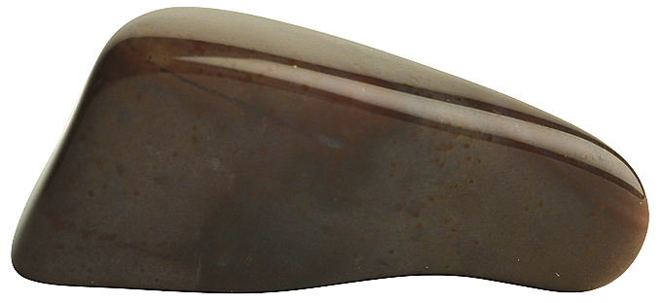
My rock
Brainstorm adjectives that describe rocks:
big, small, rough, smooth, jagged, round, irregular, dark, light, heavy, dirty

Slide 88
My rock
Give everyone a rock behind their backs.
They feel it, noticing size, shape – everything

Slide 89
My rock
Put all rocks on a table.
They direct a partner to find theirs.

Slide 90
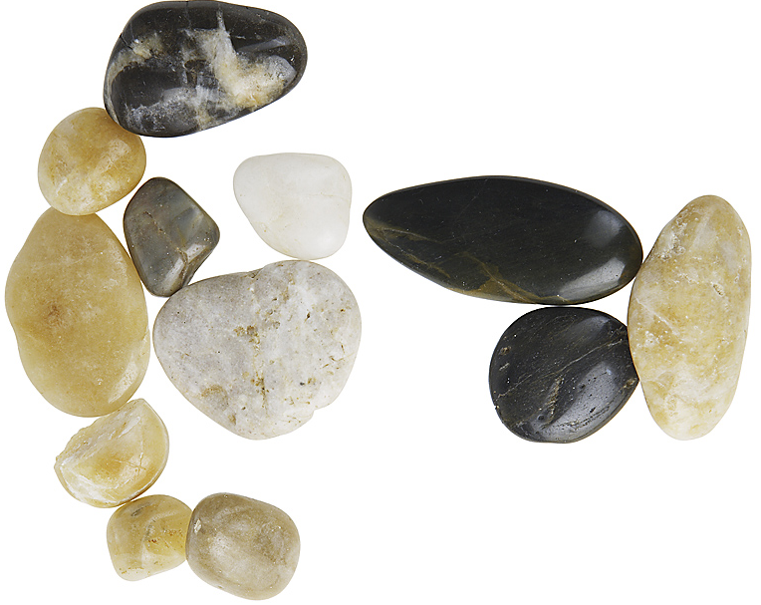
My rock
This one?
No, my rock is ____er than that.
more ___

Slide 91
End of the evening at a club:
Bartender: It’s midnight. I’m closing. Hey, MAN. GO home.
Customer: This place ROCKs!
Bartender: Some customers are such a PEN (pain).

Slide 92
Choose one traditional task you basically like (even though it is “out of date”)
Drills
Dictations
Dialogs
Oral reading
Translation
Pronunciation work
Pairwork
Drama technique
Guided visualization
Inner voice
Many people criticize it.
What are their objections?
It is x. Tasks should be y.
Dictation is very bottom-up.
Task should be more balanced.

Slide 93
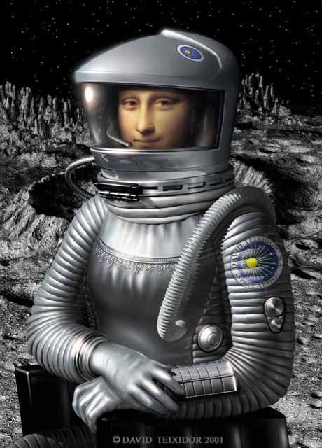
Traditional tasks
Strip it down to the basics.
Ready with ideas?
How can you reinvent it?

Slide 94
Dictation
tinyurl.com/EnglishIn3D

Slide 95
English in
in
conclusion

Slide 96
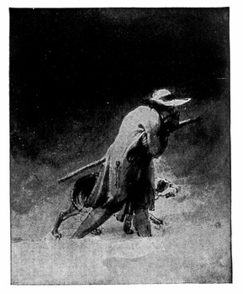
Traveler, there is no path One makes the - Antonio Machado
Traveler, there is no path.
One makes the
path by
walking.
Antonio Machado

Slide 97
There are only two mistakes one
can make along the road to truth;
There are only two mistakes one can make along the road to truth;
not going all the way,
and not starting.
not going all the way,
and not starting
泔褋赗ꠛ輋踫
- The Buddha
Photo ©
romana chapman
At Creative Commons
Used with permission
- The Buddha

Slide 98
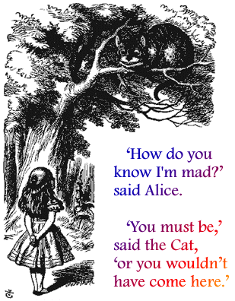
Could you tell
me, please,
which way
I ought to go?
It depends a good
deal on where you
want to get to.
Notes:
I reminded of that scene for Alice in Wonderland. Alice is lost, tired, confused. (you can see the parallels to English Language Teaching) when she comes across the Cheshire Cat. She asks, CLICK, Could you tell me please, which way I ought to go.
The cat smiles and replies.CLICK. It depends a good deal on where you want to get to. (click)

Slide 99
Thank you.

Slide 101
DIY – Do it yourself.
Think of the ideas
from today’s workshop.
How will you use
them in a class
next week?

Slide 102
Well balanced students
Notes:
102
• Different pose

Slide 103
Well balanced students
Notes:
103
• Different pose

Slide 105
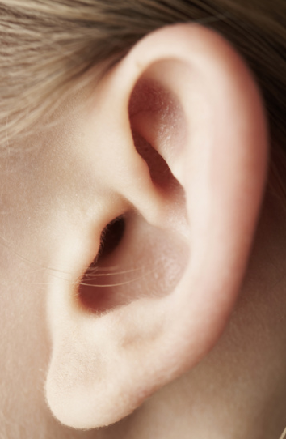
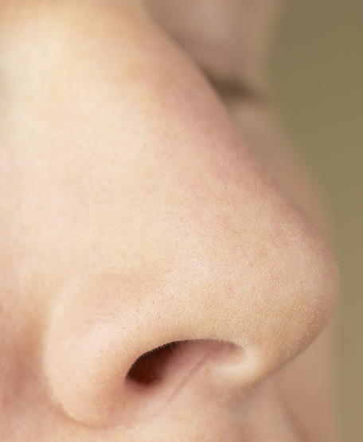
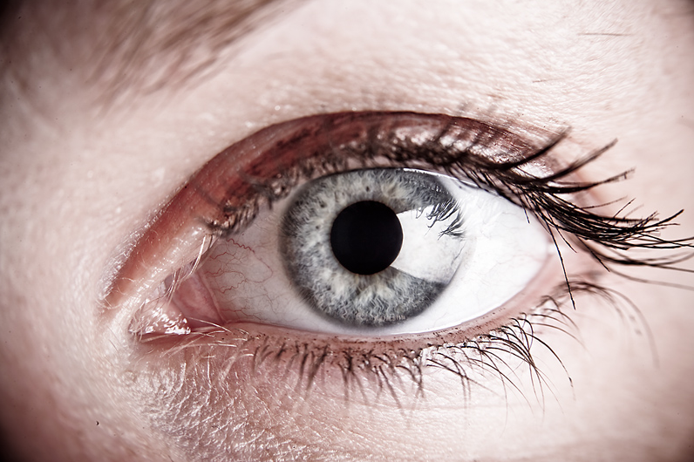
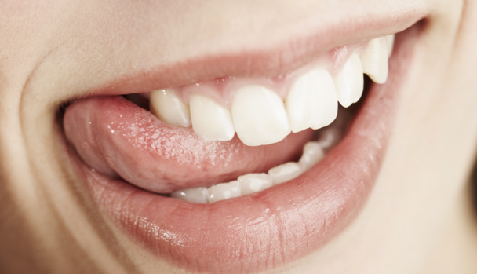
Sensory dictation
Notes:
105
Pizza
Snow
Fingernails on a chalkboard

